Slide 1
Freshers’ Week
1.10 Applying new speaking skills: What is a
good teacher?
Prepared by: Harem H. Qadir

Slide 2
Objectives of the Lecture:
Pronounce words with the sounds /I/, /i/, /p/, /b/.
Research and produce a short talk using target vocabulary, language and sub skills from the theme.

Slide 3
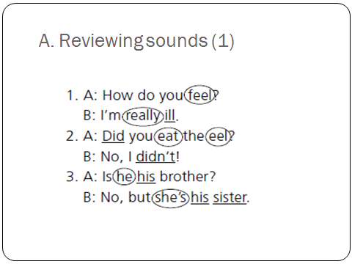
A. Reviewing Sounds (1)
Answers
1. A: How do you feel?
B: I’m really ill.
2. A: Did you eat the eel?
B: No, I didn’t!
3. A: Is he his brother?
B: No, but she’s his sister.

Slide 4
B. Reviewing Sounds (2)
 | A | B
1. | Bit | Pit
2. | Buy | Pie
3. | Bought | Port
4. | Open | Oban
5. | Cab | Cap

Slide 5
C. Researching Information
Good | Bad
keep order (= stop bad behavior) | sarcastic (= make fun of)
explain clearly | belittle children (= make feel small)
show enthusiasm (= like subject, excited about teaching) | unfair (= reward wrong children)
treat children as individuals (know names, personal facts) | give punishments (= bad things, wrong children)
sense of humor (make jokes)
other ideas • eye contact • patient • mark work and return it quickly | other ideas • angry, shout • don’t return work • don’t explain

Slide 6
D. Giving a Short Factual Talk
Staying in group A & B

