Slide 1
Ductile Structural Geology (Lecure.2)
Force, Stress, Deformation and Strain
Force (F) is a vector quantity. Force can cause a body in a state of rest to accelerate, and can cause a moving body to accelerate or decelerate or change direction.
F = ma (force = mass × acceleration) ………. Newton’s Second Law of Motion.
►There are two different types of forces.
1- Body forces: Forces that result from action of a field at every point within the body are called body forces.
2- Surface force: Forces that act on a specific surface area in a body are called surface force.
Stress represented by the symbol σ (sigma), is defined as the force per unit area [A], or
σ = F/A

Slide 2
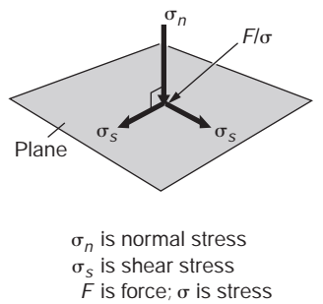
Two –Dimensional stress: Normal stress and Shear stress
Stress acting on a plane is a vector quantity, it has magnitude and direction.
Stress on a plane it can be resolved into:
(i) The vector component normal to the plane is called the normal stress, (σn) (sometimes just the symbol σ is used);
(ii) the vector component along the plane is the shear stress (σs) (sometimes the symbol τ (tau) is used)

Slide 3
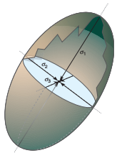
Three –Dimensional stress: Principal planes and Principal stresses
Principal stress: The normal stress on a plane with zero shear stress; three principal stresses exist, σ1 ≥ σ2 ≥ σ3. These principal stresses have two properties: (1) they are orthogonal to each other, and (2) they are perpendicular to three planes; these planes are called the principal planes of stress.
The σ1, σ2, and σ3 are the major, intermediate, and minor principal stress, respectively.
Stress ellipsoid: imaginary geometric representation of stress; the axes of the stress ellipsoid are the principal stresses.
Isotropic stress All three principal stresses have equal magnitude (describes a sphere).
Anisotropic stress At least one principal stress has a magnitude unequal to the other principal stresses (describes an ellipsoid).

Slide 5
The nine components of stress put into a matrix (second-order tensor) known
as the stress tensor or stress matrix.
σ11 σ12 σ13
σ21 σ22 σ23
σ31 σ32 σ33
The normal stresses σ11, σ22 and σ33 occupy the diagonal while the off-diagonal terms represent the shear stresses. The σm is called the mean stress; σm= (σ11+σ22+σ33)/3.
► Differential stress (σd) = (σ1 - σ3).
►Static stress as σ1 = σ2 = σ3.
►Confining pressure as σ2 = σ3 for the conditions σ1 > σ2 = σ3.

Slide 6
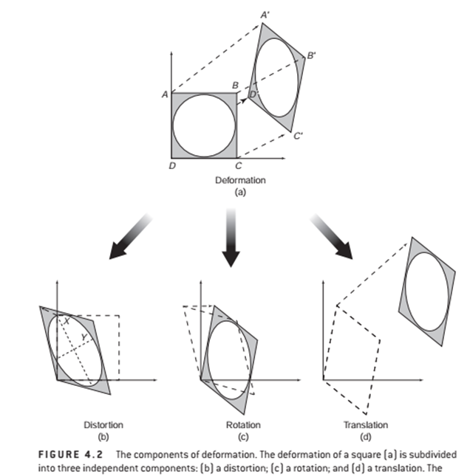
Deformation
Deformation describes the collective displacements of points in a body; in other words, it describes the complete transformation from the initial to the final geometry of a body. This change can include a translation (movement from one place to the other), a rotation (spin around an axis), and a distortion (change in shape).

Slide 7
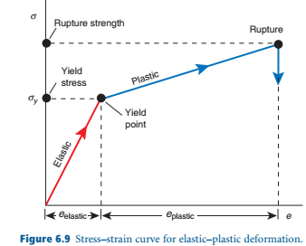
1-Elastic deformation; if the stress is withdrawn,
the body returns to its original shape and size.
Or Elastic Deformation Mechanisms by which elastic
behavior occurs, namely the bending and
stretching, without breaking, of chemical bonds
holding atoms or molecules together.
There is always a limiting stress, called
the elastic limit (yield point); if this is exceeded,
the object does not return to its original shape.
Below the elastic limit,
the deformation obeys Hooke’s law
which states that strain is proportional to stress.
Three stages of deformation
If an object is subjected to stresses it passes through three stages of deformation.

Slide 8
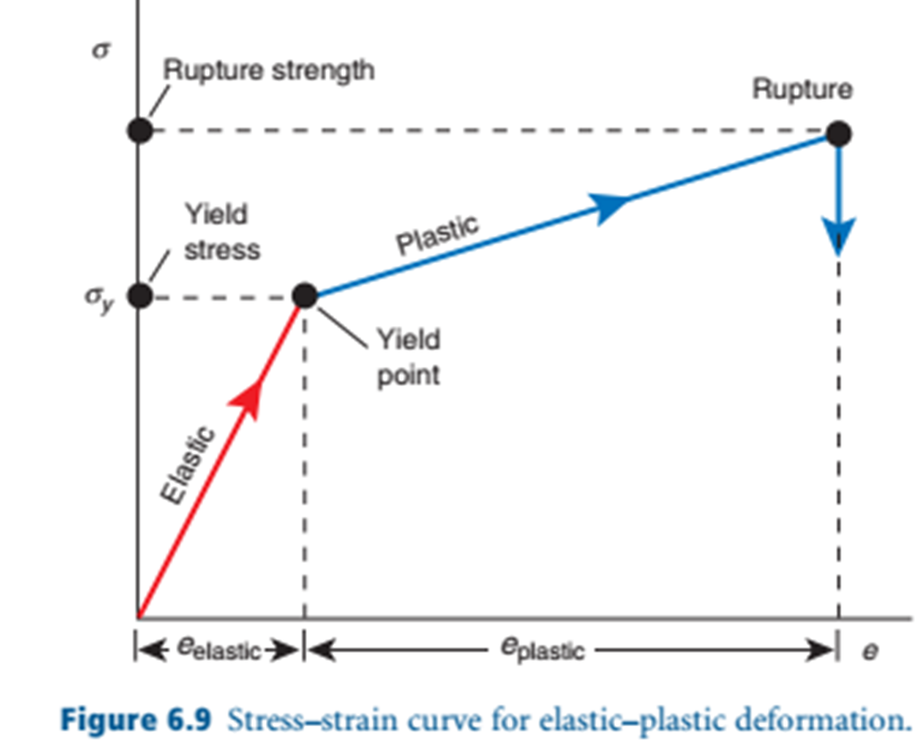
2- Plastic deformation; if the stress exceeds the elastic limit, the deformation is plastic;
that is, the specimen only partially returns to its original shape even if the stress is removed.
Or Plasticity Deformation mechanism that involves
progressive breaking of atomic bonds
without the material losing coherency.
3- Rupture; When there is continued
increase in the stress, one or more fractures
develop, and the specimen eventually fails
by rupture (fracture).Or Fracturing
Deformation Mechanism by which a rock
body or mineral loses coherency by
simultaneously breaking many atomic bonds.
Strength: Stress that a material can support
before failure.
Yield stress: Stress at which permanent strain
occurs.

Slide 9
Based on the aforementioned relation two main types of rocks/substances are distinguish.
I/Brittle substances/rocks are those that rupture before any significant plastic deformation takes place.
II/Ductile substances/rocks are those that undergo a large plastic deformation before rapture. After the elastic limit has been exceeded, ductile/plastic substances undergo a long interval of plastic deformation, and in some instances they may never rupture.
Rheology is the study of the mechanical properties of solid materials as well as fluids and gases. The name derives from the Greek word “rheo”, which means “to flow”. Rheology deals with the flow of rocks, while rock mechanics primarily deals with the way rocks respond to stress by brittle faulting and fracturing.

Slide 10
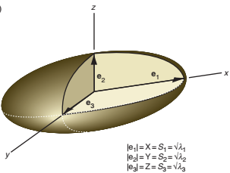
Strain
Strain describes the changes of points in a body relative to each other; so, it describes the distortion of a body.
The strain ellipsoid
The strain ellipsoid is the deformed shape of an imaginary sphere with unit radius that is deformed along with the rock volume.
The strain ellipsoid has three mutually orthogonal planes of symmetry, the principal planes of strain, which intersect along three orthogonal axes that are referred to as the principal strain axes. Their lengths (values) are called the principal stretches.
These axes are commonly designated X, Y and Z, but the designations S1, S2 and S3 as well as e1, e2 and e3 are also used.

Slide 11
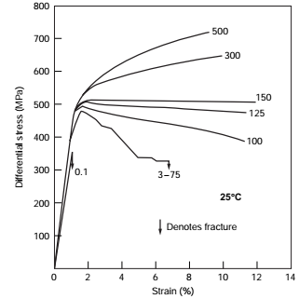
Factors controlling mechanical behavior of materials
The mechanical response of rocks to stress is different for different conditions .
Confining pressure
Figure illustrate the behaviour of Solenhofen Limestone .Seven separate experiments are shown at confining pressure of 0.1,3-75,100,125,150,300 and 500 MPa.
- increase in confining pressure increases the elastic limit and the ultimate strength.
- These experiments indicate that rocks exhibiting very little plastic deformation near the surface of the earth may be very plastic under high confining pressure.
Shortening

Slide 12
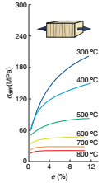
b) Temperature
Figure 2.4 shows six tests run on Yule Marble.
The uppermost curve is that obtained at 300°C temperature,
whereas lowest curve is that obtained at temperature of 800 °C .
-It is apparent that plastic deformation is less common
near the surface of the earth, where the confining pressure and temperature are low, than it is at greater depths, where higher temperatures and greater confining pressure increase possibility of plastic deformation.
An increase in temperature lowers the yield stress
or weakens the rock.
Figure 2.4 Stress-shortening (strain) curves for Yule marble.

Slide 13
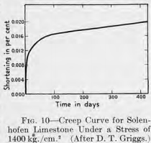
c) Time
An analysis of the effects of time is concerned with
such subjects as creep and strain rate.
Creep is the plastic deformation of a material that is
subjected to a persistent and constant stress.
Or Creep refers to the slow continuous deformation
with the passage of time .
In a short-time experiment, Solenhofen Limestone
under atmospheric pressure and room temperature
has a strength of 2560 kg/cm² .
ii) In a long-time experiment, Solenhofen Limestone
subjected to a compressive stress
of 1400 kg/cm2-half the value of the strength(i).
At the end of one day, it has been shortened about 0.0006 %;
after 10 days about 0.011 %;
after 100 days about 0.016 %;and
after 400 days a little more than 0.019 %.
Result: After long continued stress the rocks become much weaker.

Slide 14
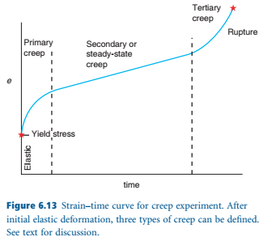
As soon as the load is applied, the rock experiences an elastic deformation.
This is followed by three kinds of mechanical response,
called primary, secondary, and tertiary creep.
Result: The initial elastic strain and primary creep are due to initial loading and
are not particularly time-dependent.
The amount of strain accommodated
by the rock during secondary and
tertiary creep is a function of the time.

Slide 15
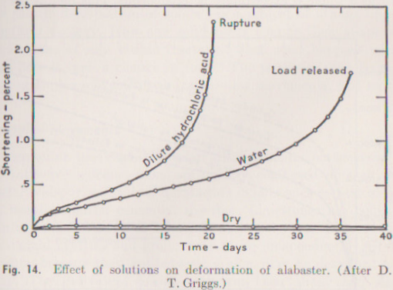
d) Solution
The solutions dissolve old minerals and
precipitate new ones.
Under such conditions the mechanical
properties of rock are greatly modified .
Experiments have been performed on
alabaster-gypsum with solution present.
In all cases compressive stress was 205 kg/cm²
(less than half the normal elastic limit
of 480 kg/cm²) ,and tempreture 24°C.
Results: Lowest curve : a dry specimen within
a few days the specimen had shortened about
0.03% , but there was no further shortening
even after 40 days. Intermediate curve
(water had access to the alabaster)had
shortened 1 % at the end of 30 days and 1.75 percent by the end of 36 days, when the load was released. Highest curve(HCl had access to the alabaster) shortened 2% before rupturing at the end of 20 days.

Slide 16
Using of different solution in the alabaster rock gives
different shortening(deformation;strength) values under similar conditions.
Reacting solutions lower the strength of the rocks.
e) Pore pressure
The pore pressure weakens the rock. Normally the strength of a rock increase at depth because of the increase in confining pressure. But with increasing pore pressure the effective confining pressure decreases. Moreover, with increasing pore pressure the rocks are less coherent.

Slide 17
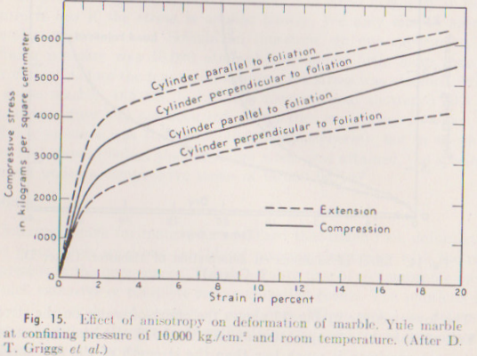
f)Anisotropy and inhomogeniety
Isoropic material is rocks whose mechanical properties were uniform in all directions. Rocks that show bedding,banding, or foliation are not isotropic.
The strength of such rocks would depend upon the orientation of the applied forces to the planar structures of rock. Yule marble specimens under confining pressure 10,000kg/cm² and room temperature show great plastic deformation. The solid lines represent compression(compressive tress),in which strain is shortening parallel to the axis of the cylinder.Under compression the cylinder perpendicular to the foliation is stronger than the cylinder parallel to the foliation. The broken lines represent tests under tension (tensile stress) ,in which strain is lengthening parallel to the cylinders.Under tension the cylinder parallel to the foliation is msch stronger than the cylinder perpendicular to foliation.
1
2
4
3
Tensile stress
Compressive stress

Slide 18
The broken lines represent tests under tension (tensile stress) ,in which strain is lengthening parallel to the cylinders. Under tension the cylinder parallel to the foliation is much stronger than the cylinder perpendicular to foliation.
1
2
4
3
Tensile stress
Compressive stress
Q.1/Compare between (a) Coaxial and Non-coxial strain;(b) Homogeneous and Heterogeneous strain.

