Slide 1
Normal Faults (extensional regime)
Normal fault settings:
There are two distinct kinematic situations in which normal faults develop in brittle or semibrittle rocks (Suppe ,1985)
Overall Horizontal Extension:
The most important tectonic setting of normal faulting is zones of plate divergence, including continental rifts, and midocean ridges and backarc basins.
(a) Continental rifting:
Continental rifts provide the best on-land exposure of structure dominated by normal faulting, particularly where horizontal extension has terminated without complete continental separation. Important examples include the East African rift, and the Basin and Range of the Western United states, and the Rhine graben of western Europe.

Slide 2
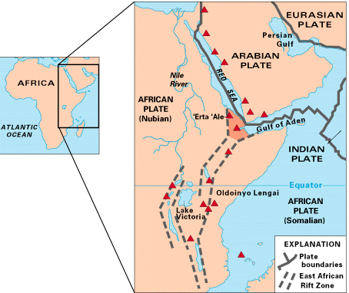

Slide 3
(b) Oceanic rifting:
Rift valleys in oceanic areas exhibit some significant differences from those on the continents because the crust that is undergoing faulting in the oceanic realm has been crated through igneous intrusion and extrusion synchronously with faulting. The example of Oceanic rifting is Mid-Atlantic ridge and Red sea ridge.
(c) Normal faults in gravity slides:
A third important setting of normal faulting is in major gravity slide structures. Large-scale landslides tens of kilometers across develop in a variety of settings as a secondary response to the relief crated by tectonic processes. For example, a system of normal faults exists in the sediments of the Gulf of Mexico continental margin.

Slide 5
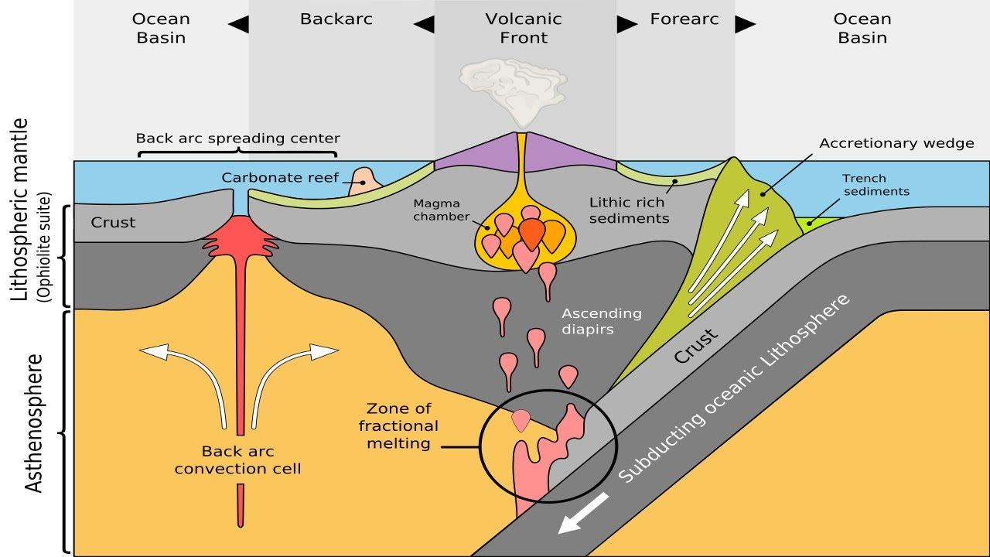

Slide 6
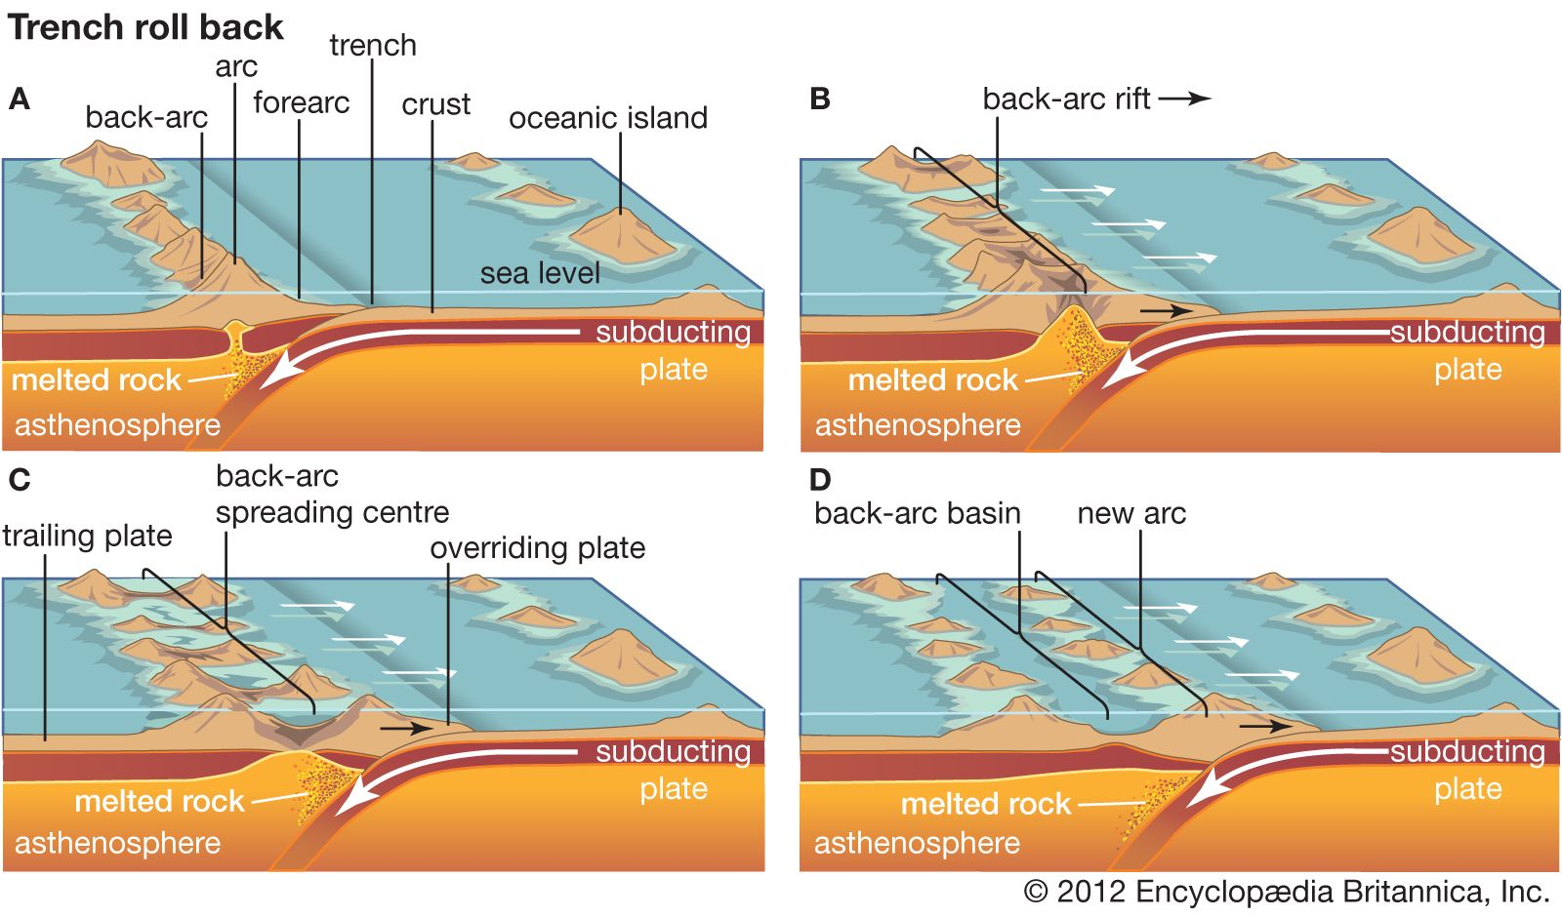

Slide 7
(d) Normal faults in response to flexure:
A fourth important situation for normal faulting in response to horizontal extension is the stretching of competent layers during flexure of anticlinal and sometimes synclinal folds. An example is the Kettleman Hills anticline of California.
2. No Overall Horizontal Extension:
Normal faulting can also be produced through the collapse of rock into a space created through the removal of underlying rock (igneous activity, and salts) with no associated net horizontal extension.

Slide 8
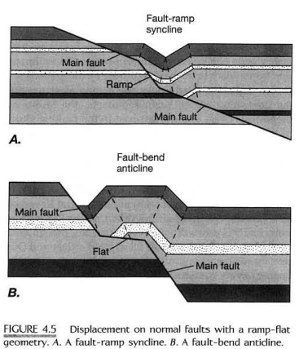
Displacement on Normal Faults
A hanging wall block moving over a fault with ramp flat geometry must in general deform internally. If a ramp connects two more shallowly dipping segments of the fault, slip on the fault produces a fault-ramp syncline
(Figure 4.5A). If a flat connects two more steeply dipping segments of the fault, slip produces a fault-bend anticline (Figure 4.5B),
which is comparable in part to a rollover anticline.

Slide 10
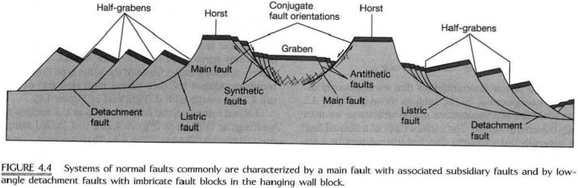
STRUCTURAL ASSOCIATIONS OF NORMAL FAULTS
Normal faults generally are present as systems of many associated faults.
In many cases, the orientations of the faults fall into two groups,
which are referred to as conjugate orientations; they have comparable dip angles but opposite dip directions and opposite senses of shear (conjugate faults bound the graben in Figure 4.4).

Slide 11
If the smaller-scale faults are parallel to the major fault and have the same sense of shear, they are synthetic faults; if they are in the conjugate orientation, that is, if they have comparable dips but in the opposite dip direction from the main faults, they are antithetic faults.

Slide 12
A graben is a down-dropped block bounded on both sides by conjugate normal faults that dip toward the down-dropped block on both sides (Figure 4.4). A half graben is a down-dropped tilted block bounded on only one side by a major normal fault.

Slide 13
A horst is a relatively uplifted block bounded by two conjugate normal faults that dip away from the uplifted block on both sides. Alternating uplifted and down-dropped fault blocks are called a horst-and-graben structure.

Slide 14
KINEMATIC MODELS OF NORMAL FAULT SYSTEMS
A kinematic model of any fault system is a description of the motion that has occurred on the faults in the system. Three models of normal fault are constructed
1- A first model of slip on listric normal faults (Model I)
First model for the geometry of displacement on a listric normal fault accompanied by rollover folding or antithetic normal faulting.

Slide 15
2- A second model for slip on a listric fault (Model II)
The hanging wall block breaks up into a set of domino-like blocks along synthetic faults dipping in the same direction as the main fault (Figure 4.20A, B). Rotation of the fault blocks requires the synthetic fault planes to rotate as well.

Slide 16
The triangular gap that opens at the right where the set of synthetic faults ends could be closed by a set of antithetic faults as shown in Figure 4.20 B. Again the small gaps that occur below the synthetic fault blocks can be accommodated by closer spacing of the faults and by localized fracturing near the base of the fault blocks.

Slide 17
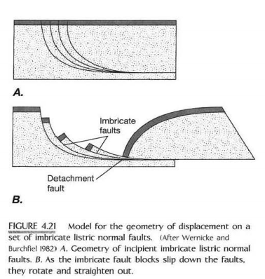
3- A third model of slip on listric normal faults (Model III)
This model requires slip of tapered fault blocks on a set of imbricate listric normal faults. As the fault blocks slip down the faults (Figure 4.21A, B), they must deform to conform to the shape of the fault. At large amounts of extension, the imbricate blocks are almost completely flattened out on the listric detachment fault, and bedding in the fault blocks is rotated into very steep dips.

Slide 18
►In principle, the latter two (II &III) models might be distinguishable in the field. For the "domino block"(II) model of planar rotational normal faults (Figure 4.20B), the dip of the bedding is constant across the entire hanging wall block above the detachment fault. For the imbricate listric fault (III) model, however, if extension has not been too great (Figure 4.21B), the dip of the bedding should increase with distance in the direction of displacement on the detachment fault.

Slide 19
DETERMINATION O F EXTENSION ASSOCIATED W ITH NORMAL FAULTS
To estimate quantitatively the amount of extension in normal fault systems. The extension ( e )defines as the change in length in a given direction caused by the deformation, divided by the original length. Thus in Fig. 4.20, for example, e = (ℓ –L)/L, where ℓ is the deformed length, and L the initial undeformed length. The amount of extension can estimate from fault geometry and by using map relationships to restore the stratigraphy to its original state.

Slide 20
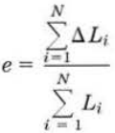
Estimates of Extension Based on Fault Geometry
1- A model of planar nonrotating normal faults
A simple cross-sectional model of planar nonrotating normal faults producing a structure (Figure 4.24A). The segments of a particular stratigraphic layer
labeled Li (L1, L2, L3, and so on), when summed together, equal the original length of the cross section. The segments labeled ∆ Li, when summed together, give
the total change in horizontal length. The extension e is calculated for a total of N faults by the formula: For an individual fault, the change in length ∆L is related to the dip-slip displacement ẟ and the dip angle of the fault Ф
by: ∆L= ẟ cos Ф

Slide 21
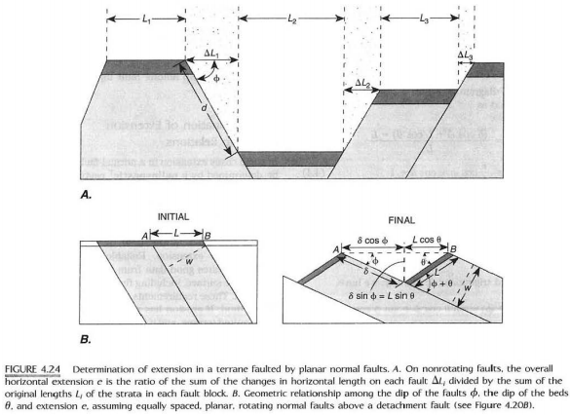
2- A model of rotating planar normal faults (Figure 4.20A, B),
assume that bedding is initially horizontal and that, on the average, the faults have the same orientation, spacing, and slip, a relationship between the extension e, the dip of the rotated bedding θ, and the dip of the rotated fault planes Ф can derive by

Slide 23
Next Lectures:
1 Ap.2024……… Lec.9;(Quiz:Lec.7 and 8 )
8 Ap.2024……… Lec.10
25 Mar. 2025……Field report
15 Ap. 2023 ………Lec. 11
2 exam ?
22 Ap. 2023 …………….Lec.12
29 Ap. 2023……….Lec. 13

