Slide 1
CHICK QUALITY

Slide 2
Introduction
When asking the question “What is good chick quality?”, the responses can be very different based on the person and their role.
--The hatchery manager
--The broiler farm manager
--The veterinarian
--The sexer

Slide 3
Parameters that affect chick quality
A-Laying and handling of the eggs
- Breeder uniformity
- Breeder nutrition
- Breeder immunity
- Breeder age
- Breeder health
- Fertility
- Egg Quality/Handling/Storage

Slide 4
B- Incubation of the eggs
- Egg transport
- Egg storage/handling
- Incubator type (single vs. multi-stage)
- Incubator temperature
- Incubator humidity
- CO2 concentration
- Air flow
- Egg temperature

Slide 5
C- Hatching of the eggs
– Listed below are some common areas where chick quality can be compromised and/or cause higher 7-day mortality levels.
Temperature: Too high/low or significant variations can influence
Optimum temperature in hatchery (37.5)c
Hatching times (too early/too late)
Chick weights (absorption of the yolk)
Hatchability levels
Cull rates
Incidence of ‘red beaks’

Slide 6
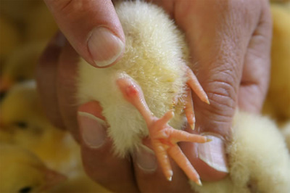
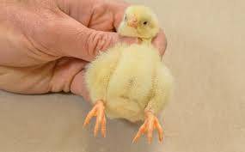
2-Humidity: Too high/low or significant variations can influence
Optimum Humidity in hatchery 55-60%
Chick yield percentage and 7-day mortality
Incidence of ‘red hocks’
Navel quality

Slide 7
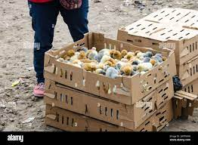
3- Chick Holding
– This area is often underestimated. After spending 21 days to produce a good quality chick, it is easy to compromise chick quality with 30 minutes of adverse holding environments.
Poor or inadequate ventilation or air movement, resulting in chicks overheating and panting.
Lack of air volumes/movement (oxygen) causing listless and ‘flat’ chicks in the boxes.
Too cold/draughts (over-ventilating) causing chicks to ‘huddle’ (تجمع) in the boxes.
Boxes stacked too close together.
Too many chicks in a box.
‘Dead spots’ in the room for airflow/circulation.

Slide 8
Chick Grading
A-Traditional observations of chicks:
Stand tall/upright
Clear, bright eyes
Clean, well-healed navel
Good feather covering
Colour – not pale chicks
Few defects – toes, legs, beaks, etc
Infection free – yolk sac, omphalitis

Slide 9
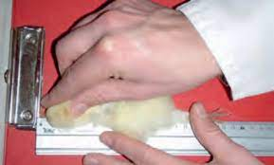
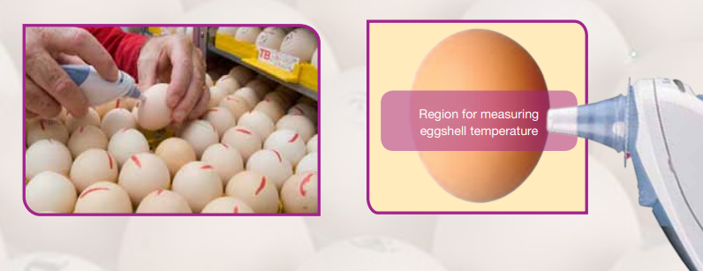
B-New concepts that are being used to try and correlate chick quality measurements to broiler performance include:
Chick weights/uniformity
Day-old chick length
Eggshell temperatures

Slide 10
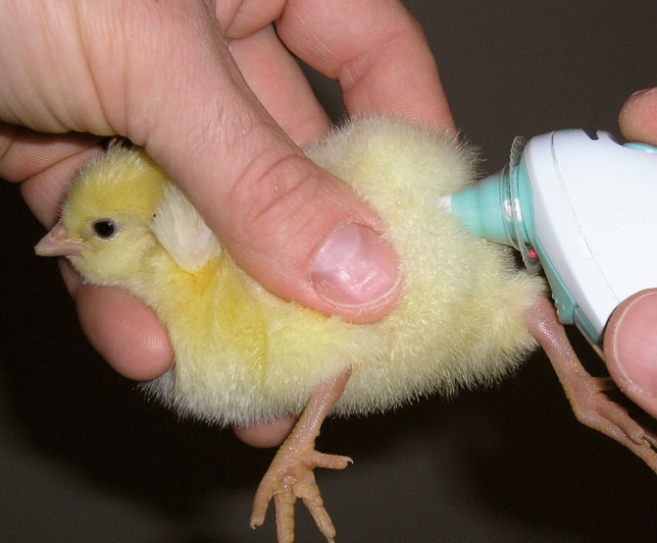
Cloaca temperatures
Chick yield % the average chick weight divided by average fresh egg weight multiplied by 100)
Organ weights (heart, gut, gizzard) – but this is destructive
Enzymatic activity and oxidative stress from blood samples
The best parameters are those that strongly correlate with final broiler performance (7-day weight and 7-day mortality)

Slide 11
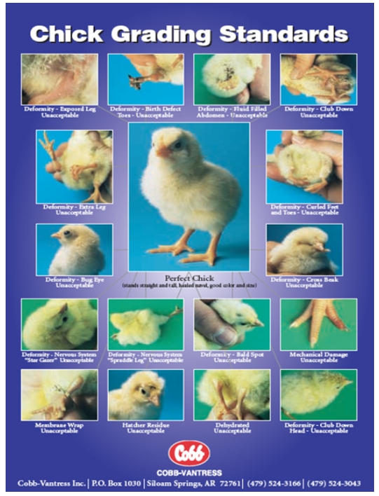
Chick Grading

Slide 12
Red Hocks – are normally associated with insufficient moisture loss (especially in the incubators), causing a small air cell.
Chick Yield Percentage - The rule of thumb for incubation is that the chick should weigh two-thirds or 67% of egg weight.

Slide 13
Conclusion In summary, the key points to chick quality are:
¬ Adapt incubation profiles to achieve a setter weight loss of 11-13% by 18 days of incubation. Young flocks will have lower weight loss and older flocks more.
¬ Achieve a chick yield between 66-68% for short distance chick deliveries and 65-66% for long distance deliveries.
¬ Eliminate stress factors after the chicks have hatched i.e. overheating or lack of ventilation in the hatcher, environmental conditions in the chick processing, holding areas, in transit and at arrival at the farm.

Slide 14
1-Avoid overheating as is common with insufficient ventilation or chick boxes placed too close together with little air circulation.
2- Avoid cold draughts that may be caused by holding room fans blowing onto chicks.
3- Park delivery truck facing the prevailing winds so the chicks are not exposed during unloading.
¬ Cloaca temperatures – should be maintained between 40.0°C – 40.6°C at all times in the first day for chicks to maintain their comfort zone. At 41.0°C, chicks will start ‘panting’ which is an indication of heat related stress.

