Slide 1
University of Salahaddin – Hawler College of Engineering Water Resources Engineering
Foundation Engineering
Introduction
E-mail: Hawkar h. Ibrahim@gmail.co
Hawkar H. Ibrahim

Slide 2
Common Types of Shallow Foundations
• Strip Footings
• Single Footings
• Combined Footings
• Mat Footing

Slide 3
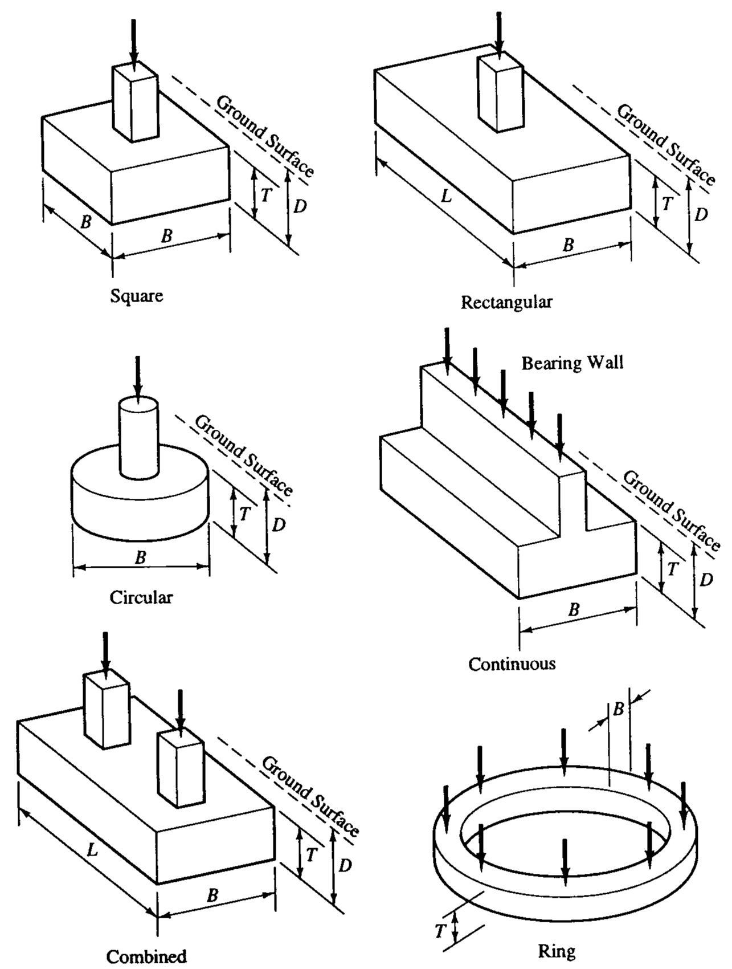

Slide 4
Combined Footings
property line
P₁
P2
Two footings are close to each other
If 1/2 < P₂/P₁ < 1
use trapezoidal footing

Slide 5
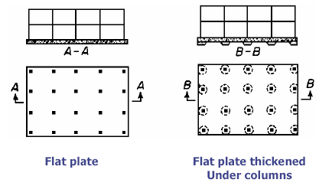
Mat (or Raft) Foundation
Notes:
Consists of one footing usually placed under the entire building area.
They are used, when
soil bearing capacity is low,
column loads are very heavy
single footings cannot be used,
piles are not used and
differential settlement must be reduced.

Slide 6
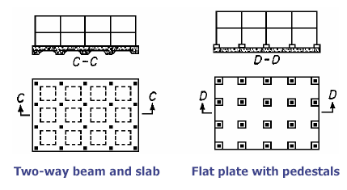
Mat (or Raft) Foundation
Notes:
Consists of one footing usually placed under the entire building area.
They are used, when
soil bearing capacity is low,
column loads are very heavy
single footings cannot be used,
piles are not used and
differential settlement must be reduced.

Slide 7
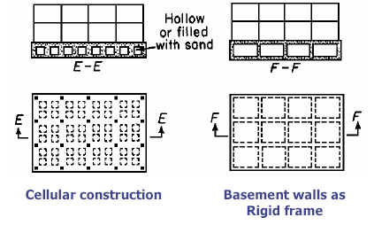
Mat (or Raft) Foundation
Notes:
Consists of one footing usually placed under the entire building area.
They are used, when
soil bearing capacity is low,
column loads are very heavy
single footings cannot be used,
piles are not used and
differential settlement must be reduced.

Slide 8
Deep Foundations
Deep Foundations are those founding too deeply below the finished ground surface for their base bearing capacity to be affected by surface conditions, this is usually at depths/ width >4 m below finished ground level.
Deep foundations can be used to transfer the loading to a deeper, more competent strata at depth if unsuitable soils are present near the surface.
Notes:
Deep foundations are used when there are weak (“bad”) soils near the surface or when loads are very high.

Slide 9
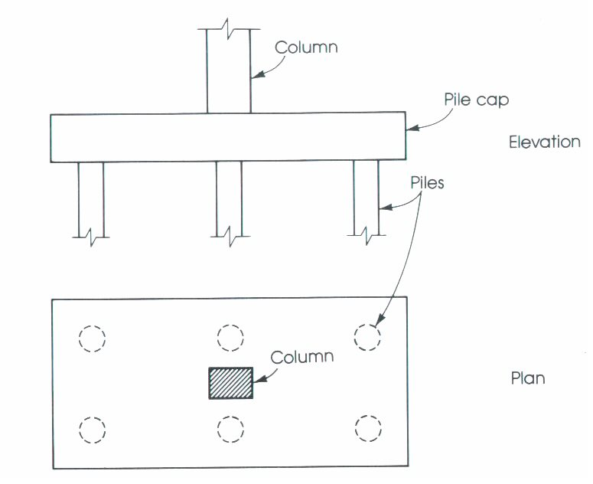
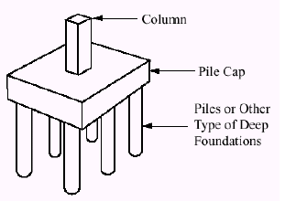
Common Types of Deep Foundations are :
1. Pile foundations 2. Piers 3. Caissons

