Slide 1

University of Salahaddin – Hawler
College of Engineering
Civil Engineering Department
Foundation Engineering
Introduction
E-mail: hawkar.ibrahim@su.edu.krd
Hawkar H. Ibrahim

Slide 2
INTRODUCTION
Foundation is the substructure which transfers the weight of a structure to the underlying soil or rock .
A foundation is interfacing element between the superstructure and the underlying soil or rock. The loads transmitted by the foundation to the underling soil must not cause soil shear failure or damaging settlement of the superstructure.

Slide 3
INTRODUCTION
The term "foundation engineering" is used to include the design of foundations for buildings, other structures and also for such non-foundation problems such as retaining walls, tunnels, and earth dams, as well as the design of natural slopes, and stabilization of soils mechanically and chemically.

Slide 4
FOUNDATION DESIGN APPROACH
1- Determine the foundation loads to be supported.
2- Evaluate the subsurface exploration and elaborator testing programs.
3- Prepare a final soil profile. Determine soil layers suitable or unsuitable for shallow foundations or deep foundations. Also consider if ground improvement techniques could modify unsuitable layers into suitable support layers.

Slide 5
FOUNDATION DESIGN APPROACH
4- Consider and prepare alternative designs.
Shallow foundations or Deep foundations.
5- Prepare cost estimates for feasible alternative foundation designs including all associated substructure cost.
6- Select the optimum foundation alternative.

Slide 6
Q. Why you must worry about FOUNDATIONS?
A. They hold everything up !!

Slide 7
Q. What factors does the Geotechnical Engineer need to consider in selecting a proper foundation?
1. Type of Structure
2. Loads (how heavy)
3. Type of Ground (“good” soil vs. “bad” soil)
4. Schedule
5. Cost
6. Accessibility
The foundation takes the load from a structure and transmits it to safely to the ground

Slide 8
Q. What kinds of loads do we need to worry about ?
A. 1. Compression (downward)
2. Tension (upward)
3. Lateral (sideways)
4. Torsion (twisting)
5. Combinations of the above

Slide 9
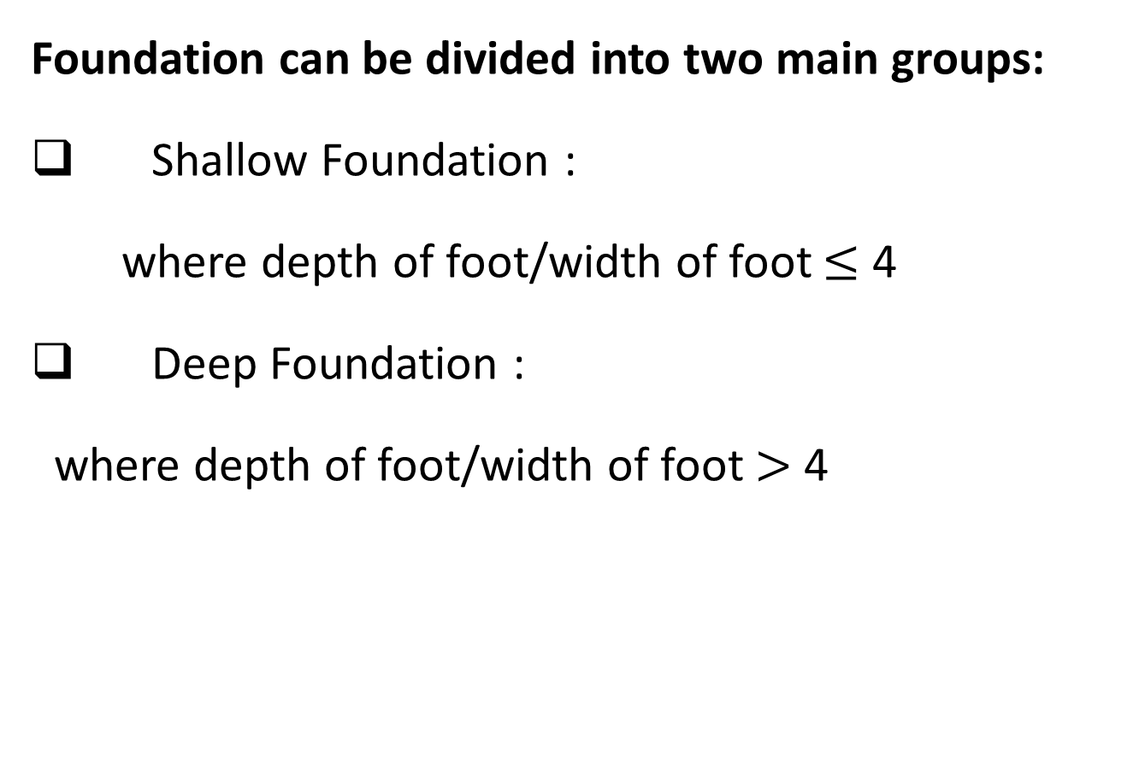
CLASSIFICATION OF FOUNDATIONS
Foundation can be divided into two main groups:
Shallow Foundation :
where depth of foot/width of foot $≤$ 4
Deep Foundation :
where depth of foot/width of foot $>$ 4

Slide 10
Shallow Foundation Types
1. Pad or column footings (Isolated or Combined)
2. Strip footings
3. Trench footings
4. Slab on grade with thickened edge
5. Interior footings for bearing walls
6. Mat (Raft) footings (Thickened slabs)

Slide 11
Common Types of Shallow Foundations
• Strip Footings
• Single Footings
• Combined Footings
• Mat Footing

Slide 12
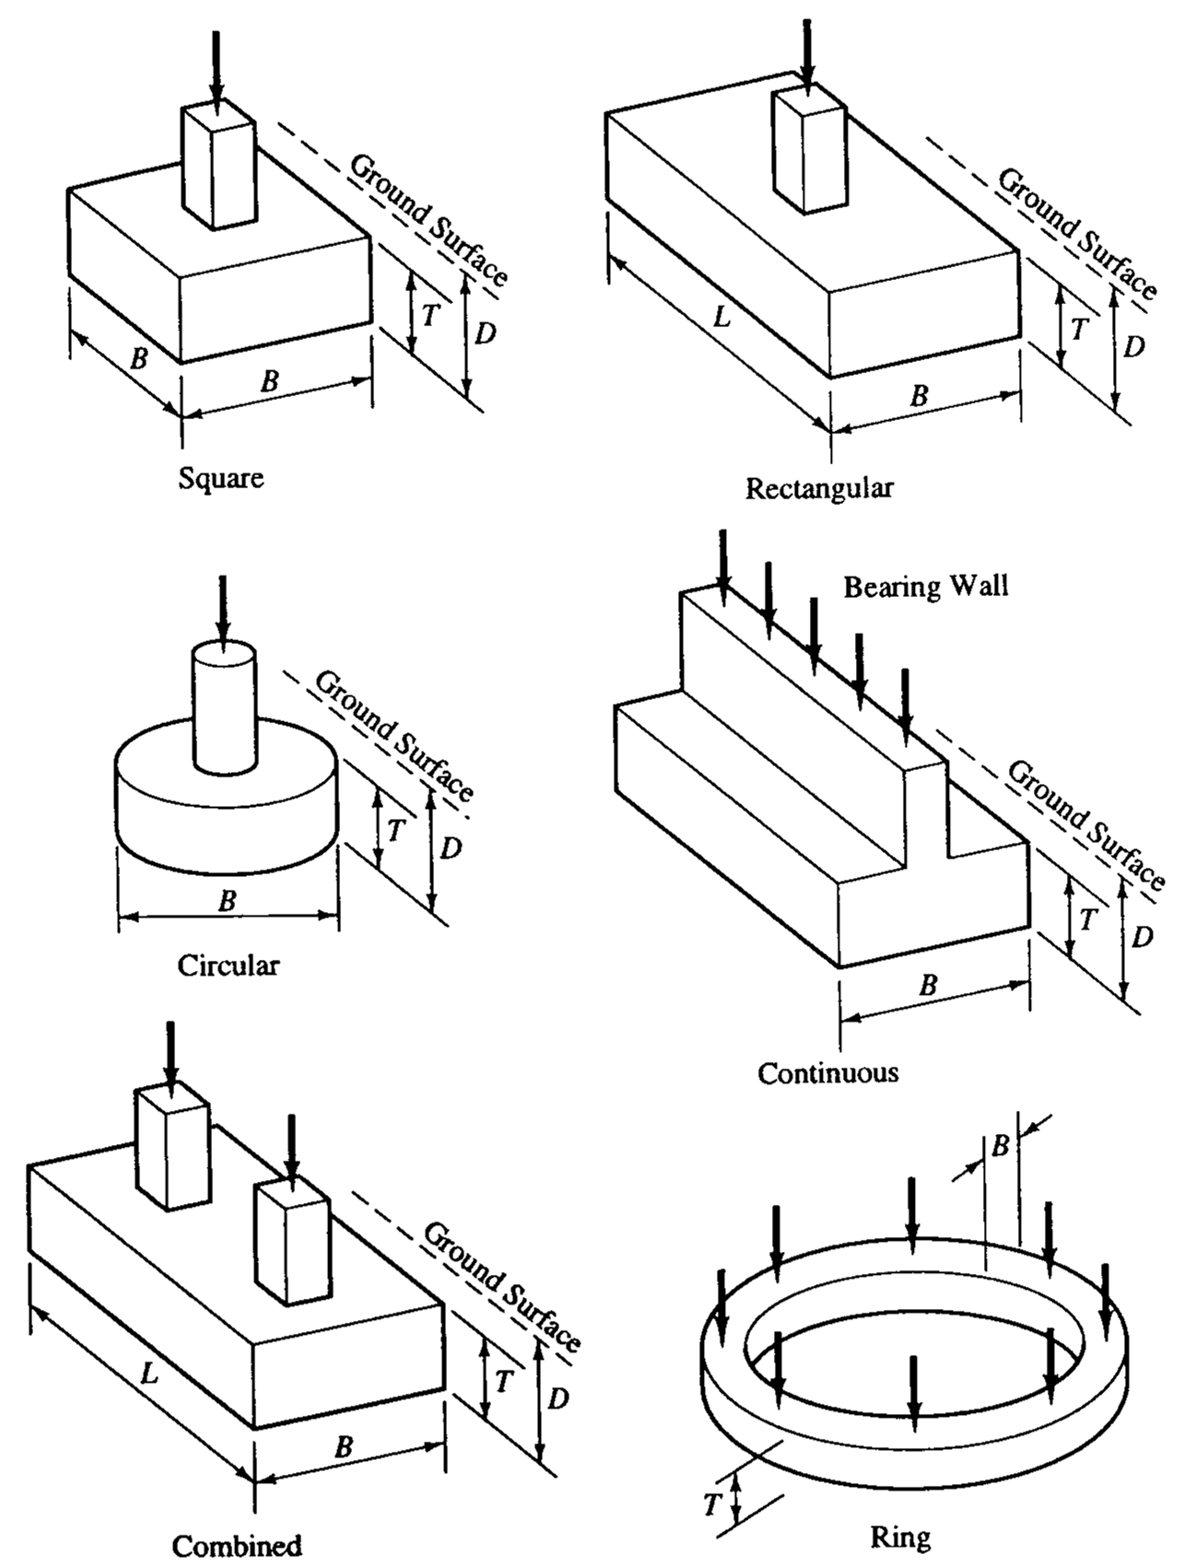

Slide 13
Combined Footings
property line
P₁
P2
Two footings are close to each other
If 1/2 < P₂/P₁ < 1
use trapezoidal footing

Slide 14
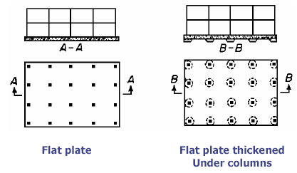
Mat (or Raft) Foundation
Notes:
Consists of one footing usually placed under the entire building area.
They are used, when
soil bearing capacity is low,
column loads are very heavy
single footings cannot be used,
piles are not used and
differential settlement must be reduced.

Slide 15
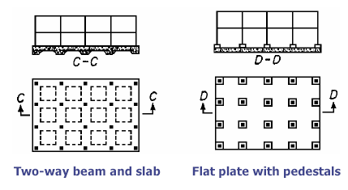
Mat (or Raft) Foundation
Notes:
Consists of one footing usually placed under the entire building area.
They are used, when
soil bearing capacity is low,
column loads are very heavy
single footings cannot be used,
piles are not used and
differential settlement must be reduced.

Slide 16
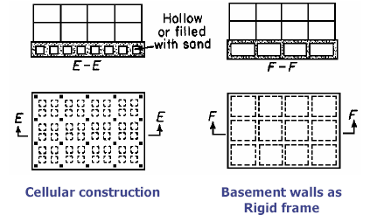
Mat (or Raft) Foundation
Notes:
Consists of one footing usually placed under the entire building area.
They are used, when
soil bearing capacity is low,
column loads are very heavy
single footings cannot be used,
piles are not used and
differential settlement must be reduced.

Slide 17
Deep Foundations
Deep Foundations are those founding too deeply below the finished ground surface for their base bearing capacity to be affected by surface conditions, this is usually at depths/ width >4 m below finished ground level.
Deep foundations can be used to transfer the loading to a deeper, more competent strata at depth if unsuitable soils are present near the surface.
Notes:
Deep foundations are used when there are weak (“bad”) soils near the surface or when loads are very high.

Slide 18
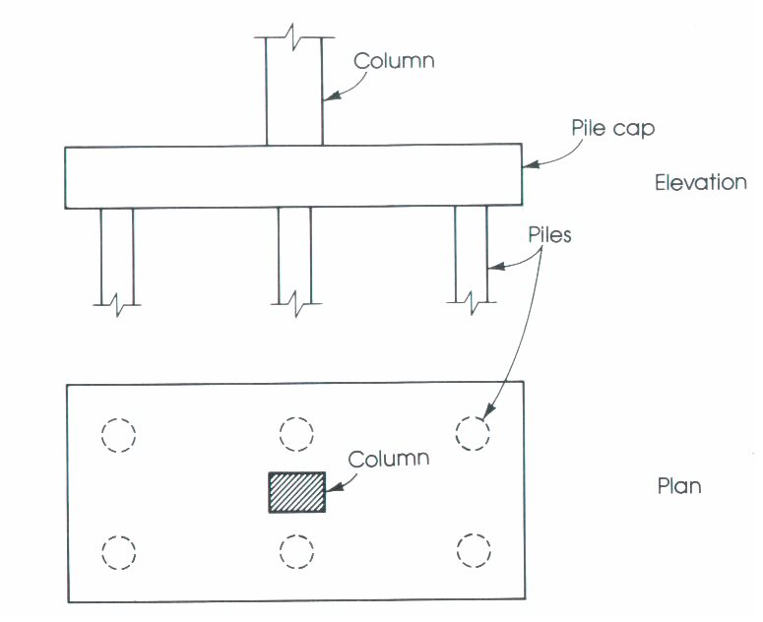
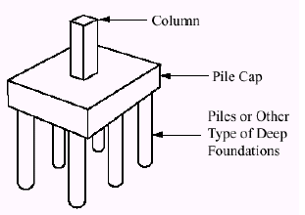
Common Types of Deep Foundations are :
1. Pile foundations 2. Piers 3. Caissons

Slide 19
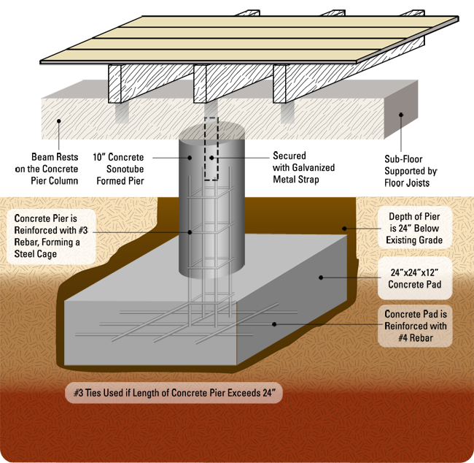
Common Types of Deep Foundations are :
1. Pile foundations 2. Piers 3. Caissons

Slide 20
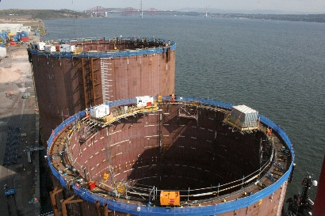
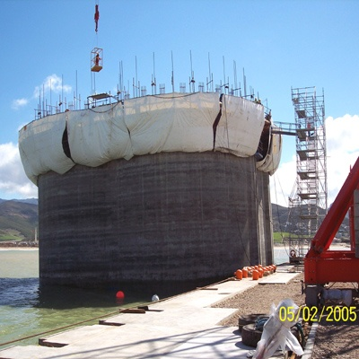
Common Types of Deep Foundations are :
1. Pile foundations 2. Piers 3. Caissons
Caissons

Slide 21
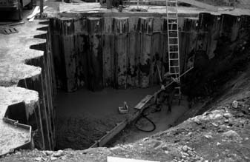
Other Foundations :
SheetPiles
Retaining Walls
Abutments

