Slide 1
University of Salahaddin – Hawler
College of Engineering
Civil Department
EXPERIMENTAL SOIL MECHANICS
Experiment No. 8
Hawkar H. Ibrahim

Slide 2
SOIL SHEAR STRENGTH
Shear strength is the ability of soil to resist failure and sliding along internal surfaces within the soil mass.
Soil failure usually happens in the form of shearing along internal surface within the soil. Thus, structural strength is primarily a function of shear strength.

Slide 3
SOIL SHEAR STRENGTH
The shear strength of a granular soil is made of two components:
Mineral to mineral friction due to sliding and rolling
Degree of interlocking
The shear strength of cohesive soil is cohesion due to the bonding between particles

Slide 4
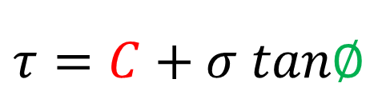
SOIL SHEAR STRENGTH
$$τ=C+σ tan∅$$
The component (c) of the shear strength is known as cohesion. Cohesion holds the particles of the soil together in a soil mass (Cementation between the grains)
The angle (Φ) is called the angle of internal friction. It represents the fractional resistance between the particles

Slide 5
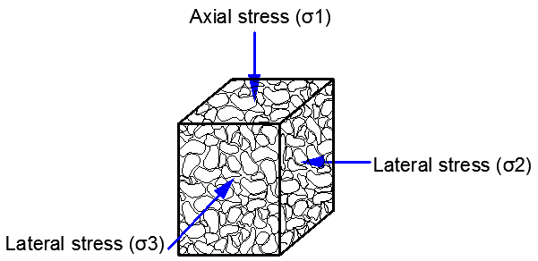
SOIL SHEAR STRENGTH
A soil mass in nature is encircled by confining pressure from the surrounding soil.
A soil mass sample in nature

Slide 6
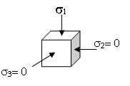
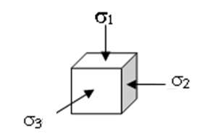
UNCONFINED COMPRESSION TEST
TRIAXIAL COMPRESSION TEST
Notes:
In the unconfined compression test, the cylindrical soil specimen loaded axially (compressive axial stress s₁) without a lateral support, which is mean that the minor principle stress s₂ & s₃ (confining pressure) is zero as shown in Fig.(1).

Slide 7
UNCONFINED COMPRESSION TEST
The unconfined compression test is a quick, relatively inexpensive means to obtain an estimation of the undrained shear strength of cohesive (fine-grained) specimens.
Axial Stress
A cylindrical sample of the soil is loaded just axially
Axial Stress

Slide 8
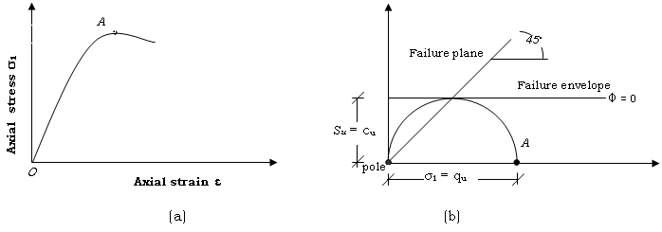

A typical stress-strain response
$$q_{u}$$

Slide 9
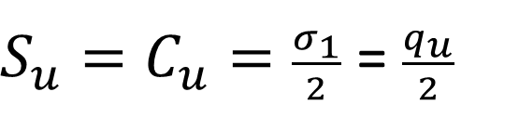
Mohr’s circle
The corresponding evolution of the Mohr circle in the total stress
$S_{u}=C_{u}=\frac{σ_{1}}{2}$ = $\frac{q_{u}}{2}$
Notes:
The Mohr circle can be drawn for stress condition at failure. As the minor principle stress is zero, the Mohr circle passes through the origin as shown in Fig. (2). The failure envelope is horizontal (Φ = 0). The cohesion intercept is equal to the radius of the circle,

Slide 10
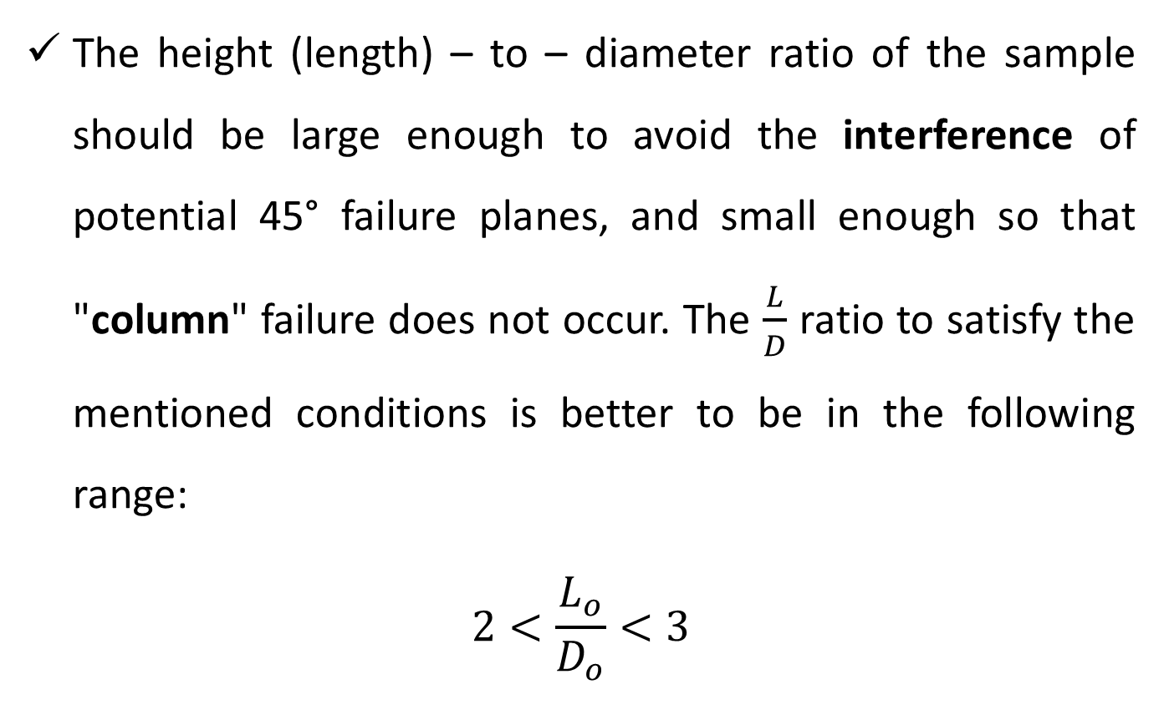
Height to Diameter Ratio
The height (length) – to – diameter ratio of the sample should be large enough to avoid the interference of potential 45° failure planes, and small enough so that "column" failure does not occur. The $\frac{L}{D}$ ratio to satisfy the mentioned conditions is better to be in the following range:
$$2<\frac{L_{o}}{D_{o}}<3$$

Slide 11
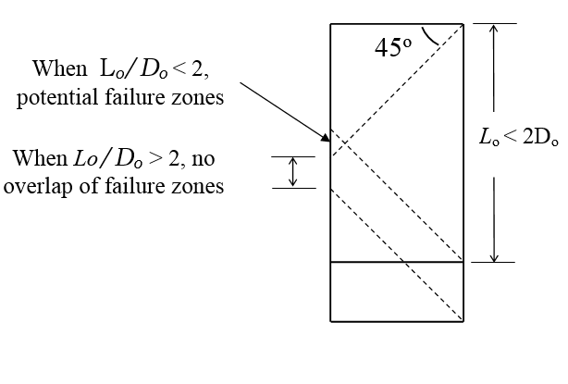
Height to Diameter Ratio

Slide 12
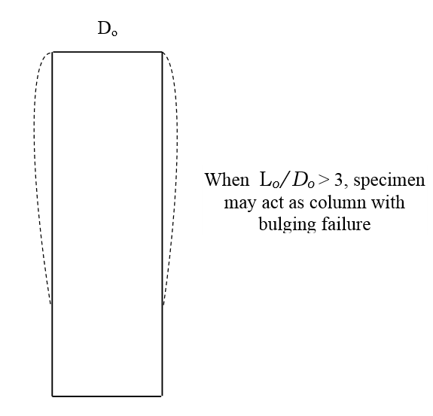
Height to Diameter Ratio

Slide 13
Failure Types
Generally, three types of failure have been recognised in unconfined compression test:
Plastic failure: It is a type of failure in which the specimen bulges laterally into a barrel shape without splitting, as in Fig 4a.
Brittle Failure: It is a type of failure in which the specimen shears along one or more well defined surfaces, as in Fig 4b.
Semi-plastic Failure: In this type, the failure tends to be intermediate between the first and the second type, as in Fig 4c.

Slide 14
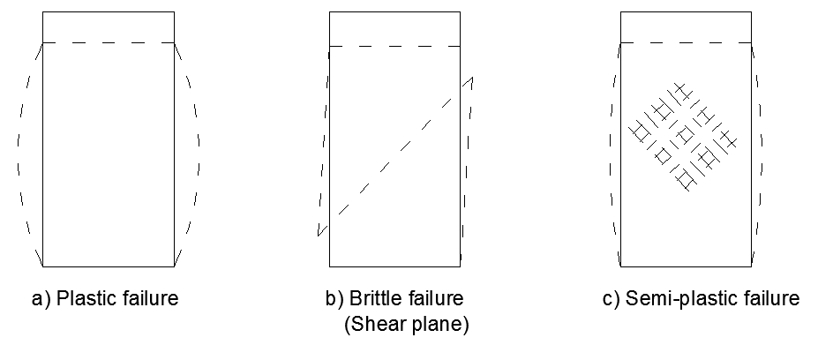
Failure Types
Fig 4: Modes of failure in compression test specimens

Slide 15
Area Correction
With the increase of the load, the height of the sample shortens and causes an increase in the cross sectional area. It is essential to correct the area for each reading of the load during the testing.

Slide 16
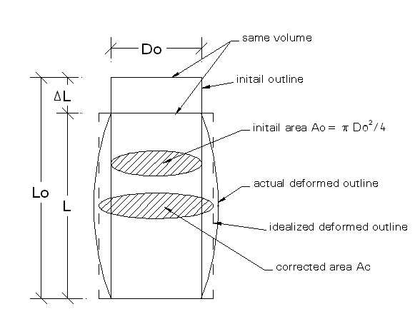
Area Correction
In the Tension case
Correction not necessary
Barrelling deformation of the compressed specimen.

Slide 17
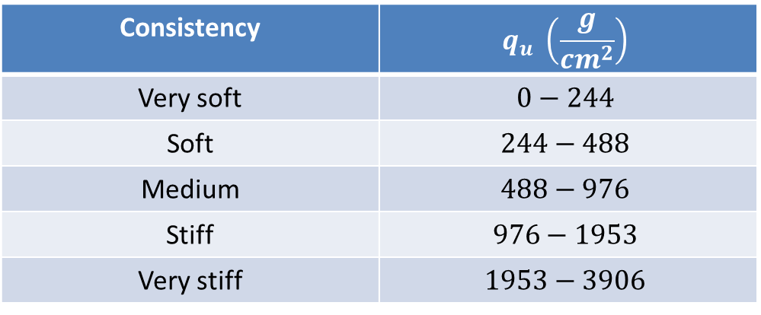
Aims and Objectives
The unconfined compression test is widely used for a quick economical means of obtaining the approximate shear strength of a cohesive soil.
The test results provide an estimate of the relative consistency of the soil, as shown in table (1).
Consistency | (kN/m²)
Very soft | 0 – 25
Soft | 25 – 50
Medium | 50 – 100
Stiff | 100 - 200
Very stiff | 200 - 400
Hard | > 400
Consistency | $$q_{u} \left(\frac{g}{{cm}^{2}}\right)$$
Very soft | $$0−244$$
Soft | $$244−488$$
Medium | $$488−976$$
Stiff | $$976−1953$$
Very stiff | $$1953−3906$$
Table (1): Relative consistency as a function of Unconfined Compressive Strength
University of Texas at Arlington, Geotechnical Engineering Laboratory, Unconfined Compressive Strength Test, lecture note 9

Slide 18
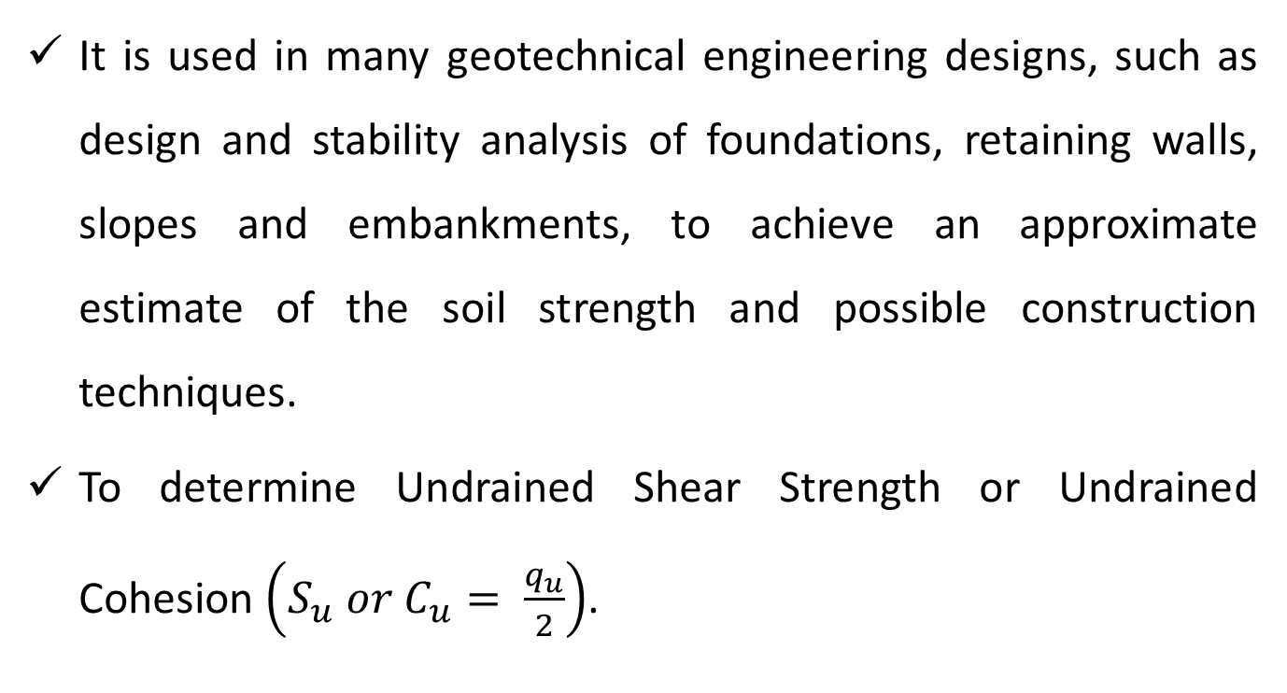
Aims and Objectives
It is used in many geotechnical engineering designs, such as design and stability analysis of foundations, retaining walls, slopes and embankments, to achieve an approximate estimate of the soil strength and possible construction techniques.
To determine Undrained Shear Strength or Undrained Cohesion $\left(S_{u} or C_{u}= \frac{q_{u}}{2}\right)$.

Slide 19
Apparatus
Unconfined compression testing machine (Triaxial Machine).
Devices for Load and deformation measurements (dial gauges or transducers).
Apparatus for extruding and trimming specimens (Split mould 38mm dia., 83mm length).
Vernier calipers.
Balance.

Slide 20
Procedures
Preparation of the machine
Ensure that the load frame stands firmly on a solid level support.
Check that the load and deformation measurement devices (transducers) are connected with the transducer read-out.
If a motorised unit is used, select the gear position which will give a platen speed of between 0.5% and 2% of the specimen length per minute.
Do not forget to examine the loading frame. Turn the crank and learn how to read the load and deformation dial gages. Determine the calibration constant for the proving ring and the units of the deformation dial gauge.

Slide 21
Procedures
Sample preparation
Undisturbed specimens from sample tube
Extrude the specimen from the base end of the sample tube which is taken in-situ by extruder devices.
Disturbed (remoulded) samples
It can be prepared by compacting the soil in a cylindrical mould (proctor compaction) and then extruded from the mould by extruder devices, or Compact the soil in Harvard miniature mould as uniformly as possible using 3 layers with 25 blows per layer.

Slide 22
Procedures
Testing procedures
Extrude the soil sample from the sampler. Cut a soil specimen so that the ratio (L/d) is roughly between 2 and 3.
Measure the length and diameter of the specimen by taking several measurements in different places along the soil sample and finding their average value.
If the unit weight of the sample is not pre-defined, weigh the sample and record the mass on the data sheet. Prior to testing, avoid any moisture loss in the sample.

Slide 23
Procedures
Carefully place the specimen on the bottom plate of the machine and centre it in a way that the specimen axis is vertical.
Adjust the device so that the upper plate just makes contact with the specimen and set the load and deformation dials to zero.
Start the test and record the readings of load and deformation from the transducer read out every ( 20 sec or 0.5mm).
Keep applying the load and take the readings certain failure has occurred due to one of the following criteria:

Slide 24
Procedures
The load decreases on the specimen significantly.
The load remains constant for at least four deformation dial readings.
As soil must have sufficient shear strength to resist shear stresses that develop during loading, it also must have adequate stiffness so that deformations resulted from loading do not cause problems. Therefore, stop the test when the deformation is significantly past the 20% strain (some standards allow the strain to reach 15%).
When the unit weight is not known, remove the sample from the compression device and achieve a sample for water content determination.

Slide 25
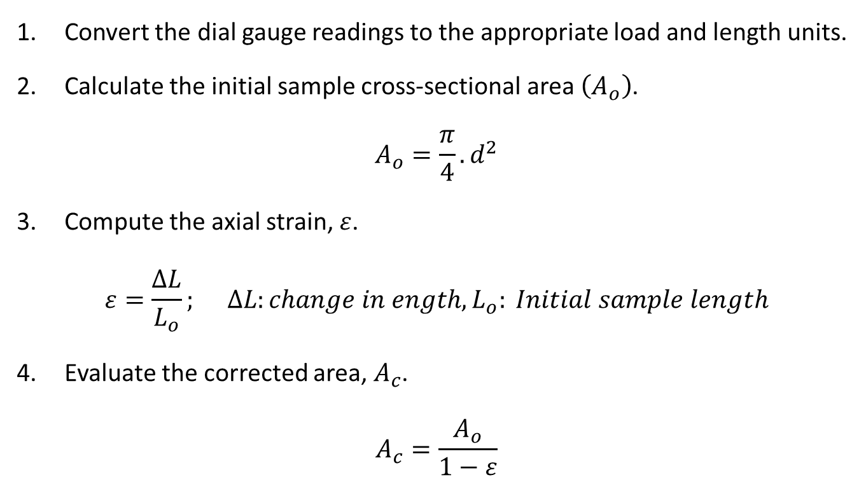
Calculation
Convert the dial gauge readings to the appropriate load and length units.
Calculate the initial sample cross-sectional area $\left(A_{o}\right)$.
$$A_{o}=\frac{π}{4}.d^{2}$$
Compute the axial strain, $ε$.
$$ε=\frac{∆L}{L_{o}}; ∆L:change in ength,L_{o}: Initial sample length$$
Evaluate the corrected area, $A_{c}$.
$$A_{c}=\frac{A_{o}}{1−ε}$$

Slide 26
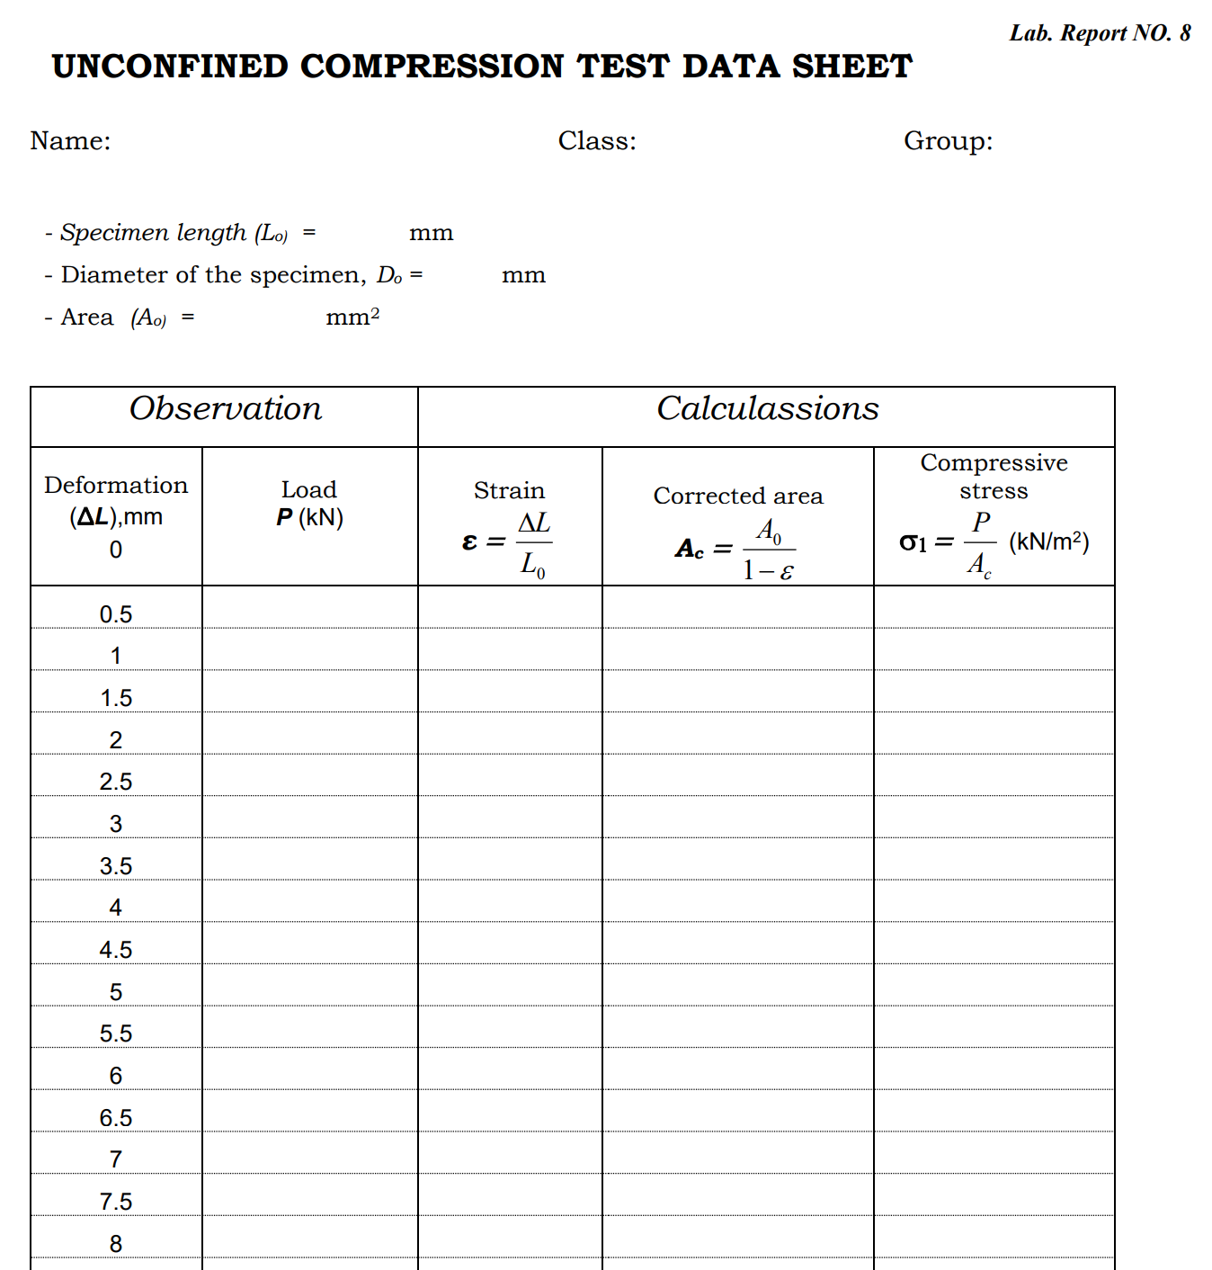
UNCONFINED COMPRESSION TEST DATA SHEET

