Slide 1
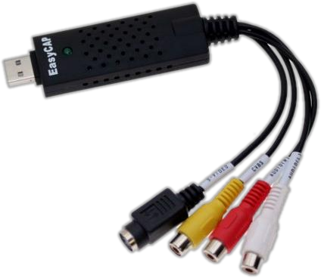
Console Input / Output

Slide 2
Table of Contents
Printing to the Console  Printing Strings and Numbers
Reading from the Console  Reading Characters  Reading Strings  Parsing Strings to Numeral Types  Reading Numeral Types
Various Examples

Slide 3
Printing to the Console
→ Console is used to display information in a text window  Can display different values:  Strings  Numeral types  All primitive data types  To print to the console use the class Console (System.Console)

Slide 4
The Console Class
Provides methods for console input and output
Input  Read(…) – reads a single character  ReadKey(…) – reads a combination of keys  ReadLine(…) – reads a single line of characters
Output  Write(…) – prints the specified argument on the console  WriteLine(…) – prints specified data to the console and moves to the next line

Slide 5
Console.Write(…)  Printing more than one variable using a formatting string
→ Printing an integer variable
→ Next print operation will start from the same line
int a = 15;
Console.Write(a); // 15
double a = 15.5;int b = 14;
Console.Write("{0} + {1} = {2}", a, b, a + b);// 15.5 + 14 = 29.5

Slide 6
Console.WriteLine(…)
Printing more than one variable using a formatting string.
Printing a string variable string str = "Hello C#!"; ... Console.WriteLine(str);
Printing more than one variable using a formatting string
string name = "Marry"; int year = 1987; ... Console.Write("{0} was born in {1}.", name, year); // Marry was born in 1987.

Slide 7
Printing to the Console – Example
static void Main(string[] args)
{
string name = "Peter";
int age = 18;
string town = "Sofia";
Console.Write("{0} is {1} years old from {2}.",
name, age, town);
// Result: Peter is 18 years old from Sofia.
Console.Write("This is on the same line!");
Console.WriteLine("Next sentence will be" +
" on a new line.");
Console.WriteLine("Bye, bye, {0} from {1}.",
name, town);
Console.ReadKey();
}

Slide 8
Using Parameters – Example
static void Main(string[] args)
{
int a = 2, b = 3;
Console.Write("{0} + {1} =", a, b);
Console.WriteLine(" {0}", a + b);
// 2 + 3 = 5
Console.WriteLine("{0} * {1} = {2}",
a, b, a * b);
// 2 * 3 = 6
float pi = 3.14159206f;
Console.WriteLine("{0:F2}", pi); // 3,14
Console.WriteLine("Bye – Bye!");
}

Slide 9
Printing a Menu – Example
static void Main(string[] args)
{
double colaPrice = 1.20;
string cola = "Coca Cola";
double fantaPrice = 1.20;
string fanta = "Fanta Dizzy";
double zagorkaPrice = 1.50;
string zagorka = "Zagorka";
Console.WriteLine("Menu:");
Console.WriteLine("1. {0} – {1}",cola, colaPrice);
Console.WriteLine("2. {0} – {1}",fanta, fantaPrice);
Console.WriteLine("3. {0} – {1}",zagorka, zagorkaPrice);
Console.WriteLine("Have a nice day!");
Console.ReadKey();
}

Slide 10
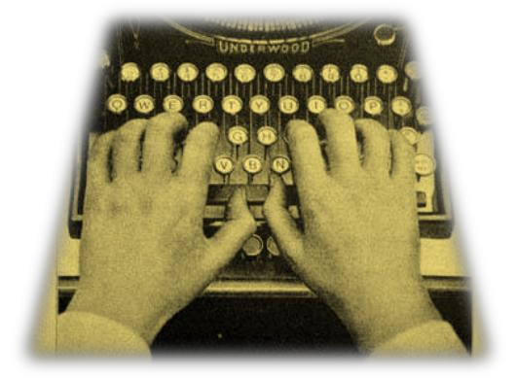
Reading from the Console  We use the console to read information from the command line  We can read:  Characters  Strings  Numeral types (after conversion)  To read from the console we use the methods Console.Read() and Console.ReadLine()
static void Main(string[] args)
{
int i = Console.Read();
char ch = (char)i; // Cast the int to char
// Gets the code of the entered symbol
Console.WriteLine("The code of '{0}' is {1}.", ch, i);
Console.ReadKey();
}

Slide 11
Console.ReadKey()
Waits until a combination of keys is pressed  Reads a single character from console or a combination of keys
Returns a result of type ConsoleKeyInfo  KeyChar – holds the entered character  Modifiers – holds the state of [Ctrl], [Alt], …
static void Main(string[] args)
{
ConsoleKeyInfo key = Console.ReadKey();
Console.WriteLine();
Console.WriteLine("Character entered: " + key.KeyChar);
Console.WriteLine("Special keys: " + key.Modifiers);
Console.ReadKey();
}

Slide 12
Console.ReadLine()
→ Gets a line of characters  Returns a string value  Returns null if the end of the input is reached
static void Main(string[] args)
{
Console.Write("Please enter your first name: ");
string firstName = Console.ReadLine();
Console.Write("Please enter your last name: ");
string lastName = Console.ReadLine();
Console.WriteLine("Hello, {0} {1}!",firstName, lastName);
Console.ReadKey();
}

Slide 13
Reading Numeral Types
Numeral types can not be read directly from the console
To read a numeral type do the following: 1. Read a string value 2. Convert (parse) it to the required numeral type
int.Parse(string) – parses a string to int
Numeral types have a method Parse(…) for extracting the numeral value from a string  int.Parse(string) – string → int  long.Parse(string) – string → long  float.Parse(string) – string → float  Causes FormatException in case of error

Slide 14
Example:
static void Main(string[] args)
{
int a = int.Parse(Console.ReadLine());
int b = int.Parse(Console.ReadLine());
Console.WriteLine("{0} + {1} = {2}",a, b, a + b);
Console.WriteLine("{0} * {1} = {2}",a, b, a * b);
float f = float.Parse(Console.ReadLine());
Console.WriteLine("{0} * {1} / {2} = {3}",a, b, f, a * b / f);
Console.ReadKey();
}

Slide 15
Converting Strings to Numbers
Converting can also be done using the methods of the Convert class  Convert.ToInt32(string) – string → int  Convert.ToSingle(string)– string → float  Convert.ToInt64(string)– string → long  Internally uses the parse methods of the numeral types
static void Main(string[] args)
{
string s = "123";
int i = Convert.ToInt32(s); // i = 123
long l = Convert.ToInt64(s); // l = 123L
string invalid = "xxx1845";
int value = Convert.ToInt32(invalid); // FormatException
Console.ReadKey();
}
Ask Mr. Google: what is the difference between ToInt32() and ToInt64()?

Slide 16
Error Handling when Parsing
Sometimes we want to handle the errors when parsing a number
use TryParse():
static void Main(string[] args)
{
string str = Console.ReadLine();
int number;
if (int.TryParse(str, out number))
{
Console.WriteLine("Valid number: {0}", number);
}
else
{
Console.WriteLine("Invalid number: {0}", str);
}
Console.ReadKey();
}

Slide 17
Printing a Letter – Example:
static void Main(string[] args)
{
Console.Write("Enter person name: ");
string person = Console.ReadLine();
Console.Write("Enter company name: ");
string company = Console.ReadLine();
Console.WriteLine(" Dear {0},", person);
Console.WriteLine("We are pleased to tell you " +
"that {1} has chosen you to take part " +
"in the \"Introduction To Programming\" " +
"course. {1} wishes you good luck!",
person, company);
Console.WriteLine(" Yours,");
Console.WriteLine(" {0}", company);
Console.ReadKey();
}

Slide 18
Calculating Area – Example
static void Main(string[] args)
{
Console.WriteLine("This program calculates " +
"the area of a rectangle or a triangle");
Console.Write("Enter a and b (for rectangle) " +
" or a and h (for triangle): ");
int a = int.Parse(Console.ReadLine());
int b = int.Parse(Console.ReadLine());
Console.Write("Enter 1 for a rectangle or 2 " +
"for a triangle: ");
int choice = int.Parse(Console.ReadLine());
double area = (double)(a * b) / choice;
Console.WriteLine("The area of your figure " +
" is "+ area);
Console.ReadKey();
}

Slide 19
Exercises
1. Write a program that reads 3 integer numbers from the console and prints their sum. 2. Write a program that reads the radius r of a circle and prints its perimeter and area. 3. A company has name, address, phone number, fax number, web site and manager. The manager has first name, last name, age and a phone number. Write a program that reads the information about a company and its manager and prints them on the console.
4. Write a program that reads two positive integer numbers and prints how many numbers p exist between them such that the reminder of the division by 5 is 0 (inclusive). Example: p(17,25) = 2. 5. Write a program that gets two numbers from the console and prints the greater of them. Don’t use if statements. 6. Write a program that reads the coefficients a, b and c of a quadratic equation ax2+bx+c=0 and solves it (prints its real roots).

Slide 20
7. Write a program that gets a number n and after that gets more n numbers and calculates and prints their sum. 8. Write a program that reads an integer number n from the console and prints all the numbers in the interval [1..n], each on a single line. 9. Write a program to print the first 100 members of the sequence of Fibonacci: 0, 1, 1, 2, 3, 5, 8, 13, 21, 34, 55, 89, 144, 233, 377, … 10. Write a program to calculate the sum (with accuracy of 0.001): 1 + 1/2 - 1/3 + 1/4 - 1/5 + ...

