Slide 1
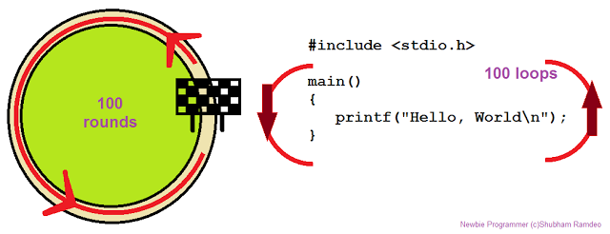
Loops Execute Blocks of Code Multiple Times

Slide 2
Table of Contents
What is a Loop?
Loops in C#
while loops
do … while loops
for loops
foreach loops
Nested loops

Slide 3
What Is Loop?
A loop is a control statement that allows repeating execution of a block of statements
May execute a code block fixed number of times
May execute a code block while given condition holds
May execute a code block for each member of a collection
Loops that never end are called an infinite loops

Slide 4
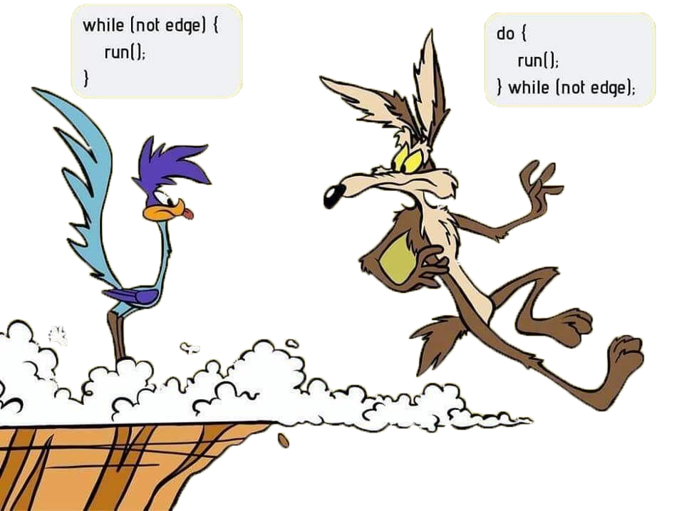
while(…) Loop
Repeating a Statement
While Given Condition Holds
while (condition) { statements; }

Slide 5
Example:
static void Main(string[] args)
{
int counter = 0;
while (counter < 10)
{
Console.WriteLine("Number : {0}", counter);
counter++;
}
Console.ReadKey();
}

Slide 6
Example:
Calculate and print the sum of the first N natural numbers
static void Main(string[] args)
{
Console.Write("n = ");
int n = int.Parse(Console.ReadLine());
int number = 1;
int sum = 1;
Console.Write("The sum 1");
while (number < n)
{
number++;
sum += number;
Console.Write("+{0}", number);
}
Console.WriteLine(" = {0}", sum);
Console.ReadKey();
}

Slide 7
Checking whether a number is prime or not
static void Main(string[] args)
{
Console.Write("Enter a positive integer number: ");
uint number = uint.Parse(Console.ReadLine());
uint divider = 2;
uint maxDivider = (uint)Math.Sqrt(number);
bool prime = true;
while (prime && (divider <= maxDivider))
{
if (number % divider == 0)
{
prime = false;
}
divider++;
}
Console.WriteLine("Prime? {0}", prime);
Console.ReadKey();
}

Slide 8
Using break Operator
Break operator exits the inner-most loop
static void Main(string[] args)
{
int n = Convert.ToInt32(Console.ReadLine());
// Calculate n! = 1 * 2 * ... * n
int result = 1;
while (true)
{
if (n == 1)
break;
result *= n;
n--;
}
Console.WriteLine("n! = " + result);
Console.ReadKey();
}

Slide 9
do { … } while (…)

Slide 10
The block of statements is repeated
While the Boolean loop condition holds
The loop is executed at least once
➔Calculating N factorial :
static void Main(string[] args)
{
int n = Convert.ToInt32(Console.ReadLine());
int factorial = 1;
do
{
factorial *= n;
n--;
}
while (n > 0);
Console.WriteLine("n! = " + factorial);
Console.ReadKey();
}

Slide 11
for Loops

Slide 12
The typical for loop syntax is:
for (initialization; test; update) { statements; }
Consists of:
Initialization statement
Boolean test expression
Update statement
Loop body block

Slide 13
A simple for-loop to calculate n!:
static void Main(string[] args)
{
int n = int.Parse(Console.ReadLine());
decimal factorial = 1;
for (int i = 1; i <= n; i++)
{
factorial *= i;
}
Console.WriteLine("N! = " + factorial);
Console.ReadKey();
}

Slide 14
Complex for-loops could have several counter variables:
static void Main(string[] args)
{
for (int i = 1, sum = 1; i <= 128; i = i * 2, sum += i)
{
Console.WriteLine("i={0}, sum={1}", i, sum);
}
Console.ReadKey();
}

Slide 15
N^M – Example
static void Main(string[] args)
{
int n = int.Parse(Console.ReadLine());
int m = int.Parse(Console.ReadLine());
decimal result = 1;
for (int i = 0; i < m; i++)
{
result *= n;
}
Console.WriteLine("n^m = " + result);
Console.ReadKey();
}

Slide 16
Using continue Operator
continue operator ends the iteration of the inner-most loop
Example: sum all odd numbers in [1, n] that are not divisors of 7:
static void Main(string[] args)
{
int n = int.Parse(Console.ReadLine());
int sum = 0;
for (int i = 1; i <= n; i += 2)
{
if (i % 7 == 0)
{
continue;
}
sum += i;
}
Console.WriteLine("sum = {0}", sum);
Console.ReadKey();
}

Slide 17
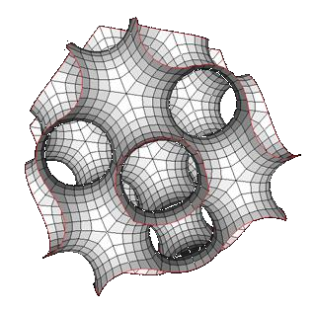
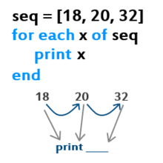
foreach Loop

Slide 18
The typical foreach loop syntax is:
foreach (Type element in collection) { statements; }
Iterates over all elements of a collection
The element is the loop variable that takes sequentially all collection values
The collection can be list, array or other group of elements of the same type

Slide 19
Example of foreach loop
static void Main(string[] args)
{
string[] days = new string[] {
"Monday", "Tuesday", "Wednesday", "Thursday",
"Friday", "Saturday", "Sunday" };
foreach (String day in days)
{
Console.WriteLine(day);
}
Console.ReadKey();
}

Slide 20
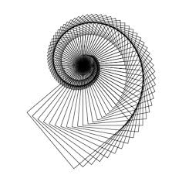
Nested Loops

Slide 21
A composition of loops is called a nested loop
A loop inside another loop
static void Main(string[] args)
{
int n = int.Parse(Console.ReadLine());
for (int row = 1; row <= n; row++)
{
for (int column = 1; column <= row; column++)
{
Console.Write("{0} ", column);
}
Console.WriteLine();
}
Console.ReadKey();
}

Slide 22
static void Main(string[] args)
{
uint n = uint.Parse(Console.ReadLine());
int m = int.Parse(Console.ReadLine());
for (uint number = n; number <= m; number++)
{
bool prime = true;
int divider = 2;
uint maxDivider = (uint)Math.Sqrt(number);
while (divider <= maxDivider)
{
if (number % divider == 0)
{
prime = false;
break;
}
divider++;
}
if (prime)
{
Console.Write("{0} ", number);
}
}
Console.ReadKey();
}

Slide 23
C# Jump Statements
Jump statements are:
break, continue, goto
How continue woks?
In while and do-while loops jumps to the test expression
In for loops jumps to the update expression
To exit an inner loop use break
To exit outer loops use goto with a label
Avoid using goto! (it is considered harmful)

Slide 24
C# Jump Statements – Example
static void Main(string[] args)
{
int outerCounter = 0;
for (int outer = 0; outer < 10; outer++)
{
for (int inner = 0; inner < 10; inner++)
{
if (inner % 3 == 0)
continue;
if (outer == 7)
break;
if (inner + outer > 9)
goto breakOut;
Console.WriteLine(outer+" "+ inner);
}// end of second loop
outerCounter++;
}// end of first loop
breakOut:// label
Console.ReadKey();
}

Slide 25
Nested Loops – Examples
Print all four digit numbers in format ABCD such that A+B = C+D (known as happy numbers)
static void Main(string[] args)
{
for (int a = 1; a <= 9; a++)
for (int b = 0; b <= 9; b++)
for (int c = 0; c <= 9; c++)
for (int d = 0; d <= 9; d++)
if (a + b == c + d)
Console.WriteLine("{0}{1}{2}{3}",
a, b, c, d);
Console.ReadKey();
}

Slide 26
Exercises 1. Write a program that prints all the numbers from 1 to N. 2. Write a program that prints all the numbers from 1 to N, that are not divisible by 3 and 7 at the same time. 3. Write a program that reads from the console a sequence of N integer numbers and returns the minimal and maximal of them. 4. Write a program that calculates N!/K! for given N and K (1<N<K). 5. Write a program that calculates N!*K! / (K-N)! For given N and K (1<N<K).
6. Write a program that, for a given two integer numbers N and X, calculates the sum S = 1 + 1!/X + 2!/X2 + … + N!/XN 7. Write a program that reads a number N and calculates the sum of the first N members of the sequence of Fibonacci: 0, 1, 1, 2, 3, 5, 8, 13, 21, 34, 55, 89, 144, 233, 377, … Each member of the Fibonacci sequence (except the first two) is a sum of the previous two members. 6. Write a program that calculates the greatest common divisor (GCD) of given two numbers. Use the Euclidean algorithm (find it in Internet).

Slide 27
10. In the combinatorial mathematics, the Catalan numbers are calculated by the following formula:
Write a program to calculate the Nth Catalan number by given N.
11. Write a program that prints all possible cards from a standard deck of 52 cards (without jokers). The cards should be printed with their English names. Use nested for loops and switch-case.
12. Write a program that reads from the console a positive integer number N (N < 20) and outputs a matrix like the following:
1 | 2 | 3
2 | 3 | 4
3 | 4 | 5
1 | 2 | 3 | 4
2 | 3 | 4 | 5
3 | 4 | 5 | 6
4 | 5 | 6 | 7

Slide 28
13. * Write a program that calculates for given N how many trailing zeros present at the end of the number N!. Examples: N = 10 → N! = 3628800 → 2 N = 20 → N! = 2432902008176640000 → 4 Does your program work for N = 50 000? Hint: The trailing zeros in N! are equal to the number of its prime divisors of value 5. Think why!
14. * Write a program that reads a positive integer number N (N < 20) from console and outputs in the console
the numbers 1 ... N numbers arranged as a spiral. Example for N = 4
1 | 2 | 3 | 4
12 | 13 | 14 | 5
11 | 16 | 15 | 6
10 | 9 | 8 | 7

