Slide 1
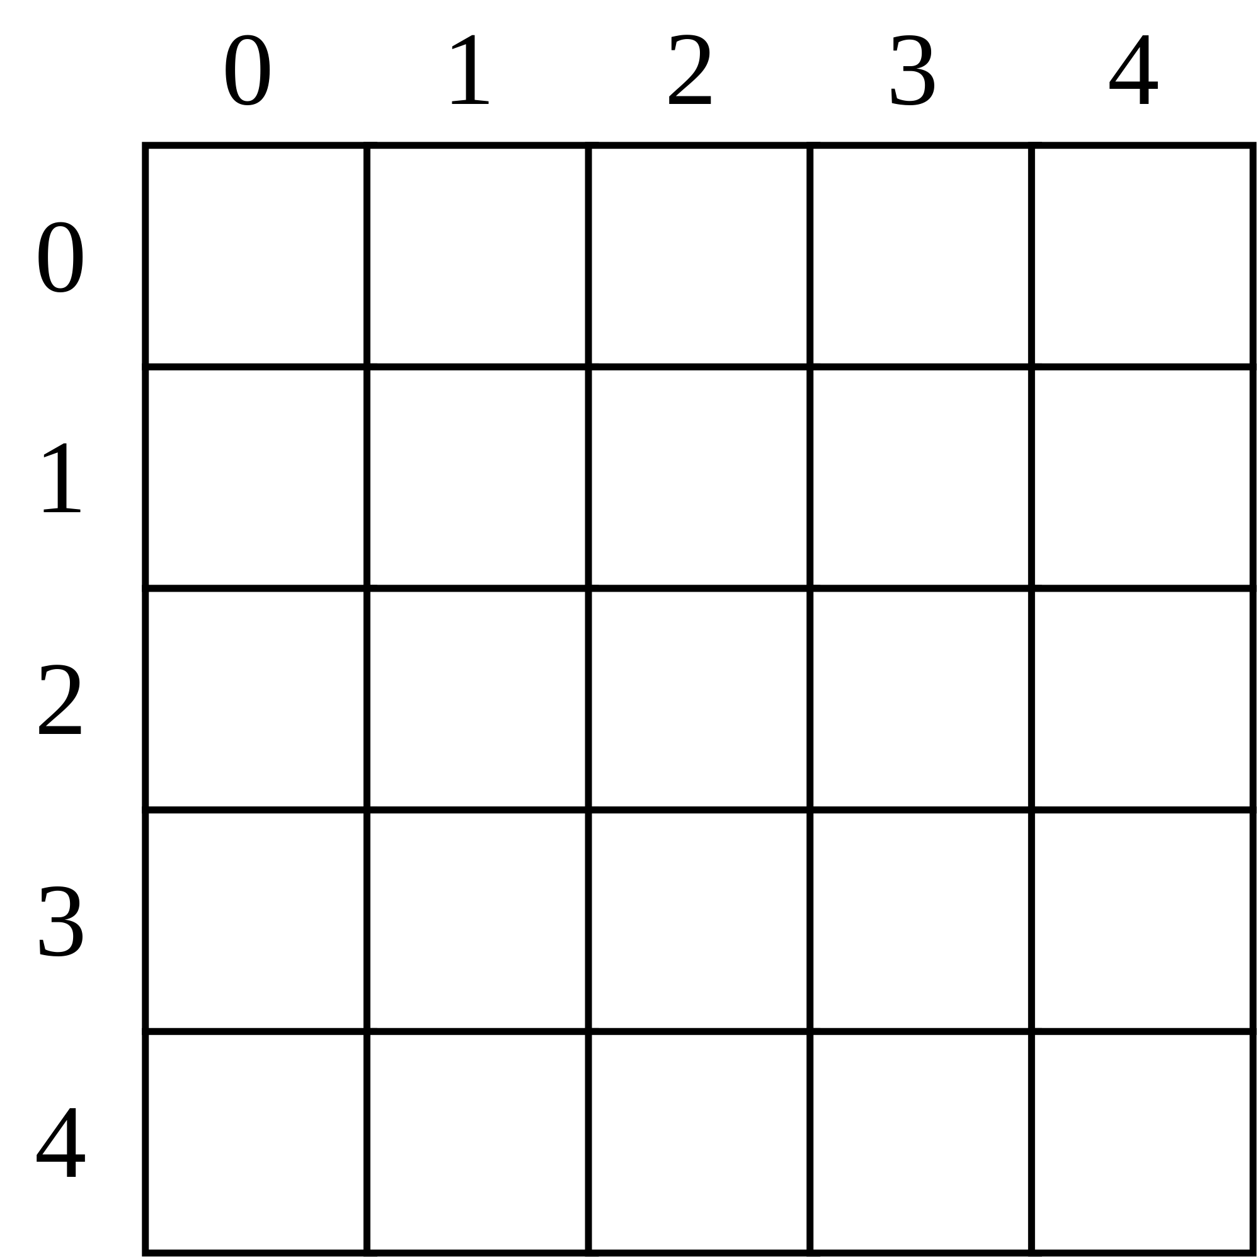
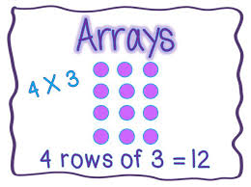
Arrays

Slide 2
Table of Contents
1. Declaring and Creating Arrays 2. Accessing Array Elements 3. Console Input and Output of Arrays 4. Iterating Over Arrays Using for and foreach 5. Matrices and Multidimensional Arrays 6. Dynamic Arrays
Lists<T>
Copying Arrays

Slide 3
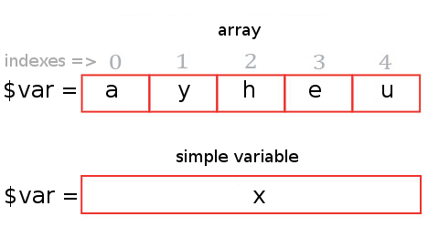
Declaring and Creating Arrays
An array is a sequence of elements
All elements are of the same type
The order of the elements is fixed
Has fixed size (Array. Length)

Slide 4
Declaration defines the type of the elements
Square brackets [] mean "array“
Examples:
string[] myStringArray;
int[] myIntArray;

Slide 5
Use the operator new
Specify array length
Example creating (allocating) array of 5 integers:
myIntArray = new int[5];
Initializing Arrays
myIntArray = {1, 2, 3, 4, 5};

Slide 6
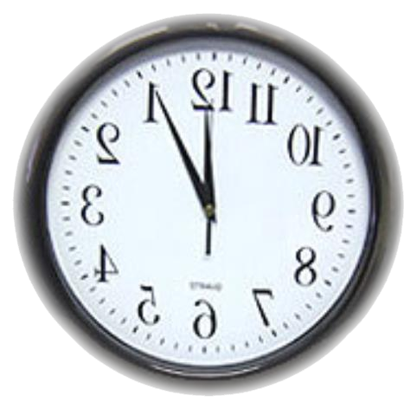
Example
static void Main(string[] args)
{
int[] array = new int[] { 1, 2, 3, 4, 5 };
// Get array size
int length = array.Length;
// Declare and create the reversed array
int[] reversed = new int[length];
// Initialize the reversed array
for (int index = 0; index < length; index++)
{
reversed[length - index - 1] = array[index];
}
for (int index = 0; index < length; index++)
{
Console.WriteLine(reversed[index]);
}
Console.ReadKey();
}

Slide 7
Reading Arrays From the Console
static void Main(string[] args)
{
int n = int.Parse(Console.ReadLine());
int[] arr = new int[n];
// reading the array
for (int i = 0; i < n; i++)
{
arr[i] = int.Parse(Console.ReadLine());
}
//printing the array
for (int i = 0; i < n; i++)
{
Console.WriteLine(arr[i]);
}
Console.ReadKey();
}

Slide 8
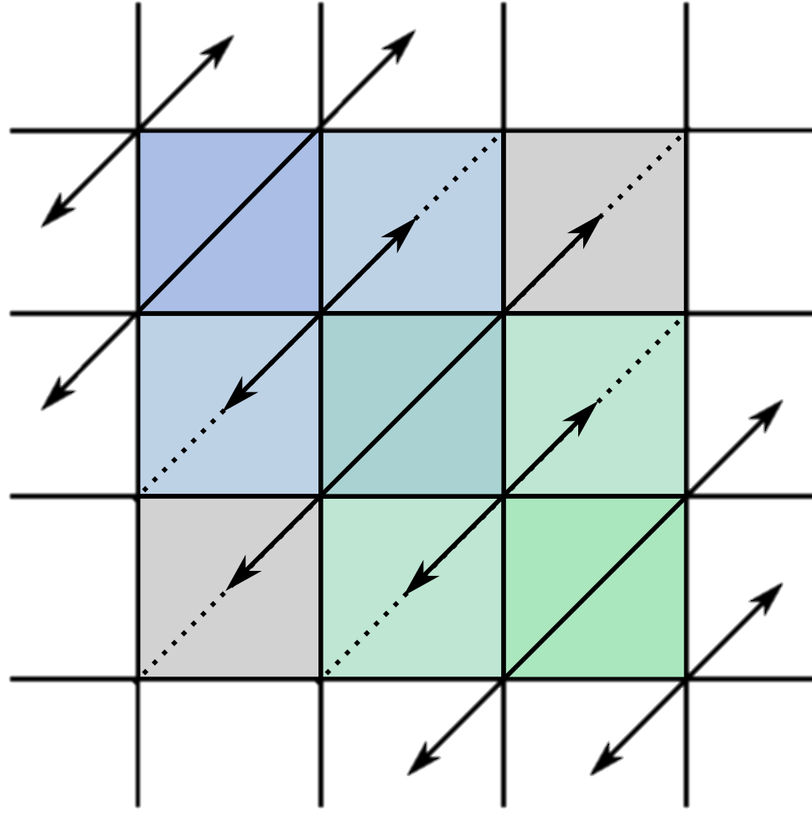
Example: Read int array from the console and check if it is symmetric:
1 | 2 | 2 | 1
1 | 2 | 3 | 2 | 1
1 | 2 | 3 | 3 | 2 | 1

Slide 9
static void Main(string[] args)
{
int n = int.Parse(Console.ReadLine());
int[] arr = new int[n];
for (int i = 0; i < n; i++)
{
arr[i] = int.Parse(Console.ReadLine());
}
bool isSymmetric = true;
for (int i = 0; i < (arr.Length + 1) / 2; i++)
{
if (arr[i] != arr[n -1- i])
{
isSymmetric = false;
}
}
Console.WriteLine(isSymmetric);
Console.ReadKey();
}

Slide 10
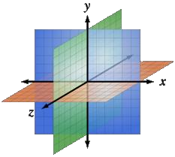
Multidimensional Arrays
Multidimensional arrays have more than one dimension (2, 3, …)
The most important multidimensional arrays are the 2-dimensional
Known as matrices or tables
Example of matrix of integers with 2 rows and 4 columns:

Slide 11
Declaring and Creating Multidimensional Arrays
int[,] intMatrix; float[,] floatMatrix; string[,,] strCube;
Creating a multidimensional array
Use new keyword
Must specify the size of each dimension
int[,] intMatrix = new int[3, 4]; float[,] floatMatrix = new float[8, 2]; string[,,] stringCube = new string[5, 5, 5];

Slide 12
Initializing Multidimensional Arrays with Values
Creating and initializing with values multidimensional array:
int[,] matrix =
{
{1, 2, 3, 4}, // row 0 values
{5, 6, 7, 8}, // row 1 values
}; // The matrix size is 2 x 4 (2 rows, 4 cols)

Slide 13
Accessing N-dimensional array element:
nDimensionalArray[index1, … , indexn]
Getting element value example:
int[,] array = {{1, 2}, {3, 4}} int element11 = array[1, 1]; //element11 = 4
Setting element value example:
int[,] array = new int[3, 4]; for (int row=0; row<array.GetLength(0); row++) for (int col=0; col<array.GetLength(1); col++) array[row, col] = row + col;
Number of rows
Number of Columns

Slide 14
Reading a matrix from the console
int rows = int.Parse(Console.ReadLine()); int columns = int.Parse(Console.ReadLine()); int[,] matrix = new int[rows, columns]; String inputNumber; for (int row=0; row<rows; row++) { for (int column=0; column<cols; column++) { Console.Write("matrix[{0},{1}] = ", row, column); inputNumber = Console.ReadLine(); matrix[row, column] = int.Parse(inputNumber); } }

Slide 15
Printing a matrix on the console:
for (int row=0; row<matrix.GetLength(0); row++) { for (int col=0; col<matrix.GetLength(1); col++) { Console.Write("{0} ", matrix[row, col]); } Console.WriteLine(); }

Slide 16
Lists
Lists are arrays that resize dynamically
When adding or removing elements
Also have indexers ( like Array)
The type that the List will hold
E.g. List<int> will hold integers
List<object> will hold objects
Basic Methods and Properties
Add(element) – adds new element to the end
Remove(element) – removes the element
Count – returns the current size of the List

Slide 17
List Example
List<int> intList = new List<int>();
for (int i = 0; i < 5; i++)
{
intList.Add(i);
Console.WriteLine(intList[i]);
}
Is the same as
int[] intArray = new int[5];
for (int i = 0; i < 5; i++)
{
intArray[i] = i;
}

Slide 18
The main difference:
Lets have an array with capacity of 5 elements
int[] intArray=new int[5];
If we want to add a sixth element ( we have already added 5) we have to do
int[] copyArray = intArray; intArray = new int[6]; for (int i = 0; i < 5; i++) { intArray[i] = copyArray[i]; } intArray[5]=newValue;
With List we simply do
list.Add(newValue);

Slide 19
Copying Arrays
Sometimes we must copy the values from one array to another one
If we do it the intuitive way we would copy not only the values but the reference to the array
Changing some of the values in one array will affect the other
int[] copyArray=array;
The way to avoid this is using Array.Copy()
Array.Copy(sourceArray, copyArray);
This way only the values will be copied but not the reference

Slide 20
int[] intArray = new int[5];int []ar=new int[5];
for (int i = 0; i < 5; i++)
{
intArray[i] = i;
}
Array.Copy(intArray,0,ar,0,5);
for (int i = 0; i < 5; i++)
{
Console.WriteLine(ar[i]);
}

Slide 21
Exercises 1. Write a program that allocates array of 20 integers and initializes each element by its index multiplied by 5. Print the obtained array on the console. 2. Write a program that reads two arrays from the console and compares them element by element. 3. Write a program that compares two char arrays lexicographically (letter by letter). 4. Write a program that finds the maximal sequence of equal elements in an array. Example: {2, 1, 1, 2, 3, 3, 2, 2, 2, 1} → {2, 2, 2}.
5. Write a program that finds the maximal increasing sequence in an array. Example: {3, 2, 3, 4, 2, 2, 4} → {2, 3, 4}. 6. Write a program that reads two integer numbers N and K and an array of N elements from the console. Find in the array those K elements that have maximal sum. 7. Sorting an array means to arrange its elements in increasing order. Write a program to sort an array. Use the "selection sort" algorithm: Find the smallest element, move it at the first position, find the smallest from the rest, move it at the second position, etc.

Slide 22
8. Write a program that finds the sequence of maximal sum in given array. Example: {2, 3, -6, -1, 2, -1, 6, 4, -8, 8} → {2, -1, 6, 4} Can you do it with only one loop (with single scan through the elements of the array)? 9. Write a program that finds the most frequent number in an array. Example: {4, 1, 1, 4, 2, 3, 4, 4, 1, 2, 4, 9, 3} → 4 (5 times) 10. Write a program that finds in given array of integers a sequence of given sum S (if present). Example: {4, 3, 1, 4, 2, 5, 8}, S=11 → {4, 2, 5}
11. Write a program that fills and prints a matrix of size (n, n) as shown below: (examples for n = 4)
1 | 5 | 9 | 13
2 | 6 | 10 | 14
3 | 7 | 11 | 15
4 | 8 | 12 | 16
1 | 8 | 9 | 16
2 | 7 | 10 | 15
3 | 6 | 11 | 14
4 | 5 | 12 | 13
7 | 11 | 14 | 16
4 | 8 | 12 | 15
2 | 5 | 9 | 13
1 | 3 | 6 | 10
1 | 12 | 11 | 10
2 | 13 | 16 | 9
3 | 14 | 15 | 8
4 | 5 | 6 | 7

