Slide 1
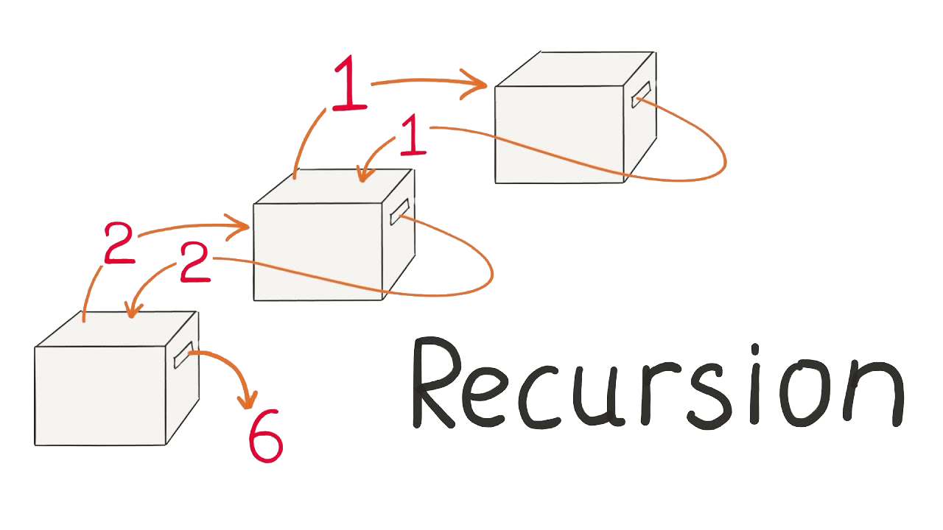
Recursion
The Power of Calling a Method from Itself
M. Hawkar Kheder Shaikha 2019-2020

Slide 2
Table of Contents
1. What is Recursion? 2. Calculating Factorial Recursively

Slide 3
Recursion is when a methods calls itself
Very powerful technique for implementing combinatorial and other algorithms
Recursion should have
Direct or indirect recursive call
The method calls itself directly or through other methods
Exit criteria (bottom)
Prevents infinite recursion

Slide 4
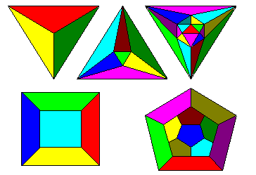
Recursive Factorial – Example
Recursive definition of n! (n factorial):
n! = n * (n–1)! for n >= 0 0! = 1
5! = 5 * 4! = 5 * 4 * 3 * 2 * 1 * 1 = 120
4! = 4 * 3! = 4 * 3 * 2 * 1 * 1 = 24
3! = 3 * 2! = 3 * 2 * 1 * 1 = 6
2! = 2 * 1! = 2 * 1 * 1 = 2
1! = 1 * 0! = 1 * 1 = 1
0! = 1

Slide 5
Recursive Factorial Example:
static void Main(string[] args)
{
Console.WriteLine(Factorial(3));
Console.ReadKey();
}
static decimal Factorial(decimal num)
{
if (num == 0)
return 1;
else
return num * Factorial(num - 1);
}

