Slide 1
Pointers
and
dynamic objects

Slide 2
Topics
Pointers
Memory addresses
Declaration
Dereferencing a pointer
Pointers to pointer
Static vs. dynamic objects
new and delete

Slide 3
Computer Memory
Each variable is assigned a memory slot (the size depends on the data type) and the variable’s data is stored there
Memory address:
1020
1024
1032
…
…
100
…
1024
…
a
Variable a’s value, i.e., 100, is
stored at memory location 1024
int a = 100;

Slide 4
Pointers
A pointer is a variable used to store the address of a memory cell.
We can use the pointer to reference this memory cell
Memory address:
1020
1024
1032
…
…
100
…
1024
…
integer
pointer

Slide 5
Pointer Types
Pointer
C++ has pointer types for each type of object
Pointers to int objects
Pointers to char objects
Pointers to user-defined objects
Even pointers to pointers
Pointers to pointers to int objects

Slide 6
Pointer Variable
Declaration of Pointer variables
type* pointer_name;
//or
type *pointer_name;
where type is the type of data pointed to (e.g. int, char, double)
Examples:
int *n;
RationalNumber *r;
int **p; // pointer to pointer

Slide 7
Address Operator &
The "address of " operator (&) gives the memory address of the variable
Usage: &variable_name
Memory address:
1020
1024
…
…
100
…
…
…
a
int a = 100;
//get the value,
cout << a; //prints 100
//get the memory address
cout << &a; //prints 1024

Slide 8
Address Operator &
Memory address:
1020
1024
1032
…
88
100
…
…
…
a
b
#include <iostream>
using namespace std;
void main(){
int a, b;
a = 88;
b = 100;
cout << "The address of a is: " << &a << endl;
cout << "The address of b is: " << &b << endl;
}
Result is:
The address of a is: 1020
The address of b is: 1024

Slide 9
Pointer Variables
The value of pointer p is the address of variable a
A pointer is also a variable, so it has its own memory address
Memory address:
1020
1024
1032
…
88
100
…
1024
…
a
p
int a = 100;
int *p = &a;
cout << a << " " << &a <<endl;
cout << p << " " << &p <<endl;
Result is:
100 1024
1024 1032

Slide 10
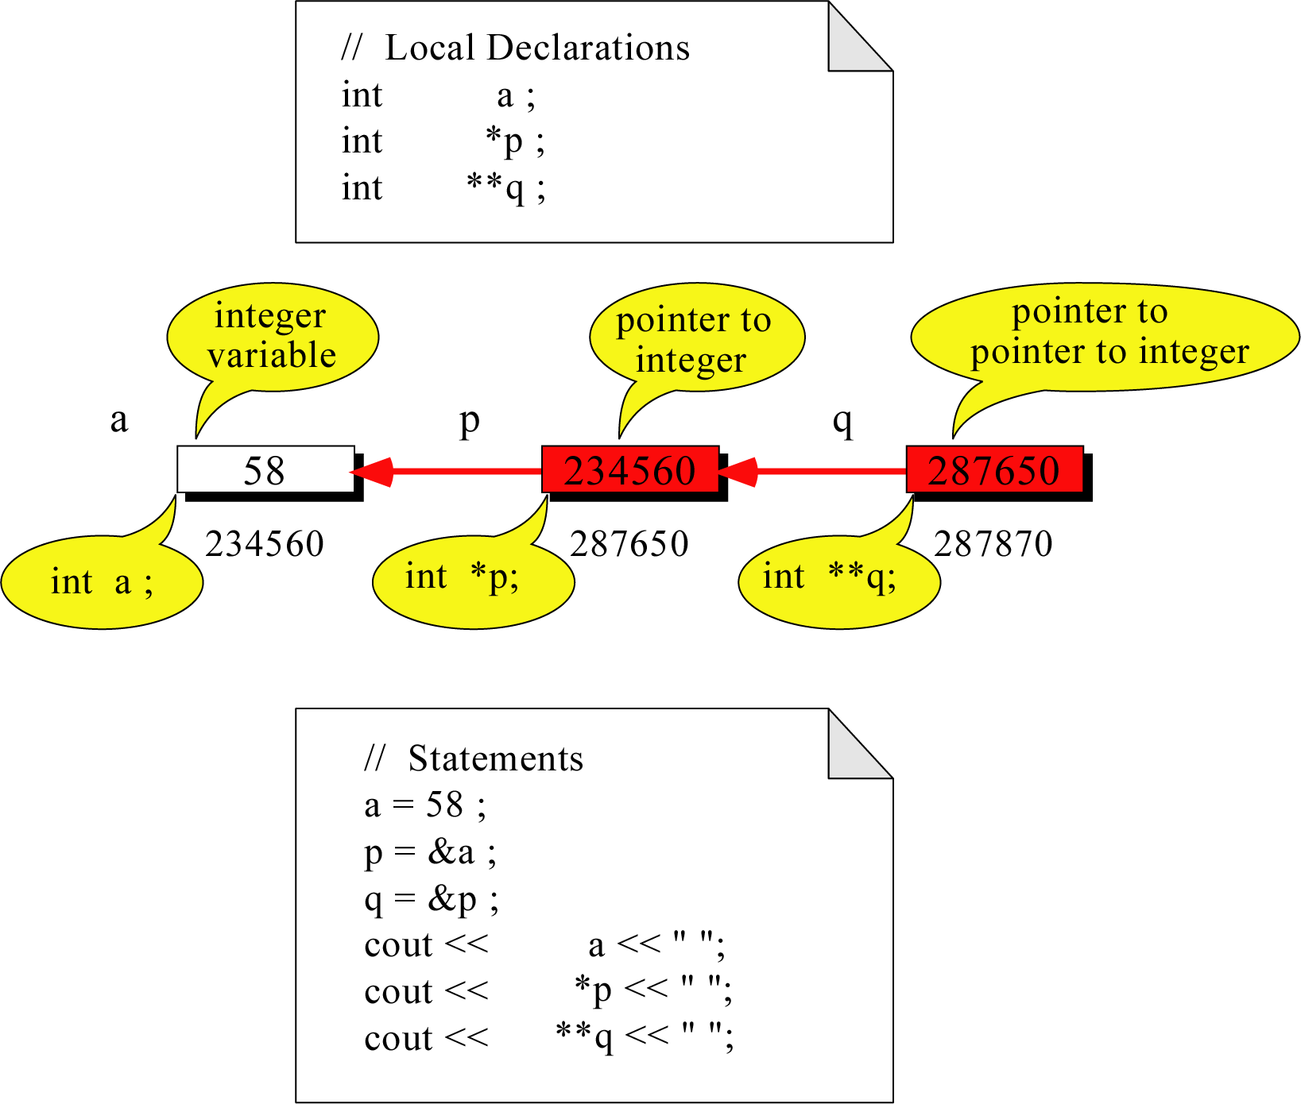
Pointer to Pointer
What is the output?
58 58 58

Slide 11
Dereferencing Operator *
We can access to the value stored in the variable pointed to by using the dereferencing operator (*),
Memory address:
1020
1024
1032
…
88
100
…
1024
…
a
p
int a = 100;
int *p = &a;
cout << a << endl;
cout << &a << endl;
cout << p << " " << *p << endl;
cout << &p << endl;
Result is:
100
1024
1024 100
1032

Slide 12
Don’t get confused
Declaring a pointer means only that it is a pointer: int *p;
Don’t be confused with the dereferencing operator, which is also written with an asterisk (*). They are simply two different tasks represented with the same sign
int a = 100, b = 88, c = 8;
int *p1 = &a, *p2, *p3 = &c;
p2 = &b; // p2 points to b
p2 = p1; // p2 points to a
b = *p3; //assign c to b
*p2 = *p3; //assign c to a
cout << a << b << c;
Result is:
888

Slide 13
A Pointer Example
Memory Layout
The code
void doubleIt(int x, int * p)
{
*p = 2 * x;
}
int main(int argc, const char * argv[])
{
int a = 16;
doubleIt(9, &a);
return 0;
}
Box diagram
main
16
p (8200)
8192
a
doubleIt
x (8196)
9
a (8192)
16
main
doubleIt
x
9
a gets 18
p
Notes:
Note the signature of main() – it’s an array parameter. And, like other examples we’ve given, it takes the number of elements as a parameter. Why?

Slide 14
Another Pointer Example
Let’s figure out:
value1==? / value2==?
Also, p1=? p2=?
#include <iostream>
using namespace std;
int main (){
int value1 = 5, value2 = 15;
int *p1, *p2;
p1 = &value1; // p1 = address of value1
p2 = &value2; // p2 = address of value2
*p1 = 10; // value pointed to by p1=10
*p2 = *p1; // value pointed to by p2= value // pointed to by p1
p1 = p2; // p1 = p2 (pointer value copied)
*p1 = 20; // value pointed to by p1 = 20
cout << "value1==" << value1 << "/ value2==" << value2;
return 0;
}

Slide 15
Another Pointer Example
int a = 3;
char s = ‘z’;
double d = 1.03;
int *pa = &a;
char *ps = &s;
double *pd = &d;
% sizeof returns the # of bytes…
cout << sizeof(pa) << sizeof(*pa)
<< sizeof(&pa) << endl;
cout << sizeof(ps) << sizeof(*ps)
<< sizeof(&ps) << endl;
cout << sizeof(pd) << sizeof(*pd)
<< sizeof(&pd) << endl;

Slide 16
Reference Variables
A reference is an additional name to
an existing memory location
Pointer:
Reference:
x
9
x
ref
9
ref
int x = 9;
int &ref = x;
int x=9;
int *ref;
ref = &x;
Notes:
References fix some of those pointer problems.
If we wanted something called “ref” to point to a variable x, we’d declare a pointer variable and assign the address of x into it. With references, we’d attach an additional name – ref – to the same memory location as x.
Note how the pointer necessitates an extra variable, whereas the reference didn’t

Slide 17
Reference Variables
A reference variable serves as an alternative name for an object
int m = 10;
int &j = m; // j is a reference variable
cout << “value of m = “ << m << endl;
//print 10
j = 18;
cout << “value of m = “ << m << endl;
// print 18

Slide 18
Reference Variables
A reference variable always refers to the same object. Assigning a reference variable with a new value actually changes the value of the referred object.
Reference variables are commonly used for parameter passing to a function

Slide 19
Traditional Pointer Usage
void IndirectSwap(char *Ptr1, char *Ptr2){
char temp = *Ptr1;
*Ptr1 = *Ptr2;
*Ptr2 = temp;
}
int main() {
char a = 'y';
char b = 'n';
IndirectSwap(&a, &b);
cout << a << b << endl;
return 0;
}

Slide 20
Pass by Reference
void IndirectSwap(char& y, char& z) {
char temp = y;
y = z;
z = temp;
}
int main() {
char a = 'y';
char b = 'n';
IndirectSwap(a, b);
cout << a << b << endl;
return 0;
}

