Slide 1
Understanding Unsafe Code in C#

Slide 2
Before we start any discussion of Unsafe Code let us see an example.
static void Main(string[] args)
{
int ab = 32;
int* p = &ab;
Console.WriteLine("value of ab is {0}", *p);
Console.ReadLine();
}

Slide 3
Why these errors occur in the program
These errors occur because we executed our program in Safe mode but we must execute our program in Unsafe mode if we are using pointers.
Now a question is, “What is meant by Safe and Unsafe Code?”
First we understand what Managed and Unmanaged Code are.
Managed Code
Managed code is that code that executes under the supervision of the Common Language Runtime (CLR). The CLR is responsible for various housekeeping tasks, like:
Managing memory for the objects
Performing type verification
Doing garbage collection

Slide 4
Unmanaged Code
On the other hand, unmanaged code is code that executes outside the context of the CLR.
In unmanaged code a programmer is responsible for:
Calling the memory allocation function
Making sure that the casting is done right
Making sure that the memory is released when the work is done
Definition of Unsafe Mode
Unsafe is a C# programming language keyword to denote a section of code that is not managed by the Common Language Runtime (CLR)

Slide 5
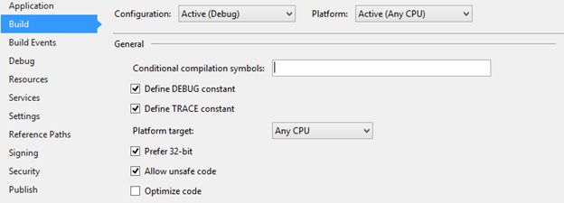
How to run a program in unsafe mode
First go to the View tab.
Select the Solution Explorer option.
Expand the Solution Explorer a double-click on the Property option.
Now select the option of ”Allow unsafe code” and mark it Check.

Slide 6
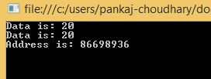
Example 1
Retrieving the Data Value Using a Pointer
static unsafe void Main(string[] args)
{
int var = 20;
int* p = &var;
Console.WriteLine("Data is: {0} ", var);
Console.WriteLine("Data is: {0} ", p->ToString());
Console.WriteLine("Address is: {0} ", (int)p);
Console.ReadKey();
}

Slide 7
Example 2
Instead using the unsafe keyword for the Main function we can use it for a specific block of code, such as:
static void Main(string[] args)
{
unsafe
{
int var = 20;
int* p = &var;
Console.WriteLine("Data is: {0} ", var);
Console.WriteLine("Data is: {0} ", p->ToString());
Console.WriteLine("Address is: {0} ", (int)p);
Console.ReadKey();
}
}
For more information about unsafe code and using pointers, ask google:
How to use unsafe code in c#?

