Slide 1
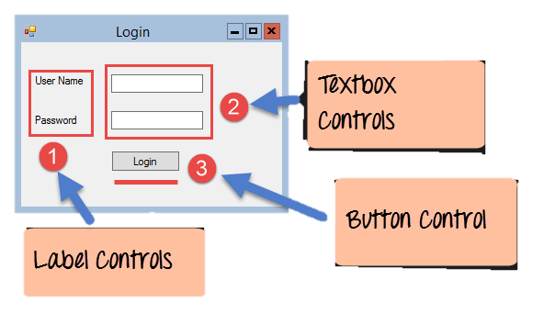
Windows Forms Basics
A Windows forms application will normally have a collection of controls such as labels, textboxes, list boxes, etc.

Slide 2
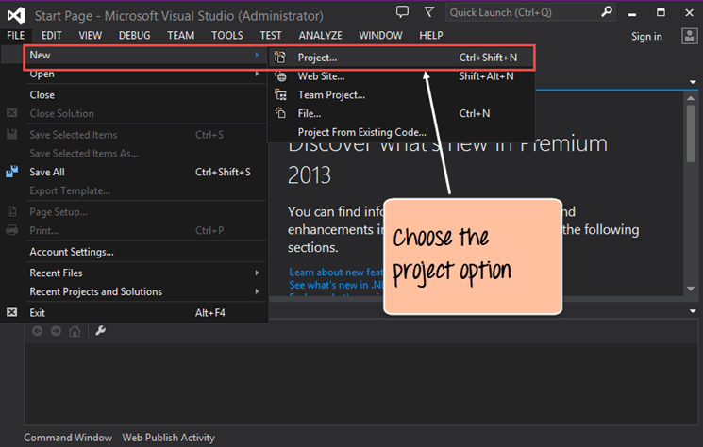
C# Hello World
Step 1) After launching Visual Studio, you need to choose the menu option New->Project

Slide 3
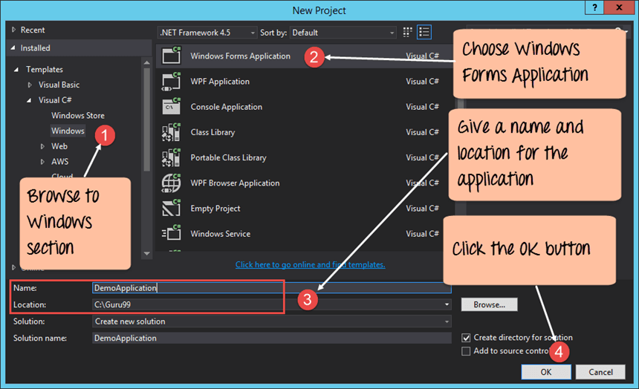
Step 2) The next step is to choose the project type as a Windows Forms application. Here we also need to mention the name and location of our project.

Slide 4
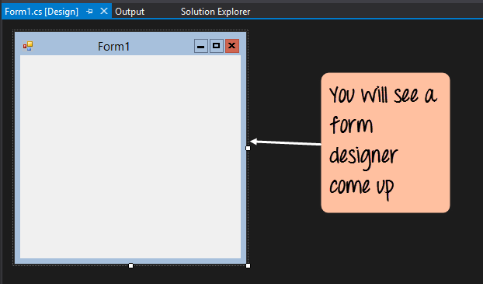
If the above steps are followed, you will get the below output in Visual Studio

Slide 5
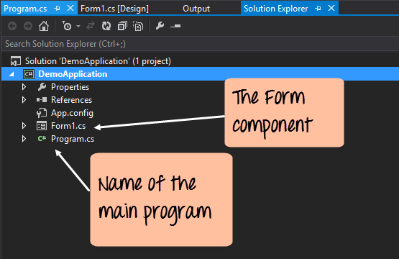
In the Solution Explorer, you will also be able to see the DemoApplication Solution. This solution will contain the below 2 project files
A Form application called Forms1.cs. This file will contain all the code for the Windows Form application.
The Main program called Program.cs is default code file which is created when a new application is created in Visual Studio. This code will contain the startup code for the application as a whole.

Slide 6
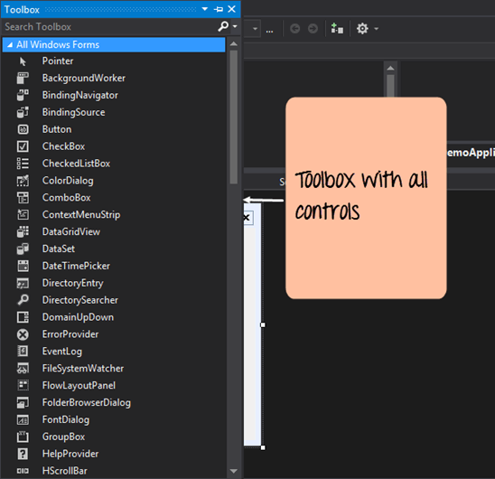
On the left-hand side of Visual Studio, you will also see a ToolBox
The toolbox contains all the controls which can be added to a Windows Forms

Slide 7
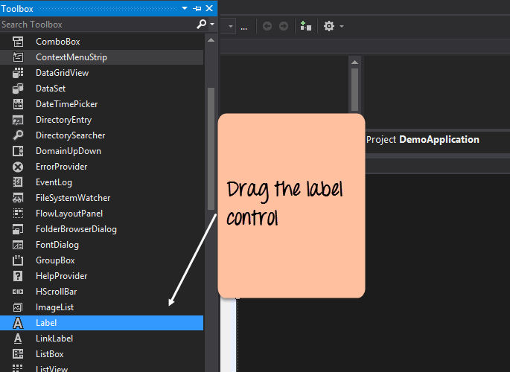
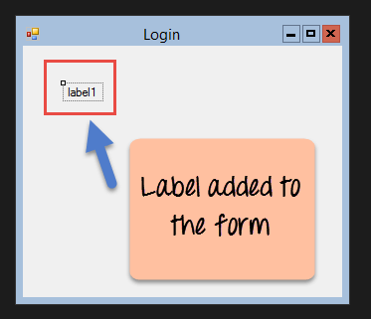
Step 3) In this step, we will now add a label to the Form which will display "Hello World."
Once you drag the label to the form, you can see the label embedded on the form as shown below

Slide 8
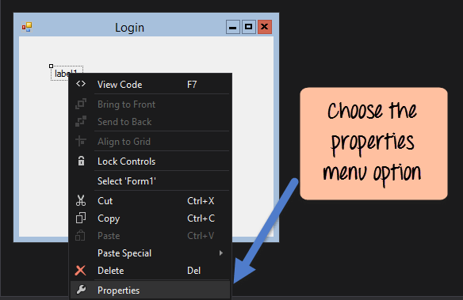
Step 4) The next step is to go to the properties of the control and Change the text to 'Hello World'.

Slide 9
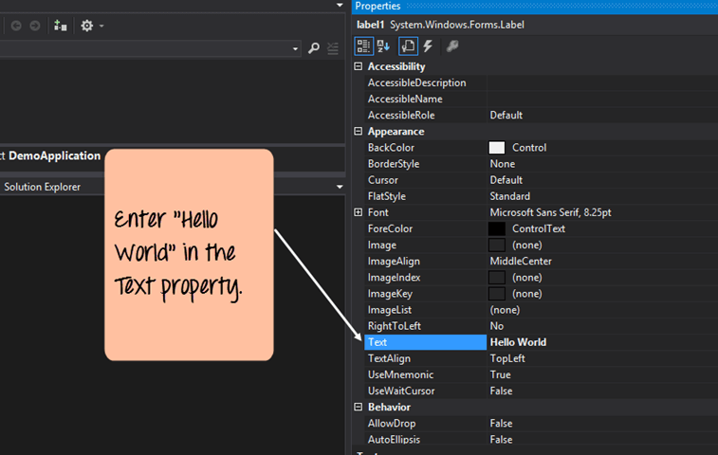
The properties panel also shows up in Visual Studio. So for the label control, in the properties control, go to the Text section and enter "Hello World".

Slide 10
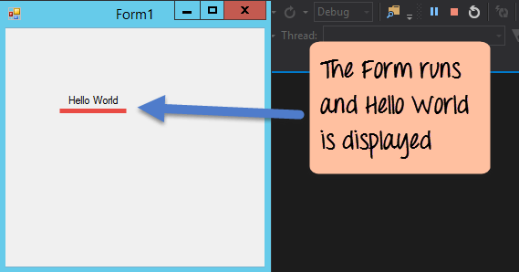
Output:-

Slide 11
Properties Window
1
2
You can choose any control to change its properties.
Change the properties for each control or set Events for the selected control.

Slide 12
Windows Form Properties
Sno | Property Name | Decription
1 | Name | Used to uniquely identify the control in code.
2 | AcceptButton | Used to set a button available on the form as accept button so that the code written for that button is automatically executed when user press enter key wherever the focus is on the form.
3 | AutoScroll | Indicates whether scroll bars are displayed when a control on the form is out side the boundary of the form.
4 | BackColor | Used to set a background color for the control.
5 | BackgroundImage | Used to display an image in the background of the form.
6 | BackgroundImageLayout | Used to set layout for the background image on the form.
7 | CancelButton | Used to set a button available on the form as cancelbutton so that the code written for that button is automatically executed when user press escape key wherever the focus is on the form.
8 | ControlBox | Indicates whether minimize, maximize and close buttons and system icon are displayed in the title bar of the form.
9 | Enabled | Indicates whether the events of the control are raised.
10 | Font | Used to set font for the text displayed in the control
11 | ForeColor | Used to set Font Color for the control.
12 | Icon | Used to set the icon to display in the title bar of the form.
13 | Location | Used to set position of the control from left and top.
14 | Size | Used to set width and height of the control.
15 | Text | Used to set a caption for the form.
16 | WindowState | Indicates the initial state of the form when it was displayed for the first time. It has three possible values., minimized, maximized and normal.

Slide 13
Events
Name | Description
Click | Occurs when a control is clicked. In some cases, this event will also occur when a user presses Enter.
DoubleClick | Occurs when a control is double-clicked. Handling the Click event on some controls, such as the Button control will mean that the DoubleClick event can never be called.
DragDrop | Occurs when a drag-and-drop operation is completed, in other words, when an object has been dragged over the control, and the user releases the mouse button.
DragEnter | Occurs when an object being dragged enters the bounds of the control.
DragLeave | Occurs when an object being dragged leaves the bounds of the control.
DragOver | Occurs when an object has been dragged over the control.
KeyDown | Occurs when a key becomes pressed while the control has focus. This event always occurs before KeyPress and KeyUp.
Name | Description
KeyPress | Occurs when a key becomes pressed, while a control has focus. This event always occurs after KeyDown and before KeyUp. The difference between KeyDown and KeyPress is that KeyDown passes the keyboard code of the key that has been pressed, while KeyPress passes the corresponding char value for the key.
KeyUp | Occurs when a key is released while a control has focus. This event always occurs after KeyDown and KeyPress.
GotFocus | Occurs when a control receives focus. Do not use this event to perform validation of controls. Use Validating and Validated instead.
LostFocus | Occurs when a control looses focus. Do not use this event to perform validation of controls. Use Validating and Validated instead.
MouseDown | Occurs when the mouse pointer is over a control and a mouse button is pressed. This is not the same as a Click event because MouseDown occurs as soon as the button is pressed and before it is released.
MouseMove | Occurs continually as the mouse travels over the control.
MouseUp | Occurs when the mouse pointer is over a control and a mouse button is released.
Paint | Occurs when the control is drawn.
Note: The events change according to each control.

Slide 14
We can change the properties of any control using source code
Double Click on the form interface you will see the source code
And then write your code to change the properties.

Slide 15
The code will run with loading the form

