Slide 1
Object Oriented Programming Polymorphism
Safeen H. Rasool
OOP
Salahaddin University-Erbil College of Science, Computer Science Department
Lecture 8
Second Year Students

Slide 2
Polymorphism in C++
The term "Polymorphism" is the combination of "poly" + "morphs" which means many forms. It is a greek word.
we can define polymorphism as the ability of a message to be displayed in more than one form.
a person have different behavior in different situations.

Slide 3
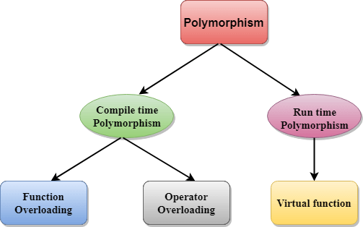
There are two types of polymorphism in C++:

Slide 4
In C++ polymorphism is mainly divided into:
Compile time Polymorphism
Runtime Polymorphism
1- Compile time polymorphism: This type of polymorphism is achieved by function overloading or operator overloading.
The information available at the compile time, therefore, compiler selects the appropriate function at the compile time.
Function Overloading: When there are multiple functions with same name but different parameters then these functions are said to be overloaded.
Functions can be overloaded by change in number of arguments or/and change in type of arguments

Slide 5
Compile time polymorphism:
Operator Overloading: C++ also provide option to overload operators. For example, we can make the operator (‘+’) for string class to concatenate two strings.
2- Runtime polymorphism: is achieved when the object's method is invoked at the run time instead of compile time.
This type of polymorphism is achieved by Function Overriding.
Function overriding When child class declares a method, which is already present in the parent class then this is called function overriding, here child class overrides the parent class. That base function is said to be overridden.
method overriding is also known as dynamic binding or late binding.

Slide 6
Polymorphism in C++ requirements:
There must be an inheritance hierarchy.
The classes in the hierarchy must have a virtual method with the same signature. (overridden method)
There must be either a pointer or a reference to a base class.

Slide 7
Virtual Function in C++
a member function which is declared within base class and is re-defined (Overriden) by derived class.
When you refer to a derived class object using a pointer or a reference to the base class, you can call a virtual function for that object and execute the derived class’s version of the function.
Virtual functions ensure that the correct function is called for an object, regardless of the type of reference (or pointer) used for function call.
They are mainly used to achieve Runtime polymorphism
Functions are declared with a virtual keyword in base class.
The resolving of function call is done at Run-time.

Slide 8
#include<iostream>
using namespace std;
class base
{
public:
virtual void print ()
{ cout<< "print base class" <<endl; }
void show ()
{ cout<< "show base class" <<endl; }
};
class derived: public base
{
public:
void print ()
{ cout<< "print derived class" <<endl; }
void show ()
{ cout<< "show derived class" <<endl; }
};
int main()
{
base *bptr;
derived d;
bptr = &d;
//virtual function, binded at runtime
bptr->print();
// Non-virtual function, binded at compile time
bptr->show();
}
Output:
print derived class
show base class

Slide 9
#include<iostream>
using namespace std;
class base
{
public:
void fun_1() { cout << "base-1\n"; }
virtual void fun_2() { cout << "base-2\n"; }
virtual void fun_3() { cout << "base-3\n"; }
virtual void fun_4() { cout << "base-4\n"; }
};
class derived : public base
{
public:
void fun_1() { cout << "derived-1\n"; }
void fun_2() { cout << "derived-2\n"; }
void fun_4(int x) { cout << "derived-4\n"; }
};
int main()
{
base *p;
derived obj1;
p = &obj1;
p->fun_1();
p->fun_2();
p->fun_3();
p->fun_4();
Output:
base-1
derived-2
base-3
base-4

Slide 10
C++ inline function
the compiler places a copy of the code of that function at each point where the function is called at compile time.
To inline a function, place the keyword inline before the function name and define the function before any calls are made to the function.
The compiler can ignore the inline qualifier in case defined function is more than a line.

Slide 11
Inline function example
#include <iostream>
using namespace std;
inline int Max(int x, int y)
{
return (x > y)? x : y;
}
int main( )
{
cout << "Max (20,10): " << Max(20,10) << endl;
cout << "Max (0,200): " << Max(0,200) << endl;
cout << "Max (100,1010): " << Max(100,1010) << endl;
return 0;
}

