Slide 1
Object Oriented Programming Generic Function and Class
OOP
Safeen H. Rasool
Salahaddin University-Erbil College of Science, Computer Science Department
Lecture 9
Second Year Students

Slide 2
Generic Function – Overloading
void my_swap (int &f, int &s )
{
int tmp = f; f=s; s=tmp;
}
void my_swap (string &f, string &s )
{
string tmp = f; f=s; s=tmp;
}
overloading: set of methods all having
1- the same name
2-different arguments list (signature)

Slide 3
generic function – void pointers
void my_swap (void* &f, void* &s )
{ void* tmp = f; f=s; s=tmp; }
int main() {
void* a; void* b;
a = new std::string("hello"); b = new std::string("world");
cout << *((string*) a) << *((string*) b) << endl;
my_swap (a,b);
cout << *((string*) a) << *((string*) b) << endl;
void* x; void* y;
x = new int(33); y = new int(44);
cout << *((int*) x) << *((int*) y) << endl;
my_swap(x,y);
cout << *((int*) x) << *((int*) y) << endl;
cout << "a = " << *((int*) a) << endl;
return 0;
}

Slide 4
void*
we can write a method that takes a void pointer as an argument, and then use that method with any pointer.
this method is more general and can be used in more places.
we need cast from void pointer to a specific pointer.

Slide 5
Template
templates allows functions and classes to operate with generic types
● with templates a function or a class can work on many different data
types without being rewritten for each one
kinds of templates:
– function templates
– class templates
– variable templates

Slide 6
Function templates
are special functions that can operate with generic types.
This allows us to create a function template whose functionality can be adapted to more than one type or class without repeating the entire code for each type.
In C++ this can be achieved using template parameters.

Slide 7
A template parameter is a special kind of parameter that can be used to pass a type as argument: just like regular function parameters can be used to pass values to a function.
The format for declaring function templates with type parameters is:
template <class identifier> function_declaration;
template <typename identifier> function_declaration;
Can be called
function_name <type> (parameters)

Slide 8
The following example creates a template function that returns the greater one of two objects we could use:
template <class myType>
myType GetMax (myType a, myType b) {
return (a>b?a:b);
}
the function template GetMax returns the greater of two parameters of this still-undefined type.
int x,y;
GetMax <int> (x,y);

Slide 9
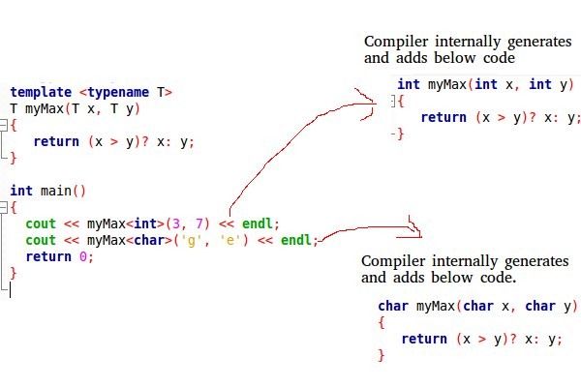

Slide 12
Class templates
a class can have members that use template parameters as types. For example:
template <class T>
class mypair {
T values [2];
public:
mypair (T first, T second)
{ values[0]=first;
values[1]=second; }
};
mypair<int> myobject (115, 36);
mypair<double> myfloats (3.0, 2.18);

Slide 13
Static Variable and static function
When we declare a member of a class as static it means no matter how many objects of the class are created, there is only one copy of the static member.
A static member is shared by all objects of the class.

Slide 14
#include <iostream>
using namespace std;
class Box {
public:
static int objectCount;
Box(double l = 2.0, double b = 2.0, double h = 2.0) {
cout <<"Constructor called." << endl;
length = l; breadth = b; height = h;
objectCount++;
}
double Volume() {
return length * breadth * height;
}
static int getCount()
{ return objectCount; }
private:
double length; // Length of a box
double breadth; // Breadth of a box
double height; // Height of a box
};
int Box::objectCount = 0;
int main() {
cout << "Inital Stage Count: " << Box::getCount() << endl;
Box Box1(3.3, 1.2, 1.5); // Declare box1
Box Box2(8.5, 6.0, 2.0); // Declare box2
// total number of objects after creating.
cout << "Final Stage Count: " << Box::getCount() << endl;
return 0;
}
The result is

Slide 15
For each in C++
#include <iostream>
using namespace std;
int main()
{
int arr[] = { 10, 20, 30, 40 };
// Printing elements of an array using foreach loop
for (int x : arr)
cout << x << endl;
}

