Slide 1
Computation Theory
COURSE
Lec. 14
Under Graduated Degree
Second stage
Academic Year
2022/2023
Lecturer
Mr. Hawkar Kheder Shaikha
MSc in Computer Science
Email: hawker.shaiha@su.edu.kr
Salahadden-Hawler University
Science College
Computer Department

Slide 2
Pushdown Automata (Introduction)
A Pushdown Automata (PDA)is a way to implement a Context Free Grammar in a similar way we design Finite Automata for Regular Grammar.
It is more powerful than Finite State Machine(FSM)
FSM has a very limited memory but PRA has more memory
PDA = Finite State Machine + A Stack
A stack is a way we arrange elements one on top of another
A stack does two basic operations:
PUSH: A new element is added at the Top of the stack
POP: The Top element of the stack is read and removed

Slide 3
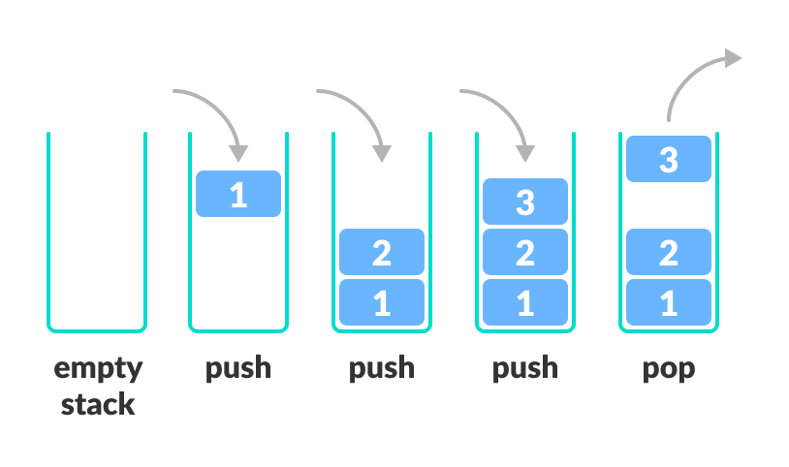

Slide 4
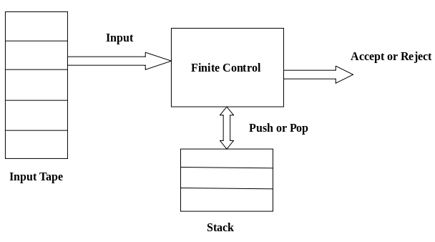
A Pushdown Automata has 3 components:
An input tape
2) A Finite Control Unit
3) A Stack with infinite size

Slide 5
A pushdown automaton (PDA) is a seven-tuple:
M = (Q, Σ, Г, δ, q₀, z₀, F)
Q A finite set of states
Σ A finite input alphabet
Г A finite stack alphabet
q₀ The initial/starting state, q₀ is in Q
z₀ A starting stack symbol, is in Г // need not always remain at the bottom of stack
F A set of final/accepting states, which is a subset of Q
δ A transition function, where

