Slide 1
The Blanket
By: Floyed Dell
(1887-1969)

Slide 2
Schema Activation Questions
Thinking Before You Read
What is a nursing home? Have you ever visited anyone in a nursing home?
Do you or did you have a grandparent you particularly loved or admired?
What are some of the things you enjoyed doing with that grandparent?
How are older people treated in your country?
Is it okay to send old people away to nursing home without their will?
Shouldn’t children stay with people they love?

Slide 3
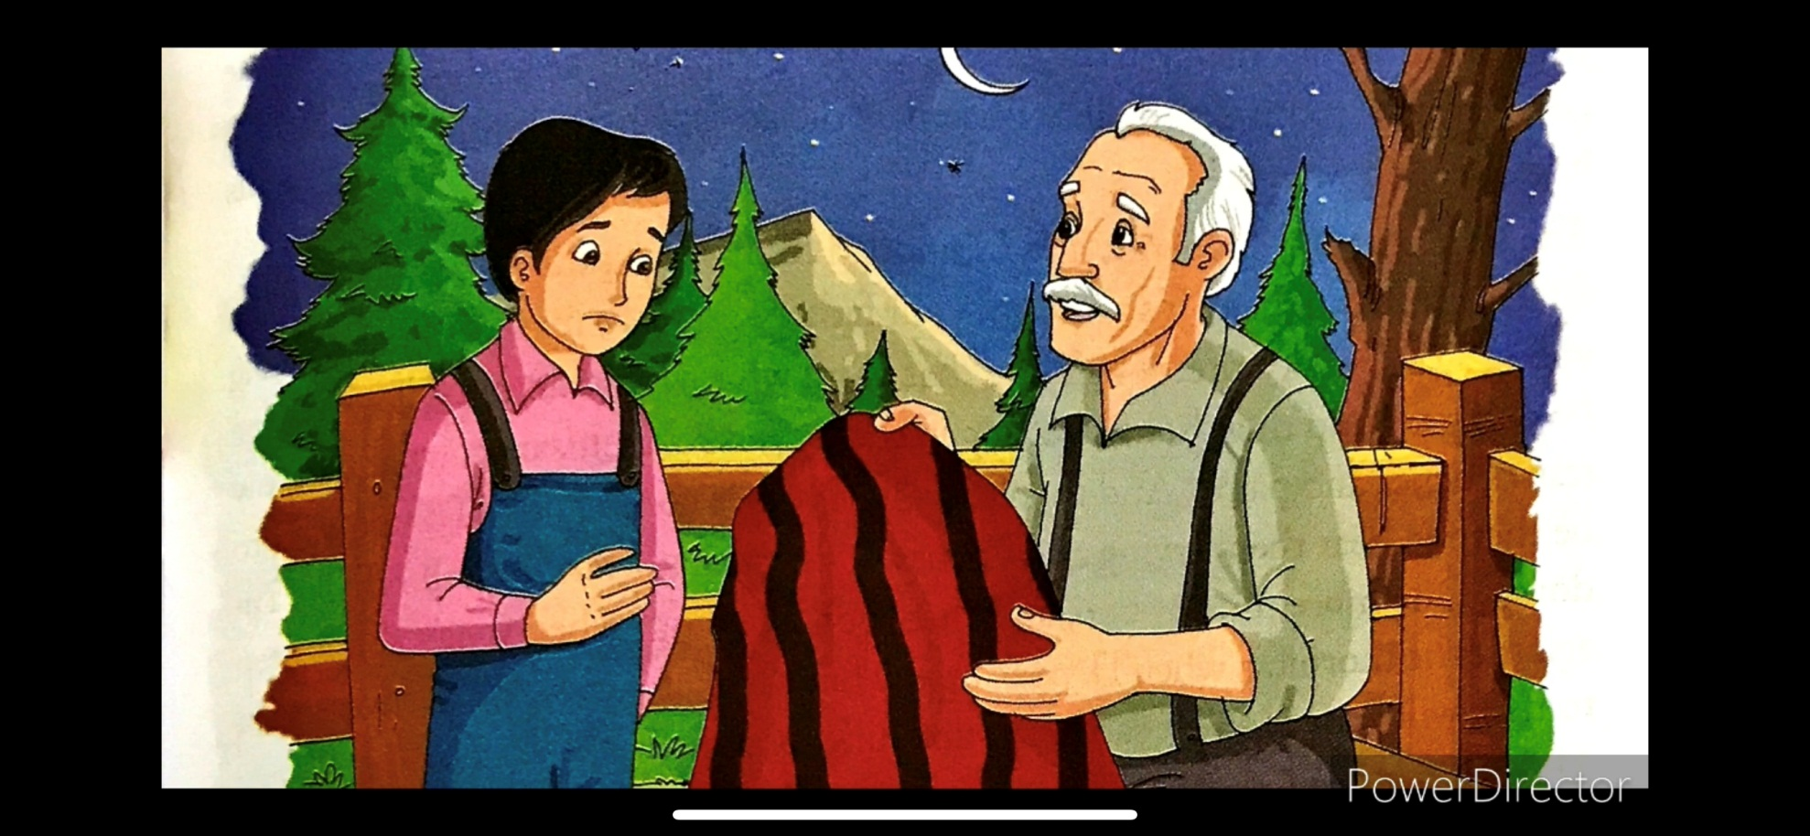
The Blanket
By: Floyed Dell

Slide 4
Making Prediction
How significant is the title of the story “The Blanket”
From the story preview, try to predict what Petey's father will do. Explain reason(s) for your prediction.

Slide 5
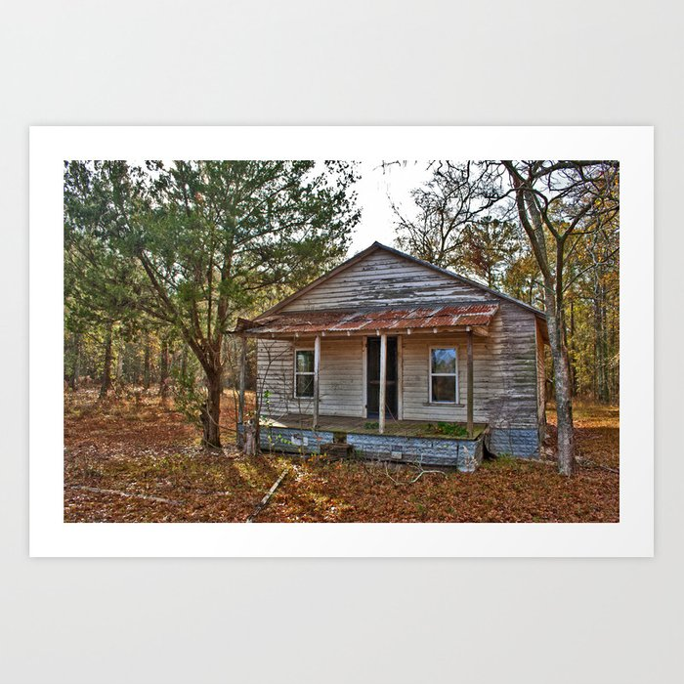
Shanty and Porch

Slide 6


Slide 7
Comprehension Questions
Why is Granddad being sent away?
How old is Petey?
What makes Petey realize that Granddad is really going to the nursing home?
What excuses does Granddad make for his son's plan to send him away?
How would you describe the woman that Petey's father intends to marry?
Do you think that Dad will change his mind about sending Grandad away, at this point? Find sentence from the story that support your opinion.

Slide 8
Elements of the Story
1- Discuss the plot structure of the story?
2-Who is the protagonist in the story?
3- Who is the antagonist?
4-What conflict does the protagonist encounter?
5- Analyze the conflict in the story? How is resolved?
6- What other important characters are involved in the conflict?
7- What kind of person is the protagonist?
8- What evidence in the story leads you to this opinion of the protagonist?

Slide 9
Elements of the Story
9- Where and when does this story take place?
10- How would you describe the mood? How does the author establish this mood?
11- Discuss the role of setting in establishing the meaning of the story? What does it symbolize?
12- Summarize the theme of this short story.
13- Is there a sentence or short passage that states or strongly implies the theme? If so, what is it?
14- Analyze the story in terms of poetic justice. Discuss each character's actions and the things that happen to each character at the end of the story.

Slide 10
Critical Questioning
1- If Petey has been exposed to social media or internet, would he have developed the same intimacy with the granddad as has been shown in the story?
2- Why does Petey dislike the woman that his father intends to marry?
3- Do you think that Petey's father will ever marry his fiancée? Why or why not?
4- What is the real reason that Petey's bought the blanket?
5- Nice people sometimes do unkind things. Give an example from your own experience or from another story you have read.
6- What lesson do you think Petey's father learned? In your opinion, did the fiancée get what she deserved?

Slide 11
Critical Questioning
7- Why did Petey's father intend to send Granddad away?
8- Why did the fiancée object to the gift of the blanket?
9- Why does the author describe Dad's fiancée as "the pretty girl with the hard, bright face like a china doll's"? What does he want to emphasize?
10- Why does Petey’s Dad get angry with the girl he was going to marry?
11- What is your first impression on each of the following characters in the story? Does the character remind you of anyone in your life? At this moment, what do you think of that character? The characters are: Petey, Granddad, Dad, and Dad's fiancée.
12- As you read lines 66-74 of the story, do you notice any changes in Dad's fiancée words and manner? Describe that change and mention the reasons of her change.

Slide 12
Writing Assignment
1- Write a summary of the story in two or three paragraphs. Make sure to include all the major events.
2- Why do some people cry when they are happy? Write a short essay about an experience when you or someone you knew cried for?
3- Make up a conversation between Petey and Granddad the morning after the incident with the blanket.
4- People often buy gifts to cover up a guilty feeling. Compare the father's gift to Granddad with a present that was given to you because someone else felt guilty.
5- Discuss some of the problems grown children sometimes face with their parents. What problems do parents have relating to adult children?

Slide 13
6- What is your opinion on each of the following characters in the story now? What kind of person is that character? Give your personal evidence concerning your claims; what kind of feeling do you have toward that character? The characters are: Petey, Granddad, Dad, and Dad's fiancée.
7- Which part of the story do you like? Why? Explain. Which part of the story you do not like? Why? Explain. (
8- How would the story be different if (a) Dad did not buy the blanket? (b)Character Petty was removed from the story? (C)The story was narrated from the girl's (dad's fiancée) point of view? (D)Dad did not want to marry that girl? (E)It was a chilly January night?
9- Write a letter to each of the following characters in the story? Tell him/her what you wish to tell him expressing your real feelings toward him/her. Would you like to advice that character, for example? How would the story be different if the character took the advice?
10- Write a diary entry stating your experience with the story. What did you learn from this story? What do you think the value and beliefs of this author to be? Do you like this author be one you like to have influence your students or your children in the future? Why or why not?

