Slide 1
PA-Lecture 3
Data Processing and Utilization in Precision
Agriculture

Slide 2
Acquisition of Crop Information Based on Remote Sensing Technique
Precision agriculture requires:
a high-density, high-speed, and low-cost supply of spatial information on crops, soil, and environmental conditions to guide management decisions. Conventional techniques for acquiring this information rely mainly on surveys, field sampling, and laboratory analysis.
To address this issue, remote sensing techniques can be used to acquire spatial information about farmlands for decision making in precision agriculture.

Slide 3
AQUISITION OF CROP INFORMATION BASED ON REMOTE
SENSING TECHNIQUES
Crop growth status can be determined by various factors such as:
leaf area, color, inclination angle, plant height, and stalk diameter.
Other factors like crop nitrogen, leaf area index, and biomass are also used for characterization.
Nitrogen deficiency can cause changes in physiological status, biochemical composition, and canopy structure leading to small leaves and low biomass.
Water stress is a common limitation to photosynthesis and plant productivity which can be measured for irrigation practices and drought assessments.
Changes in these parameters affect the plant's spectra which serves as the physical basis for remote sensing detection of nitrogen or water content of crops.

Slide 4
1- Chlorophyll in Crops
Chlorophyll is a crucial compound for photosynthesis in crops and serves as an indicator of crop growth status.
Canopy chlorophyll density (CCD) is a sensitive indicator of N deficiencies in wheat.
Various types of spectral indices have been used to estimate chlorophyll content, including continuous wavelet transform (CWT) to estimate the chlorophyll content of maize leaves in different layers from their visible to near-infrared spectra.

Slide 5
2-Nitrogen in Crops
Nitrogen is vital for crop growth and timely fertilizer supply can increase production and efficiency.
Lab tests are effective for N recommendations.
Leaf chlorophyll concentration correlates to leaf N concentration, allowing for determination of crop N status through spectral reflectance. Canopy N density is a sensitive indicator to detect N deficiency in wheat. Remote sensing technology can capture leaf N distribution in the crop canopy, with existing studies grouped into three classes based on hyperspectral data used.

Slide 6
3-Water Content of Crops
Water is crucial for plants, involved in photosynthesis and transpiration.
It's important for agricultural irrigation and can be measured using the weighting method.
Leaf water absorbs light at specific frequencies, affecting spectral characteristics.
Remote sensing of liquid water in vegetation has applications in agriculture and forestry. Water stress limits photosynthesis and productivity, making measurement important for irrigation and drought assessments.
NIR bands' reflectance is determined by internal structure, dry matter content, and minor water-related absorption bands. Secondary effects on reflectance are influenced by transmissive properties of water. Decreases in leaf water content may affect internal structure and NIR reflectance.

Slide 7
Data Processing and Utilization in Precision Agriculture It maybe possible to use crop reflectance to estimate LWC.LWC was calculated as
where LFWC is the sample fresh leaf mass (kg)and LDWC is the sample dry leaf mass (kg).

Slide 8
4- Leaf Area Index (LAI)
Leaf Area Index (LAI): is a crucial indicator of crop growth and a basis for variable-rate fertilization and irrigation.
LAI can be estimated by multiplying plant population by leaf area per plant or measured using direct or semi-direct methods such as leaf area meter or LAI-2000 instrument.
Remote sensing technology can also be used to estimate LAI through statistical algorithms, nonparametric algorithms, physical models, and data assimilation algorithms.
Timely and accurate measurement of crop LAI is beneficial for suitable field management strategies in agricultural production.

Slide 9
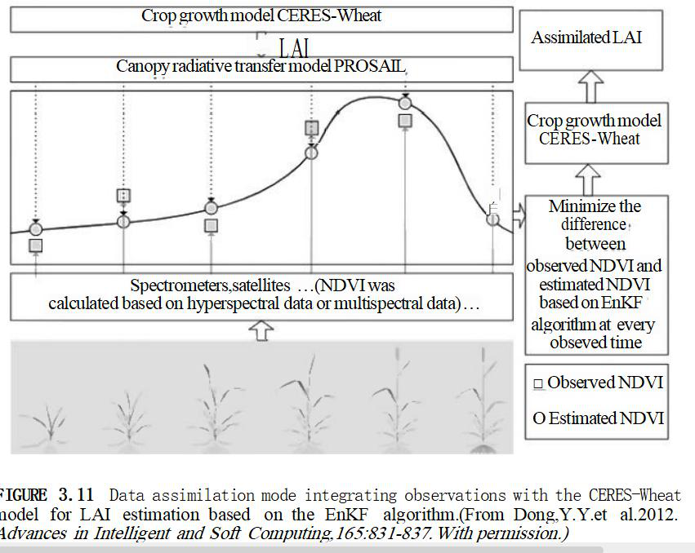

Slide 10
ACQUISITION OF FARMLAND DATA BY MACHINE
Acquisition of Crop Yield Information by Combine Harvester
Precision agriculture uses crop yield data and spatial distribution diagrams to make informed decisions about crop production.
These systems include sensors for measuring grain flow, water content, and machine distance traveled.
Differential GPS provides position information for the data recorded on a memory card, which is then processed using software to generate yield diagrams.
Instant Yield Map is a software program that can generate point diagrams, grid maps, smooth grid maps, and line graphs of yield based on the original data stored in the card.
It also allows for management of yield data by harvest time and place and visualization of low-yield areas through color-coding.

Slide 11
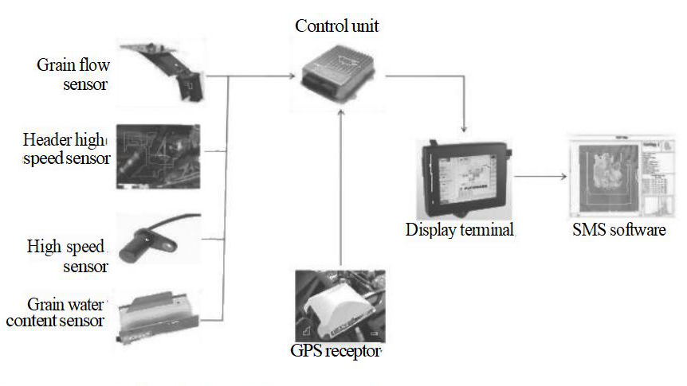

Slide 12
Recording Instrument:
The recording device aids in soil sampling by capturing coordinates and providing a platform for design and management.
The soil-information-sampling system has five functions: design, navigation, positioning, analysis, and detection.
It consists of peripherals (GPS receivers and sensors) and software (programs and databases) with a man-machine interface. See Figure 2 for the system structure.

Slide 13
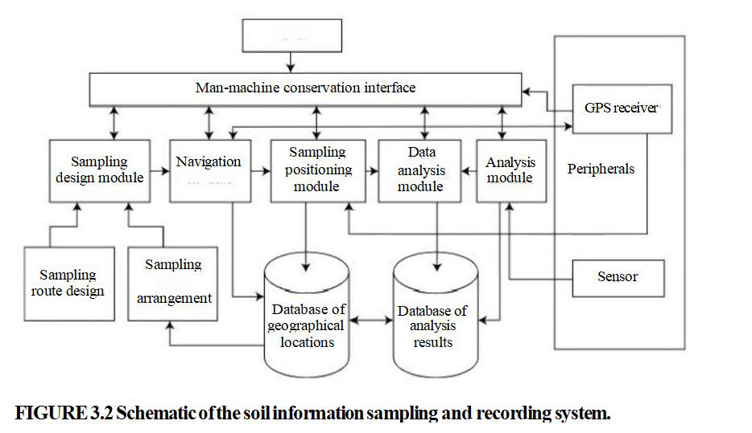
Acquisition of Soil Nutrition Data

Slide 14
Collection Equipment:
The collection equipment has 12 components, including a sampling tube, hydraulic cylinder guider, locator on the sampling head, slide rail for supporting frame of the hydraulic cylinder, and more.
The hydraulic power unit is driven by a motor and supplies high-pressure power to the system.
The soil collection device is fixed on a pickup's lateral trough and slides outward via the slide trail of the fixed frame.
The operator adjusts the sampling depth before the hydraulic module performs its work.

