Slide 1
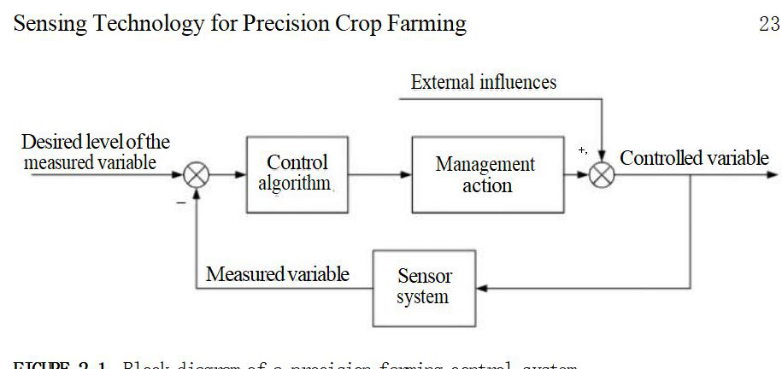
Block diagram of a precision farming control system.

Slide 2
Precision agriculture is based on sensing and responding to crop variability.
Sensing technologies have been used in crop irrigation since ancient times, but modern electronics have made broader sensing technologies available.
Yield monitoring systems were introduced in the late 1980s, utilizing GPS location data.
The control algorithm is the relationship between sensed parameters and management action, which consists of sensors and a control algorithm.
The fundamental components of a PA system are: sensor(s), control algorithm, and management action.

Slide 3
Precision farming systems use sensors to manage fertilizer application based on harvested yield.
Promising sensing technologies can be identified by examining a typical farm budget, focusing on areas such as nitrogen use efficiency and seed technologies. Crop reflectance-based sensor technology has been shown to effectively address nitrogen use inefficiency.

Slide 4
Production costs for continuous farming of corn and small grains provide a technique for identifying potential with those crops, but different perspectives exist for irrigated crop production and other crops.

Slide 5
SENSOR-BASED ALGORITHMS FOR FERTILZER NITROGEN
One pressing issue is the misuse of fertilizer nitrogen for cereal grain production.
The use of algorithms that apply nitrogen correctly will have a significant impact on our world. This review aims to highlight these algorithms and their components for better nitrogen management.

Slide 6
The yield goal is used to estimate preplant fertilizer N rates.
Yield potential (YP0) is the upper level yield boundary that is dictated by a host of factors.
Response index (RI) determines the likelihood of obtaining a response to applied fertilizer.
Sufficiency is dependent on the environment and in-season growing conditions, so midseason fertilizer rates should be tied to yield level.
Maximum return to nitrogen (MRTN) provides N rate recommendations based directly from analysis of N response trials and return to N.

Slide 7
Yield monitoring
Yield monitoring is crucial in Precision Agriculture. It helps to evaluate farming practices and manage fertilization. Georeferenced yield monitoring emerged in the early 1990s and is widely used. There are different types of yield sensing systems for different crop applications. Yield is expressed as a volume per unit area, which allows for easy comparisons and computation of total yield from average yield and area. Monitoring the harvested area is necessary for accurate yield data.

Slide 8
OPTICAL AND RADIATION-BASED YIELD MEASURING SYSTEMS
Optical-based systems use light transmission to measure crop mass and have been applied in cotton and sugarcane. They are also available for peanut yield monitoring and potato tuber yield monitoring. Radiation-based mass detection has been used in commercial grain yield monitors in Europe but faces regulatory limitations. Most combine yield monitors also measure grain moisture, which is important for precision farming and nutrient replacement control algorithms.

Slide 9
YIELD MAPS
Data from combine yield maps are normally recorded with geographical coordinates associated with each measurement.The data are typically placed into commercial farm GIS packages where the data are placed into map form.Interpolation is used to allow a spatially continuous representation of yield to be made.

Slide 10
CROP CANOPY REFLECTANCE SENSING
SPECTRAL INDICES AND THEIR RELATIONSHIP TO CROP:
Plants appear green due to the absorption of red light by chlorophyll. Canopy reflectance sensing technology uses ratios of different portions of the spectrum to assess spectral differences in plant canopies.
The NDVI is a spectral index that measures the difference between reflected energy in the near-infrared and red portions of the spectrum. It is effective in distinguishing chlorophyll-containing plants from soil backgrounds. However, soil variations can interfere with measurements, but this variation is typically small enough not to be significant.

Slide 11
Spectral Indices
NDVI
The Near-Infrared (NIR) and Red bands were also applied to calculate the NDVI images [39]. The NDVI index is calculated with the aid of the red (Red) and the Near- Infrared (NIR) bands of Sentinel-2 images, using Equation (1), as follows [39]:
NDVI = (B8 - B4)/(B8 + B4)
NDMI
The NDMI normalizes the different moisture response bands between near-infrared (NIR) and shortwave infrared (SWIR) (Equation (2)). The linear correlation between the NIR/SWIR ratio and leaf relative water content was discovered by Hunt Jr and Rock [41]. He calculated NDMI using the following equation:
NDMI = NIR - SWIR/NIR + SWIR

Slide 12
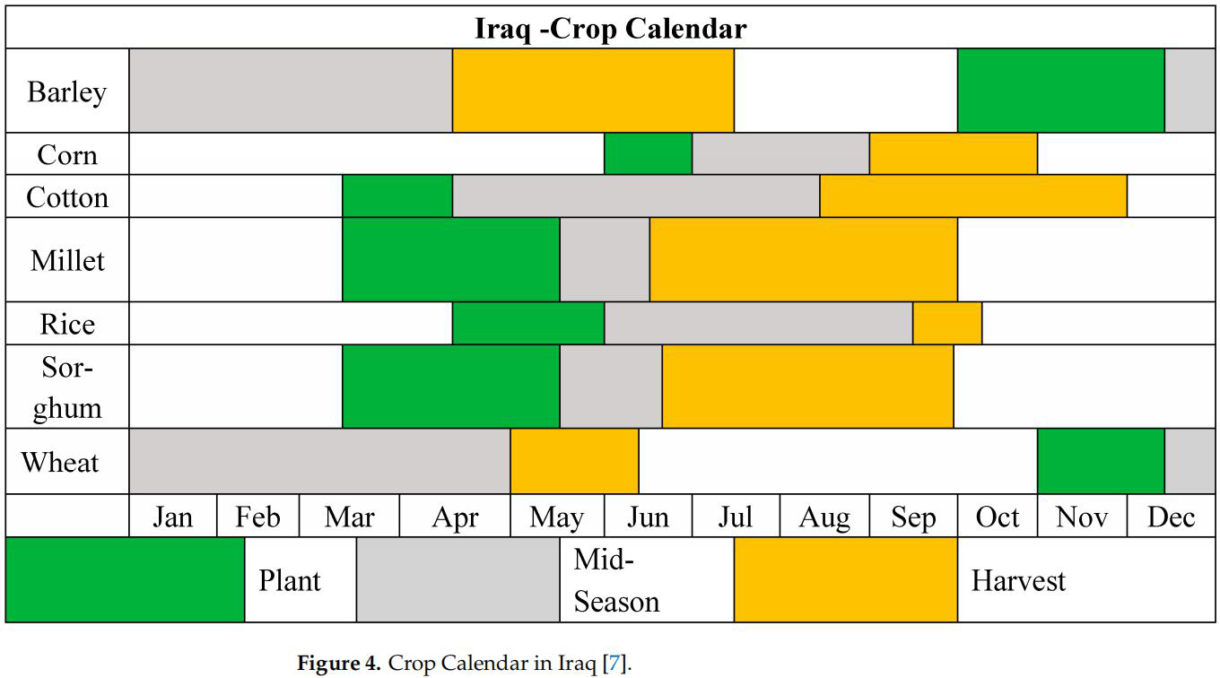

Slide 13
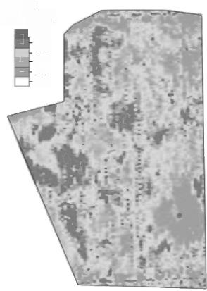
”NDVI is a spectral index relating the difference between reflected energy in the near-infrared (NIR)portion of the spectrum and reflected energy in the red portion of the spectrum.
Legend
Yield (t/ha)
+5.0
-4.0
-3.0
2.0
1.0
0.0

Slide 14
Wheat Irrigation Monitoring based on NDVI

Slide 15
Reflectance(%)
Spectral reflectance of wheat and soil.

Slide 16
Several indices have been studied for potential use in PA. Careful consideration is needed when selecting an index and its purpose. Dg was found to be a better indicator of chlorophyll concentration than NDVI, but NDVI can correlate with biomass.
NDVI has a high correlation with vegetative biomass and area-specific chlorophyll content, independent of plant type. Nitrogen content can be estimated with 550 nm reflectance measurements. Biomass is highly correlated with the simple ratio (SR), which can also correlate with yield. Vegetative indices differ depending on whether correlation to chlorophyll concentration or content is sought. Chlorophyll content is mainly determined by nitrogen availability, making reflectance indices useful for determining nitrogen availability. The spectral relationship between nitrogen availability and reflectance spectra changes in winter wheat shows a lowering of spectra in the red region and a rise in the NIR region with higher nitrogen availability.

Slide 17
Many indices have been examined for use in PA.
However, wider band indices like NDVI are better for biomass detection. NDVI is well correlated to vegetative biomass and area-specific chlorophyll content, while simple ratio (SR) is highly correlated to yield. Vegetative indices vary depending on whether the correlation sought is with chlorophyll concentration or content. Reflectance indices can be used to determine nitrogen availability, as shown by the spectral relationship between nitrogen availability and changes in reflectance spectra of winter wheat.

Slide 18
Red-edge inflection point (REIP)given in Equation
Canopy reflectance technology helps manage nitrogen for field crops. Nitrogen uptake is used in algorithms for fertilization. Canopy reflectance is used to assess the need for additional nitrogen fertilizer in winter wheat.

Slide 20
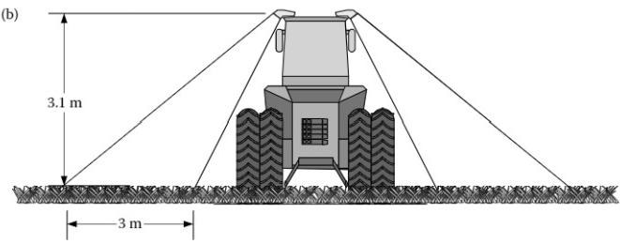
Sensor mounting geometries for boom-mounted rellectance sensors

Slide 21
Sensors can be mounted on sprayer booms and tractor cabs to view crops. Satellite systems require correction for atmospheric interference and illumination effects. Different sensor systems have variations in bandwidth of spectral channels, affecting the NDVI response.

Slide 22
SOIL PROPERTY SENSING
Crop growth depends on the quality of the soil it grows in, and management decisions can be made based on soil characteristics.
Sensing technology can be used to:
assess soil properties, but the type of sensing required depends on economic return and difficulty of integration into crop management.
Nutrient variability also affects sensing requirements, with nitrogen needing to be sampled before, during, and after growing season while parameters associated with P, K, and N may only need to be sampled once per season. Soil nutrient spatial variability impacts sampling requirements.

Slide 23
Next Lecture
Data Processing and Utilization in Precision Agriculture

