Slide 1
Experiment 2
Determination the Order of the Reaction for Sodium Sulphite with Potassium Iodate in Acidic medium using Half Time method

Slide 2
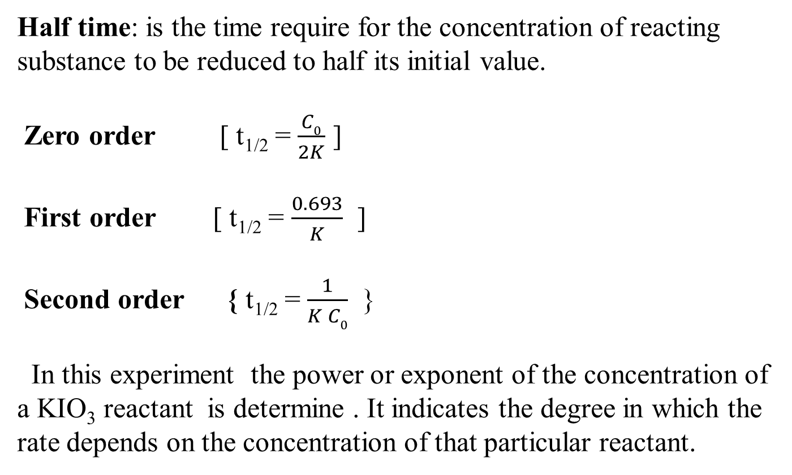
Half Time
Half time: is the time require for the concentration of reacting substance to be reduced to half its initial value.
Zero order [ t_{1/2} = $\frac{C0}{2K}$ ]
First order [ t_{1/2} = $\frac{0.693}{K}$ ]
Second order { t_{1/2} = $\frac{1}{K C0}$ }
In this experiment the power or exponent of the concentration of a KIO₃ reactant is determine . It indicates the degree in which the rate depends on the concentration of that particular reactant.

Slide 3
Reaction of the Experiment
H₂SO₄
KIO₃ + Na₂SO₃ I₂+K₂SO₄+ Na₂SO₄
Mechanism:-
1- Na₂SO₃+ H₂SO₄ H₂SO₃+Na₂SO₄
2- IO₃ +3H₂SO₃ I +6H⁺ +3SO₄⁻² (r.d.s)
3- IO₃ +5I +6H⁺ 3 H₂O +3I₂
4- H₂O + I₂ + H₂SO₃ 2I⁻ +SO₄⁻² +4H⁺
-
-
-
-

Slide 4

Determination Order of Reaction by Half Time
t_{1/2} α $\frac{1}{C^{n−1}}$ → t_{1/2} = $\frac{K}{C^{n−1}}$ → [t_{1/2}]₁ = $\frac{K}{{C1}^{n−1}}$ , [t_{1/2}]₂ = $\frac{K}{{C2}^{n−1}}$
$\frac{\text{[}\text{t}\text{1}\text{/}\text{2}\text{]}\text{2}}{\text{[}\text{t}\text{1}\text{/}\text{2}\text{]}\text{1}}$ = $\frac{\frac{K}{{C2}^{n−1}} }{\frac{K}{{C1}^{n−1}}}$ → $\frac{\text{[}\text{t}\text{1}\text{/}\text{2}\text{]}\text{2}}{\text{[}\text{t}\text{1}\text{/}\text{2}\text{]}\text{1}}$ = $\frac{{C1}^{n−1}}{{C2}^{n−1}}$ → $\frac{\text{[}\text{t}\text{1}\text{/}\text{2}\text{]}\text{2}}{\text{[}\text{t}\text{1}\text{/}\text{2}\text{]}\text{1}}$ =[ $\frac{C1}{C2}$]^{n-1}
log $\frac{\text{[}\text{t}\text{1}\text{/}\text{2}\text{]}\text{2}}{\text{[}\text{t}\text{1}\text{/}\text{2}\text{]}\text{1}}$ = (n-1) log $\frac{c1}{c2}$
log $\frac{\text{[}\text{t}\text{1}\text{/}\text{2}\text{]}\text{2}}{\text{[}\text{t}\text{1}\text{/}\text{2}\text{]}\text{1}}$ = n log $\frac{c1}{c2}$ - log $\frac{c1}{c2}$
log $\frac{\text{[}\text{t}\text{1}\text{/}\text{2}\text{]}\text{2} }{\text{[}\text{t}\text{1}\text{/}\text{2}\text{]}\text{1}}$ + log $\frac{c1}{c2}$ = n log $\frac{c1}{c2}$
n= $\frac{\text{log} \frac{\text{[}\text{t}\text{1}\text{/}\text{2}\text{]}\text{2} }{\text{[}\text{t}\text{1}\text{/}\text{2}\text{]}\text{1}}\text{ + }\text{log} \frac{c1}{c2}}{\text{log} \frac{c1}{c2} }$

Slide 5
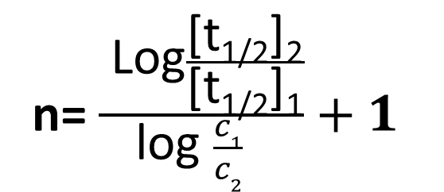
Determination Order of Reaction by Half Time-Curve
n= $\frac{ \text{Log}\frac{\text{[}\text{t}\text{1}\text{/}\text{2}\text{]}\text{2}}{\text{[}\text{t}\text{1}\text{/}\text{2}\text{]}\text{1}}}{\text{log} \frac{c1}{c2} }+1$
C₁
t_{(1/2)}1
t_{(1/2)}2
Con/(M)
KIO₃
C₂
C₁/2
C₂/2
Time(sec.)

Slide 6
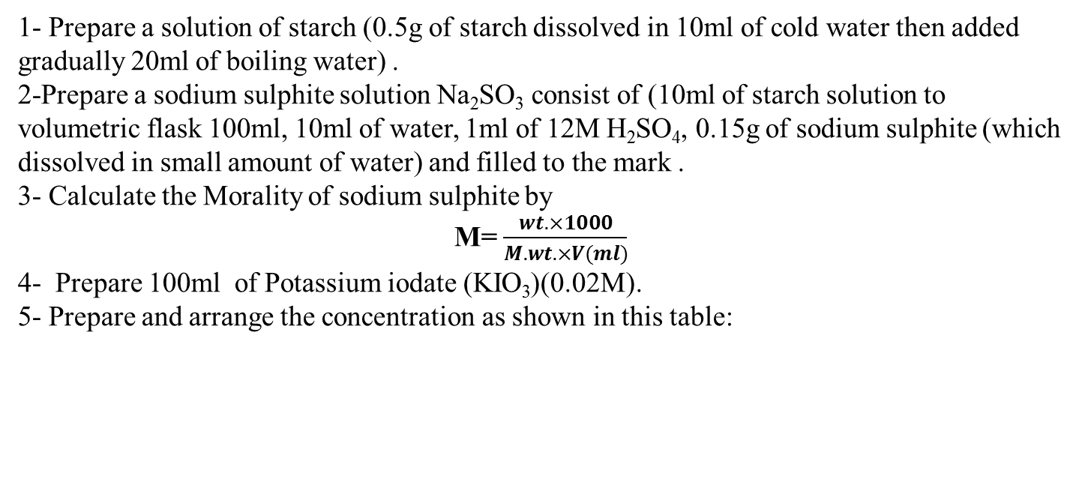
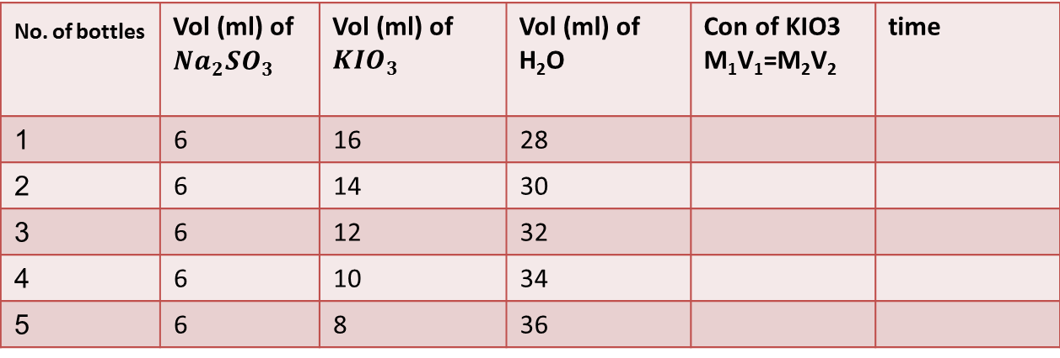
Procedure
1- Prepare a solution of starch (0.5g of starch dissolved in 10ml of cold water then added gradually 20ml of boiling water) .
2-Prepare a sodium sulphite solution Na₂SO₃ consist of (10ml of starch solution to volumetric flask 100ml, 10ml of water, 1ml of 12M H₂SO₄, 0.15g of sodium sulphite (which dissolved in small amount of water) and filled to the mark .
3- Calculate the Morality of sodium sulphite by
M= $\frac{wt. ×1000}{M.wt. ×V(ml)}$
4- Prepare 100ml of Potassium iodate (KIO₃)(0.02M).
5- Prepare and arrange the concentration as shown in this table:
time | Con of KIO3 M₁V₁=M₂V₂ | Vol (ml) of H₂O | Vol (ml) of ${KIO}_{3}$ | Vol (ml) of ${Na}_{2}{SO}_{3}$ | _{No. of bottles}
 |  | 28 | 16 | 6 | 1
 |  | 30 | 14 | 6 | 2
 |  | 32 | 12 | 6 | 3
 |  | 34 | 10 | 6 | 4
 |  | 36 | 8 | 6 | 5

Slide 7
Procedure
6-Add to each mixture 6ml of sodium Sulphite alone.
7- Record the time required to appear the blue color.
8- Determine the concentration(c) of Potassium iodate for each solution by
M₁V₁=M₂V₂
9- Plot a graph between the concentration of Potassium iodate and the time (t) then calculate the rate of reaction by this equation
n= $\frac{ \text{log} \frac{\text{[}\text{t}\text{1}\text{/}\text{2}\text{]}\text{2} }{\text{[}\text{t}\text{1}\text{/}\text{2}\text{]}\text{1}}\text{ + }\text{log} \frac{c1}{c2}}{\text{log} \frac{c1}{c2} }$
C₁
t_{(1/2)}1
t_{(1/2)}2
Con/(M)
KIO₃
C₂
C₁/2
C₂/2
Time(sec.)

Slide 8
Kinetic Study For The Reaction Between Acetone And Iodine
Experiment 3

Slide 9
Zero-order Reactions
The rates of the zero-order reactions do not vary with increasing nor decreasing reactants concentrations. This means that the rate of the reaction is equal to the rate constant, k, of that reaction.
There are two general conditions that can give rise to zero-order rates:
Only a small fraction of the reactant molecules are in a location or state in which they are able to react, and this fraction is continually replenished from the larger pool.
When two or more reactants are involved, the concentrations of some are much greater than those of others.

Slide 10
Differential Form of the Zeroth Order Rate Law
Rate=−d[A]/dt=k${\left[A\right]}^{0}$ = k = constant (1)
Where Rate is the reaction rate and k is the reaction rate coefficient. In this example, the units of k are M/s. For zero-order reactions, the units of the rate constants are always M/s.
Integrated Form of the Zero-th Order Rate Law
Integration of the differential rate law yields the concentration as a function of time. Start with the general rate law equations
$Rate=k{\left[A\right]}^{n}$ (2)
First, write the differential form of the rate law with n=0
$Rate=\frac{−d\left[A\right]}{dt}=k$ (3)
then rearrange
$d\left[A\right]=−k$ $dt$ (4)
Second, integrate both sides of the equation.
$\int_{{\left[A\right]}_{0}}^{\text{[}\text{A}\text{]}}{\text{d}\text{[}\text{A}\text{]}=−\int_{0}^{t}{kdt}}$ (5)
Third, solve for [A]
. This provides the integrated form of the rate law.
[A]=${\left[A\right]}_{0}$ − kt (6)

Slide 11
Graphing Zero-order Reactions
[A] = −kt + ${\left[A\right]}_{0}$ (7)
Concentration
Rate
Time
Time

Slide 12
Relationship Between Half-life and Zero-order Reactions
The half-life $t_{1/2}$, is a timescale in which each half-life represents the reduction of the initial population to 50% of its original state. We can represent the relationship by the following equation.
[A]=$1/2{\left[A\right]}_{0}$ (8)
Using the integrated form of the rate law, we can develop a relationship between zero-order reactions and the half-life.
[A]=${\left[A\right]}_{0}$ − kt (6)
Substitute
$1/2{\left[A\right]}_{0}$=${\left[A\right]}_{0}$− k$t_{1/2}$ (9)
Solve for $t_{1/2}$
$t_{1/2}$=${\left[A\right]}_{0}$ /2k (10)
*Notice that, for zero-order reactions, the half-life depends on the initial concentration of reactant and the rate constant.

Slide 13
Experimental Reaction
CH₃COCH₃ + I₂ = CH₃COCH₂I + HI
The order of this reaction is zero order( it mean the rate of reaction not depend on concentration).
$\frac{dx}{dt}$=K
$\int_{0}^{x}{dx}$= K$\int_{o}^{t}{dt}$
X = K t
let X=Vt
Vt˥$\begin{matrix}vt \\ v0\end{matrix}$= Kt
Vt + Vo= Kt
Vt =V0 - Kt

Slide 14
Procedure
1- Prepare a solution 100ml of 0.05M iodine in 10%of Potassium iodide (KI), 50ml of H2SO4 ,250ml of 0.01M from Sodium thiosulphate(Na₂S₂O₃ .5H₂O) .
2-(a)Put 200ml of water in conical flask, 25ml of acetone and 10ml of sulphuric acid. (b)Put 50mL of iodine in another conical flask after thermal equilibrium(10 minutes) mix the two solution (a & b) with recording time.
3- Pipette 5ml from the mixture to another conical flask containing 100ml of water (to stop reaction), titrate with Sodium thiosulphate(Na₂S₂O₃ .5H₂O) using starch as indicter, record the time till disappear the blue color and V_{t} is the volume of Sodium thiosulphate(Na₂S₂O₃ .5H₂O) which equivalent the unreacted iodine(I₂) after (t)time, Repeat this step every five minutes .

Slide 15
Procedure
4- Arrange your experiment data as the fallowing table:-
Vol (ml) of Na₂S₂O₃ from burette( Vt) | time
 | 2
 | 4
 | 6
 | 8
 | 10
5- Plot a graph between the $Vt$and time (t) and calculate the rate constant (k) from the slope .
V_{t} = Vo - K.t
slope = -K
Vt
t

