Slide 1
Methods for determination of Order of reaction:
-5-
Consider the reaction between hydrogen peroxide and iodide ions in acidic solution.
H₂O_{2(aq)} + 2I⁻_{(aq)} + 2H⁺_{(aq)} → 2H₂O_{(l)} + I_{2(aq)}
The rate equation for this reaction can be written as:
Rate = k[H₂O_{2(aq)}]ª[I⁻_{(aq)}]^{b}[H⁺_{(aq)}]^{c}
The orders of reaction, a, b and c, have to be determined by experiment. This is why the rate equation is said to be experimentally determined.

Slide 2
For determination of the order of a reaction, following methods are usually employed.
1-Traial method
a) Graphical method
b) Equation method
2-Initial Rate method
3-Half life method

Slide 3
Experimentally Determined Data
The following data were collected for a hypothetical reaction whose rate is known to only depend on the concentration of a single reactant, A. The order of the rate law with respect to A is unknown.
This data can be used to determine the order of the reaction. We assume that the reactions are either zero, first or second order.

Slide 4
a-by equation:
Reaction Order | Differential Rate Law | Integrated Rate Law | Linear Plot | Slope of Linear Plot | Units of Rate Constant
0 | - d[A] / dt = k | [A] = [A]₀- kt | [A] vs t | - k | mol · L⁻¹ · s⁻¹
1st | - d[A] / dt= k [A] | [A] = [A]₀e ^{- kt} | ln[A] vs t | - k | s⁻¹
2nd | -d[A]/dt=k[A]² | 1/[A]=1/[A]₀+kt | 1/[A] vs t | k | L.mol⁻· s⁻¹

Slide 5
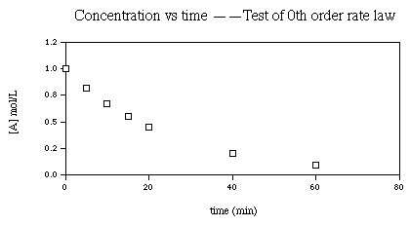
b-by carve:
Is the reaction 0th order?
If the reaction is 0th order, a plot of concentration versus time will result in a straight line. Since this plot is clearly non-linear, the reaction is not 0th order.

Slide 6
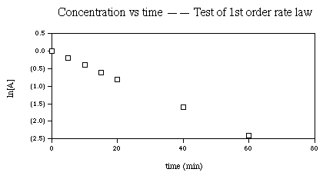
Is the reaction 1st order?
If the reaction is 1st order, a plot of the ln of concentration versus time will result in a straight line. Since this plot is clearly linear, the reaction is 1st order.

Slide 7
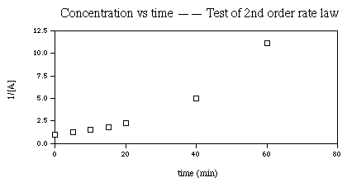
Is the reaction 2nd order?
If the reaction is 2nd order, a plot of one over concentration versus time will result in a straight line. Since this plot is also clearly non-linear, the reaction is not 2nd order.

Slide 8
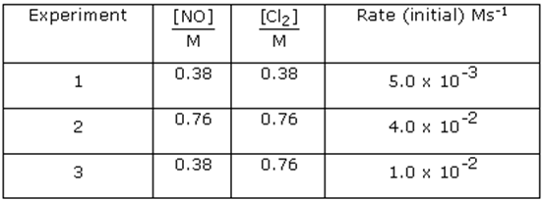
Example :
Nitric oxide NO reacts with chlorine Cl₂ to form NOCl initial rates were measured at two different initial concentrations of nitric oxide and chlorine data obtained is given below.
Suggested answer:
The order of the reaction with respect to Cl₂ is determined by using the rates obtained in experiment 1 and 3

Slide 9
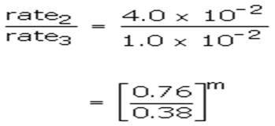
m=2
Therefore the probable rate law for the reaction is
R= k [NO]² [Cl₂]¹
The over all order of reaction is 3

Slide 10
Common Uses of the Method of Initial Rates:
1. To determine the order of the
reaction.
2. Find the rate constant, k .
Common Uses of the Method of Integrated Rate Laws:
1. To determine the order of the
reaction.
2. Find the rate constant, k .
3. To determine the concentration
at a certain time.
4. To determine at what time a
certain concentration will be
reached.

