Slide 1
Salahaddin University- Erbil College of Agricultural Engineering Sciences Department of Animal Resources Class: 2nd year/1st sem. 2021-2022
Subject:
Practical of Principle of Microbiology
Assist. Lecturer
Mr. Hemin Hussein Ali
M. Sc. Biotechnology
Department of Animal Resources

Slide 2
List of some equipment / apparatus used in Microbiology laboratory
Second Practical

Slide 3
List of some equipment / apparatus used in Microbiology laboratory
Autoclave
Incubator
Refrigerator
Thermometer
Hot air oven
Inoculating loop
Laminar Air flow
Hot plate with magnetic stirrer
pH meter
Bunsen burner
Balance
Centrifuge

Slide 4
Autoclave
Autoclave is a robust, electrically heated steam vessel meant for sterilizing culture media, glassware, and other materials that are not spoiled by moist heat.
Autoclave runs on the principle of pressure cooker.
The moist heat (steam) has a very good penetrating power.
Microorganisms/cells are killed as a result of denaturation of cellular constituents (protein and nucleic acids).
In routine process, sterilization can be achieved by operating the autoclave at 121°C (15 psig) for 15 min.
Notes:
Robust: به‌هيز

Slide 5
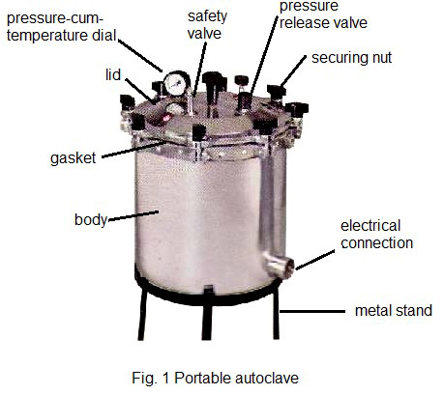
Autoclave

Slide 6
Incubator
Incubator is a device used to grow and maintain microbiological cultures or cell cultures.
The incubator maintains optimal temperature, humidity and other conditions such as the carbon dioxide (CO2 and oxygen content of the atmosphere inside.
The cabinet is insulated and thermostatically controlled.
For routine purposes, the temperature is maintained at 28-30°C for bacteria, about 25°C for molds, and 35-37°C for mesophilic bacteria.
A temperature as high as 100°C can also be maintained for extremely thermophilic organisms (stereothermophiles).
Notes:
Insulate جيادةكاتةوة يعزل

Slide 7
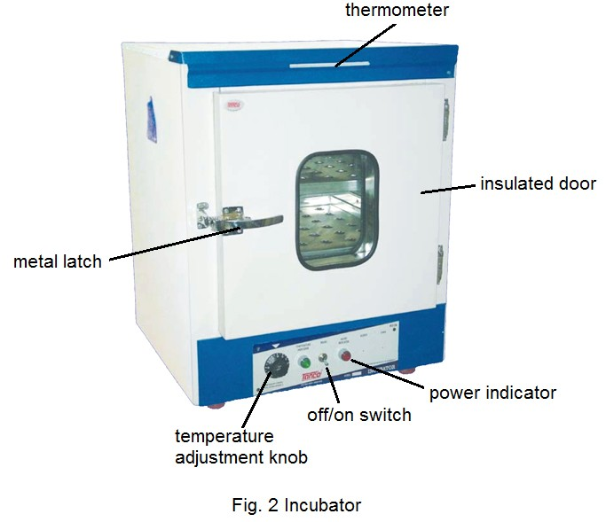
Incubator

Slide 8
Refrigerator
This is common household equipment for keeping foods and beverages cool.
This equipment is used in microbiology laboratory for storing / preserving cultures, media, and many sensitive materials.
Thermometer
Thermometers are required to ensure the heating equipment is running at the correct temperature.
The temperature of the medium, incubator, and water bath need to be frequently checked.
Mercury in glass thermometers are standard thermometers.

Slide 9
Hot air oven
Hot air oven is used for sterilization of glassware and materials that are spoiled by moist heat.
This is similar to incubator in make except that it can operate at temperatures up to 300°C and has a fan for circulating hot air.
The death of cells occurs due to the oxidation of cellular constituents by the dry heat.
The most common time-temperature relationships for sterilization with hot air sterilizers are:
170ºC (340ºF) for 60 minutes,
160ºC (320ºF) for 120 minutes, and
150ºC (300ºF) for 150 minutes or longer depending up the volume.

Slide 10
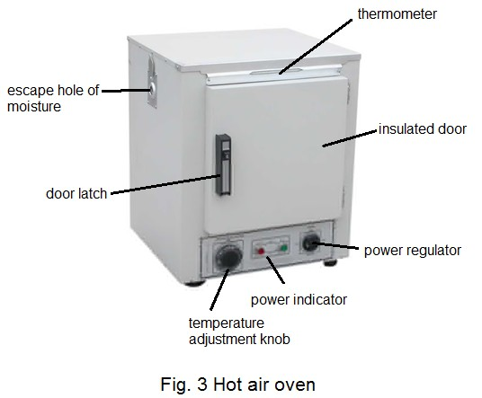
Hot air oven

Slide 11
Inoculating loop
This is a tool for transferring and streaking cultures.
It consists of a thin wire whose one end is twisted into a small loop while the other end is fixed to a thermoset plastic handle.
Sometimes, the looped end is straightened out to form what is called inoculating needle.
Inoculating needles are used for preparing ‘stab’ cultures.
Notes:
stab ليَدان ( خةنجةر )

Slide 12
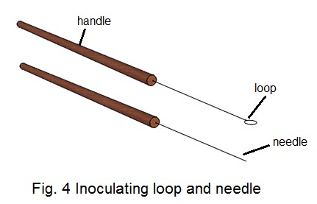
Inoculating loop

Slide 13
Laminar Airflow
Laminar Airflow cabinets are designed for creation of a bacterial dust free air space.
They are used for work with low-risk substances and materials,
when protection of working material from environment is required or work with item requires a sterile working zone.

Slide 14
Hot plate with magnetic stirrer
This is an electrically powered equipment performs the dual function of heating and agitation.
The agitation occurs by magnetic arrangement.
Magnetic beads are used for the agitation of medium.

Slide 15
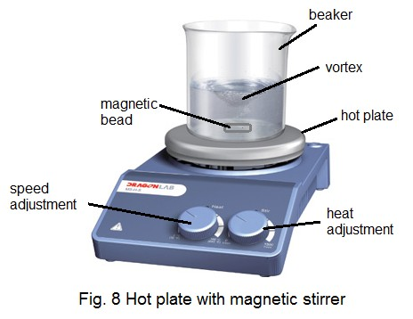
Hot plate with magnetic stirrer

Slide 16
pH meter
pH meter is an electrical instrument used for measuring hydrogen ion concentration of solutions and mixtures.
In microbiology lab, it is used for maintaining pH of the medium and diluents.
Since the instrument is very sensitive, it must not be used for stirring and it must not be dipped in hot or very cold solutions.
The electrodes must always be kept immersed in suitable solutions.

Slide 17
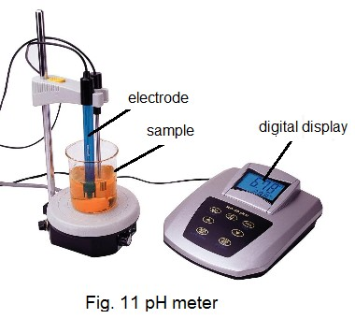
pH meter

Slide 18
Bunsen burner
Bunsen burner is a common tool used in microbiology lab.
It is used for sterilizing inoculating loop, test tubes, plating out cultures, transferring cultures, heat-fixing of smears and creating a sterile zone for aseptic operation.
When using a Bunsen burner to flame loops, needles, and Inoculating loops and needles should be heated until they are red-hot.
Before they are introduced into cultures, they must be allowed to cool down sufficiently to prevent killing organisms that are to be transferred.
Notes:
aseptic پاك خاوين

Slide 19
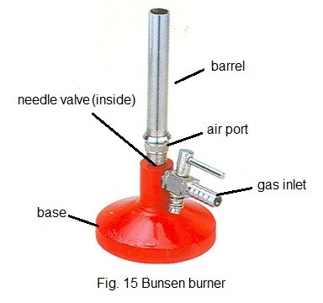
Bunsen burner

Slide 20
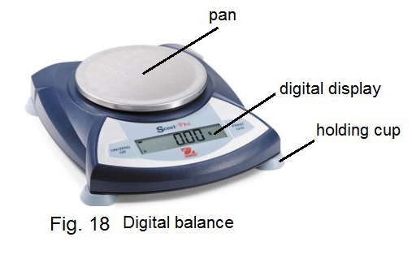
Balance
Balance is needed in microbiology lab for weighing media, chemicals, samples, etc.
Digital balances are fast to work.

Slide 21
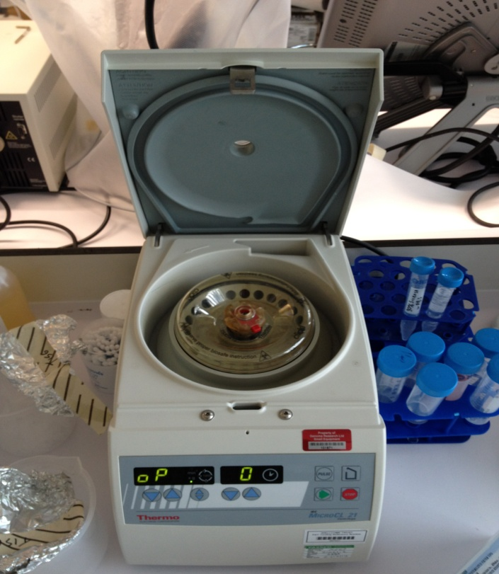
Centrifuge
Centrifuge is a piece of laboratory equipment, driven by a motor, which spins liquid samples at high speed.
It works by the sedimentation principle, where the centripetal acceleration is used to separate substances of greater and lesser density.
Notes:
driven : ليَخورِاو centripetal : دوور له‌ ناوه‌ند acceleration : تاودان

Slide 22
Quiz
Q1) Write function (or Define )of the following terms?
Autoclave
Incubator
Bunsen burner,
Inoculating loop and needle

