Slide 1
ENGINEERING DRAWING
Syllabus
Chapter One : Principles of Engineering Drawing
Chapter Two : Geometrical Operation
Chapter Three : Dimensions
References
1- FUNDAMENTALS OF ENGINEERING DRAWING by: Warren J. Luzadder
2- TECHNICAL DRAWING by: Goetsch nelson chalk
3- الــــرســــــــــــــــــــم الهندســـــــــــــــي د. فتحي شريف
4- الــــرســــــــــــــــــــم الهندســــــــــــــي كتاب منهجـــي
5- DESCRIPTIVE GEOMETRY by: Yousif Nicola
01

Slide 2
CHAPTER ONE : PRINCIPLES OF ENGINEERING DRAWING
1.1 : INTRODUCTION
Engineering drawing is a formal and precise way of communicating
Information about the shape, size, features and precision of physical objects.
Drawing is the universal language of engineering.
1.2 : BASIC INSTRUMENTS
1.2.1 : Drawing Sheets
A4
A4
Symbol Sheet Dimensions
----------- ---------------------------
A0 ( 1089 X 841 ) mm
A1 ( 841 X 594 ) mm
A2 ( 594 X 420 ) mm
A3 ( 420 X 297 ) mm
A4 ( 297 X 210 ) mm
A5 ( 210 X 148 ) mm
A2
A3
A0
A1
02

Slide 3
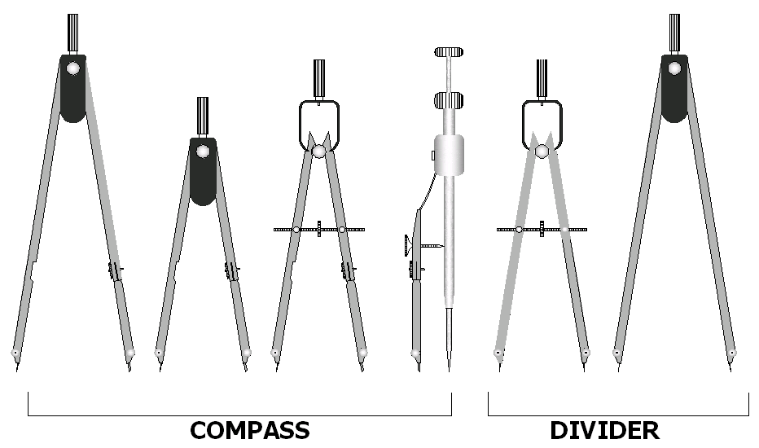
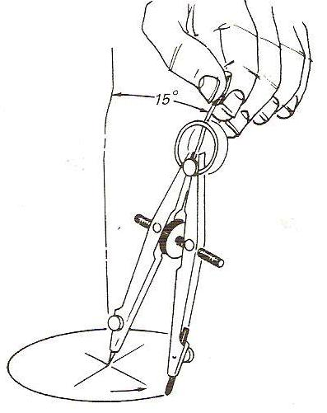
1.2.2 : T-SQUARE &TRINGLES
90⁰
60⁰
45⁰
90⁰
30⁰
45⁰
90⁰
T - SQUARE
30⁰ and 60⁰ Triangle
45⁰ Triangle
1.2.3 : COMPASS AND DIVIDERS
03

Slide 4
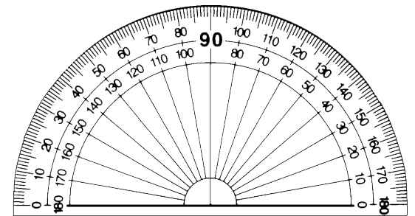
1.2.4 : PENCILS AND ERASERS
WOODEN PENCILS
ERASER
MECHANICAL PENCILS ( 0.5 OR 0.7 ) mm
1.2.5 : TAPES AND SCALES
1.2.6 : PROTRACTOR
04

Slide 5
1.3 : LETTERING
In Engineering drawing there are dimensions and notes that are written on
the sheet and must be clear , have convenient size and easy to read, letters and
Numbers must be written in Engineering way.
75⁰
6 mm
1.4 : DRAWING SHEET PAPER
12 cm
50 cm
2 cm
1cm
الاســـــــــــم بالـــعـــربـــــــي
1 cm
6 cm
35 cm
1 cm
Tittle block
1 cm
1 cm
Tittle block
05

Slide 6
10 cm
1.5 : TYPES OF LINES
Visible outline ( Full Line )
A
A
Hidden Line ( Dashed Line )
Break Line
Cutting Plane
Center Line
Extension Line
Dimension Line
10 cm
Section lining
SECTION A-A
Note:
1- For lines have spacing, the space should be approximately (1 ) mm.
2- For Hidden line the dashes must be approximately (2 – 8 ) mm.
3- For Center line the long dashes must be approximately (5 – 20 ) mm and the
dashes must be approximately (2 ) mm .
06

Slide 7
1.6 : SCALES
The Scales used in engineering practice are :
Full size scale
Reducing scale
Enlarging scale
1 : 5
1 : 10
10 : 1
1 : 1
1 : 20
5 : 1
1 : 25
2 : 1
1 : 50
1 : 100
07

