Slide 1

2nd Lab.
The modifications of insect mouth part
&Role of beneficial insects in agriculture:-
Salahaddin University - Erbil
Collage of Agricultural Engineering sciences
plant protection Department
Lecturer: Hero Muhyaddin Muhammad
Horticulture Insects- 4th stage
E. mail: hero.muhammad@su.edu.krd
Date: 4/10/2023

Slide 2
MOUTHPARTS
Insects are the largest group of animals that live in every type of habitat available on earth. They are plant feeding, predators, parasitic and decomposers,
a structure or appendage use in gathering or eating food.
The second appendages of head developed during embryonic period ,from segments of head.,
In each insect the mouth parts compose of 5 segments
1.Labrum
2.Labium
3.Mandibles
4.Maxillae
5.Hypopharynx

Slide 3
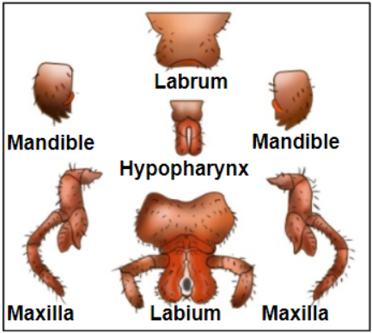

Slide 4
Mouthparts of insects vary among insects depending upon their feeding habitus:-
Mandibulate and haustellate.
1.Mandibulate:-feeding mainly solid food (chewing) mouthparts.
2.Haustellate:-feeding mainly liquid food mouthparts can be further classified as piercing-sucking, sponging, and siphoning.

Slide 5
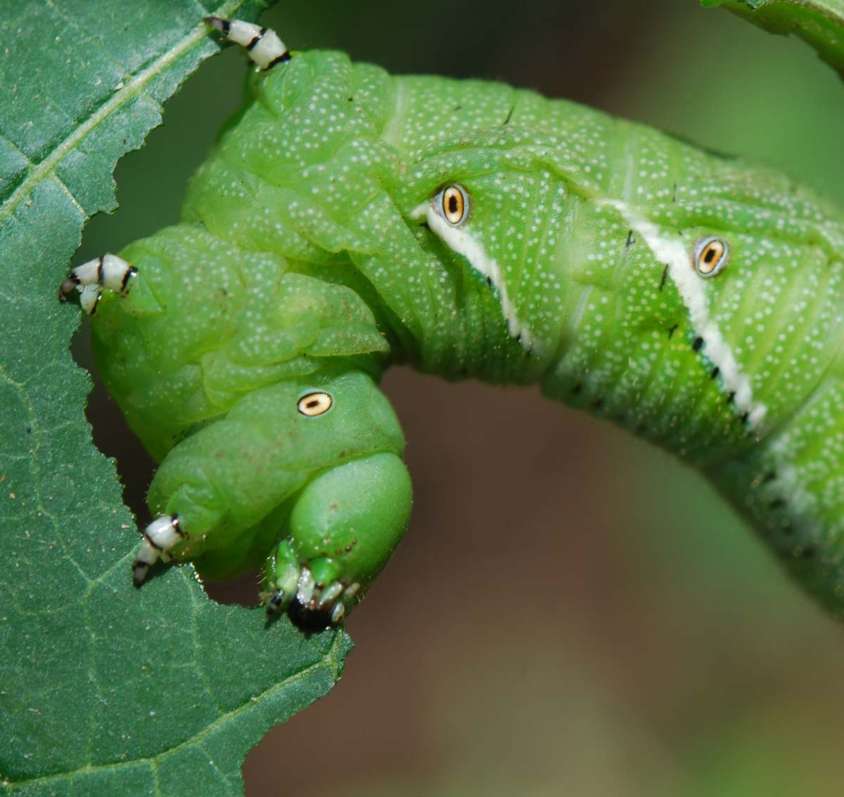
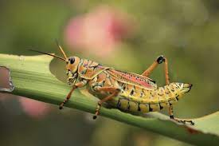
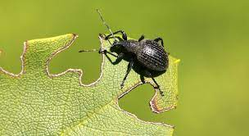
TYPES OF MOUTHPARTS
1-Biting & chewing mouthparts are used for biting and grinding solid foods .
EX: Beetles (Order: Coleoptera)
cockroaches (Order: Blattaria)
Grasshoppers, crickets
(Order: Orthoptera)
Caterpillars(larvae) (Order: Lepidoptera). Adult Lepidoptera have siphoning mouthparts.

Slide 6
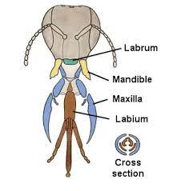
labrum:- (often called the upper lip) is a simple flattened piece of cuticle, , covers the mouth cavity from above helps to pull the food in to mouth.

Slide 7
2. labium (often called the lower lip):- It is made of three basal plates, namely,
submentum,
mentum and
prementum, the last plate carries a chemoreceptor bearing segmented palp. On the tip of labium are attached paired glossa
paraglossa

Slide 8
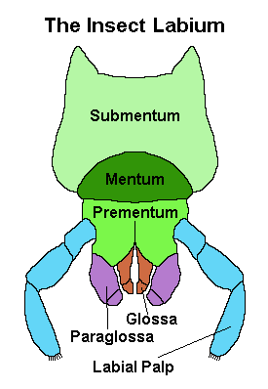

Slide 9
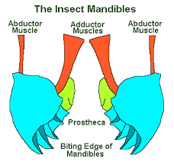
3.Mandibles, primary jaws:- are highly sclerotized paired structures. They are used for biting, chewing and severing food.

Slide 10
4.Maxillae, secondary jaws:- The maxilla are paired and arranged behind the mandibles. They are used to hold and control food so that it can be chewed or cut up by the mandibles.
Each maxilla is made of 5 parts :-
1.cardo
2.stipes
3.Galea
4.Lacinia
5.Maxillary palp

Slide 12
5.Hypopharynx:- or true tongue that is located in the middle of these mouth parts and carries the openings of salivary glands.

Slide 13
Haustellate mouthparts:- are primarily used for sucking liquids and can be divided into two subgroups: those that possess stylets and those that do not. For example adult of butterfly and moth of order (lepidoptera)
House fly (diptera)
Truebug (hemiptera)

Slide 14
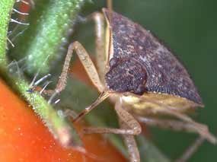
2-Piercing &Sucking mouth part
Stylets are needle-like projections used to penetrate plant and animal tissue. The modified mandibles , maxilla, and hypopharynx form the stylets and the feeding tube.
After piercing solid tissue, insects use the modified mouthparts to suck liquids from the host.
For example: mosquito in order diptera
True bug in order hemiptera

Slide 16
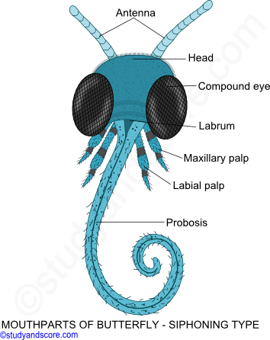
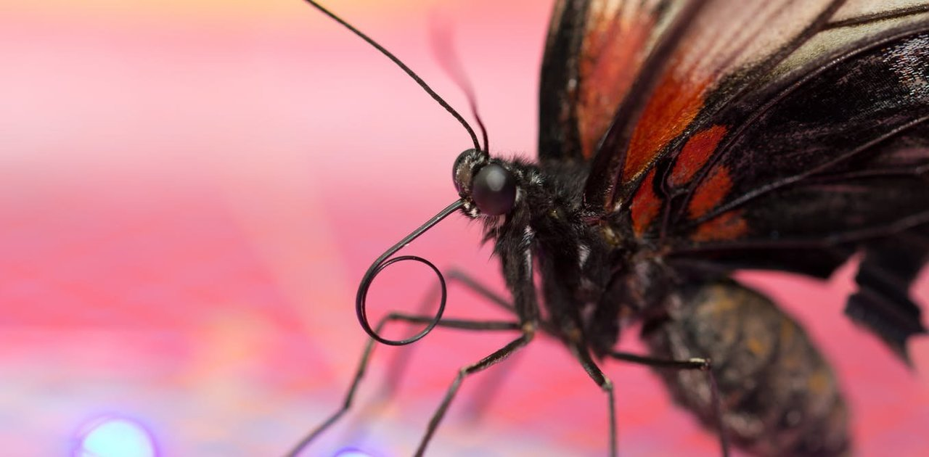
3.Siphoning(sucking) M. P.
This type of mouth parts are adapted wonderfully for sucking flower nectar,
found in butterflies and moths
belonging to the order Lepidoptera.
They have a long tube
which they usually
carry curled up and called proboscis.

Slide 17
4.Spoinging or lapping m.p.
Sponging mouthparts are used to sponge and suck liquids. Examples: House flies (order Diptera)

Slide 18
5-Chewing –lapping M.P.
This insect feeding on different types of food : solid (pollen) and liquid (flower juice)
Ex : Honeybee worker

Slide 19
Food of insects
According to nutritional requirements ,insects are categorized into:
Omnivorous: which feed on both plant and animal ,ex. Wasps and cockroache.
Carnivorous: Which feed on other animal as parasites and predators . Ex. Lady bird beetle and Mantids.
Herbivorous : which feed on living plant (crop pests).
a/ Polyphagous : which feed on wide range of cultivated and wild plants.
b/ Monophagaous : which feed on single species of plants ex.Rice stem borer.
c/ Oligophagous : which feed on plants of one botanical family ex. Cabbage butterfly .

Slide 20
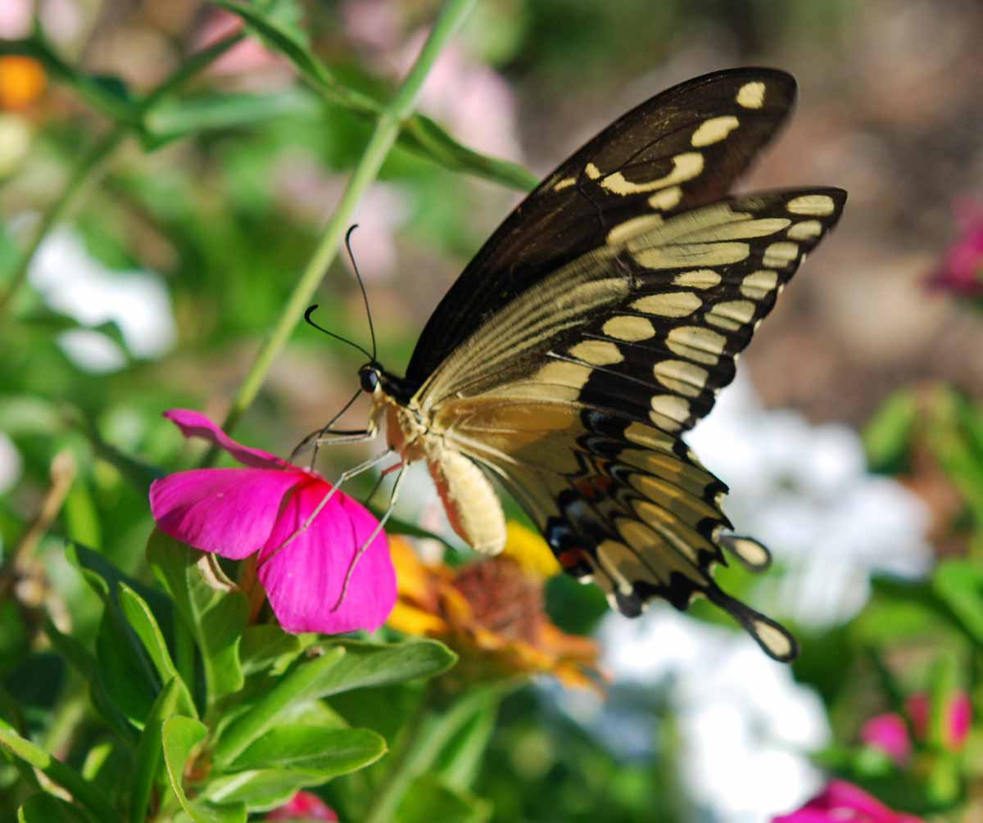
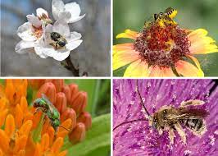
Role of beneficial insects in agriculture:-
1.Pollinators: Insect pollinators are flower visiting Insects that feed on flowering plants to obtain plant-provided food (nectar, pollen). Flower-visiting insects have the potential to transfer male gametes (contained in pollen) to the female gametes while foraging, resulting in pollination.
Example:- bees, flies,, beetles, butterflies and moths.

Slide 21
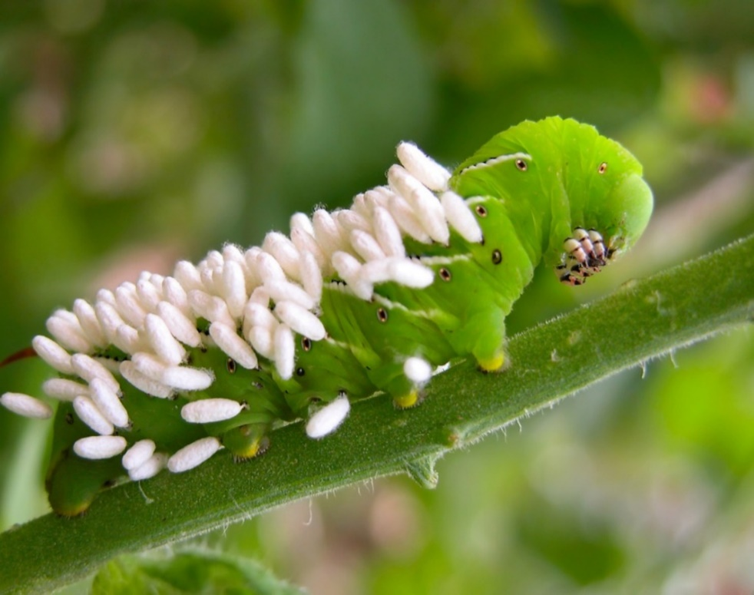
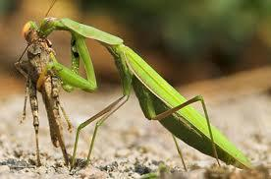
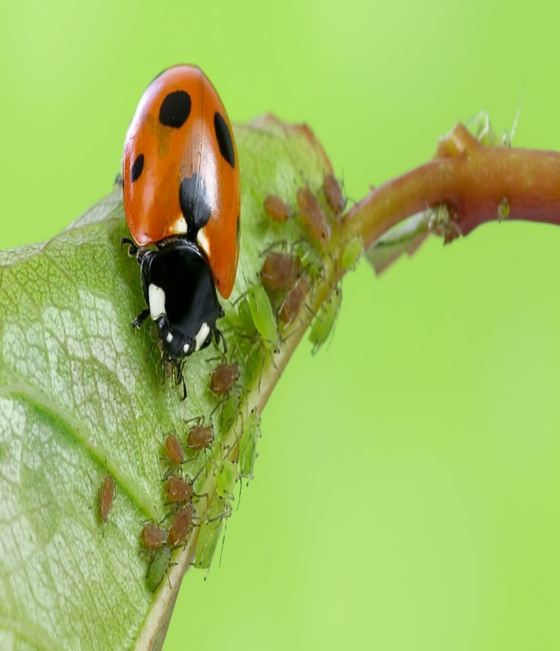
2.Natural Enemies:
Insect predators and parasitoids that attack and feed on other insects, particularly on insect pests of plants are considered
natural enemies.
Example ladybeetle. Lacewings, ground beetle,
and parasitic wasp

Slide 22
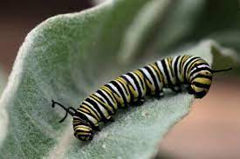
3.Weed Killers:
So many insects feed upon unwanted weeds just the same manner they do with the cultivated crops. In many cases the occurrence of these insects has contributed much towards eradication of the weeds. Exampl: grasshopper, weevil, larvae of butterfly

Slide 23
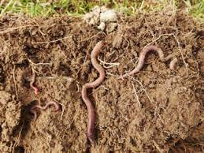
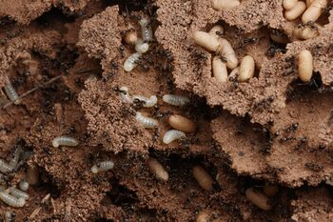
4.Soil Builders:
Insects which live in soil make tunnels, creating channels for smaller organisms, water, air, and roots to travel through. Insects improves soil ventilation example: earthworm, termite

Slide 24
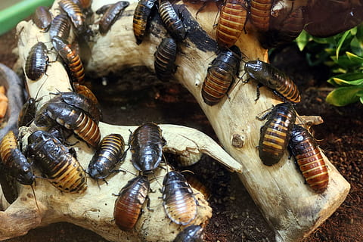
5. Scavengers:
Insects which feed on dead and decaying matter of plants and animals are called as scavengers. Insects (scavengers and decomposers) help in the recycling of the nutrients in the ecosystem.Examples: Bark beetle, water scavenger beetle, Cockroaches.

Slide 25
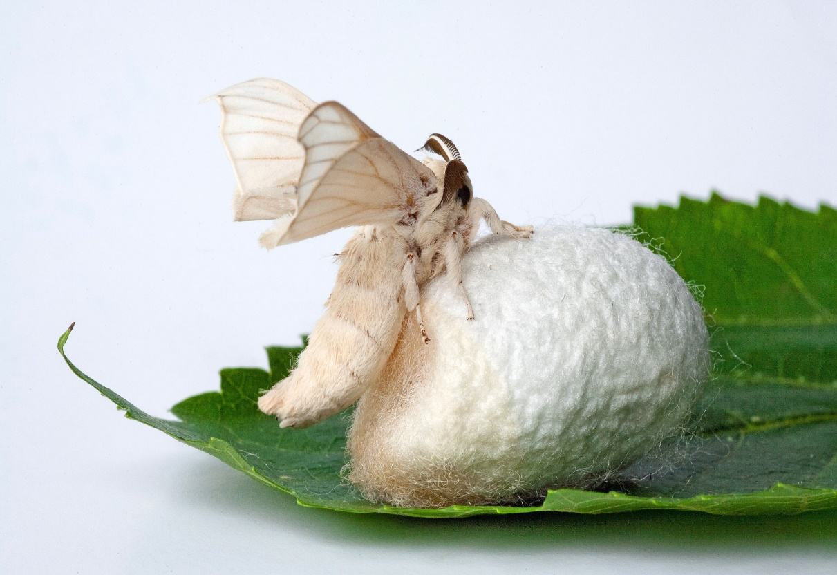
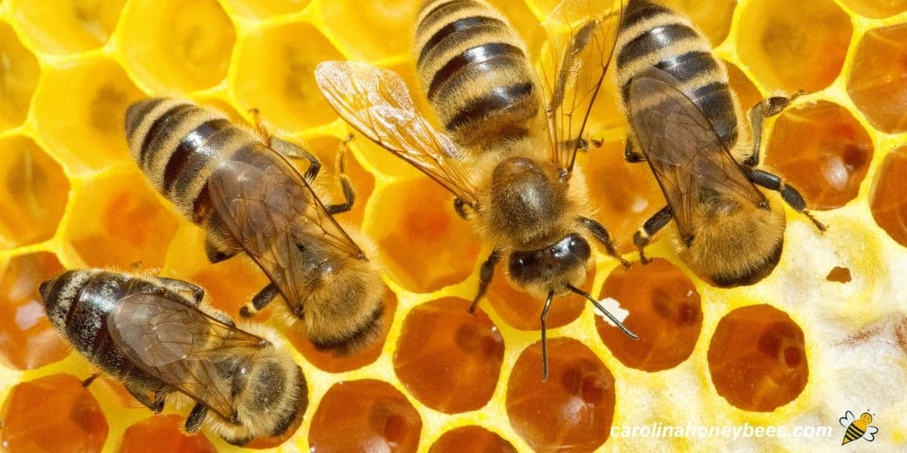
Some Products from Beneficial Insects:-
1.Production of Honey and Bee Wax: From thousands of year Apis melifera L. (Honey bees) are important for ahead Honey and bee wax.
2. Production of Silk: A unique natural fiber silk cloth, which usually derives from silkworm, Bombyx mori

