Slide 1
Salahaddin University - Erbil Collage of Agricultural Engineering sciences plant protection Department
Field crop insects
Lab 3
Cereal Crop
Lecturer: Hero Muhyaddin Muhammad
E. mail: hero.Muhammad@su.edu.krd
Date:5/2/ 2024

Slide 2
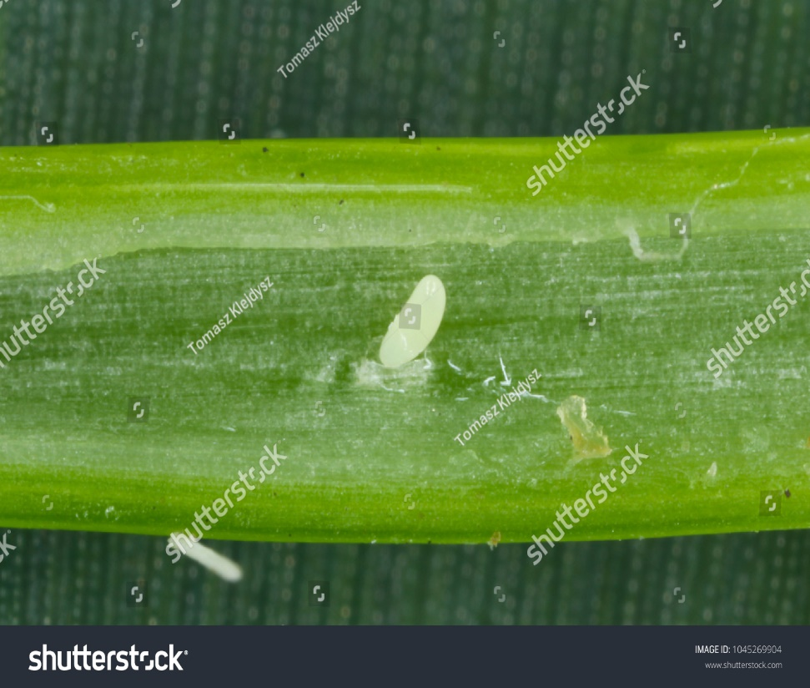
5- Wheat Stem Sawfly,
Cephus pygmaeus
(Hymenoptera: Cephidae)
Description
Eggs:
Size: Very small, about 0.5 mm long
Shape: Oval and creamy white
Location: Laid inside the stems
of cereal crops

Slide 3
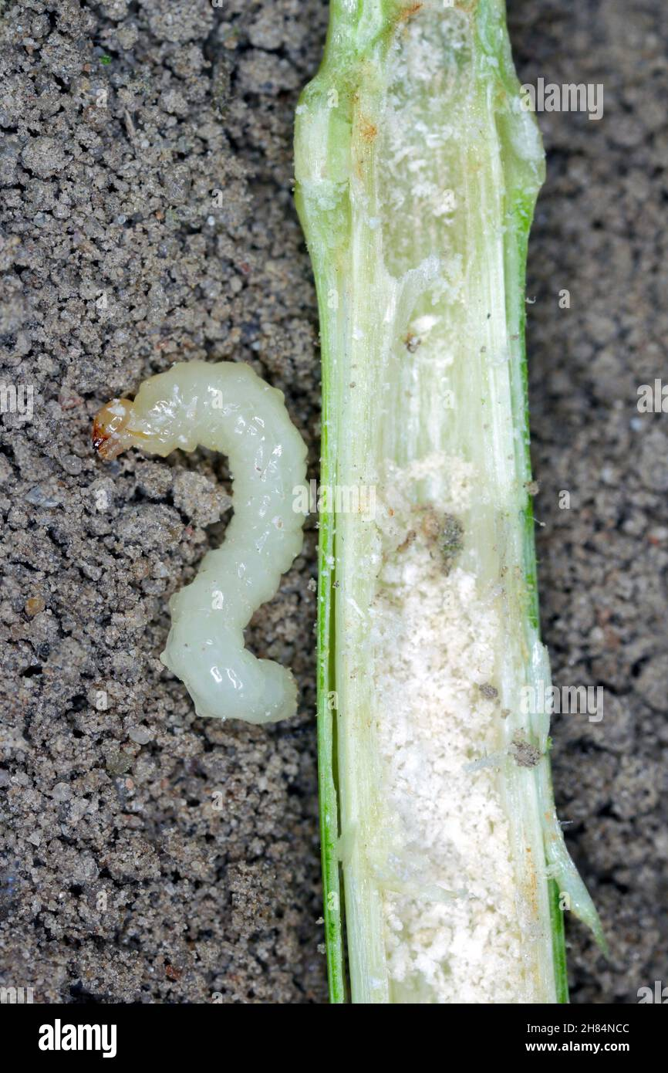
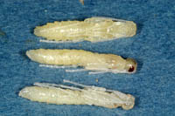
Larva:Size: Up to 15 mm long
Body: White, legless, and curved
Head: Brown or amber-colored
pupae
The wheat stem sawfly pupae resemble adults, but are white in color with their limbs remaining close to the body.

Slide 4
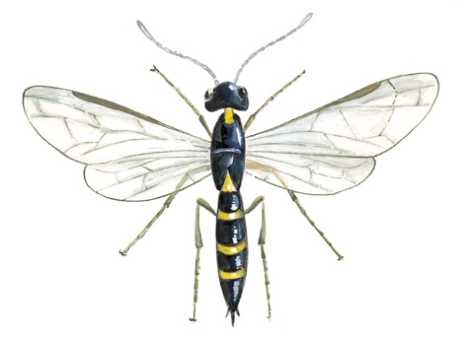
Adult:
Size: 5-10 mm long
Body: Black with yellow markings on the abdomen
Head: Large, black, with prominent compound eyes
Wings: Two pairs of membranous wings, the front pair slightly larger than the back pair.

Slide 5
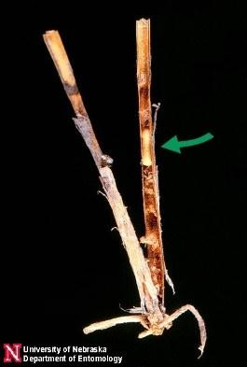
Damage:
Larvae can cause significant damage to cereal crops by weakening the stems and making them more susceptible to breaking over
This can lead to yield losses
as a result, losses of grain increase at harvest. Harmfulness of the Wheat Stem Sawfly varies widely, from 3 to 30%, depending on stem infestation

Slide 6
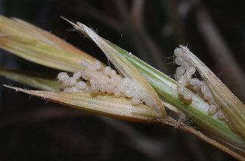
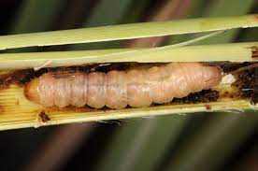
6- Corn Stem Borer,
Sesamia cretica
(Lepidoptera: Noctuidae)
Description
Egg:Hemispherical,1 mm in diameter,
with circular edges
Larva:Up to 40 mm long
Creamy white with a pinkish
Smooth and shiny Brown head

Slide 7
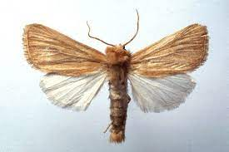
Adult:
Wingspan: 20-30 mm
Forewings: Pale brown with variable darker markings
Hindwings: Lighter brown
Body: Stout and hairy

Slide 8
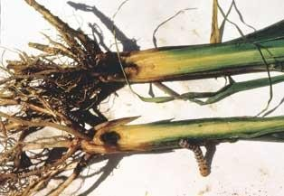
Damage:
The larvae bore in the stem of the various Cereal crops, cause to weakening the stem mechanically, making them susceptible to lodging (breaking over).
Tunnels disrupt sap flow, reducing plant growth and yield.
Severe infestations can lead to plant death.

Slide 9
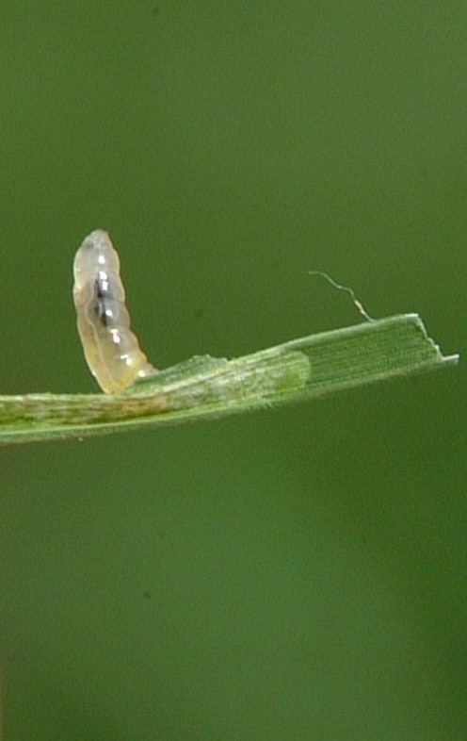
7.Cereal Leaf Miner (Rice Whorl Maggot),
Hydrellia griseola
(Diptera: Ephydridae)
Description
Egg:-The egg is white, elongated, 0.5-0.6 mm in length and 0.2 mm in width.
Larvae:-Legless, white maggots
that grow
to about 5-6 millimeters in length.
dark mouthparts.and Body segments

Slide 10
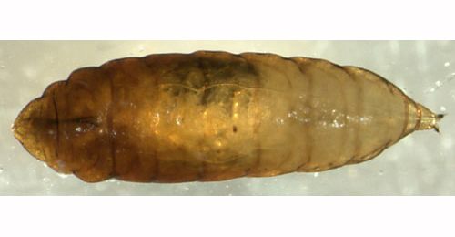
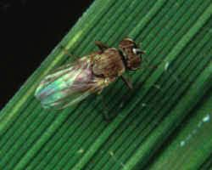
Pupae:-Brown, barrel-shaped pupal cases that form inside.
Adults: Tiny flies, measuring only about 2-3 millimeters in length.
Gray bodies with yellowish markings on the head and thorax.
Large, dark eyes that are covered in fine hairs.
Transparent wings with dark veins.

Slide 11
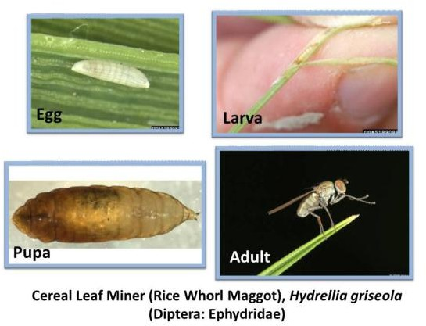
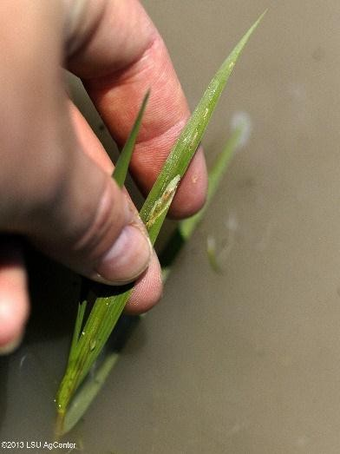

Slide 12
Damage:
Larvae tunnel between the layers of the leaf, attacking and killing leaves. The larvae of the rice cause significant damage to rice and other gramineous plants. Their feeding create that disrupt photosynthesis, leading to:
Stunted growth
Reduced yields
Yellowing and wilting of leaves
In severe cases, plant death

Slide 13
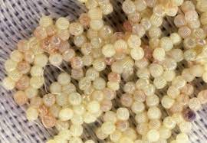
8.Corn earworm
tomato fruit worm
Helicoverpa zea (Boddie),
(Lepidoptera : Noctuidae)
Description
Egg:The dome-shaped egg, about 0.5 mm in diameter,
is pale white when first laid and develops a reddish-brown
band before hatching.

Slide 14
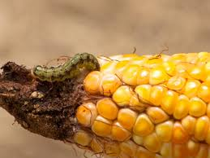
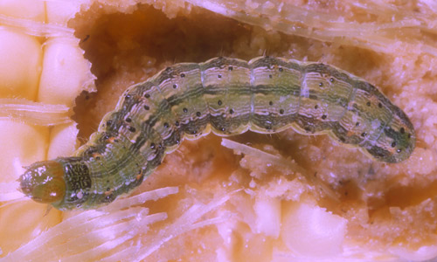
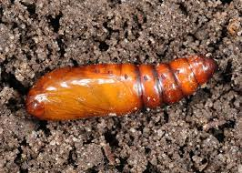
Larvae :Green to pink caterpillars with darker stripes and spots.
Body covered in fine hairs.
Reach a maximum length of around 40mm
The pupa is brown in color, and measures 17 to 22 mm in length

Slide 15
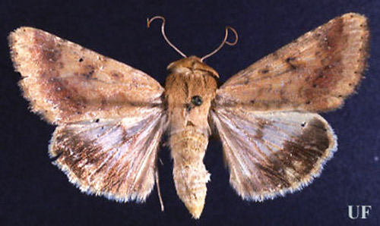
Adult: Wingspan ranging from 32 to 45mm.
The forewings of the moths usually are yellowish brown in color, and often bear a small dark spot centrally.
The hind wings are creamy white basally and blackish distally
the moths are principally nocturnal, Stout bodies with a noticeable difference in size between genders (females larger than males).

Slide 16
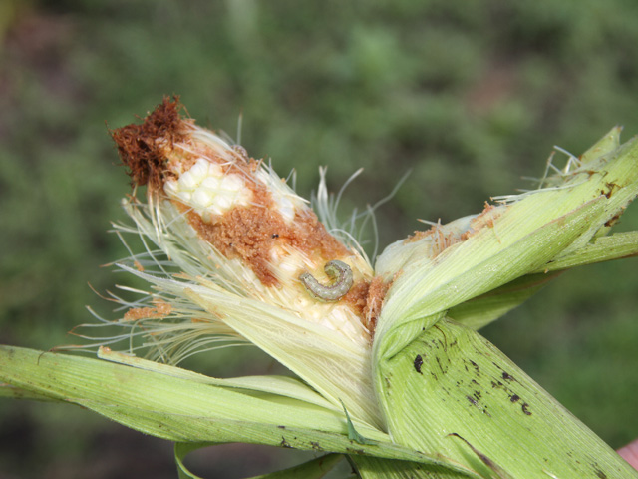
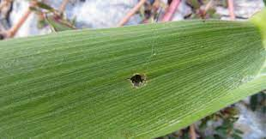
Damage:
Larvae feed on various parts of corn plants, including silks, kernels, and ears. This can result in yield loss, quality reduction, and increased susceptibility to fungal diseases.

