Slide 1
Exam

Slide 2
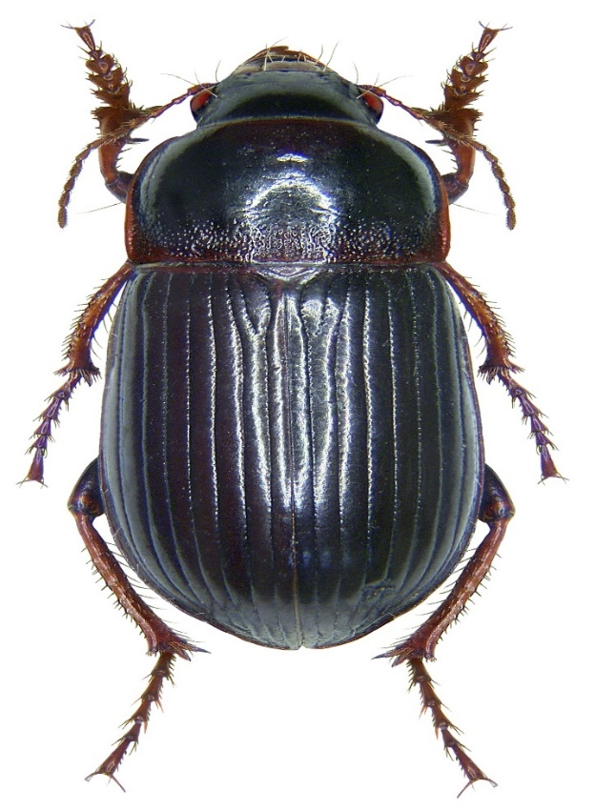
Q1/Identify this spacemen
1.Common name
2.Scientific name
3.Order
4.Family

Slide 3
Q2/ A. Write name 5 crops included in the grain crops B. list 5 Insect pests that attack of Leguminous Plants

Slide 4
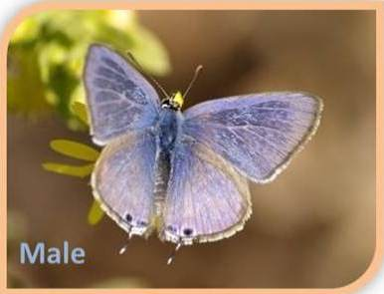
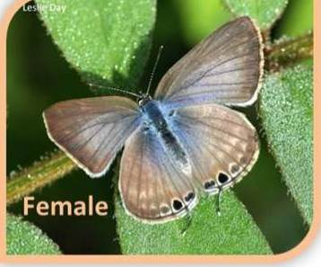
Q3/ what are differences between male and female of blue butterfly ? Which of this female and male
A
B

Slide 5
Q4/ what is the meaning of:-
1.Internal feeders
2. Injection of toxins
3. Parthenogenetic
4. Apodous
5

Slide 6
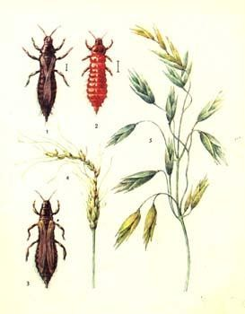
Q5/Mention the damage caused by Wheat Thrips

Slide 7
Q6/ What is Solitary Phase and Gregarious phase?

Slide 8
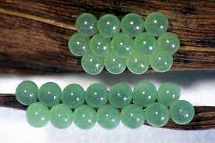
Q7/ Describe the egg stages of Sunn Pest, where to lay? and write the name of hosts

Slide 9
Q8/ Describe color changes in the newly hatched, older, and mature alfalfa weevil larvae and pupa

Slide 10
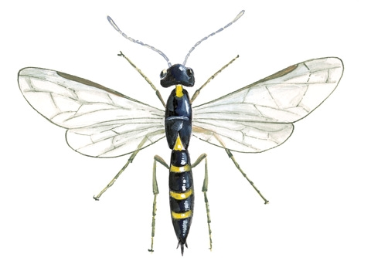
Q9/ what are the diagnostic characters of this samples with common name?

Slide 11
Q10/What do you know about wireworm? And write the symptoms

Slide 12
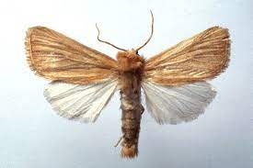
Q11/ write
1.Common name
2.Scientific name
3.Order
4.Family

