Slide 1
Laboratory Manual
General Chemistry - Practical
First Year – physical department
2023 - 2024

Slide 2
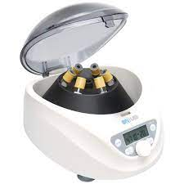
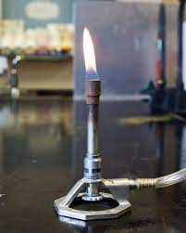
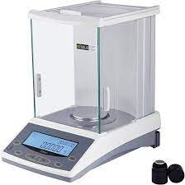
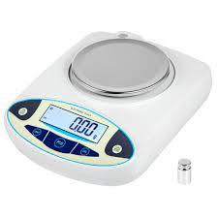
Equipment Required for Chemistry Laboratory
General Purpose Equipment Used in Chemistry Laboratory
Bunsen burner
Tongs
Test tube holder and rack
Centrifuge
Filter paper
Laboratory thermometer
Litmus paper
Analytical balance
Droppers

Slide 3
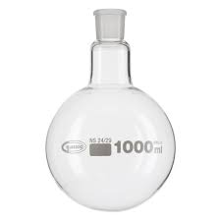
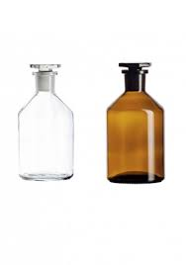
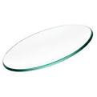
Glassware used in the Chemistry Laboratory
Test tubes
Round bottom flask
Beaker
Glass rod
Glass tube
Funnel
Watch glass
Reagent bottle

Slide 4
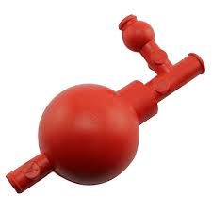
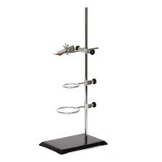
Special Purpose Laboratory Equipment
Titration Equipment
Pipette
Pipette bulb
Graduated cylinder
Burette
Conical flask
Burette clamp and ring stand
Volumetric flask

Slide 6
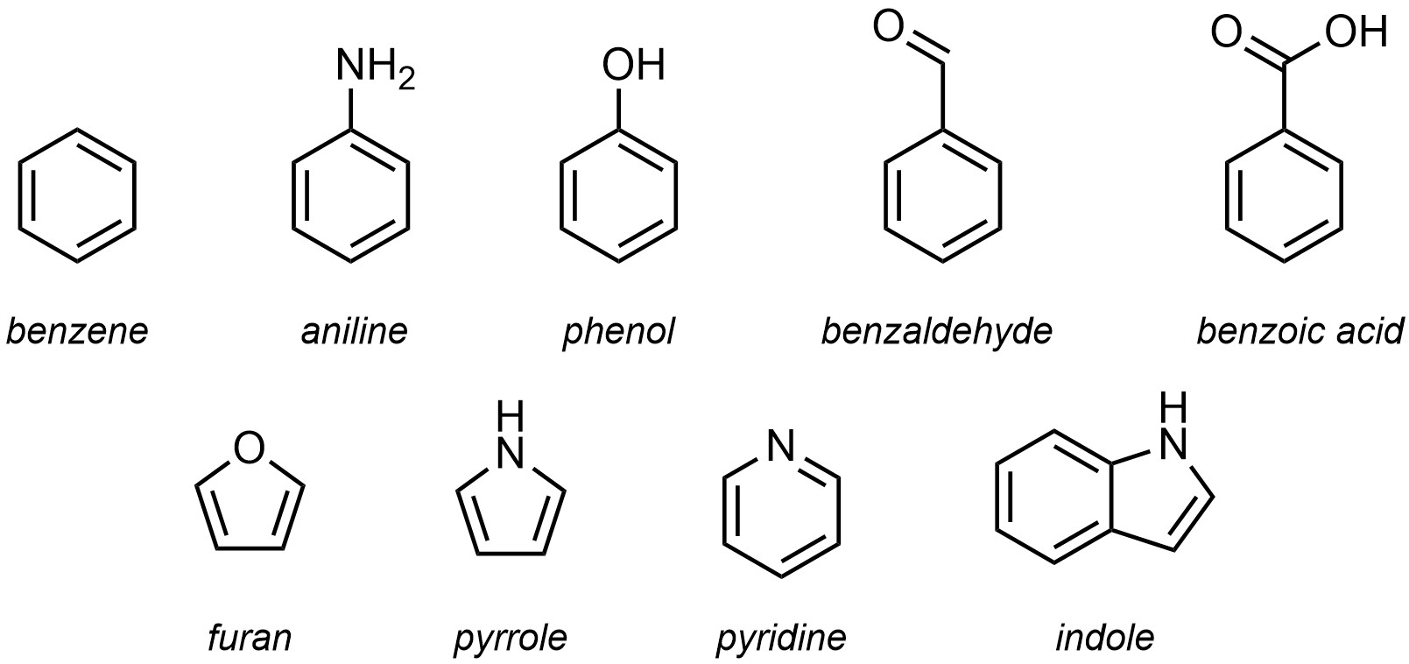
Types of Chemical Compounds
Organic compounds: any of a large class of chemical compounds in which one or more atoms of carbon are covalently linked to atoms of other elements, most commonly hydrogen, oxygen, or nitrogen.

Slide 7
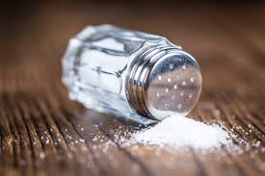
Inorganic compounds: inorganic compounds are made up of atoms connected using ionic bonds.

Slide 8
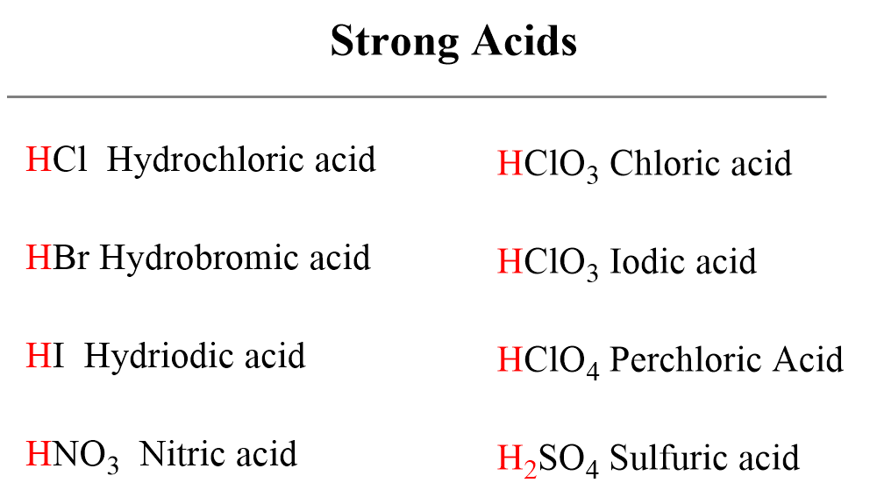
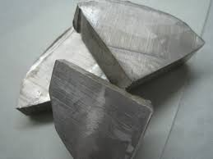
Hazardous chemicals
Hazardous chemicals are substances that can cause adverse health effects such as poisoning, breathing problems, skin rashes, allergic reactions, allergic sensitization, cancer, and other health problems from exposure.
Na metal
Notes:
Na

Slide 9
Laboratory Safety Rules
Always wear a lab coat inside the laboratory
Wear lab safety glasses or gloves whenever your lab instructors advise you to Always wear gloves in the laboratory

Slide 10
Tie loose hair and tuck scarf ends under your lab coat.

Slide 11
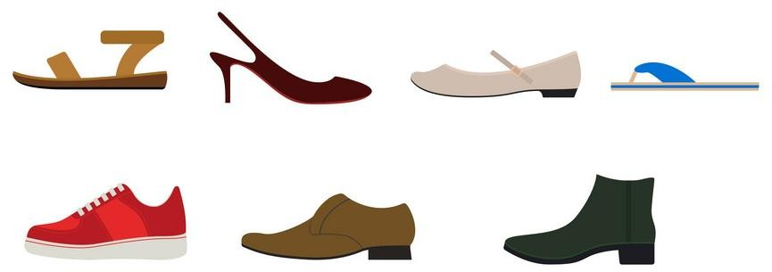
The lab does not permit open-toe shoes, high heels, and sandals.
Wear shoes that are comfortable and can protect your feet from chemical spills.

Slide 12
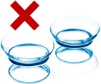
Do not wear contact lenses (medical or otherwise) in the lab.
Drinking and eating are prohibited in the lab.

Slide 13
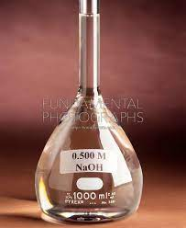
Never taste, smell, or inhale chemicals in the lab. If smelling the chemical is required, gently waft the air above the container toward your nose.
All containers should be labeled properly.
Never use chemicals with missing or damaged labels.

Slide 14
Before you come to the lab
1. Read about your experiment, so that you have a good understanding of what it entails, steps, and the equipment involved.
2. Take note of safety precautions associated with the chemicals and equipment used in the experiment

