Slide 1
Introduction to Social Change
Salahaddin University- Erbil
College of Arts
Department of Sociology
Lecturer:
Dr. Hewa Ali Omar
2023-2024

Slide 2
What is the position of Change in sociology?
The study of social change is at the very core of sociology.
What is the relationship between Change and Social Reality?
Change is such an evident feature of Social Reality that any social-scientific theory, whatever its conceptual starting point, must sooner or later address it' (Haferkamp and Smelser 1992a: 1).

Slide 3
Why was Sociology born?
Sociology was born in the nineteenth century as an attempt to comprehend the fundamental transition from traditional to modern society, the rise of the urban, industrial, capitalist order.
Does the need to understand change matter to anyone?
The need to understand ongoing social change is again acutely perceived by ordinary people and sociologists alike: It was already clear in the 1970s that the most striking feature of contemporary life is the revolutionary pace of social change.

Slide 4
What do we mean when we say that nothing can escape from change?
Never before have things changed so fast for so much of mankind: Everything is affected: art, science, religion, morality, education, politics, the economy, family life, even the inner aspects of our lives - nothing has escaped (Lenski and Lenski 1974. 3).

Slide 5
Historical View to Social Change

Slide 6
We use seconds, minutes, and hours to analyze types of social change and their relationship to each other. As for the forces that carry these pointers, we take them as the driving force of change:

Slide 7
What do we need to understand contemporary phenomena?
There is sociological wisdom says: in order to understand any contemporary phenomenon, we must look back to its origins and the processes that brought it about.

Slide 8
Count some of the examples that analyze the history of society?
Spencer ( the law of universal evolution),
Durkheim (the division of labor),
Marx (his study of conflict),
Pareto (the elites) and
Weber (historical comparative).

Slide 9
What is Synchronic Method?
Synchronic is a method to study a certain social phenomena invariably appear together (Searching for laws of coexistence). Synchronic(or cross-sectional) study was defined as looking at society in a timeless, static perspective,
What is Diachronic Method?
Diachronic: is a method to study a certain social phenomena invariably precede or follow others (Searching for laws of succession). Diachronic (or sequential) study', as recognizing the flow of time and focusing on ongoing social changes.

Slide 10
Briefly, then, we can say that the early sociologists brought to social reality not the eye of a photographer, who grasps only a fixed moment outside time, but rather that of a film-maker who records on his film the movement of beings and the course of events (Rocher, 1972).
Social Reality
As Film-maker
As Photographer
In Past: Noumenon (Process, Structure & Mechanism)
In Time (Now):
Phenomenon (Appearance)
Sociological Imagination
Anthropology & Ethnography,

Slide 11
Definitions of Social Change

Slide 12
What is Social Change?
W. Moore: “Social change is the significant alteration of social structures including consequences and manifestations of such structures embodied in norms, values and cultural products and symbols” (Moore, 1968:366).

Slide 13
What is Social Structure?
Social Structure, is the way in which society is organized into predictable relationships (Schaefer & Kassop, 2000: 62).
Social Structures: Repeated and more or less predictable patterns of behavior.

Slide 14
What is Social Norms?
Patterns produced by Norms.
Norms are created by Values.
Norms: Rules for how things ought to be done, Informal and Invisible.
Norms enforced by sanctions and rewards for abiding.

Slide 15
Types of Social Structure
Status
Groups
Organizations
Institutions
Societies

Slide 16
Types of Social Patterns
Cooperation
Competition
Exchange
Conflict

Slide 17
Social Pattern according to Max Weber
A social pattern consists of forms of social actions that are repeated and have some probability of recurring again.
These forms are in their turn caused by social actions as well.
Social actions are behavior in which a meaning is invested; they are also oriented to other actors or to an order.

Slide 18
Social Change according to System Model
Social change, accordingly, is conceived as the change occurring within, or embracing the social system. More precisely, it is the difference between various states of the same system succeeding each other in time.

Slide 19
Classic Sociologists

Slide 20
August Comte(1798-1857)
Comte divided his system of theory into two separate parts: 'social statics' and 'social dynamics. Underlying the distinction was an implicit metaphor made fully explicit some time later by Herbert encer (1820-1903), the analogy between a society and a biological organism (Sztompka, 1993).
Static sociology would study what he called order, or the means by which the members of a collectivity arrive at a consensus through which the society can exist, maintain itself, and function.

Slide 21
A. Comte (cont..)
Dynamic sociology would study progress, or the transformation of societies throughout the history of mankind. It is here that we can locate Comte's law of the three states, and the historical analysis that he derived from it
To Comte, dynamic sociology was much more important than static sociology; in fact, he gave it a central place in his work.

Slide 22
The Relationship between Order and Change

Slide 23
Order
Change

Slide 24
The Relations between the two: 1.Order in Change; Order of Change 2.Change in Order; Change of Order

Slide 25
Any theory of change must contain three main elements:
1. Structural determinants of social change, such as population changes, the dislocation occasioned by war, or strains and contradictions.
2. Processes and mechanisms of social change, including precipitating mechanisms, social movements, political conflict and accommodation, and entrepreneurial activity.
3. Directions of social change, including structural changes, effects, and consequences.

Slide 26
Structural Determinants
Processes and Mechanisms
Directions & Consequences

Slide 27
Modernity: What Is…?
Modernity
Changes brought about by the Industrial Revolution
Modernization
Process of social change begun by industrialization

Slide 28
Four major dimensions of modernization
Decline of small, traditional towns
Expansion of personal choice
Increasing social diversity
Orientation toward the future and a growing awareness of time.

Slide 29
Q/ What is the main idea of modernization theory?
Modernization theory rested on the idea that societies were more or less independent entities that could be expected to go through the same stages of development. The big changes happened to European societies first and their recent histories could be taken as a template for the near future of other “less developed” societies.

Slide 30
By Whom was written the most famous version of the modernization theory?
The most famous version of the modernization theory was written by an economist W.W. Rostow (Stages of Economic Development) likened modernization to the gradual acceleration of an airplane on a runway, from a standing start to a successful “take–off” into sustained industrial growth.

Slide 32
Four major characteristics of
Social Change
Social change happens all the time.
Social change is sometimes intentional but often unplanned.
Social change is controversial.
Some changes matter more than others.

Slide 33
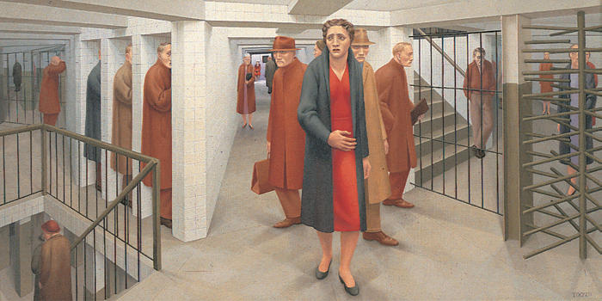
F. Tönnies: The Loss of Community
With modernization comes the loss of Gemeinschaft (human community).
Modernity brings Gesellschaft (impersonal relationships).
Evaluation
Gemeinschaft exists in modern society.
No differentiation between cause and effect.
Traditional societies are romanticized.
George Tooker’s 1950 painting The Subway depicts a common problem of modern life: Weakening social ties and eroding traditions create a generic humanity in which everyone is alike yet each person is an anxious stranger in the midst of others.

Slide 34
E. Durkheim: The Division of Labour
Specialized economic activity moves from Mechanical solidarity to Organic solidarity.
Mechanical solidarity refers to a time when society was held together by social bonds (ties) anchored in common moral sentiments.
Organic solidarity refers to modernity during which time social bonding is accomplished by way of mutual dependence.
Evaluation: Society’s norms and values are strong enough to avoid anomie for most people, and people value the personal freedom of modern society despite the risks.

Slide 35
M. Weber: Rationalization
Weber define modernization as a means replacing a traditional worldview with a rational way of thinking.
Modern people value efficiency, have little reverence for the past and adopt whatever social patterns allow them to achieve their goals.
Modern society is “disenchanted”: science replaces gods.
Evaluation: Rationalization could erode the human spirit, but the alienation he attributes to bureaucracy could stem from social inequality.

Slide 36
K. Marx: Capitalism
Capitalism is an economic and political system in which a country’s trade and industry are controlled by the private owners for profit, rather than by the state.
Modernity weakened small-scale communities
Social conflict in capitalism sows seeds of egalitarian socialist revolution
Evaluation: Complex theory underestimates dominance of bureaucracy, and stifling socialist bureaucracies were as bad or worse than dehumanizing capitalism.

Slide 37
Components of Social Change
Steven Vago says that the Social change is conceptualized as the Process of Planned or Unplanned, Qualitative or Quantitative Alterations in Social Phenomena that can be analyzed in terms of Five Interrelated Components: Identity, Level of Change, Duration, Magnitude, and Rate of Change.
Identity of change (Types of Change) refers to a specific social phenomenon undergoing transformation such as a behavior, attitude, authority structure, productivity rate etc.

Slide 38
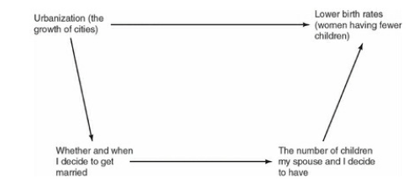
Level of change delineates the location in a social system where a particular change takes place. Several levels may be designated, such as individual, group, organization, institution, and society:

Slide 39
Duration it may refer to the life span of long-term or short-term (transitory) change phenomena.
Magnitude may be based on the three-part scheme of incremental or marginal, comprehensive, and revolutionary changes.
Rate of change may be based on any arbitrary scale, such as fast or slow, continuous or spasmodic, orderly or erratic

Slide 40
Sources of Social Change
Demography
Technology
Economic change
Planned change
Organizations
Institutions

Slide 41
How the Demographic Transition cause the Social Change?
Industrialization upgraded both manufacturing and agricultural productivity so that the economic base could support much larger populations.
Medical advances in the control of epidemic disease and improvements in public services contributed to improved health and reduced mortality rates.
As populations became increasingly urbanized, family changes occurred: Children- their education- became more of an economic burden than an asset. Industrialization was coupled with opportunities for women to work outside the family and the establishment of national social security programs apart from kinship.

Slide 42
Continue..
Research shows that while industrialization is inversely related to fertility, another important consequence was the level of economic equality:
“In the European nations the demographic and economic transitions led to a general improvement in living standards for all persons and a gradual reduction in income inequalities”.
However it came about, birth rates in all industrialized countries began to decline as economic development proceeded.

Slide 45
The system model: engendering the concept of social change
What is System?
The idea of a system denotes a complex whole, consisting of multiple elements bound together by various interrelations and separated from the environment by a boundary.
Examples: Organisms are clearly cases of systems, but so are molecules, buildings, planets, galaxies.

Slide 46
N | Components of any System | Types of Change | Examples
1 | The ultimate elements | Change in elements | number and variety of human individuals and their actions
2 | Interrelations among elements | Change in relations | social bonds, loyalties, dependencies, linkages between individuals
3 | The functions of elements | Change in functions | the occupational roles played by the individuals,
4 | The boundary | Change in boundary | criteria of inclusion, conditions for acceptance of individuals in the group,
5 | The subsystems | Change in subsystems | the number and variety of distinguishable specialized, sections
6 | The environment | Change in environment | natural conditions, geo-political location

Slide 47
What is Functionalism?
Functionalism or Structural Functionalism assumes that society is a system of interrelated parts that function in ways that promote the survival of the whole system.

Slide 48
What are the Four basic functions of society
1. Adaptation (the generation of resources from the environment).
2. Goal attainment (choices about the consumption of resources).
3. Integration (regulation of relationships between the parts of the system).
4. Latency or “pattern maintenance” (providing cultural legitimation for the manner in which other functions are accomplished).

Slide 49
How Functionalism thinking about change?
Functionalist thinking about change begins by asserting that in the actual world, integration and “balance” in society are always incomplete.

Slide 50
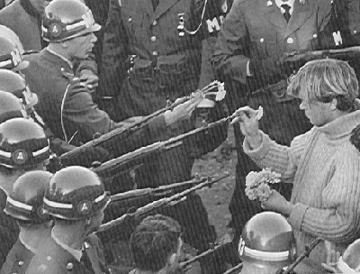
What is Social Movement?
social movement Continuous, large-scale, organized collective action motivated by the desire to enact, stop, or reverse change in some area of society
Types of movements
Reform Movement
Countermovement
Revolutionary Movement
Notes:
A reform movement attempts to change limited aspects of a society but does not seek to alter or replace major social institutions.
Countermovements are designed to prevent or reverse the changes sought or accomplished by an earlier movement. A countermovement is most likely to emerge when the reform movement against which it is reacting becomes large and effective in pursuing its goals and therefore comes to be seen as a threat to personal and social interests (Chafetz & Dworkin, 1987; Mottl, 1980),
revolutionary movements attempt to overthrow the entire system itself, whether it is the government or the existing social structure, in order to replace it with another (Skocpol, 1979). American Revolution of 1776, the French Revolution of 1789, the Russian Revolution of 1917, the Iranian Revolution of 1979, and the Afghan Revolution of 1996 are examples of movements that toppled existing governments and created a new social order.

Slide 51
Global Theories of Social Change
Globalization involves increased interconnectedness that can erase or magnify cultural differences.
World Systems Theory - nations are members of a worldwide system of unequal political and economic relationships.
Dependency theory - industrialized nations tend to imprison developing nations through trade and debt dependency.

Slide 52
Why real societies are out of sync to some degree?
for a variety of reasons. They develop inconsistencies, contradictions, and institutional practices that do not mesh in an integrated way

Slide 53
Why there is a constant struggle to maintain order and integration in society?
There is a constant struggle to maintain order and integration in light of these strains (inconsistencies and lack of integration).

Slide 54
What is the Functionalist understanding to social change?
Functionalist theory understands social change as the maintenance of a moving, or dynamic, rather than a static equilibrium between the components of the social system.

Slide 55
Where are the sources of strains that causes change in society?
Since social systems are all open to their environments to varying degrees, strains can result from exogenous discrepant cultural items that are imported from surrounding natural and social environments.

Slide 56
Conflict Theory of Change
Functionalist theory focused on broad developmental change, dealing primarily with the growth and differentiation of social systems. Conflict theorists focus on the accumulation of contradictions and the transformation of systems, often with concrete historical referents.

Slide 57
Continue..
Unlike Marx, Dahrendorf (1959) argues that it is not control of the means of production, per se, but social control in general that is the broadest basis of conflict in social systems.
Some clusters of roles have power to extract conformity from others. Further, power relationships in established systems tend to be institutionalized as authority, where power to control becomes invested with normative rights to dominate others

Slide 58
Continue..
At any rate, Dahrendorf is certainly right in assuming that in any established social system some have authority to give orders and others are obliged to obey (thus, parents have authority over children, teachers over students, correctional officers over prison inmates, and so forth). Those in charge are assumed to have an inherent interest in maintaining control, while subordinates have a similar interest in gaining concessions and control.

Slide 59
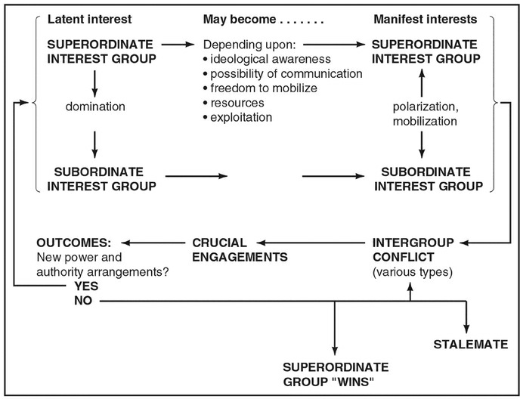
Causal Conflict Theory of Change

Slide 60
Structural-functional theory: Modernity as mass society
Mass-society theory
Scale of modern life has greatly increased.
Geographic mobility, mass communication, and exposure to diverse ways of life all weaken traditional values.
Population becomes a generic mass.

Slide 61
Structural-functional theory: Modernity as mass society
The ever-expanding state
Power resides in large bureaucracies; local communities have reduced control.
Regulations may protect and advance social equality, but they also undermine autonomy of families and local communities.

Slide 62
Structural-functional theory: Modernity as mass society
Critical evaluation
Positive aspects of growing modern life is matched with loss of some cultural heritage.
Modern societies may create reduced family values and patterns and increased sense of individual feelings of isolation, powerless, and materialism.
Theory romanticizes past.

Slide 63
Social-Conflict Theory: Modernity as Class society
Persistent inequality
Contends elite class still exists as people are still born to wealth and power
Suggests state can only accomplish minor forms become of capitalist control of economy
Posits gains of working people and minorities are result of political struggle and not government goodwill

