Slide 1
Nuclear Models
The short -range force that binds nucleons so securely into nuclei is by far the strongest type of force known. Unfortunately the nuclear force is not as well understood as the electromagnetic force ,and the theory of nuclear structure is less complete than the theory of atomic structure . However , even without a full understanding of the nuclear force ,much progress has been made in deriving nuclear models able to account for prominent aspects of nuclear properties and behavior .

Slide 2
Nuclear Models
To explain the various nuclear phenomenon such as stability, spin, magnetic moment, etc., various nuclear models have been proposed. The nuclear models are ;
Liquid Drop Model
Shell Model
Collective Model
Optical Model
Fermi Model.

Slide 3
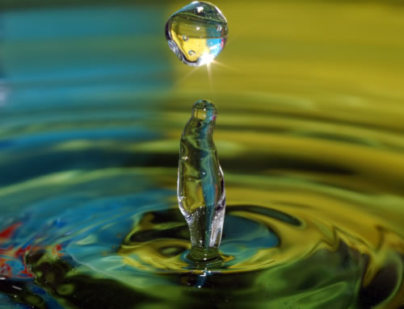
1- Liquid Drop Model
Liquid Drop Model of Nucleus ( Binding Energy Formula)
This model was proposed by Bohr. According to this model, the nucleus is similar to a small electrically charged liquid drop, i.e., the nucleus takes a spherical shape for its stability. The nucleons move within this spherical enclosure like molecules in a liquid drop. The motion of nucleons within nucleus is a measure of its temperature. The nucleons always remain a constant distant apart and share among them the total binding energy of the nucleus.

Slide 4
1- Liquid Drop Model
The essential assumptions of the liquid model are
The nucleus consist of incompressible matter so that R $\sim A^{1/3}$
The nuclear force is identical for every nucleon and in particular does not depend on whether it is a neutron or proton .
The nuclear force saturated .

Slide 5
Semi empirical Mass Formula
A formula which would allow the calculation of nuclear mass or binding energies accurately .It is related to the liquid drop model of the nucleus .
As before ,the binding energy of nucleus with A nucleons is ;
${ B.E}_{tot}\left(A,Z\right)$ $=\left\{ ZM_{H}+NM_{n}−M\left( A,Z\right)\right\}c^{2}$ ( 3-1 )
or $M(A,Z)=ZM_{H}+NM_{n}−\frac{{ B.E}_{tot}\left(A,Z\right)}{c^{2}}$ ( 3-2)
The mass $M(A,Z)$ can be considered accurately if the total binding energy ${ B.E}_{tot}\left(A,Z\right)$ were considered accurately . The different factors which affect the nuclear binding energy ,
${B.E}_{tot}\left(A,Z\right)={B.E}_{1}+{B.E}_{\begin{aligned}2 \\ \end{aligned}}+ {B.E}_{3 }+{B.E}_{4 }+{B.E}_{5}+$……. ( 3-3 )

Slide 6
The Semi-empirical Mass Formula
Total Binding Energy of a nucleus:
± δ + η
η= shell term, positive if (N) or (Z) approaches a magic number.
B_{tot} (A,Z) = a_{v} A – a_{s}A^{2/3} – a_{c}
Pairing
Term
Closed shell
Term
Volume
Term
Surface
Term
Coulomb
Term
Asymmetry
Term

Slide 7
1) The first term ${B.E}_{1}$ (Volume energy term)${B.E}_{v}$
The mass dependence of this term follows directly from the saturation of the nuclear force . A nucleon in the nuclear interior interacts , on average ,with affixed number of neighboring nucleon within short range of the nuclear force, the binding energy per nucleon , therefor, will be constant and the total contribution to the nuclear binding energy will be proportional to mass number A and proportional to the nuclear volume .
Since $\frac{{B.E}_{tot}}{A} ≈$ Constant
${B.E}_{tot}≈constant A$
${B.E}_{tot}{ ∝}_{ }A$
Since the volume of the nucleus $V=\frac{4}{3} π R_{o}^{3}{\left( A^{\frac{1}{ 3}}\right) }^{3}$ = $\frac{4}{3} π {R_{o}}^{3}A$ is proportional to A , this term is regard as volume energy .
${ B.E}_{v }= a_{v}A$ where $a_{v}$ is the proportional constant . (3-4)

Slide 8
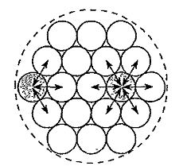
3-1-b ) Surface Energy Term ( ${B.E}_{s }$ )
In a finite nucleus , a nucleon near the surface interact with fewer nucleons and, therefore, is less tightly bound then if it is in the interior .Thus a term proportional to the surface area (or the square of the nuclear radius R) must be subtracted from the volume term to correct for this, since ;
surface area of the sphere is $S=4πR^{2}=4 π R_{0}^{2} A^{2/3}$
$S$ $∝$ $A^{2/3}$
${ ∴B.E}_{s }∝A^{2/3}$
${ B.E}_{s }=− a_{s}A^{2/3}$ (3-5)
Since there is a large fraction of surface nucleons in light nuclei than in medium and heavy nuclei the total binding energy is smaller for small A .
Fig (3-1); A nucleon at the surface of a nucleus interacts with fewer other nucleons
than one in the interior of the nucleus and hence its binding energy is less.

Slide 9
3-1-c ) Coulomb Energy Term ( ${B.E}_{c}$)
The coulomb energy between the protons tends to lower the binding energy and its effect appears as a term with a minus sign .The coulomb repulsion becomes important for heavier nuclei , because of saturation of attractive nuclear force .
The coulomb energy ${B.E}_{c}$ is directly proportional to the number of proton pairs in the nucleus ;
${B.E}_{c}$ $∝ \frac{Z( Z−1)}{2}$
${B.E}_{c} ∝\frac{1}{R}$ and ∵ $R=R_{0 }A^{1/3}$
∴ ${B.E}_{c} ∝ \frac{Z(Z−1)}{ 2 R_{0 }A^{1/3}}$
${B.E}_{c}=−a_{c} \frac{Z(Z−1)}{ A^{1/3}}$ (3-6)

Slide 10
3-1- d ) Asymmetry Parameter Term (${B.E}_{as}$ )
In the absence of the coulomb force ,the most stable nuclei would have equal number of neutrons N and Z protons ;In the absence of the coulomb effect , a departure from the condition N=Z or Z = $\frac{A}{2}$ would tend to lead to instability and smaller value of the binding energy , A term proportional to $\left(N−Z\right)$² and inversely with A .
The asymmetry energy is the difference in a nuclear energy of a nucleus with neutron and proton number N and Z and that of the isobar with neutron and proton numbers both equal to Z = $\frac{A}{2}$
${B.E}_{as}∝{(N−Z)}^{2}$
${B.E}_{as}∝ \frac{1}{A}$
${B.E}_{as}= − a_{as} \frac{{(N−Z)}^{2}}{A}$ (3-7)
where a_{a} is asymmetry parameter .

Slide 11
3-1-e) Pairing energy $E_{δ}$
Nuclei with even-even number of protons and neutrons are the most abundant and presumably the most stable. Nuclei with odd numbers of both proton and neutron are the least stable , while nuclei for which either the proton or neutron is even are intermediate in stability .The value of odd-even effect can be represent by term called Paring energy E_{δ} depend on N or Z as follows ;
A Z N E_{δ}
even even even δ/2
odd even odd 0
odd 0dd even 0
even odd odd - δ/2
The paring term δ should be roughly equal to ½ of pairing energy
Finally the formula of binding energy obtained by combining all of the terms just discussed into the equation . The semi –empirical mass formula is then ;
${B.E}_{tot}\left(A,Z\right)= a_{v }A− a_{s}{A }^{\frac{2}{3}} − a_{c} \frac{Z\left(Z−1\right)}{ {A }^{\frac{1}{3}}}$ $− a_{a}\frac{{\left(N−Z\right)}^{2}}{A} ±$E_{δ} (3-8 )
Substituted equation(3-8)into equation (3-2)to get equation of mass formula;
M(A,Z)= Z M_{H} + N M_{n} - $\left\{\frac{a_{v }A }{c^{2}}−\frac{a_{s}{A }^{\frac{2}{3}}}{c^{2}}−a_{c}\frac{Z\left(Z−1\right)}{c^{2} {A }^{\frac{1}{3}}}−a_{a}\frac{{\left(N−Z\right)}^{2}}{c^{2}A}±\frac{E_{δ} }{c^{2}}\right\}$ (3-9)
The values of constants ;${ a}_{v }=14.0 MeV$ , $a_{s}=13.1MeV$ ,${ { a}_{c}=0.72 MeV a}_{a}=19.4MeV$

Slide 12
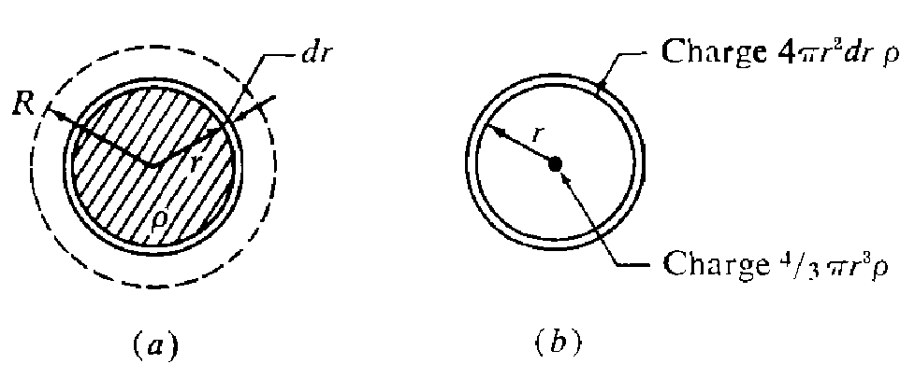
3- 1-f )Coulomb Energy of Spherical Nucleus
Consider the nucleus as a uniformly charged sphere of charge Ze and the charge density $ρ$ .
$ρ= \frac{ Ze }{\frac{4}{3} π R^{3}}$ (3-10)
Assume a charged sphere of radius(r) has been built up as shown in Fig.( 3-2a ). The additional work required to add a layer of thickness dr to the sphere can be calculated by assuming the charge $\frac{4}{3} π r^{3}ρ$ of the original sphere is concentrated at the center of the shell. The electrical potential energy of the nucleus is therefore
$V_{coulomb }=\int_{0}^{R}{\frac{4}{3} π r^{3}ρ}.4π r^{2}drρ.\frac{1}{r}$
$V_{coulomb = } \frac{16}{15} π ρ^{2 } R^{5}$ (3-11)
Substuting for $ρ$ from eq.(3-10 )
$V_{coulomb }= \frac{3 Z^{2}e^{2}}{5 R}$ (3- 12)
Fig (3-2); Coulomb energy of a uniform charged sphere (a) Actual charge distribution; a layer of thickness dr is added to sphere of radius r. (b) Equivalent charge distribution for potential calculation.

Slide 13
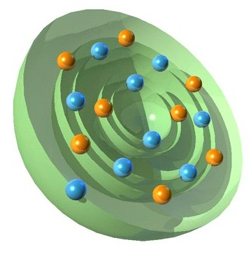
Shell Model
The shell model of the nucleus is an attempt to a count for the existence of magic numbers and certain other nuclear properties in term of nucleon behavior in a common force field produced by all the other nucleons .
The Magic numbers are ; 2 , 8 , 20 , 28 , 50 , 82 and 126 .
The shell model accounts also for several nuclear phenomena in addition to magic numbers, for example, it can also predict the total angular momentum of nuclei (nuclear spin).

Slide 14
Evidence for the shell structure of nuclei
Elements with magic numbers ,Z or N ,have many more isotopes or isotones respectively, than their neighbors .For example ¹¹²Sn (Z=50) has 10 stable isotopes ,while In(Z=49) and Sb (Z=51) each have only two .
If the shell of the nuclei close at the magic numbers , the nuclides corresponding to these magic numbers should be very stable .
The cross section for neutron capture versus neutron number for which magic number should have very low cross section because closed shells mean there is no more vacancy .
3- 2-c) Theory
The radial part of Schrodinger wave equation to be solved
Where U(r) = rR is the radial wave function, E is energy egen values V(r) is the potential energy ( square well potential)

Slide 15
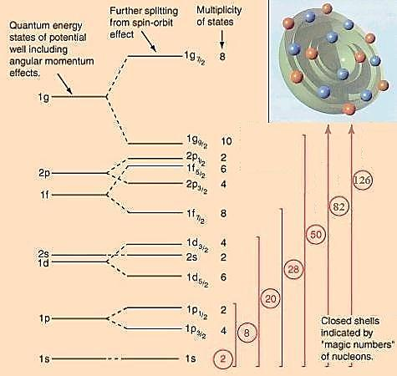
Shell Model
Taking into consideration the interaction between the orbital and spin angular momenta of each nucleon, the resulting energy levels obtained by solving Schrödinger wave equation are ;
1s _{1/2} , 1p _{3/2} , 1p _{1/2} ,
1d_{5/2 ,} 2s_{1/2 ,} 1d_{3/2} ,
1f _{7/2} , 2p_{3/2} , 1f _{5/2} ,
2p _{1/2}, 1g _{9/2} , 1g _{7/2} ………………………….etc .

Slide 16
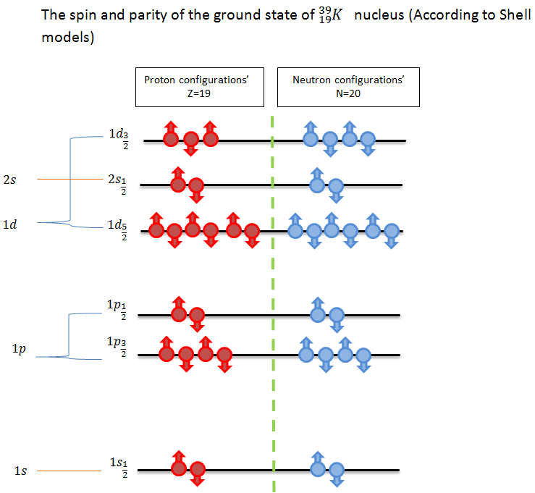
Shell Model
Note 1) In any filled level there are 2J+1 nucleons .
Note2) The parity of a system ( 𝝅) is given by $\left(π\right)= {(−1)}^{l}$ where
$l$ is orbital quantum number of the last odd nucleon $l$.
Note3);
The same quantum numbers
n,$l$ , $j$ ,$m_{j}$ ,resulting in both
an atomic and nuclear shell model
.Also we use the atomic notation ,
$l$ = 0 1 2 3 4
S p d f g
standing for subshell configuration .

