Slide 1
Electronic Contract
Pr.Dr.Hozan Mohsin
College of law
Salaheddin university
Postgraduate Master

Slide 2
What Is an Electronic Contract?
Electronic Contracts (E-Contracts): The What, Why and How
If you have visited a particular website for the first time today, or updated the software on your smartphone, you have seen (and agreed to!) an electronic contract. These types of agreements are everywhere in the modern world.
When a business uses electronic contracts (e-contracts) the right way, they can help improve customer experience, streamline transactions and increase efficiency. But it’s important to understand the different ways these contracts can be created and implemented, in order to minimize risk and maximize the benefits.
Read on for everything a business leader needs to know about e-contracts.
What is an e-contract?
An electronic contract (e-contract) is simply a contract created using electronic means. Like physical contracts, e-contracts have three components:

Slide 3
Offer. The set of terms and conditions presented by the party that drafted the contract.
Acceptance. Approval by all parties as indicated by electronically signing the contract.
Consideration. Following through on all terms and agreements in the contract.
These three components are the basis for all contracts, and it is likely that you sign some form of electronic contact every day. Everything from clicking “I agree” on an app’s terms of service to using e-signature to sign a purchase agreement when buying a house is considered signing an electronic contract. And although it may not feel as formal as signing a paper contract, e-contracts are just as legally binding and enforceable when properly administered.

Slide 4
Advantages of e-contracts
Upgrading from pen and paper to e-contracts comes with a host of benefits. But when it comes to how it benefits your business, there are three primary considerations that all add up to increased cost savings, quicker payments, and overall better business deals.
Faster time to sign. E-contracts are as quick and easy to send as any other digital file. By taking advantage of workflow automation, a contract can be instantly sent to the next signer as soon as it is signed. No more sending paper contracts from room to room—or city to city.
Version control. E-contracts can be updated for all parties simultaneously in a central location, without having different drafts of the contract in multiple locations.
Better security. Paper contracts are vulnerable to countless threats, like theft, sabotage, forgery and water damage. Best-in-class electronic contract providers offer a suite of digital and physical security measures to ensure the contracts stay safe from unauthorized access and tampering.

Slide 5
How e-contracts are used
E-contracts can be used in just about any industry for nearly every type of contract. Here are a few of the most common types of contracts used across business functions and industries:
Human resources Employee offer letters New hire paperwork Employee policy updates | Sales Sales quotes Service agreements Statements of work
Legal Nondisclosure agreements Master services agreements Merger and acquisition agreements | Financial services Account opening Loan applications Proof of identity
Healthcare: Patient intake forms Care Transfer Agreements Vendor contracts | Real estate: Purchase agreements Deeds of trust Assignment contracts

Slide 6
Types of electronic signatures for contracts
The most important part of an electronic contract is the ability to sign it electronically. There are four main types of electronic signature:
Browsewrap
Browsewrap is an agreement between a website and a user that is made by the user continuing to use the website. The “wrap” portion for this and other contracts comes from the term “shrinkwrap agreement,” where a software’s user agreement would be agreed to when the shrinkwrap was removed from the box.
On a website using a browsewrap agreement, the terms and conditions may be linked, but there is no requirement on the part of the user to click a button or check a box before they can proceed. The passive nature of this style of agreement means that browsewrap contracts can be very difficult to enforce.

Slide 7
Clickwrap
Clickwrap is an agreement that requires the user to take the action of clicking a button or checking a box that indicates their agreement. It is most commonly used in situations where there is a high volume of standardized agreements, such as terms of service or privacy policies.
There are also two common variations of the clickwrap contract. The first is scrollwrap contracts, which function in the same way as a clickwrap contract with the addition of requiring the user to scroll to the bottom of the agreement before being allowed to agree. The other variation is the sign-in-wrap contract, which requires the user to sign
اتفاقية قانونية تُستخدم للبرامج أو الخدمات عبر الإنترنت، والتي يشير المستخدم إلى قبولها عن طريق تحديد رمز أو رابط معين قبل منحه حق الوصول.
Clickwrap عبارة عن اتفاقية تتطلب من المستخدم اتخاذ الإجراء بالنقر فوق زر أو تحديد المربع الذي يشير إلى موافقته. يتم استخدامه بشكل شائع في المواقف التي يوجد فيها حجم كبير من الاتفاقيات الموحدة، مثل شروط الخدمة أو سياسات الخصوصية.

Slide 8
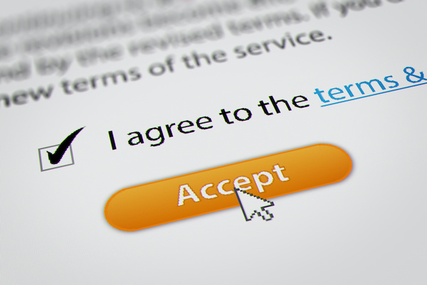
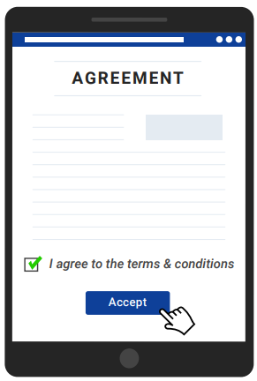

Slide 9
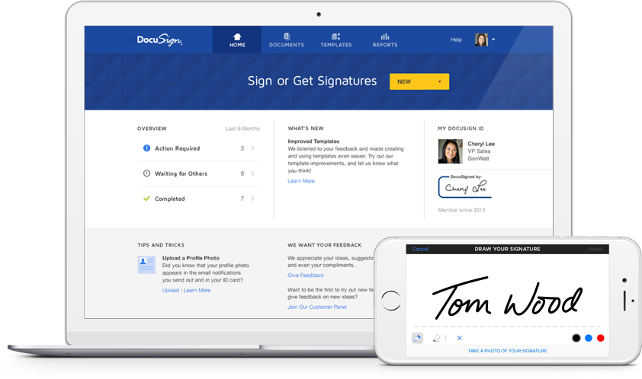
Electronic signatures
DocuSign eSignature is a more robust platform for e-contracts that allows you to securely send and sign contracts while maintaining a complete audit trail.. This technology supports additional levels of authentication, such as SMS or email. It also provides options for collecting additional information from the signer, all within one platform.

Slide 10
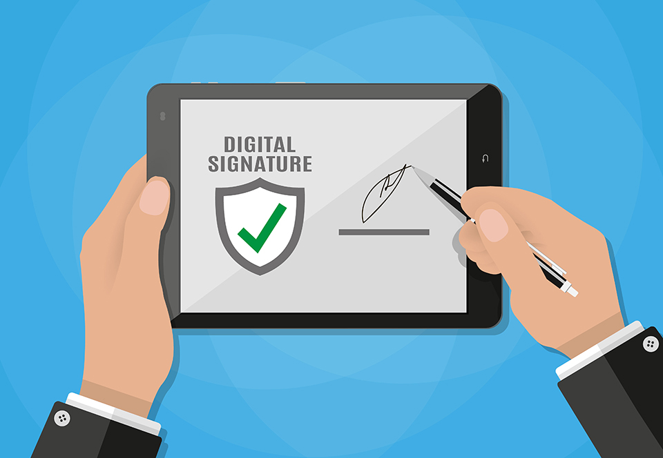
Digital signature
Digital signatures are a type of electronic signature used for e-contracts that require a higher degree of signer authentication. They use a globally accepted set of standards called Public Key Infrastructure (PKI) to create a tamper-proof “digital seal” that ties the signer to the document and provides a digital certificate to indicate that the signer has confirmed their identity. This level of security provides more through signer authentication but it can also take longer.

Slide 11
How to create and manage e-contracts
Contracts require more than signatures. They have to be generated, negotiated, signed, stored, and retrieved on demand. This collection of processes is known as contract lifecycle management (CLM). E-contracts allow organizations to take advantage of DocuSign CLM, eSignature, and hundreds of integrations to enable faster contract generation, streamlined negotiation and signing processes, and centralized storage and retrieval.
These process enhancements take companies from generation to payment faster than would ever be possible with an old pen-and-paper contract workflow. The result? A streamlined contracting process, improved efficiency, and boosted revenue.
Understanding what an electronic contract is is essential to your business’ success in an increasingly digital world. An electronic contract is an agreement that is drafted, negotiated, and executed completely online. Electronic contracts can eliminate many costs associated with traditional pen-and-paper contracts and have countless other advantages.
As electronic contracts become more popular, your business must understand how to make them enforceable and binding. Federal law like the ESIGN Act makes digital contracts just as binding as traditional contracts, but it requires proper tracking and record-keeping. With effective contract management, you can learn how to create and manage electronic contracts to streamline your processes and reduce costs.

Slide 13
Are electronic contracts legally binding?
Yes, electronic contracts are legally binding. Thanks to the Electronic Signatures in the Global and International Commerce Act (ESIGN Act) and the Uniform Electronic Transactions Act (UETA), they are just as enforceable as traditional pen-and-paper contracts. Both acts stipulate that e-Signatures are valid, just like their traditional paper counterparts.
The UETA specifically holds that clickwraps and other “standard webpage click-through process” agreements are valid. When clickwraps meet the requirements of the law and best practices, users have notice of the terms and conditions and give affirmative assent. When this is the case, courts will enforce electronic contracts—including clickwraps.
Other forms of electronic contracts, like browsewrap and sign-in wrap agreements, tend to have low enforceability. These agreements typically fail because the court finds that users were not aware of what they agreed to. These agreements typically don’t require the user’s affirmative assent to the terms, creating an ambiguous situation that courts do not like. Sign-in wraps are sometimes deemed unenforceable, as courts have held they use a “dual-purpose” button and don’t clearly demonstrate that the user agreed to be bound to the terms.

Slide 14
Low transaction cost
Electronic contracts offer a lower overall cost per transaction. This is especially true in high-volume agreements, like Terms and Conditions changes. A sophisticated clickwrap agreement, for example, can automatically require acceptance of the new terms from all relevant parties. It will then record important information without the need for expensive employee time. It also saves money on paper, ink, and other costs associated with traditional contracts.
Saves time
Traditional contracts require cumbersome redlining and going back and forth on emails. It may even require a physical meeting to sign the document or hash out the remaining details. Electronic contracts can be handled online without the need to meet in person.

Slide 15
How to create and manage electronic contracts
Contract management is the process of handling agreements with vendors, employees, partners, or customers.
Contracts are at the core of your company and require appropriate management. Out-of-date contract management methods can slow your company down and lead to costly errors. Effective contract management lets you control your agreements at every stage of the process:
Generate: Manage drafting contracts and easily handle requests. You can create easy-to-use workflows customized to your contract process.
Negotiate: Communicate easily with contracting parties within a single platform. The Ironclad Editor lets you work collaboratively in one system, rather than redlining through emails.
Approve: Run the contract by stakeholders and get approval within a single platform.
Accept: Decide how the contract will be signed, and all parties can sign digitally.
Fulfill: Once the contract is approved, you can meet important deadlines, account for renewals, and meet other obligations.
Analyze: Contract management lets you analyze your contract after the deal has concluded. Useful metadata can inform business and contracting decisions for the future.
Optimize: Analyzed data can be used to automate processes, improve business operations, and find growth opportunities.
Renew: You can create alerts to stay on top of renewal dates. Contract management software also gives you the data to know whether you want to renew based on your business performance.

Slide 16
Effectively manage your electronic contracts
Electronic contracts are more popular than ever before. The business world is increasingly digital, especially in the post-Covid era.
Electronic contracts offer many advantages, including the ability to easily modify, manage, and store them. You can create and manage electronic agreements that fit your company’s needs.

Slide 17
Does Iraq recognize electronic contracts and signatures thereon?
The Iraqi law recognizes the conclusion of contracts in electronic form with similar effect to paper [classic] form; the practice, though, faces difficulty in time/place evidencing of the conclusion of electronic contract. Article 88 of the Iraqi Civil Code states that “conclusion of the contract by phone or any other means of communication is a contract between absentees in the place and present in time” this is an implicit reference to electronic contracts and the mechanisms of concluding them. In 2012, Iraq passed the Law of Electronic Transactions and Electronic Signature Law, which has defined the electronic contract as “linking the offer issued by one of the contracting parties to the acceptance of the other in a way that proves its effect on the contract, which is done by electronic means.” The same Law in Article 4 defined electronic signature as “a personal mark that takes the form of letters, numbers, symbols, signs, sounds, or others, and has a unique character that indicates its relation to the signatory and is approved by the certification body.”
Now, in theory and from a legal provision perspective, Iraq fully recognizes the conclusion of electronic contracts and signing by electronic signatures; however, the foregoing text considers the existence of a certification body as a precondition for the validity of the electronic signature on contracts and other transactions.
However, since the formation of the said certification body has not yet been finalized and therefore the contract concluded and signed electronically remains valid between its parties but faces evidence challenge in the case disputed about before an Iraqi court, which mainly considers paper procedures with ink-signature or fingerprints. Until the formation of the certification body is fulfilled, subsequent to the availability of automation and adequate infrastructure, the electronic signature, whether by finger drawing or pre-designed, remains pending an established practice.

Slide 18
هل يعترف العراق بالعقود الإلكترونية والتوقيعات عليها؟
يعترف القانون العراقي بإبرام العقود بصيغة إلكترونية ذات تأثير مماثل للشكل الورقي [الكلاسيكي]. هذه الممارسة ، على الرغم من أنها تواجه صعوبة في الوقت / المكان في إثبات إبرام العقد الإلكتروني. تنص المادة 88 من القانون المدني العراقي على أن “إبرام العقد عن طريق الهاتف أو بأي وسيلة اتصال أخرى هو عقد بين الغائبين في المكان والحاضر في الوقت المناسب” وهذه إشارة ضمنية إلى العقود الإلكترونية وآليات إبرامها. في عام 2012 ، أصدر العراق قانون المعاملات الإلكترونية وقانون التوقيع الإلكتروني ، الذي عرّف العقد الإلكتروني بأنه “يربط العرض الصادر عن أحد الطرفين المتعاقدين بقبول الطرف الآخر بطريقة تثبت تأثيره على العقد ، الذي يتم بالوسائل الإلكترونية “. عرّف نفس القانون في المادة 4 التوقيع الإلكتروني بأنه “علامة شخصية تأخذ شكل حروف أو أرقام أو رموز أو إشارات أو أصوات أو غيرها ، ولها طابع فريد يشير إلى علاقتها بالموقع وتتم الموافقة عليها من قبل شهادة التصديق.”
الآن ، من الناحية النظرية ومن منظور النص القانوني ، يدرك العراق تمامًا إبرام العقود الإلكترونية والتوقيع بالتوقيعات الإلكترونية ؛ ومع ذلك ، يعتبر النص السابق وجود شهادة التصديق كشرط مسبق لصحة التوقيع الإلكتروني على العقود والمعاملات الأخرى.
ومع ذلك ، نظرًا لأن تشكيل هيئة التصديق المذكورة لم يتم الانتهاء منه بعد ، وبالتالي فإن العقد المبرم والموقع إلكترونيًا يظل ساري المفعول بين أطرافه ولكنه يواجه تحديًا في الأدلة في القضية المتنازع عليها أمام محكمة عراقية ، والتي تنظر بشكل أساسي في الإجراءات الورقية بالحبر- التوقيع أو البصمات. حتى يتم الانتهاء من تشكيل هيئة إصدار الشهادات ، بعد توفر الأتمتة والبنية التحتية المناسبة ، يظل التوقيع الإلكتروني ، سواء عن طريق رسم الإصبع أو التصميم المسبق ، في انتظار الممارسة المعمول بها

