Slide 1
Salahaddin University College of Agriculture Department Plant Protection
Insect Taxonomy – Practical
2nd Class 2017 - 2018

Slide 2
The principles of the classification of Insects Orders
The characters most useful for identifying insects to order are:-
1-wings, their development, texture, venation and number.
2-Mouth parts, if they are chewing, sucking, or other modified type.
3-The kind of life history and immature stages

Slide 3
The classification of the insects Orders
Kingdom: Animalia
Phylum: Arthropoda
Subphylum: Mandibulata or Uniramia
Class: Insecta (is divided into (2) subclasses)
Subclass: Apterygota (which is divided into (4) Orders)
Order: Thysanura (Bristetails)
Order: Protura (Telsontails)
Order: Diplura
Order: Collembola (Springtails)

Slide 4
1- Order: Thysanura (Silverfish)
The classification of order Thysanura
Kingdom Animalia Phylum Arthropoda Subphylum Hexapoda Class Insecta Order Thysanura (also known as Zygentoma)
Family: Lepismatidae
Genus: Lepisma
Species: saccharina

Slide 5
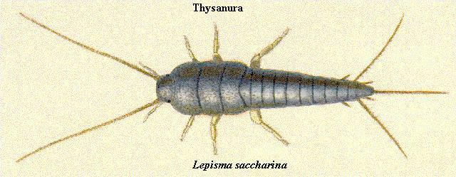
The main characteristics of order: Thysanura 1- Body elongated and oval shaped, soft, flatted from top to bottom. 2- They are silvery to brown color. 3- have (2) long antenna and (3) long tail.

Slide 6
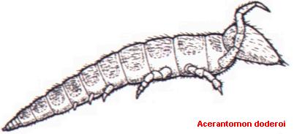
2- Order: Protura (Telsontails)
Scientific classification:-
Kingdom: Animalia
Phylum: Arthropoda
Class: Insecta
Order: Protura
Main characteristic :-
1- tiny( less than 2 mm body length)
2- pale, usually white or off-white, soft body.
3- wingless, no eyes, no antenna
4- enlarged forelegs.

Slide 7
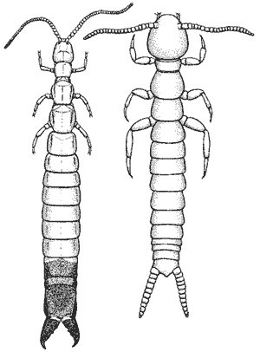
3- Order: Diplura
Scientific classification
Kingdom: Animalia
Phylum: Arthropoda
Class: Insecta
Order: Diplura
Main characteristic
1- small narrow, elongate body, colourless.
2- wingless, eyes absent.
3- long antenna, and with (2) cerci.

Slide 8
4- Order: Collembola (Springtails)
Scientific classification
Kingdom: Animalia
Phylum: Arthropoda
Class: Insecta
Subclass: Apterygota
Family: Hypogastruridae
Genus: Hypogastrura
Species: nivicola

Slide 9
Main characteristic
1- antenna (4-6) segment and abdomen (6) segment.
2- Collophore in 1st abdominal segment.
3- Tenaculum in 3rd abdominal segment.
4- Furcula (Springtail) in 4th abdominal segment.
5- Body frequently covered with scales.
. Thorax 1 2 3 4 5 6
Collophore Furcula (springtail)

Slide 10
The classification of the insect’s orders:
2- subclass: Pterygota is divided into two divisions:-
A- Division: Exopterygota- insects with simple metamorphosis
B- Division: Endopterygota- insects with complete metamorphosis
Note:- Each division contains many orders.

Slide 11
Division(A): Exopterygota Exopterygota includes these orders:
1- Order: Ephemeroptera
2- Order: Odonata
3- Order: Orthoptera
4- Order: Isoptera
5- Order: Dermaptera
6- Order: Mallophaga
7- Order: Anoplura
8- Order: Hemiptera
9- Order: Homoptera
10- Order: Thysanoptera
11- Order: Embioptera
12- Order: Pscoptera
13- Order: Zoraptera

Slide 12
Division (B): Endopterygota
1- Order: Coleoptera
2- Order: Lepidoptera
3- Order: Diptera
4- Order: Hymenoptera
5- Order: Neuroptera
6- Order: Siphonoptera
7- Order: Tricoptera
8- Order: Mecoptera
9- Order: Strepsiptera.

Slide 13
2- subclass: Pterygota 1- Division: Exopterygota 1- Order: Orthoptera
Classification of this order
Kingdom: Animalia
Phylum: Arthropoda
Class: Insecta
Order: Orthoptera
1- Suborder: Ensifera
2- Suborder: Caelifera

Slide 14
The characteristics of the order: Orthoptera
1- (2) pairs of wings or wingless.
2- The body elongated.
3- Many species have large long ovipositor as long as the body; the cerci are usually well developed
5- Mouth parts are of the chewing type.
6- incomplete metamorphosis.

Slide 15
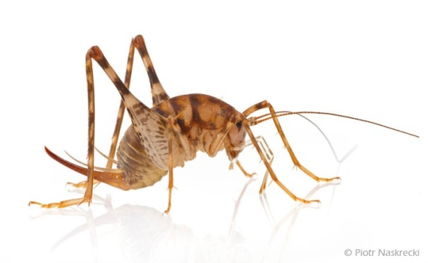
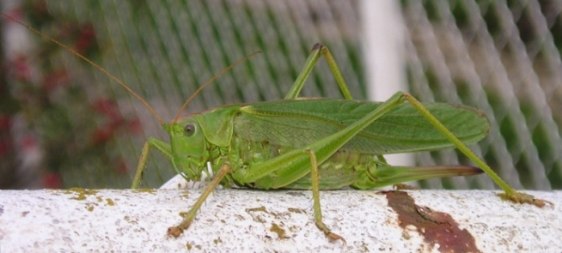
1-suborder:Ensifera (divided into (4) Family are)
1-Family:Rhaphidophoridae (Cave [camel] crickets)
2-Family:Tettigoniidae (Long-horned grasshopper)

Slide 16
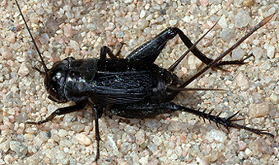
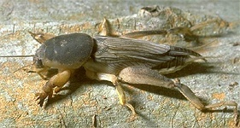
3-Family:Gryllidae (Crickets)
4-Family: Gryllotalpidae (Mole Crickets)

Slide 17
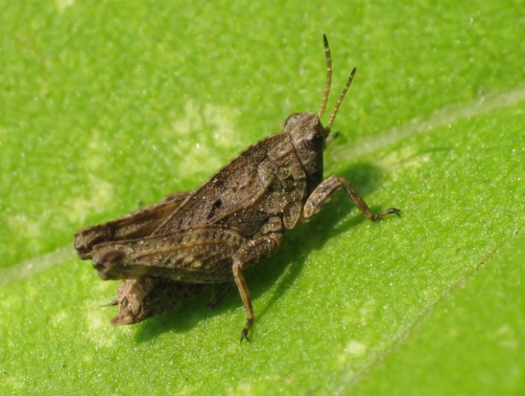
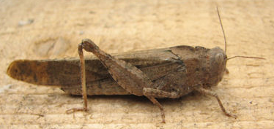
2-suborder:Caelifera (divided into (2) Family are)
1-Family:Tetrigidae
2-Family: Acrididae

Slide 18
2- Order: Mantodea
Classification of this order
Kingdom: Animalia
Phylum: Arthropoda
Class: Insecta
Order: Mantodea
Family: Mantidae
Genus: Mantis
Species: religosa

Slide 19
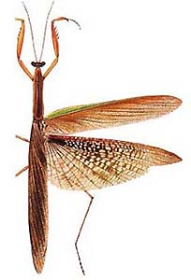
Main characteristic of this order:-
1- Raptorial front legs with one or two rows of spines.
2- Forewings leathery hind wings membranous.
3- antenna filiform.

Slide 20
3- Order: Blattodea
Main characteristic of this order:
1- oval and flattened body shape.
2- Thorax covered by a large plate (Pronotum).
3- 2 Pairs of membranous wing; long antenna; prominent cerci.

Slide 21
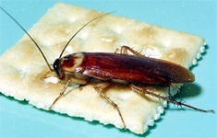
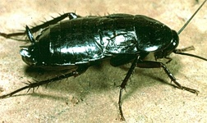
Family: Blattidae 1- Example: Periplanata Americana (American cockroach)
2- Blattela germanica
3- Blattela orientalis

Slide 22
4- Order: Phasmatodea (stick and leaf insects)
Main characteristic of this order:
1- Body shape variable most are elongate ; cylindrical or flattened and resemble sticks , leaves or grass.
2- 2 pairs of wing some species are wingless; wings when present consist of short, hardened forewings hind wing large membranous.
3- antenna filiform.

Slide 23
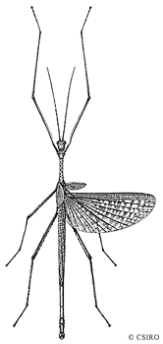
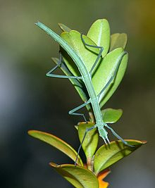
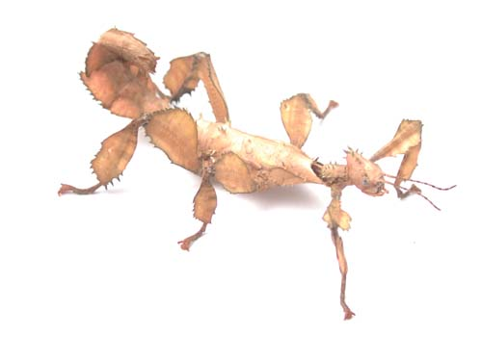
Family: Phasmatinae Ctenomorphodes tessulatus

Slide 24
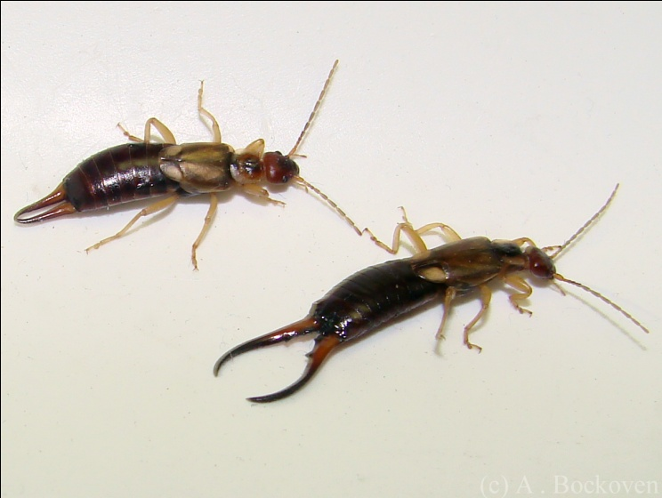
5- Order: Dermaptera (Earwigs)
Main characteristic of this order:
1- Flattened elongated body.
2- 2 pair of wings, forewings short hardened and hind wings membranous.
3- Heavily sclerotised pincer-like cerci; Females have straight cerci and Males have curved cerci.
There are (3) family are:
1- Family: Labiduridae (Reddish-brown earwigs with long cerci)
Labidura riparia

