Slide 1
Experiment No. (4)
Gravimetric Determination of Fluoride as Lead(II) Chlorofluoride [PbClF] by precipitation method

Slide 2
Fluorine (F) is the first element in the Halogen group (group 17) in the periodic table. It is the most electronegative element, and therefore is very reactive. It has 5 valence electrons in the 2p level and usually forms the anion F⁻ due to it is extremely electronegative, which means that it accepts electrons when reacting.
Fluoride (F⁻) is the reduced form of fluorine (F). Both organic and inorganic compounds containing the element fluorine are considered fluorides.

Slide 3
This method which is based upon the precipitation of lead chlorofluoride (PbClF), has been used extensively for the determination of macro and semimicro amounts of fluoride.
NaF + NaCl + Pb(NO₃)₂ PbClF + 2NaNO₃
The advantages of the method are:
1) The precipitate is granular
2) Readily settle down in bottom of the beaker
3) It is easily filtered

Slide 4
Notes:
1- Fluoride it was determined gravimetrically most commonly as lead chlorofluoride and calcium chlorofluoride. Lead chlorofluoride is soluble to the extent of 0.37 gm/L, while calcium chlorofluoride is soluble to the extent of about 0.016 gm/L and usually forms gelatinous precipitates which are difficult to the filter.

Slide 5
2- After adding 1gm of lead nitrate, the solution heated on water bath and stir until the lead nitrate dissolved, and then immediately crystallized sodium acetate added and stir.
3- The silver ion must be absent to prevent formation of AgCl ppt.

Slide 6
4- Aluminum must be entirely absent, because when aluminium and fluoride are together in aqueous solution, they readily form stable soluble complex ions such as [AlF(H₂O)₅]²⁺, AlF₃(H₂O)₃, and [AlF₆]³⁻ ,then causes remaining of fluoride in the solution and low result (-ve error).
Al³⁺ + F⁻ + H₂O [AlF(H₂O)₅]²⁺ + AlF₃(H₂O)₃ + [AlF₆]³⁻
5- The procedure is carried out at pH 3.6 – 5.6, so that substances which might be interfered, such as phosphates, sulphates and chromates.

Slide 7
Procedure

Slide 9
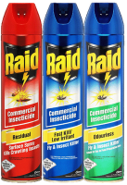
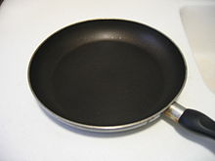
- Hydrofluoric acid (HF) has a variety of specialized applications, including its ability to dissolve glass
Sulfuryl fluoride is used as a pesticide on agricultural crops
polytetrafluoroethylene, Teflon, are used as chemically inert and biocompatible materials for a variety of applications, including as non-stick surfaces in cookware and bakeware

Slide 10
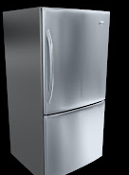
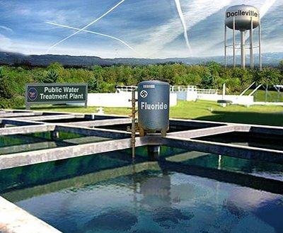
Fluorochlorohydrocarbons are extensively used in air conditioning and refrigeration.
Originally, sodium fluoride was used to fluoridate water; hexafluorosilicic acid (H₂SiF₆) and its salt sodium hexafluorosilicate (Na₂SiF₆) are more commonly used additives. The fluoridation of water is known to prevent tooth decay
(0.7ppm to 1.2ppm) fluoride

Slide 11
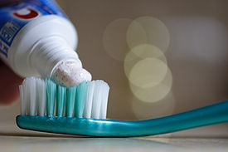
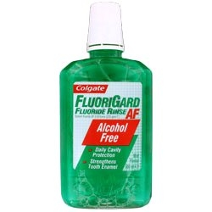
Sodium Fluoride (NaF) is used in toothpaste and rinses to prevent tooth decay.
Fluoride can greatly help dental health by strengthening the tooth enamel, making it more resistant to tooth decay. It also reduces the amount of acid that the bacteria on your teeth produce.

