Slide 1
Experiment (3).
Gravimetric Determination of Chloride (Cl⁻) as Silver Chloride (AgCl) by Precipitation Method

Slide 2
The aqueous solution of the chloride is acidified with nitric acid and a slight excess of silver nitrate solution is added, whereupon silver chloride is precipitated.
NaCl + AgNO₃ AgCl + NaNO₃
The precipitate, which is initially colloidal, is coagulated by heating the solution and stirring the suspension vigorously.

Slide 3
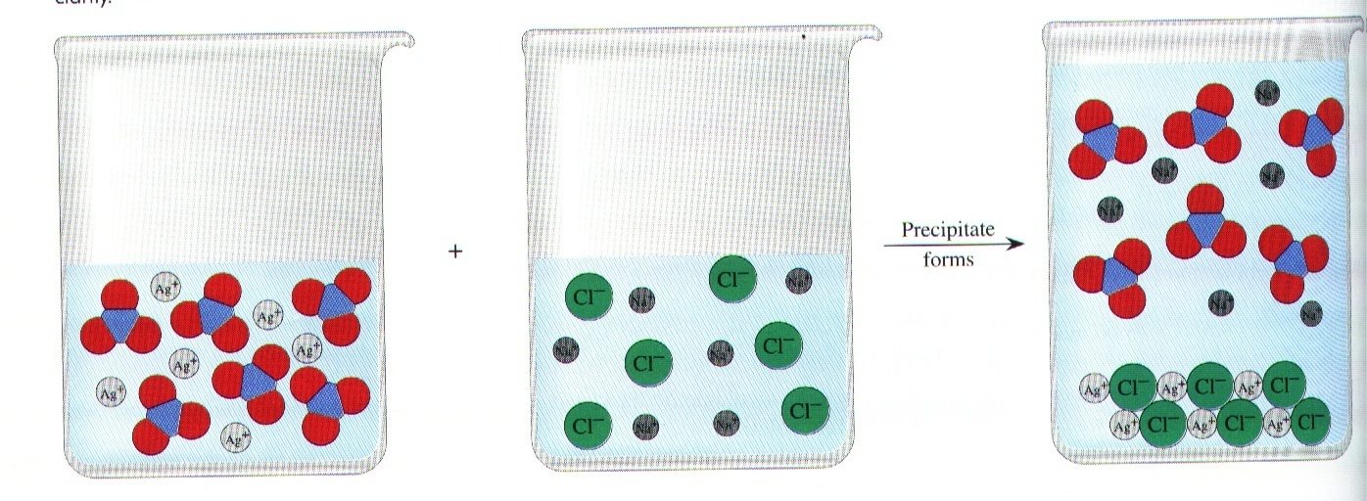
AgNO₃ + NaCl NaNO₃
+ AgCl
^{Precipitate}

Slide 4
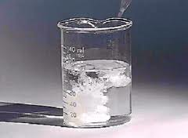
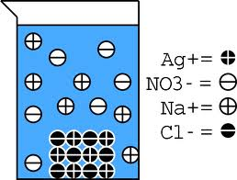

Slide 5
Silver chloride (AgCl) has solubility in water of 1.4mg/L at 20°C, and 21.7 mg/L at 100 °C. The solubility is less in the presence of very dilute nitric acid (HNO₃), and is very much less in the presence of moderate concentrations of silver nitrate (AgNO₃).

Slide 6
Notes:
1- The sample solution was acidified in order to prevent the precipitation of other silver salt such as phosphate and carbonate, or formation of insoluble AgOH in alkaline medium.

Slide 7
2- The formed ppt. is sensitive to the light.
2AgCl_{(s)} ^{light} 2Ag_{(s)} + Cl_{2(aq)}
The results will be (-ve error) due to the removal of Cl⁻ from the ppt. In the absence of excess silver nitrate (AgNO₃).
But causes (+ve error) in the presence of excess silver nitrate (AgNO₃), because the chlorine (Cl₂) changed back to ppt. (AgCl), which cause further precipitation of silver chloride according to this reaction:
2AgCl_{(s)} ^{light} 2Ag_{(s)} + Cl_{2(aq)}
3Cl_{2(aq)} + 3H₂O + 5AgNO₃ 5AgCl_{(s)} + HClO₃ + 5HNO₃

Slide 8
3- The precipitant agent was added slowly with constant stirring, to prevent local high concentration of the ppt.
4- 10% excess of the real volume of AgNO₃ was added to decrease the solubility of silver chloride by common-ion effect.
AgCl Ag⁺ + Cl⁻
AgNO₃ Ag⁺ + NO₃⁻
Common ion

Slide 9
5- When a very slight excess than 10% of silver ion was added then the solubility of silver chloride increase due to formation of the soluble complex cations:
AgCl_{(s)} + Ag⁺_{(excess)} Ag₂Cl⁺_{(aq)}
Ag₂Cl⁺ + Ag⁺_{(excess)} Ag₃Cl⁺⁺_{(aq)}

Slide 10
6- The ppt. was washed with 0.01M HNO₃ (dilute), not higher concentration because the solubility of AgCl is greater in the stronger HNO₃.
7- Solubility of AgCl is increased by increasing temperature therefore it is filtered at room temperature.
8- Precipitant agent (AgNO₃) is light sensitive, therefore it must be protect from the light.
2AgNO₃ ^{light} 2Ag_{(s)} + 2NO₂ + O₂

Slide 11
Procedure:

