Slide 1
Precipitation method
1
C
The analyte is separate from a solution of the sample as a precipitate and weighed or it converted to a compound of known stable chemical composition that can be weigh.
Reagent + Analyte Solid Product
(collect and measure mass)
Ex. In the determination of Cl⁻ using AgNO₃ as precipitating agent and precipitated Cl⁻ as AgCl.

Slide 2
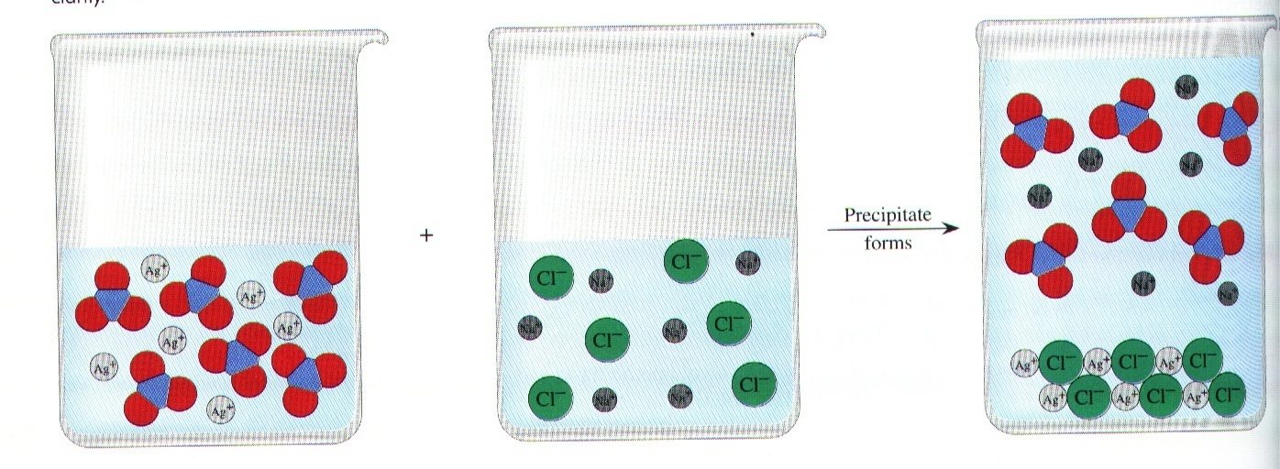
Example:
AgNO₃ + NaCl NaNO₃ + AgCl
precipitate

Slide 3
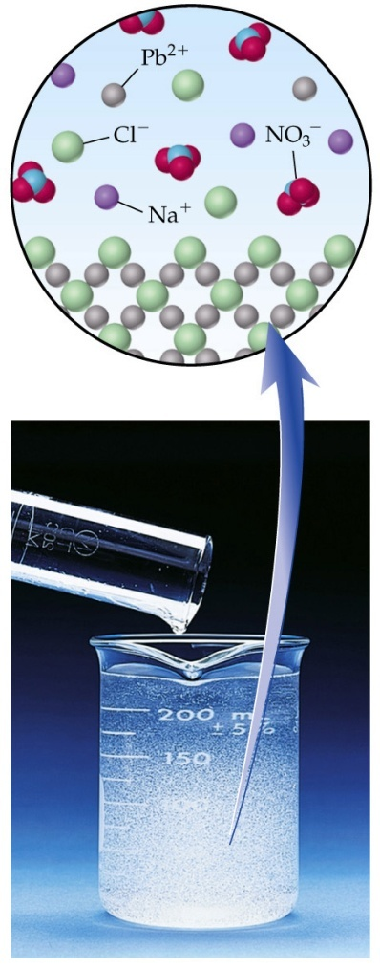
NaCl
Pb(NO₃)₂
PbCl₂
ppt.
+
NaNO₃

Slide 4
Steps of Precipitation Gravimetry
1
1
Preparation of sample solution
Dissolving the sample
1
2
Precipitation
By using precipitating agent (precipitant)

Slide 5
Properties of precipitating agent
Specific
Selective
Precipitates a single chemical species
Precipitates a limit number of chemical species

Slide 6
Types of precipitating agents
Precipitating agents
Organic
Inorganic
they are less selective
such as AgNO₃, BaCl₂,
etc.
they are more selective
such as oxine, dimethyl
Glyoxime (DMG).

Slide 7
Steps of Precipitation Gravimetry
1
3
Digestion
Allowing the precipitate at room temperature or heating to stand in contact with the liquid that formed in it, to obtain complete precipitation in a form which can be readily filter.

Slide 8
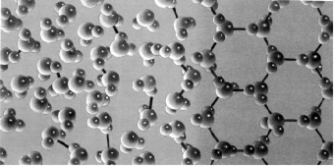
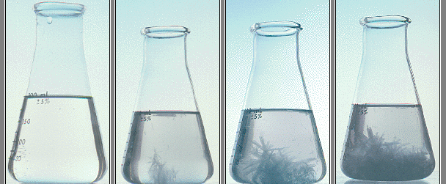

Slide 9
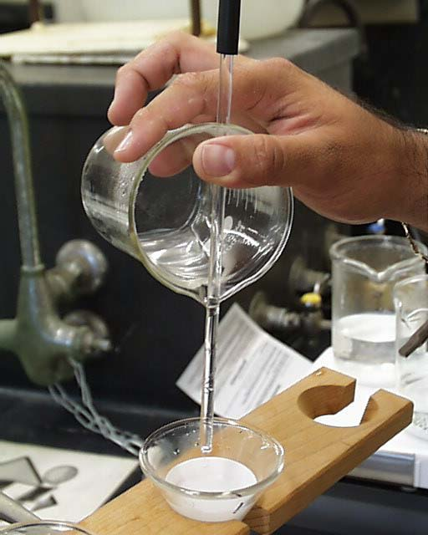
Steps of Precipitation Gravimetry
1
4
Filtration
The ppt. should be large enough to collect on filter, doesn’t clog filter
and doesn’t pass through filter.
Best case: Pure crystals
Worst case: Colloidal suspension,
it is difficult to filter due to small size

Slide 10
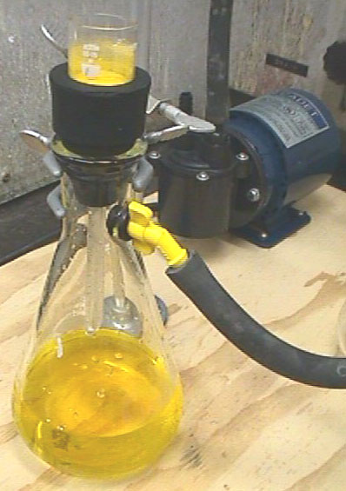
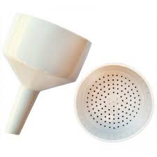
Vacuum filtration
Buchner funnel
Buchner bung
Buchner flask

Slide 11
Steps of Precipitation Gravimetry
1
5
Washing
To remove some of the foreign ions (coprecipitate) and substances that use for washing should be volatile or removed by drying.

Slide 12
Steps of Precipitation Gravimetry
1
6
Drying
OR
Igniting
Precipitates are dried for accurate weight measurements
(very high-temp.) to convert to a stable chemical form
*Converts hygroscopic compound to non-hygroscopic compound
1
7
Weighing
1
8
Calculation

Slide 13
Decantation: Is the process of pouring the liquid above the precipitate through the filter to increase filtration rate.
Coprecipitation: Is tendency of the precipitates to carry down from the solution other constituent that are normally soluble causing contamination of the precipitate.
Post-precipitation: Some time the precipitate is allowed to stand in contact with mother liquor, a second substance will slowly form a precipitate with the same precipitant reagent.

Slide 14
A successful analysis by precipitation was obtained by these conditions:
conditions of precipitation
The precipitate must be very low soluble or insoluble
The ppt. must be easily separates from the solution by filtration.
The ppt. can be converts into a definite or stable chemical composition.
The ppt. must be very pure.

