Slide 1
Practical Instrumental Analysis
4th Stage (Biology)
2022– 2023
Prepared by:
Dr. Kamal Mohamoud – Huda Ali

Slide 2
Spectroscopy

Slide 3
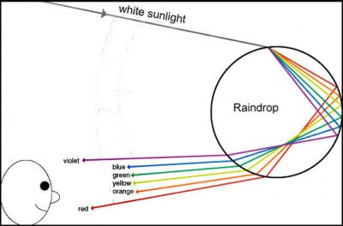
Spectroscopy
Is the study of the interaction of electromagnetic waves and matter. The simple example is the scattering of sun’s ray by raindrops to produce a rainbow and appearance of a colorful spectrum.

Slide 4
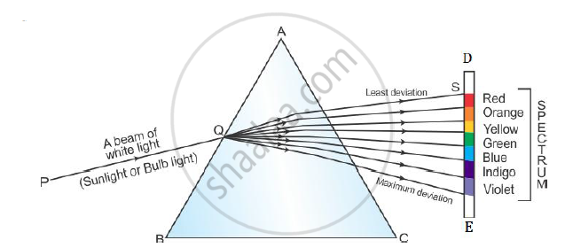
Spectroscopy
When a narrow beam of sunlight is passed through a triangular glass prism is separated into the visible spectrum of primary colors.

Slide 5
Any interaction of matter with radiative energy as a function of its wavelength or frequency is often represented by a spectrum,
Spectrum is a plot of the response of interest as a function of wavelength or frequency.

Slide 6

-Wavelength is defined as the distance between adjacent peaks (or troughs) , and may be designated in meters , centimeters or nanometers(10⁻⁹meters).
- Frequency is the number of wave cycles that travel past a fixed point per unit of time , and is usually given in cycles per second , or hertz(Hz).

Slide 7
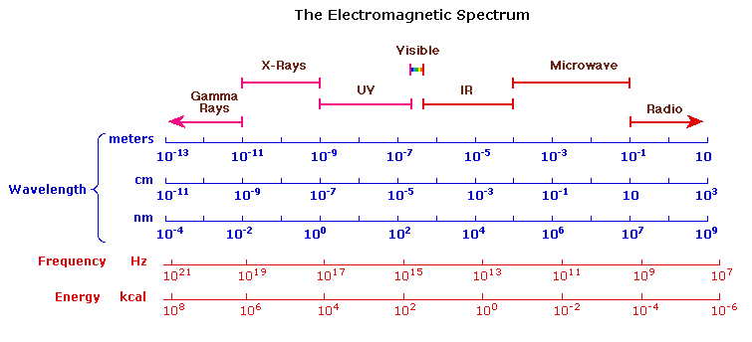
The Electromagnetic Spectrum
The electromagnetic spectrum ranges from very short wavelengths, gamma and x-rays, to very long wavelengths, including micro- and broadcast radio waves.

Slide 8
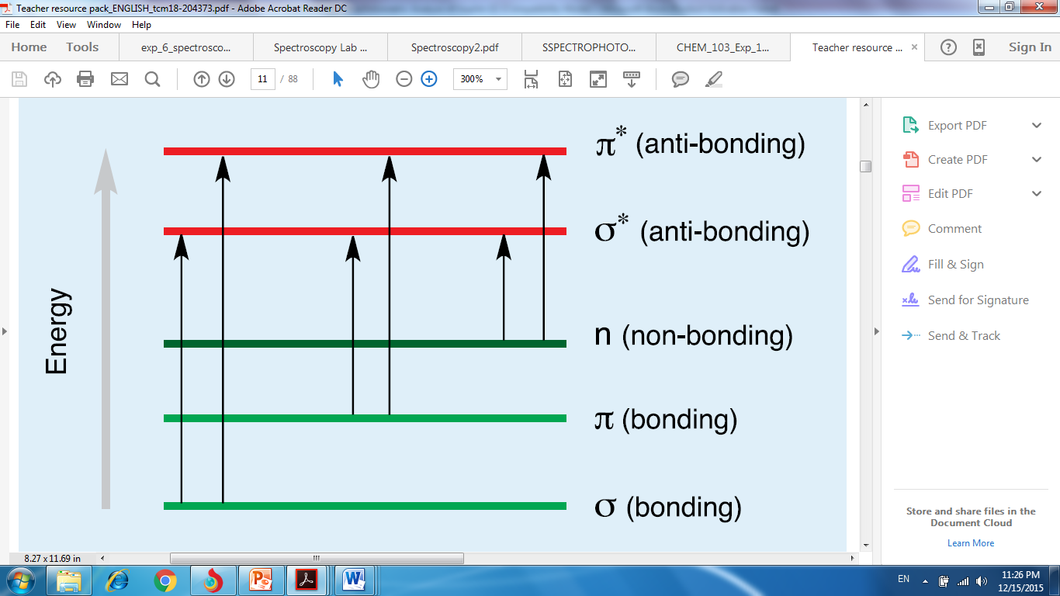
UV/ Vis. Spectrophotometry
When a beam of radiation passes through matter, a portion of radiation is frequently absorbed; this process involves a transfer of radiant energy to the system, thus electrons of the molecules are excited to higher energy levels.

Slide 9
When white light passes through or reflected by a colored substance, a characteristic portion of the mixed wavelengths is absorbed. The remaining light assumes the complementary color to the wavelengths absorbed. This relationship is demonstrated by the color wheel . Here, complementary colors are diametrically (completely) opposite to each other.

Slide 10
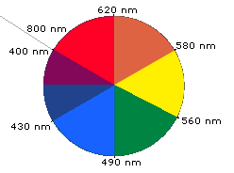
Thus, absorption of 420-430 nm light makes a substance yellow, and absorption of 500-520 nm light makes it red. Green is unique in that It can be created by absorption close to 400 nm as well as absorption near 800 nm.

Slide 11
Absorption and Emission
nm | Colour | Complementary
~180-380 | UV | -
400-435 | Violet | Yellow-green
435-480 | Blue | Yellow
480-490 | Blue-green | Orange
490-500 | Green-blue | Red
500-560 | Green | Purple
560-580 | Yellow-green | Violet
580-595 | Yellow | Blue
595-650 | Orange | Blue-green
650-750 | Red | Green-blue
UV
Visible spectrum

Slide 12
Question?
Why the colour of this solution is red?
Because the molecules absorbs green component from the incoming white radiation and reflected red components.

Slide 13
UV-Vis Spectroscopy

Slide 14
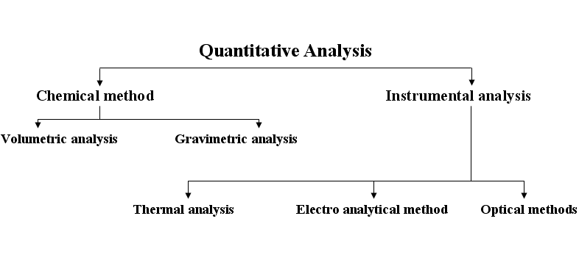
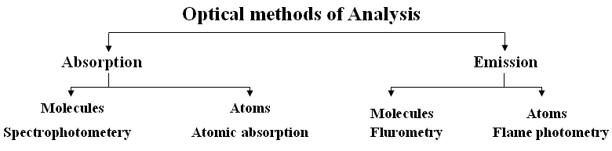

Slide 15
Principle of ultraviolet-visible absorption
Molecules containing π-electrons or non-bonding electrons (n-electrons) can absorb the energy in the form of ultraviolet or visible light to excite these electrons to higher anti-bonding molecular orbitals. The more easily excited electrons absorb the longer wavelength of light.
The UV-VIS is used to show the range of the electromagnetic spectrum from around 200nm to around 800nm. The energy absorbed comes from the excited electrons of a molecules of the solution.

Slide 16
Ultraviolet-Visible molecular absorption spectroscopy is widely used for the quantitative determination of large number of organic, inorganic, and biological species based on the measurement of the absorbance or transmittance of the solutions contained in transparent cells having a path length in centimeters.

Slide 17
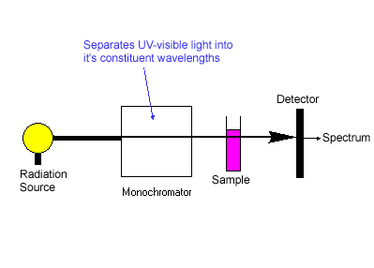
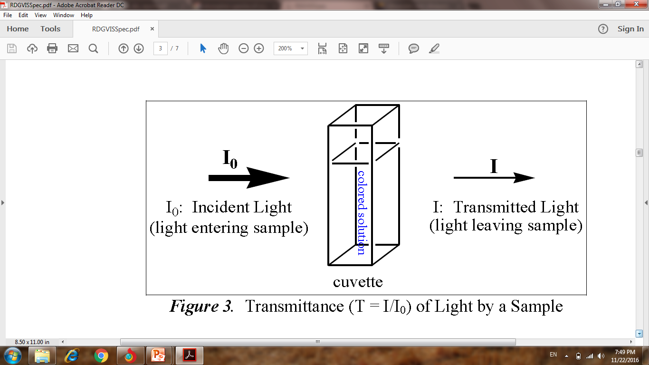
aaammaabbbbaaaaa

Slide 18
Beer-Lambert law
When abeam of monochromatic light passed through a solution contains absorbing molecules, the light intensity decreased continuously as the number of absorbing molecules will be increased in the optical path.

Slide 19



This means that:
The light intensity will depend on the concentration of the absorbing molecules (C) and the length of the optical path(b).
Now this two factors are converted to the mathematical equation:
1-If the amount of light absorbed is ….
…………eq.(1)
This equation is called Lambert equation

Slide 20
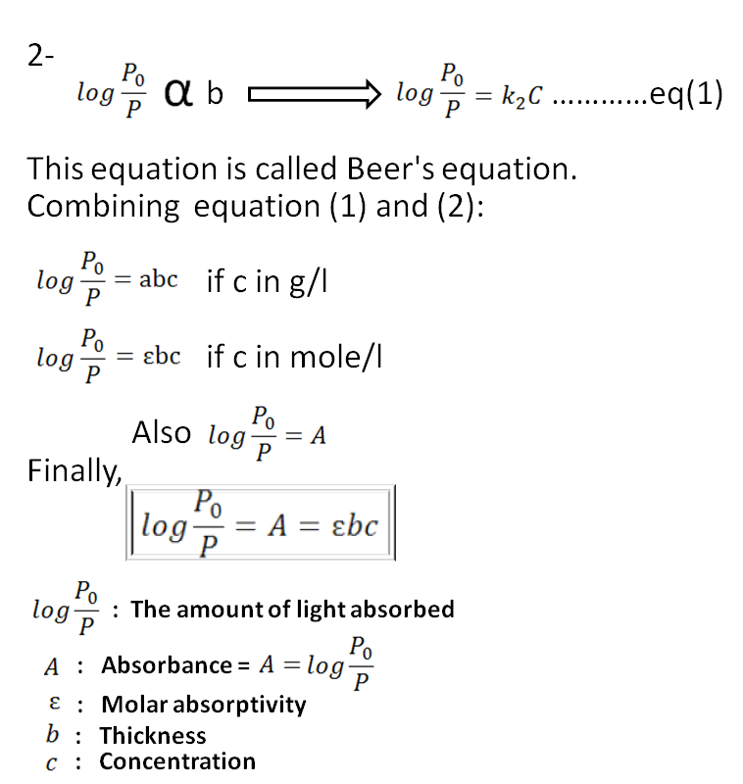
b

Slide 21
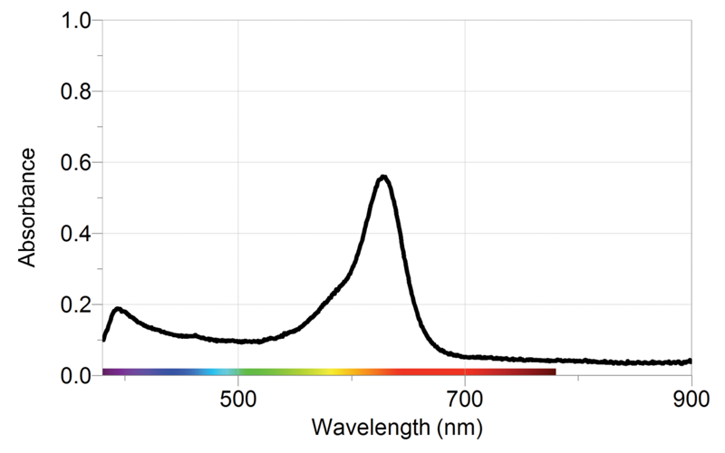
A Beer’s Law Plot is a calibration curve of absorption plotted as a function of concentration. An absorption spectrum must be taken first to determine the wavelength of maximum absorbance, λmax, for the compound being studied. All absorbance's are taken at this wavelength setting because the signal is the strongest.
λmax

Slide 22
To create the calibration graph, the absorbance's of at least three solutions of known concentration are measured. A graph of absorbance versus concentration is constructed and a best fit straight line is drawn through the data points.
Then the absorbance of a solution of unknown concentration is measured and its concentration is determined by comparison to the Beer's Law calibration graph. The “Plot” must be used to determine the unknown’s concentration.

Slide 23
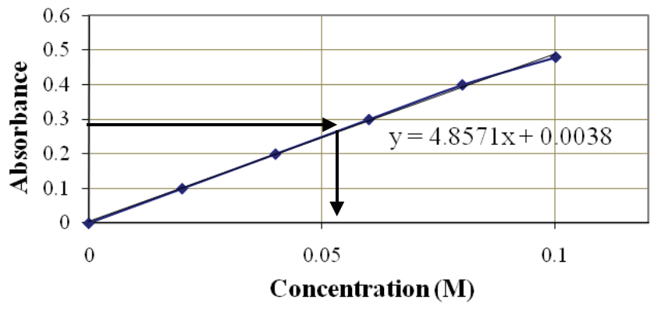
A horizontal line is drawn from the value of the experimentally found absorbance on the y-axis to the calibration curve; a vertical line is then drawn to the x-axis to determine the unknown solution concentration.

Slide 24
Experiment no. (1)
Determination of wavelength of maximum absorbance & calibration curve
Part 1: Absorption Spectra
A graphical plot of absorbance versus wavelength is referred to as an absorption spectrum.
Apparatus
Spectrophotometer with 1 cm matched quartz cells.
Reagents
Prepare the following solutions.
Stock solution of 0.1880M Co(NO₃)₂.6H₂O.
Working standard solution of 0.0752 M Co(II), by pipetting 10ml of stock solution of Co(NO₃)₂.6H₂O into a 25ml volumetric flask and diluting to the mark.

Slide 25
Procedure
Obtain two matched cuvettes, the first cuvette is for distilled water and the second one is for the cobalt solution.
Hold cuvette by the rough sides. Rinse the second cuvette with a small amount of the cobalt solution and then fill the cuvette 3/4 full.
Fill the first cuvette with distilled water to be used as a blank.
Set the wavelength dial 370nm.
Insert the blank into the cell holder and close the door. Position the cell so that the light passes through clear walls.

Slide 26
Press Cal to set the blank to 0 Abs.
Remove the blank and insert sample into the cell holder. Record the absorbance on the data sheet.
Reset the wavelength to 380nm and repeat steps 6, 7 and 8.
Repeat steps 5, 6, 7 and 8, recording absorbance at every 5nm using this technique until you reach 700nm.
Determine the wavelength of maximum absorbance by creating a graph of the data – placing wavelength on the x- axis and absorption on the y- axis

Slide 27
Part 11: Beer's Law
Beer's Law plots
Graphs of absorbance vs. concentration, or log %T vs. concentration, are known as [Beer's Law plots]. These are prepared by measuring the light absorbed by a series of solutions with different known concentrations. The cell width and the wavelength of the light are maintained constant. If a linear plot is obtained [the Beer-Lambert relationship holds for the solution (and instrument) at that wavelength], the plot may be used with confidence to determine the concentrations of unknown solutions.

Slide 28
Constructing the standard curve
Perform a series of serial dilutions of the Co(NO₃)₂.6H₂O solution as a table below:
Conc. of Co(NO₃)₂.6H₂O | Abs.
0.0376M
0.0752M
0.1128M
0.1504M

Slide 29
Measure the absorbance of the solutions and record the absorbance of each conc. in the appropriate space on the table.
Plot on linear graph paper (A) vs. (Conc. of Co(NO₃)₂.6H₂O), you should be able to draw a straight line though the data and that line should also pass through the origin.
Determine the slop of the line that should be the molar extinction coefficient of the Co⁺² at its wave length of maximum absorbance.

Slide 30
Determination of Iron (II) using visible spectrophotometer
Experiment no. (2)

Slide 31
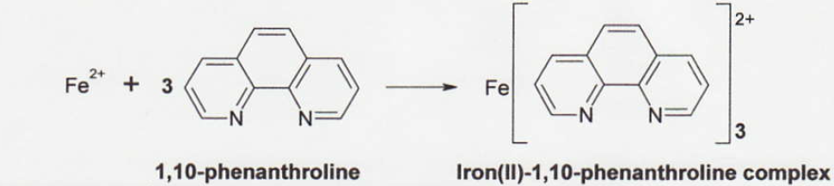
Introduction
Any solution which is colored or can be made to be colored by adding a complexing agent can be analyzed using a spectrophotometer. Solutions containing iron ions( Fe³⁺ , Fe²⁺ ) are colorless. Iron can be analyzed spectrophotometrically by forming the reddish-orange tris-complex of iron (II) and 1,10-phenanthroline. This complex absorbs light in the visible region strongly with a maximum absorbance occurring around 510 nm.

Slide 32
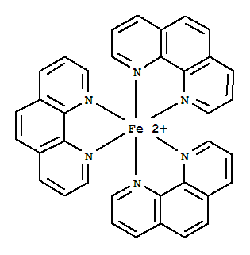
(Structure of Tris(1,10-phenanthroline)iron(II) ion complex)
To form a complex, the ferric ion(Fe³⁺) must be first reduced to its ferrous ion(Fe²⁺). This is done by reacting the iron with (hydroxylamine, NH2OH) by the following reaction:
2 Fe³⁺ + 2 NH2OH + 2 OH⁻ 2 Fe²⁺ + N2 + 4 H2O

Slide 33
Procedure
Dissolve (0.7022) grams of ferrous ammonium sulfate, hexahydrate [Fe(NH4)2(SO4)2.6H2O] in (5mL) (6M) H2SO4 and complete the solution to (1 L) with distilled water. This solution is 100 mg/L Fe⁺² (equal to 100 ppm).
Prepare standard solutions of 0, 5, 10, 15, and 20ppm respectively by diluting stock solution into five separate 100 mL volumetric flasks. To each flask add 5mL of a 0.1% 1,10-phenanthroline solution. Dilute each solution with deionized water to 100 mL.

Slide 34
Preparation of the unknown Weigh accurately about 0.2 gm of the unknown into a 100mL volumetric flask. Add about (5mL) (6M) H2SO4 to dissolve the sample, Add 10mL of freshly prepared 10% w/v hydroxylamine hydrochloride (NH2OH.HCl) and wait 5 to 10 minutes for the reduction of any Fe(III) to Fe(II). Add 8 mL of the sodium acetate buffer, Add 10 mL of 0.25% 1,10-phenanthroline solution, complete to the mark with water and mix thoroughly. Allow 10 minutes for the reddish-orange color to develop completely.

Slide 35
Calibrate the spectrophotometer by the blank as a reference ( which consist of all chemicals except analytes ) and measure the absorbance for each diluted standard solution and unknown solution with a maximum absorbance occurring around 510 nm.
Draw the calibration curve and find the concentration of unknown.

