Slide 1
Experiment no. (4)
FLAME SPECTROSCOPY
The concentration of an element in a solution is determined by measuring the absorption or emission of electromagnetic radiation by its monoatomic particles in gaseous state in the flame.

Slide 2
Flame Emission
Atoms in gaseous state in the flam absorb thermal energy from the flame itself ,some of the atoms get excited & as they return back to the ground state they emit radiation having energy equal to that absorbed.
The emission is proportional to the number of excited atoms, which is proportional to the total number of atoms in the flame i.e. the sample concentration.
Na Na *
Na * Na + hν
Energy from flame
Proportional to conc.

Slide 3
Flame photometry: is an atomic emission method for the
routine detection of metal salts , principally Na, K, Li, Ca and Ba .
The method is selective to ward detection of alkali and alkaline earth metals and simple, inexpensive, used for clinical, biological ,and environmental analysis.
Flame photometry has limited application because the temperature of flame is not high enough to atomize and excite transition metals or other metals.

Slide 4
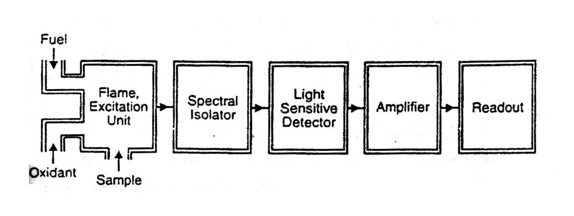
INSTRUMENT FOR FLAME EMISSION
1-Flame atomizer with the Sample.
2- Wavelength selector (Filter or Monochromator)
3- Detector.
4- Readout (meter).

Slide 5
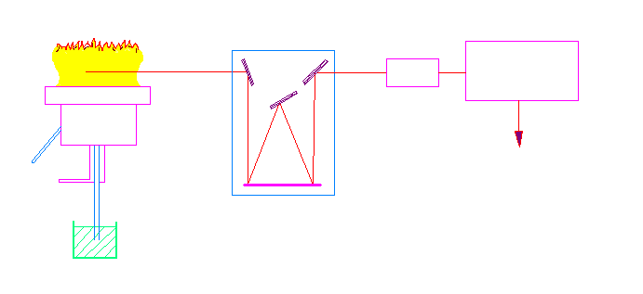
flame
Dc amplifier
Photo multiplier
fuel
recorder
oxidant
monochromator
sample
Flame photometry diagram

Slide 6
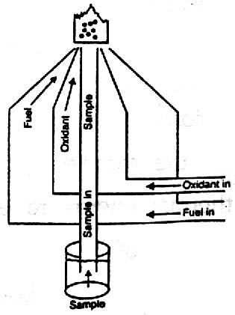
The temperature of the flame produced depends on (fuel-oxidant ) ratio and its kinds
Fuels | Oxidants
Hydrogen | Air
Acetylene | Oxygen
Propane | Nitrous oxide
Natural gas | Air

Slide 7
The process that done inside the flame
1- The solvent is evaporated leaving minute particles of dry salt (S).
2- The dry solids are converted into the gaseous state.
3- A part of all the gaseous molecules are dissociated to
give neutral atoms or radicals. The atomization step.
4-A portion of the neutral atoms may be thermally excited.
5-Some of the neutral atoms may combine with radicals
in the flame gases to form new gaseous compounds.

Slide 8
The process that done inside the flame:
Sample nebulization desolvated
Vaporized
Atomized
hν
return to a lower ground stat excited electronic state
(Flame photometry)
• Those which are activated (excited) will drop back to ground state with the emission
of a photon of radiation which can be identified and measured with a suitable
(flame photometry).

Slide 9
Exp. No. (4) Determination of sodium and potassium in soil by flame photometry
Procedure
1. Preparation of Stock solution:
Prepare (100 ppm) of Na⁺ from NaCl in (250 ml).
Prepare (100 ppm) of K⁺ frome KCl in (250 ml).
2. Preparation of Calibration Curve:
- Prepare (5,10,15, 20, 25 ppm) of Na⁺ from the stock solution,
Complete the volume to (50 ml) by (D.W.).
- Prepare (10, 20, 30, 40, 50 ppm) of K⁺ from the stock solution Complete the volume to (50 ml) by (D.W.).

Slide 10
3. Preparation of the unknown:
Weight (2 g) of soil, add (5 ml) of conc. HCl heat for (2 min), add a few drops of (D.W.) and filter the solution then complete the volume to (50 ml).
4. Set the instrument to read 100% for the most concentrate
Na⁺ solution, determine the intensity of the other Na⁺ solution as compared to this. Run of sample.
5. Set the instrument to 100% with the most concentrated K⁺
Solution. Read the intensity of the K⁺ solutions as compared
to this. Run an unknown sample.
6. Determine the concentration of Na⁺, K⁺ in the sample.

Slide 11
Emission %
conc. unknown
Conc. ppm ( Na )
Calibration curve for Na or K

