Slide 2
Basic Definitions
Set - Collection of objects, usually denoted by capital letter
Member, element - Object in a set, usually denoted by lower case letter
Set Membership - a ∈ A denotes that a is an element of set A
Cardinality of a set - Number of elements in a set, denoted |S|

Slide 3
Special Sets
N - set of natural numbers = {0,1,2,3,4, …}
P or Z+ - set of positive integers = {1,2,3,4, …}
Z - set of all integers, positive, negative and zero
R - set of all real numbers
Ø or {} - empty set
U - Universal set, set containing all elements under consideration

Slide 4
Set Builder Notation
Format: “such that”
{[element structure] | [necessary properties to be members]}
Examples:
Q = {m/n | m,n ∈ Z, n≠0}
Q is set of all rational numbers
Elements have structure m/n; must satisfy properties after the | to be set members.
{x ∈ R | x² = 1}
{-1,1}

Slide 5
Subsets
S ⊆ T (S is a subset of T)
Every element of S is in T
∀x(x ∈ S → x ∈ T)
S = T (S equals T)
Exactly same elements in S and T
(S ⊆ T) ∧ (T ⊆ S) Important for proofs!
S ⊂ T (S is a proper subset of T
S is a subset of T but S ≠ T
(S ⊆ T) ∧ (S ≠ T)

Slide 6
Interval Notation - Special notation for subset of R
[a,b] = {x ∈ R | a ≤ x ≤ b}
(a,b) = {x ∈ R | a < x < b}
[a,b) = {x ∈ R | a ≤ x < b}
(a,b] = {x ∈ R | a < x ≤ b}
How many elements in [0,1]?
In (0,1)?
In {0,1}

Slide 7
Set Operations
B
B (B complement)
{x | x∈U ∧ x∉B}
Everything in the Universal set that is not in B
A ∪ B (A union B)
{x | x∈A ∨ x∈B}
Like inclusive or, can be in A or B or both
A
B

Slide 8
More Set Operations
A ∩ B (A intersect B)
{x | x∈A ∧ x∈B}
A and B are disjoint if A ∩ B = Ø
A - B (A minus B or difference)
{x | x∈A ∧ x∉B}
A-B = A∩B
A⊕B (symmetric difference)
{x | x∈A ⊕ x∈B} = (A∪B) - (A∩B)
We have overloaded the symbol ⊕. Used in logic to mean exclusive or and in sets to mean symmetric difference

Slide 9
Simple Examples
Let A = {n² | n∈P ∧ n≤4} = {1,4,9,16}
Let B = {n⁴ | n∈P ∧ n≤4} = {1,16,81,256}
A∪B = {1,4,9,16,81,256}
A∩B = {1,16}
A-B = {4,9}
B-A = {81, 256}
A⊕B = {4,9,81,256}

Slide 10
Approaches to Proofs
Membership tables (similar to truth tables)
Convert to a problem in propositional logic, prove, then convert back
Use set identities for a tabular proof (similar to what we did for the propositional logic examples but using set identities)
Do a logical (sentence-type) argument (similar to what we did for the number theory examples)

Slide 11
Prove (A∩B) ∪ (A∩B) = B
A B (A∩B) (A∩B) (A∩B)∪(A∩B)
1 1 1 0 1
1 0 0 0 0
0 1 0 1 1
0 0 0 0 0

Slide 12
Prove (A∩B) ∪ (A∩B) = B
(A∩B) ∪ (A∩B)
= {x | x∈(A∩B)∪(A∩B)} Set builder notation
= {x | x∈(A∩B) ∨ x∈(A∩B)} Def of ∪
= {x | (x∈A ∧ x∈B) ∨ (x∉A ∧ x∈B)} Def of ∩ x2 and Def of complement
= {x | (x∈B ∧ x∈A ) ∨ (x∈B ∧ x∉A )} Commutative x2
= {x | (x∈B ∧ (x∈A ∨ x∉A )} Distributive
= {x | (x∈B ∧ T } Or tautology
= {x | (x∈B } Identity
= B Set Builder notation

Slide 13
Set Identities (Rosen, p. 89)
A∪ Ø = A
A∩U = A
A∪U = U
A∩ Ø = Ø
A∪A = A
A ∩A = A
(A) = A
Identity Laws
Domination Laws
Idempotent Laws
Complementation Law

Slide 14
Set Identities (cont.)
A ∪ B = B ∪ A
A ∩ B = B ∩ A
A∪(B∪C) = (A∪B)∪C
A∩(B∩C) = (A∩B)∩C
A∩(B∪C)=(A∩B)∪(A∩C)
A∪(B∩C)=(A∪B)∩(A∪C)
A ∪ B = A ∩ B
A ∩ B = A ∪ B
Commutative Laws
Associative Laws
Distributive Laws
De Morgan’s Laws

Slide 15
Prove (A∩B) ∪ (A∩B) = B
(A∩B) ∪ (A∩B) =
(B∩A) ∪ (B∩A) Commutative Law x2
=B ∩ (A ∪ A) Distributive Law
=B ∩ U Definition of U
=B Identity Law

Slide 16
Prove (A∩B) ∪ (A∩B) = B
Proof: We must show that (A∩B) ∪ (A∩B) ⊆ B and that B ⊆ (A∩B) ∪ (A∩B) .
First we will show that (A∩B) ∪ (A∩B) ⊆ B.
Let e be an arbitrary element of (A∩B) ∪ (A∩B). Then either e∈ (A∩B) or e∈ (A∩B). If e∈ (A∩B), then e∈B and e∈A. If e∈ (A∩B), then e∈B and e∈A. In either case e ∈B.

Slide 17
Prove (A∩B) ∪ (A∩B) = B
Now we will show that B ⊆ (A∩B) ∪ (A∩B).
Let e be an arbitrary element of B. Then either e∈ A∩B or e∈ A∩B. Since e is in one or the other, then e ∈ (A∩B) ∪ (A∩B).

Slide 18
Prove: [A∪B ⊆ A∩B] → [A = B]
Proof: We must show that when A∪B ⊆ A∩B is true then A=B is true. (Proof by contradiction) Assume that A∪B ⊆ A∩B is true but A≠B. If A≠B then this means that either ∃ x∈A but x∉B, or ∃ x∈B but x∉A. If ∃ x∈A but x∉B, then x ∈ A∪B but x ∉ A∩B so A∪B is not a subset of A∩B and we have a contradiction to our original assumption. By a similar argument A∪B is not a subset of A∩B if ∃ x∈B but x∉A.
Therefore [A∪B ⊆ A∩B] → [A = B].

Slide 19
Prove or Disprove
[A∩B=A∩C] → [B=C]
False! A= Ø, B={a}, C={b}
[A∪B=A∪C] → [B=C]
False! A={a}, B= Ø, C={a}

Slide 20
Ordered n-tuple
The ordered n-tuple (a1,a2,…an) is the ordered collection that has a1 as its first element, a2 as its second element . . . And an as its nth element.
2-tuples are called ordered pairs.

Slide 21
Cartesian Product of A and B
Let A and B be sets. The Cartesian product of A and B, denoted A x B is the set of all ordered pairs (a,b) where a ∈A and b ∈ B. Hence
A x B = {(a,b) | a ∈A ∧ b ∈ B}
The Cartesian product of the sets A1,A2, .. , An denoted by A1 x A2 x … x An is the set of ordered n-tuples (a1,a2,..,an) where ai belongs to Ai for I = 1,2,... ,n.
A1 x A2 x…x An = {(a1,a2,..,an) | ai ∈Ai for I=1,2…,n}

Slide 22
Prove (A⊕B) ⊕ B = A
A B A⊕B (A⊕B) ⊕ B
1 1 0 1
1 0 1 1
0 1 1 0
0 0 0 0

Slide 23
Prove (A⊕B) ⊕ B = A
Proof: We must show that (A⊕B) ⊕ B ⊆ A and that A ⊆ (A⊕B) ⊕ B.
First we will show that (A⊕B) ⊕ B ⊆ A . Let e∈ (A⊕B) ⊕ B. Then e ∈ (A⊕B) or e ∈ B but not both. If e ∈ (A⊕B), then either e∈A or e∈B. If e∈A and e∉B then we are done. If e∈B, and e∉A, then e∈ (A⊕B) but can not be an element of (A⊕B) ⊕ B by definition so this case can not exist.

Slide 24
Proof of (A⊕B) ⊕ B = A, cont.
Now we will show that A ⊆ (A⊕B) ⊕ B . Let e∈A. Either e is also ∈B or e∉B. If e ∈B, then e ∉(A⊕B) so e is an element of (A⊕B) ⊕ B. If e∉B, e is an element of (A⊕B) and e must be an element of (A⊕B) ⊕ B .
Thus (A⊕B) ⊕ B = A.

Slide 25
Definition of Function
Let A and B be sets.
A function f from A to B is an assignment of exactly one element of B to each element of A.
We write f(a) = b if b is the only element of B assigned by the function, f, to the element of A.
If f is a function from A to B, we write f:A → B.
f
a1
a3
f
a2
A
f
b1
b2
b3
B

Slide 26
Addition and Multiplication
Let f1 and f2 be functions from A to R (real numbers).Then
f1+f2 is defined as (f1+f2) (x) = f1(x) + f2(x).
f1f2 is defined as (f1f2)(x) = f1(x)f2(x).
And both of these are also from A to R.
(Two real valued functions with the same domain can be added and multiplied.)
Example: f1(x) = x² ; f2 = x+x²
(f1+f2)(a) = a² + a + a² = 2a² + a
f1f2(a) = (a²)(a+a²) = a³+a⁴

Slide 27
Are f1+f2 and f1f2 Commutative?
Prove: (f1+f2)(x) = (f2+f1)x where x∈R
Proof: Let x∈R be an arbitrary element in the domain of f1 and f2. Then (f1+f2)(x) = f1(x) + f2(x) = f2(x) + f1(x) = (f2+f1)(x).
Prove: (f1f2)(x) = (f2f1)(x) where x∈R
Proof: Let x∈R be an arbitrary element in the domain of f1 and f2. Then (f1f2)(x) = f1(x)f2(x) = f2(x)f1(x) = (f2f1)(x).

Slide 28
One-to-one function
A function f is said to be one-to-one, or injective, if and only if f(x) = f(y) implies that x=y for all x and y in the domain of f.
f
a1
f
a2
a3
A
f
f
a1
f
b1
a2
a3
One-to-one?
b2
b3
A
B
∀a0,a1 ∈ A [f(a0) = f(a1)] → [a0 = a1] OR [a0 ≠ a1] → [f(a0) ≠ f(a1)]
f
b4
b1
b2
One-to-one?
b3
B

Slide 29
Let f:Z→Z, where f(x) = 2x
Prove that f is one-to-one
Proof: We must show that ∀ x₀, x₁ ∈Z [f(x₀) = f(x₁) → x₀ = x₁].
Consider arbitrary x0 and x1 that satisfy f(x₀) = f(x₁). By the function’s definition we know that 2x₀ = 2x₁. Dividing both sides by 2, we get x₀ = x₁. Therefore f is one-to-one.

Slide 30
Let g:Z→Z, where g(x) = x²-x-2
Is g one-to-one?
No! To prove a function is not one-to-one it is enough to give a counter example such that f(x₁) = f(x₂) and x₁≠x₂.
Counter Example: Consider x₁ = 2 and x₂ = -1.
Then g(2) = 2²-2-2 = 0 = g(-1) = (-1)² + 1 -2. Since g(2) = g(-1) and 2 ≠ -1, g is not one-to-one.

Slide 31
Onto Function
A function f from A to B is called onto, or surjective, if and only if for every element b∈B there is an element a∈A with f(a) = b.
f
a1
f
a2
a3
A
f
f
a1
f
b1
a2
a3
b2
A
∀b∈B ∃ a∈A such that f(a) = b
B
f
b1
b2
b3
B

Slide 32
Let f:R→R, where f(x) = x²+1
Prove or disprove: f is onto
Counter Example: Let f = 0, then there does not exist an x such that f(x) = x² + 1 since x² is always positive.

Slide 33
Let g:R→R, where g(x) = 3x-5
Prove: g(x) is onto.
Proof: Let y be an arbitrary real number (in g). For g to be onto, there must be an x∈R such that y = 3x-5. Solving for x, x = (y+5)/3 which is a real number. Since x exists, then g is onto.

Slide 34
Correspondence Diagrams: One-to-One or Onto?
1
2
3
4
a
b
c
d
a
b
c
d
1
2
3
4
a
b
c
1
2
3
One-to-one, not onto
Onto, not one-to-one
One-to-one, and onto
a
b
c
d
1
2
3
4
1
2
3
4
a
b
c
Neither one-to-one nor onto
Not a function!

Slide 35
Inverse Function, f⁻¹
Let f be a one-to-one correspondence from the set A to the set B. The inverse function of f is the function that assigns to an element b belonging to B the unique element a in A such that if f(a) = b, then f⁻¹(b) = a.
Example:
f(a) = 3(a-1)
f⁻¹(b) = (b/3)+1
f
b
a
f⁻¹

Slide 36
Let f be an invertible function from A to B. Let S be a subset of B. Show that f⁻¹(S) = f⁻¹(S)
Proof: We must show that f⁻¹(S) ⊆ f⁻¹(S) and that f⁻¹(S) ⊆ f⁻¹(S) .
Let x ∈ f⁻¹(S). Then x∈A and f(x) ∈ S. Since f(x) ∉ S, x ∉ f⁻¹(S). Therefore x ∈ f⁻¹(S).
Now let x ∈ f⁻¹(S). Then x ∉ f⁻¹(S) which implies that f(x) ∉ S. Therefore f(x) ∈ S and x ∈ f⁻¹(S)
Notes:
If x ∈ f⁻¹(S). Then f(x) ∈ S after taking the inverse of both sides (i.e., x = f⁻¹(y) means y = f(x); therefore y ∈ S).

Slide 37
Let f be an invertible function from A to B. Let S be a subset of B. Show that f⁻¹(S) = f⁻¹(S)
Proof:
f⁻¹(S) = {x∈A | f(x) ∉ S} Set builder notation
= {x∈A | f(x) ∈ S} Def of Complement
= f⁻¹(S) Def of Complement

Slide 38
Sequence
A sequence is a discrete structure used to represent an ordered list.
A sequence is a function from a subset of the set of integers (usually either the set {0,1,2,. . .} or {1,2, 3,. . .}to a set S.
We use the notation a_{n} to denote the image of the integer n. We call a_{n} a term of the sequence.
Notation to represent sequence is {a_{n}}

Slide 39
Examples
{1, 1/2, 1/3, 1/4, . . .} or the sequence {a_{n}} where a_{n} = 1/n, n∈Z⁺ .
{1,2,4,8,16, . . .} = {a_{n}} where a_{n} = 2^{n}, n∈N.
{1²,2²,3²,4²,. . .} = {a_{n}} where a_{n} = n², n∈Z⁺

Slide 40
Summations
Notation for describing the sum of the terms a_{m}, a_{m+1}, . . ., a_{n} from the sequence, {a_{n}}
_{n}
a_{m}+a_{m+1}+ . . . + a_{n} = ∑ a_{j}
^{j=m}
j is the index of summation (dummy variable)
The index of summation runs through all integers from its lower limit, m, to its upper limit, n.

Slide 41
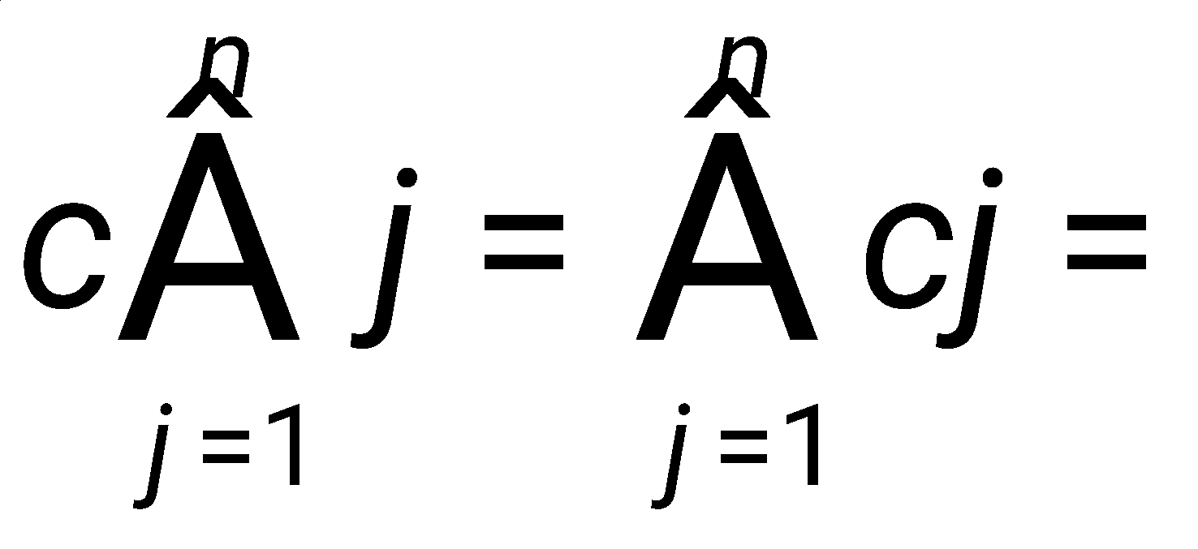
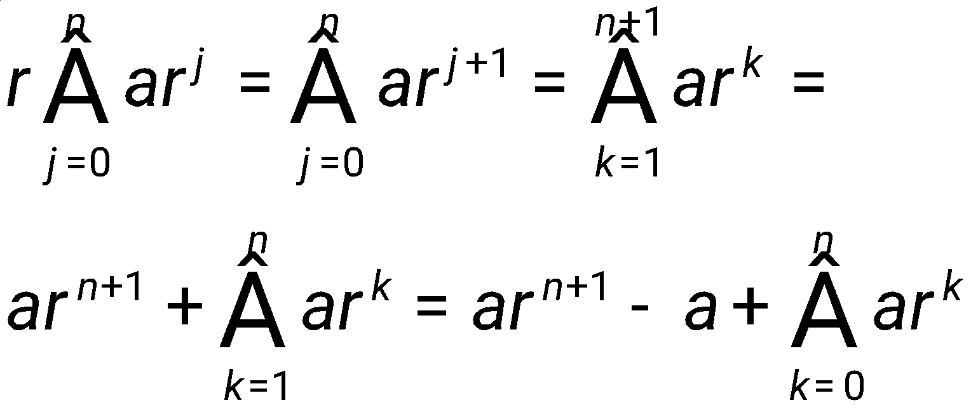
Summations follow all the rules of multiplication and addition!
c(1+2+…+n) = c + 2c +…+ nc

Slide 42
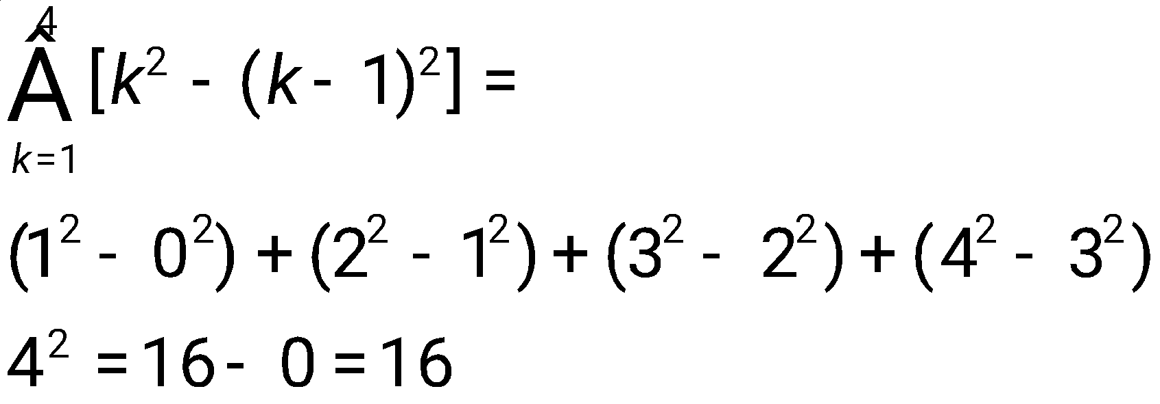
Telescoping Sums
Example

Slide 43
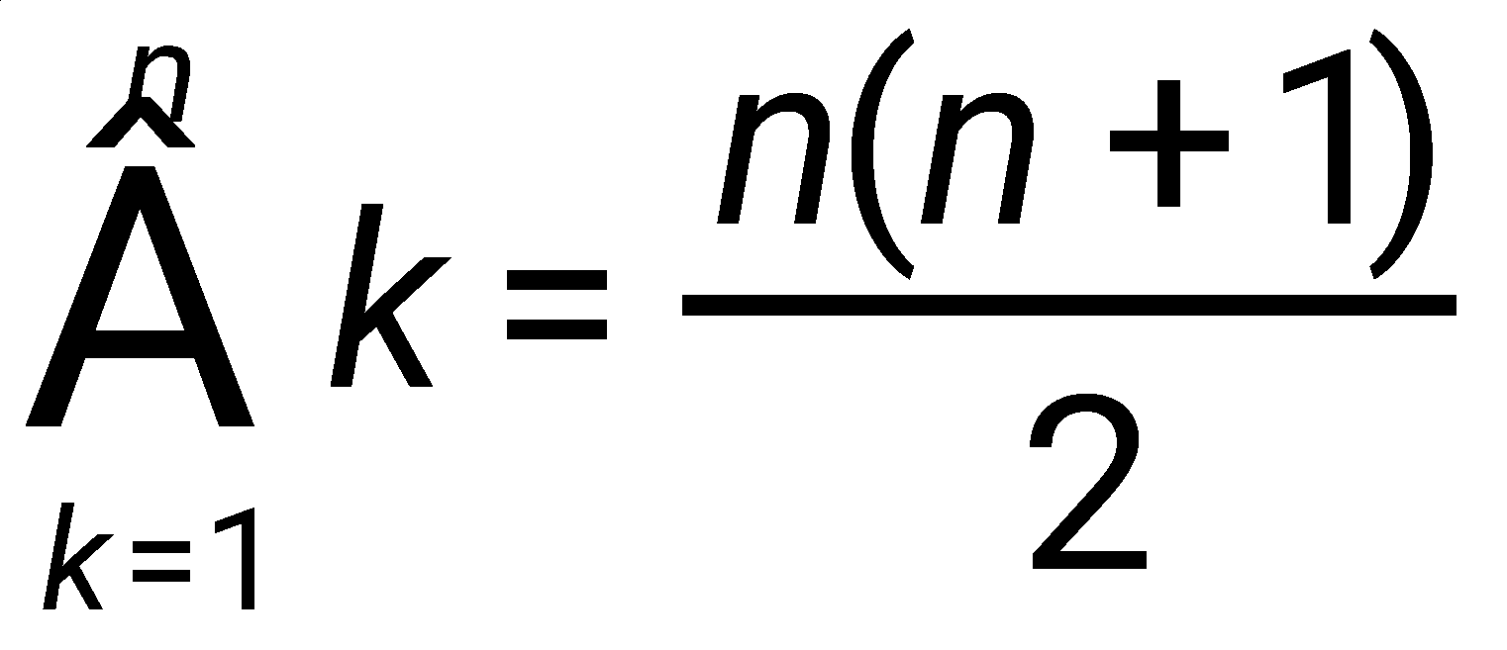
Closed Form Solutions
A simple formula that can be used to calculate a sum without doing all the additions.
Example:
Proof: First we note that k² - (k-1)² = k² - (k²-2k+1) = 2k-1. Since k²-(k-1)² = 2k-1, then we can sum each side from k=1 to k=n

Slide 44
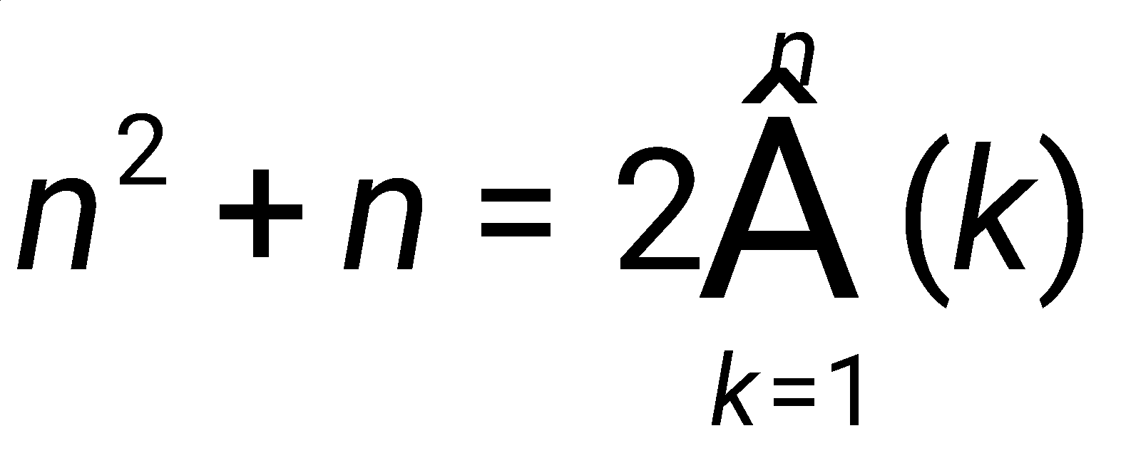
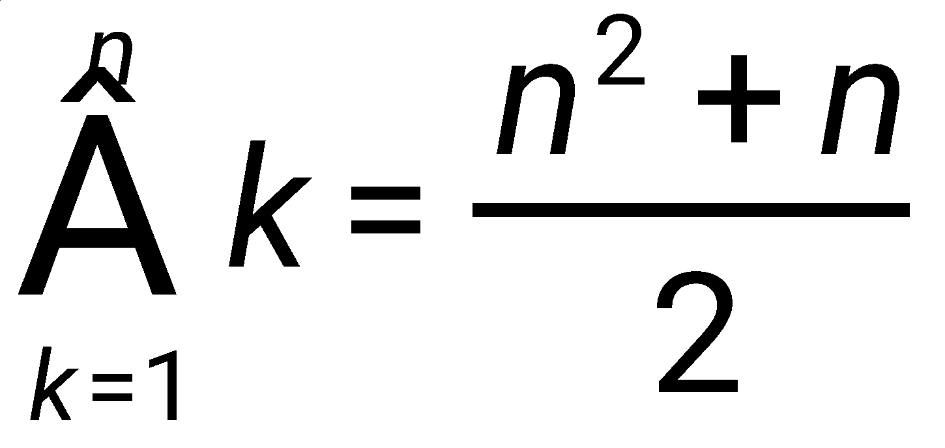
Proof (cont.)
Notes:
1.7: Ex 20, 21a

Slide 45
Big-O Notation
Let f and g be functions from the set of integers or the set of real numbers to the set of real numbers. We say that f(x) is O(g(x)) if there are constants C∈N and k∈R such that
|f(x)| ≤ C|g(x)| whenever x > k.
We say “f(x) is big-oh of g(x)”.
The intuitive meaning is that as x gets large, the values of f(x) are no larger than a constant time the values of g(x), or f(x) is growing no faster than g(x).
The supposition is that x gets large, it will approach a simplified limit.

Slide 46
Show that 3x³+2x²+7x+9 is O(x³)
Proof: We must show that ∃ constants C∈N and k∈R such that |3x³+2x²+7x+9| ≤ C|x³| whenever x > k.
Choose k = 1 then
3x³+2x²+7x+9 ≤ 3x³+2x³+7x³+9x³ = 21x³
So let C = 21.
Then 3x³+2x²+7x+9 ≤ 21 x³ when x ≥ 1.

Slide 47
Show that n! is O(n^{n})
Proof: We must show that ∃ constants C∈N and k∈R such that |n!| ≤ C|n^{n}| whenever n > k.
n! = n(n-1)(n-2)(n-3)…(3)(2)(1)
≤ n(n)(n)(n)…(n)(n)(n) n times
=n^{n}
So choose k = 0 and C = 1

Slide 48
General Rules
Multiplication by a constant does not change the rate of growth. If f(n) = kg(n) where k is a constant, then f is O(g) and g is O(f).
The above means that there are an infinite number of pairs C,k that satisfy the Big-O definition.
Addition of smaller terms does not change the rate of growth. If f(n) = g(n) + smaller order terms, then f is O(g) and g is O(f).
Ex.: f(n) = 4n⁶ + 3n⁵ + 100n² + 2 is O(n⁶).

Slide 49
General Rules (cont.)
If f₁(x) is O(g₁(x)) and f₂(x) is O(g₂(x)), then f₁(x)f₂(x) is O(g₁(x)g₂(x)).
Examples:
10xlog₂x is O(xlog₂x)
n!6n³ is O(n!n³)
=O(n^{n+3})

Slide 50
Example: Big-Oh Not Symmetric
Order matters in big-oh. Sometimes f is O(g) and g is O(f), but in general big-oh is not symmetric.
Consider f(n) = 4n and g(n) = n². f is O(g).
Can we prove that g is O(f)? Formally, ∃ constants C∈N and k∈R such that |n²| ≤ C|4n| whenever n > k?
No. To show this, we must prove that negation is true for all C and k. ∀C∈N, ∀k∈R, ∃n>k such that n² > C|4n|.

Slide 51
∀C∈N, ∀k∈R, ∃n>k such that n² > 4nC.
To prove that negation is true, start with arbitrary C and k. Must show/construct an n>k such that n² > 4nC
Easy to satisfy n > k, then
To satisfy n²>4nC, divide both sides by n to get n>4C. Pick n = max(4C+1,k+1), which proves the negation.

Slide 52
Steps in an Induction Proof
Basis step : The proposition is shown to be true for n=1 (or, more generally, the first element in the set)
Inductive step: The implication P(n)→P(n+1) is shown to be true for every positive integer n (more generally, for every integer element above a lower bound, which could be negative).
For n∈Z⁺
[P(1)∧∀n(P(n)→P(n+1))] →∀nP(n)

Slide 53
Example:If p(n) is the proposition that the sum of the first n positive integers is n(n+1)/2, prove p(n) for n∈Z⁺.
Basis Step: We will show p(1) is true.
p(1) = 1(1+1)/2 = 2/2 = 1
Inductive Step:
We want to show that p(n) → p(n+1)
Assume 1+2+3+4+. . . + n = n(n+1)/2
Then 1+2+3+4+. . . + n + (n+1) = n(n+1)/2 + n+1 = n(n+1)/2 + (n+1)(2/2) =
[n(n+1) + 2(n+1)]/2 = [n² + 3n +2]/2 = [(n+1)(n+2)]/2
Since p(1) is true and p(n) → p(n+1), then p(n) is true for all positive integers n.

Slide 54
If p(n) is the proposition that the sum of the first n odd integers is n², prove p(n) for n∈Z⁺
Induction Proof
Basis Step: We will show that p(1) is true.
1 = 1²
Inductive Step
We want to show that p(n) → p(n+1)
Assume 1 + 3 + 5 + 7 + . . .+ (2n-1) = n²
Then 1 + 3 + 5 + 7 + . . .+ (2n-1) + (2n + 1) = n² + 2n + 1 = (n+1)²
Since p(1) is true and p(n) → p(n+1), then p(n) is true for all positive integers n.

Slide 55
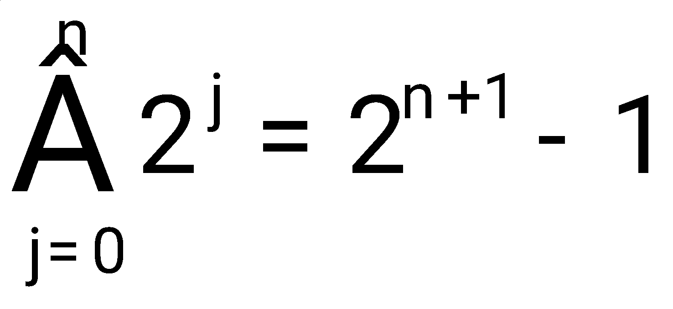
If p(n) is the proposition that prove p(n) when n is a non-negative integer.
Inductive Proof
Basis Step: We will show p(0) is true.
2⁰ = 1 = 2-1 = 2⁰⁺¹ -1
Inductive step: We want to show that p(n) → p(n+1)
Assume 2⁰ + 2¹ + 2² + 2³ + . . . + 2^{n} = 2^{n+1} - 1, then
2⁰ + 2¹ + 2² + 2³ + . . . + 2^{n} + 2^{n+1} = 2^{n+1} - 1 + 2^{n+1}
= 2(2^{n+1}) -1 = 2^{n+2} - 1
Since p(0) is true and p(n) → p(n+1), then p(n) is true for all nonnegative integers n.

Slide 56
Second Principle of Mathematical Induction (Strong Induction)
Basis Step: The proposition p(1) is shown to be true.
Inductive Step: It is shown that [p(1)∧p(2)∧ … ∧p(n)] → p(n+1) is true for every positive integer n.
Sometimes have multiple basis steps to prove.

Slide 57
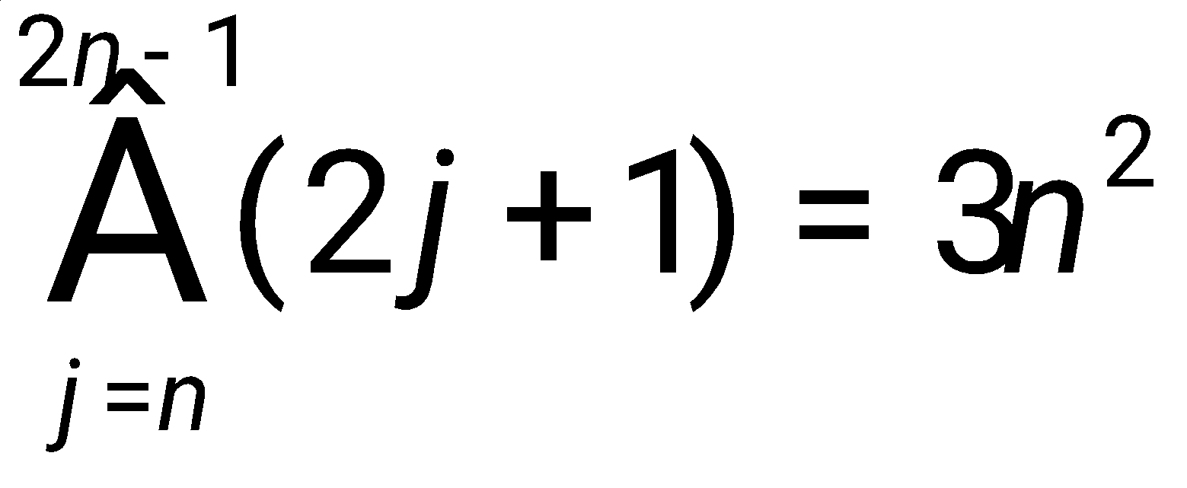
Prove that whenever n is a positive integer.
Proof:
Basis Case: Let n = 1, then

Slide 58
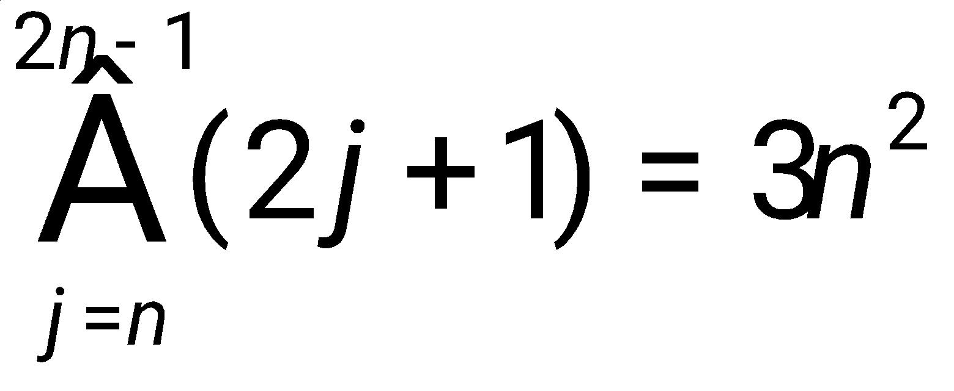
Prove that whenever n is a positive integer.
Inductive Case:
Assume that the expression is true for n, i.e., that
Then we must show that:

Slide 59
