Slide 1
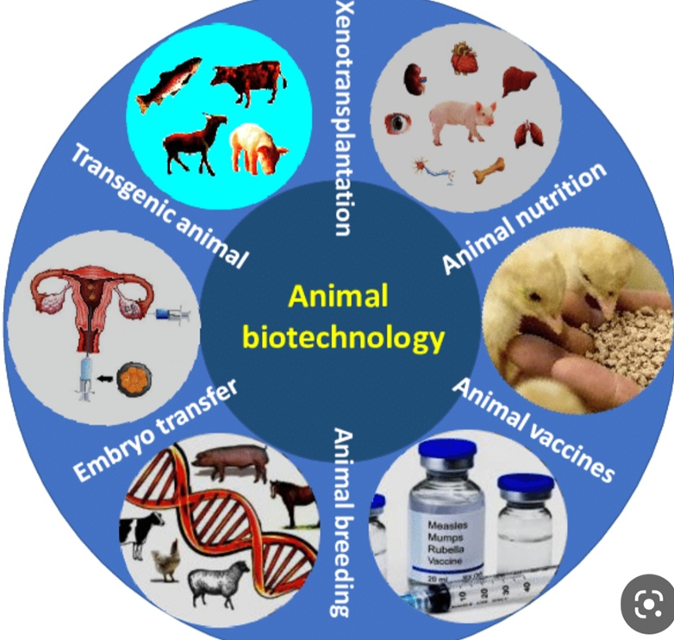
Biotechnology
Assist. Prof. Dr. Hurea Haddad
2023

Slide 2
Biotechnology – using living organisms, or the products of living organisms, for human benefit to make a product or solve a problem• Historical Examples (Fermentation, Selective breeding, Use of antibiotics)

Slide 3
Branches Of Biotechnology
-Animal Biotechnology
-Medical Biotechnology
-Environment Biotechnology
-Industria;L Biotechnology
-Plant Biotechnology

