Slide 1
Economic Systems

Slide 2
Economic Systems
Def. The method used by a society to produce and distribute goods and services.
The way a society produces goods & services
The way a society provides and distributes goods & services to its citizens

Slide 3
All Economic Systems Must Consider the Following Questions:
What goods and services to produce?
How will they produce them?
Who will get them?
How much will they produce now, and how much later?
Each economic system answers these questions in a DIFFERENT WAY.

Slide 4
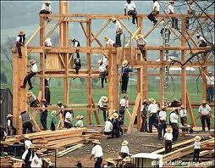
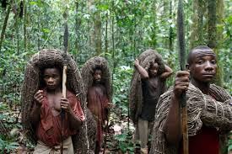
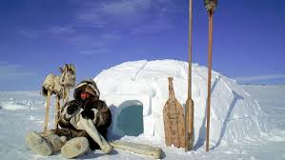
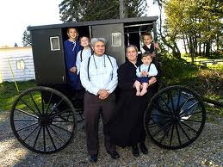
There are 3 basic types of economic systems. 1. Traditional Economy
Economic questions are answered by habits and customs
Children work the same jobs parents worked, often farming or hunter/gatherer
Ex. Eskimos, the Amish,
Pigmies .

Slide 5
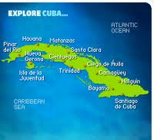
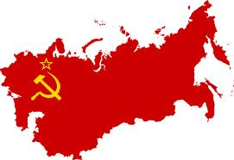
2. Command Economy
The government answers the basic economic questions
Advantages: able to act quickly in emergencies, provide for all people equally
Disadvantages: Inefficient, no incentive to work hard or be creative
Ex. Communist Countries (China, Vietnam, North Korea, former
Soviet Union, Cuba)

Slide 6
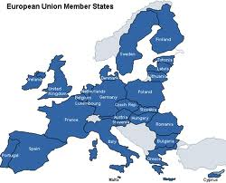
3. Free Market Economy
Economic questions are answered by individual buyers and sellers.
Supply and demand influence economy
People act out of self interest; motive for profit (money) drives the economy
Also known as FREE ENTERPRISE or CAPITALISM
Ex. The United States, Western
Europe, Japan

Slide 7
I said there were 3 types of economic systems, but there is a 4th!
Mixed Economy: No economy is pure market, pure command or pure traditional, elements of each appear in all economies, some have more elements of one economy than another.
Market Mixed Command
USA Great Britain China

Slide 8
American Mixed Economy
While the United States is mostly a free market economy, it does have elements of a command economy.

