Slide 1
Calculus II
Lecture #5
Techniques of Integration

Slide 2
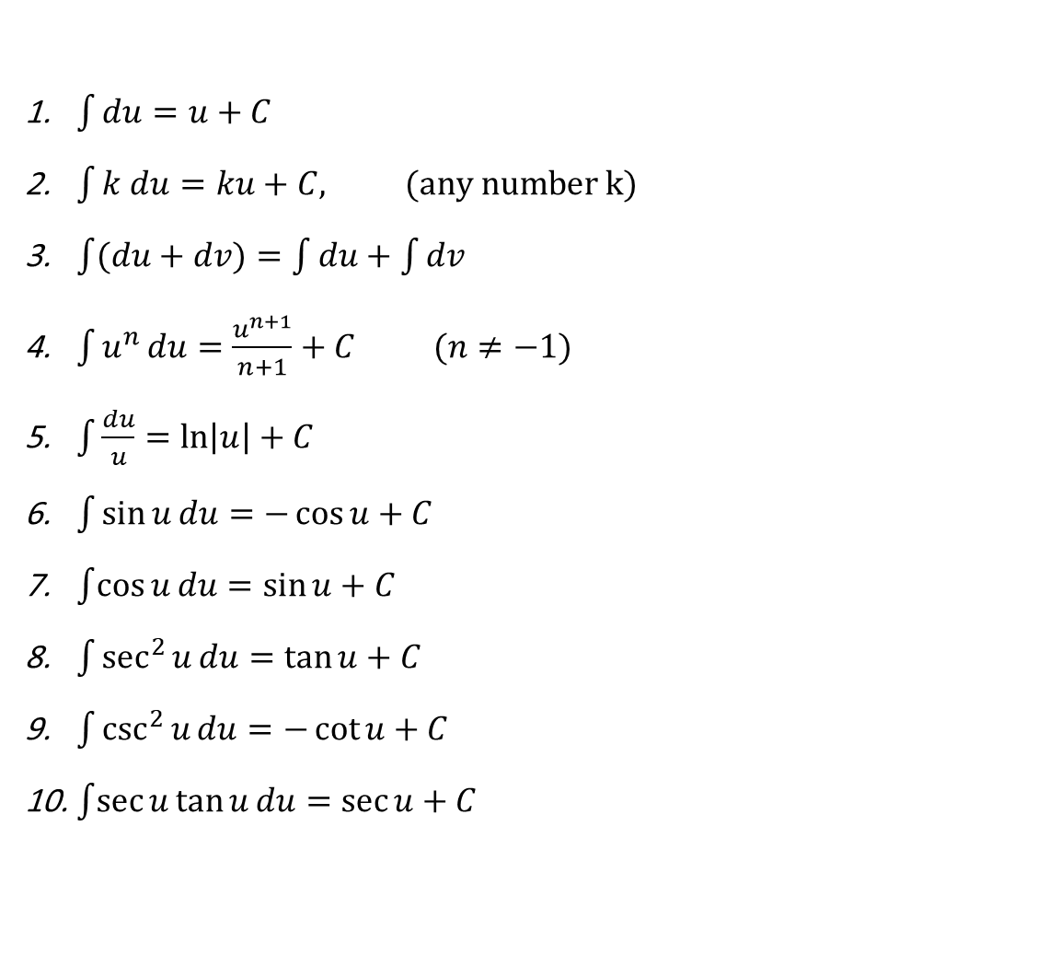
Basic Integration Formulas
$\int{du}=u+C$
$\int{k du}=ku+C, (any number k)$
$\int{(du}+dv)=\int{du}+\int{dv}$
$\int{u^{n}}du=\frac{u^{n+1}}{n+1}+C (n≠−1)$
$\int{\frac{du}{u}}=\ln\left|u\right|+C$
$\int{\sin{u}}du=−\cos{u}+C$
$\int{\cos{u}}du=\sin{u}+C$
$\int{\sec^{2}{u}}du=\tan{u}+C$
$\int{\csc^{2}{u}}du=−\cot{u}+C$
$\int{\sec{u}}\tan{u}du=\sec{u}+C$

Slide 3
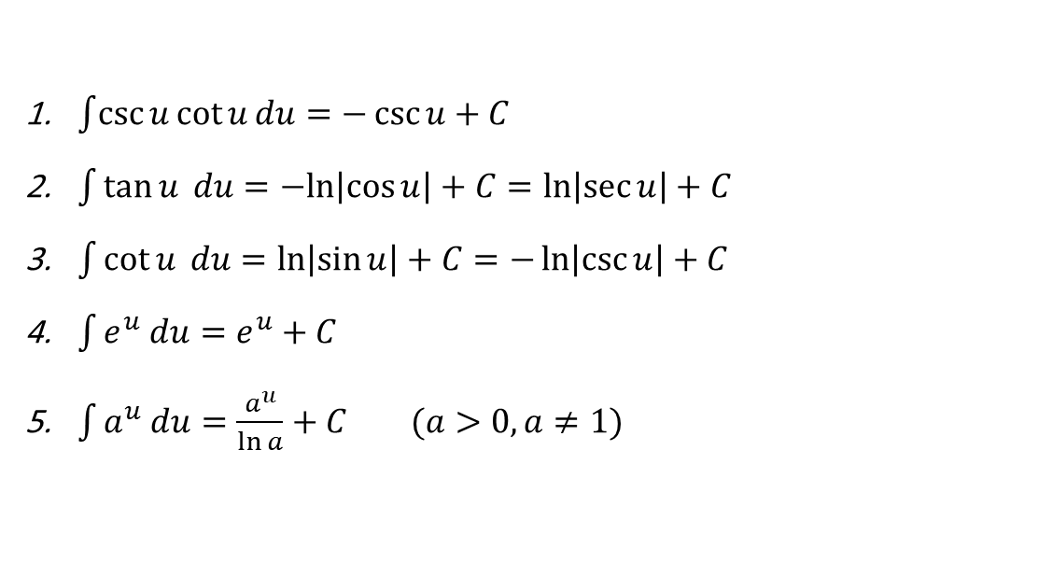
Basic Integration Formulas
$\int{\csc{u}}\cot{u}du=−\csc{u}+C$
$\int{\tan{u} du}=−ln\left|\cos{u}\right|+C=\ln\left|\sec{u}\right|+C$
$\int{\cot{u} du}=\ln\left|\sin{u}\right|+C=−\ln\left|\csc{u}\right|+C$
$\int{e^{u} du}=e^{u}+C$
$\int{a^{u} du}=\frac{a^{u}}{\ln{a}}+C (a>0, a≠1)$

Slide 4

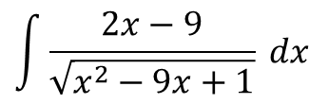
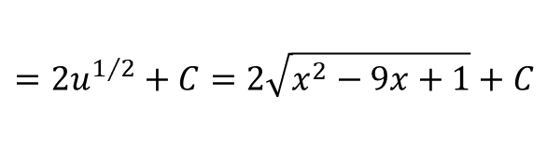
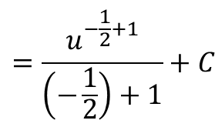
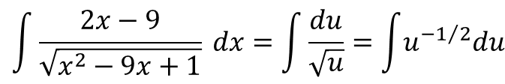
Making a simplifying substitution
Example 1: Evaluate the following integral
$$\int{\frac{2x−9}{\sqrt{x^{2}−9x+1}}} dx$$
Solution:
Let:$u=x^{2}−9x+1 , du=2x−9$
$$\int{\frac{2x−9}{\sqrt{x^{2}−9x+1}}} dx=\int{\frac{du}{\sqrt{u}}}=\int{u^{−1/2}du}$$
$$=\frac{u^{−\frac{1}{2}+1}}{\left(−\frac{1}{2}\right)+1}+C$$
$$=2u^{1/2}+C=2\sqrt{x^{2}−9x+1}+C$$

Slide 5
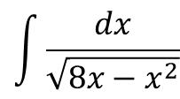
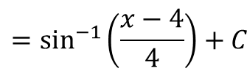

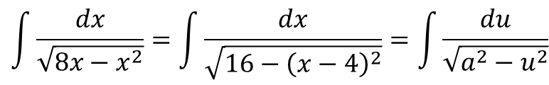
Completing the Square
Example 2: Evaluate the following integral
$$\int{\frac{dx}{\sqrt{{8x−x}^{2}}}}$$
Solution:
$$8x−x^{2}=−\left(x^{2}−8x\right)=−\left(x^{2}−8x+16\right)+16=16−{\left(x−4\right)}^{2}$$
$$\int{\frac{dx}{\sqrt{{8x−x}^{2}}}}=\int{\frac{dx}{\sqrt{16−{\left(x−4\right)}^{2}}}}=\int{\frac{du}{\sqrt{a^{2}−u^{2}}}}$$
$${=sin}^{−1}\left(\frac{u}{a}\right)+C$$
$${=sin}^{−1}\left(\frac{x−4}{4}\right)+C$$

Slide 6

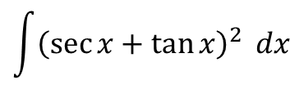
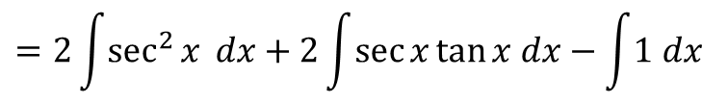

Expanding a Power and Using Trigonometric Identity
Example 3: Evaluate the following integral
$$\int{{\left(\sec{x+\tan{x}}\right)}^{2}} dx$$
Solution:
$$\int{{\left(\sec{x+\tan{x}}\right)}^{2}} dx=\int{{\left(sec\right.}^{2}{x}}+2\sec{x}\tan{x+}\tan^{2}{x) dx}$$
But, $\sec^{2}{x}=\tan^{2}{x+1}$, therefore,
$$\int{{\left(sec\right.}^{2}{x}}+2\sec{x}\tan{x+}\tan^{2}{x) dx}=\int{{\left(sec\right.}^{2}{x}}+2\sec{x}\tan{x+}\sec^{2}{x}−1) dx$$
$$=2\int{\sec^{2}{x}} dx+2\int{\sec{x}\tan{x dx}}−\int{1 dx}$$
$$=2\tan{x}+2\sec{x}−x+C$$

Slide 7
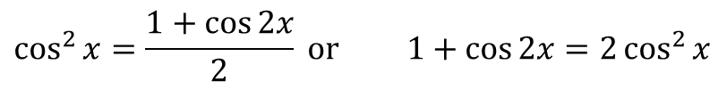
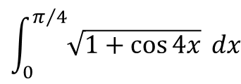
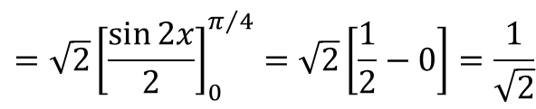
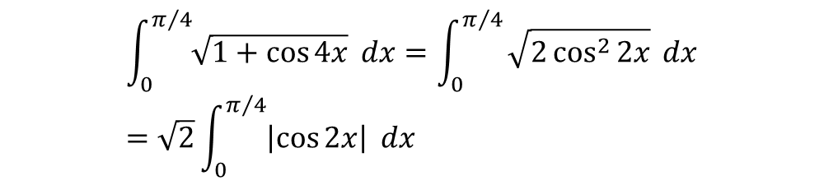
Eliminating a Square Root
Example 4: Evaluate the following integral
$$\int_{0}^{π/4}{\sqrt{1+\cos{4x}}} dx$$
Solution:
$$\cos^{2}{x}=\frac{1+\cos{2x}}{2} or 1+\cos{2x}=2\cos^{2}{x}$$
$$With the same identity the angle x can be doubled:1+ cos{4x}=2\cos^{2}{2x}$$
$$\int_{0}^{π/4}{\sqrt{1+\cos{4x}}} dx=\int_{0}^{π/4}{\sqrt{2\cos^{2}{2x}}} dx=\sqrt{2}\int_{0}^{π/4}{\left|\cos{2x}\right|} dx$$
$$=\sqrt{2}{\left[\frac{\sin{2x}}{2}\right]}_{0}^{π/4}=\sqrt{2}\left[\frac{1}{2}−0\right]=\frac{1}{\sqrt{2}}$$

Slide 8
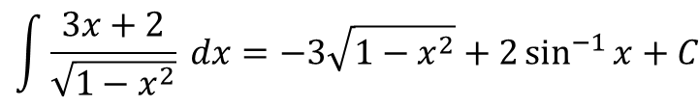
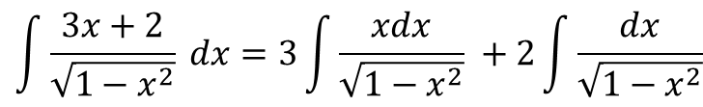
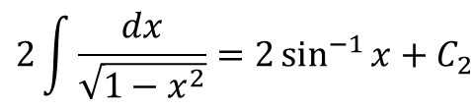
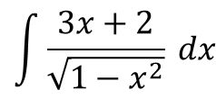
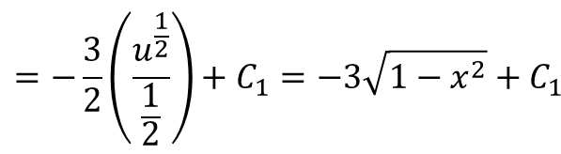
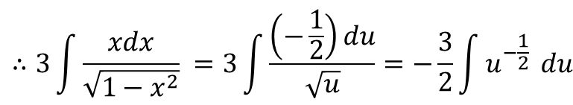
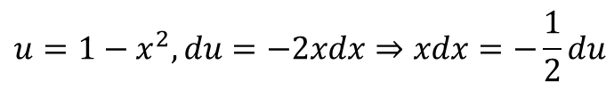
Separating a fraction
Example 5: Evaluate the following integral
$$\int{\frac{3x+2}{\sqrt{1−x^{2}}}} dx$$
Solution:
The second of these integrals will be solved as:
$$\int{\frac{3x+2}{\sqrt{1−x^{2}}}} dx=3\int{\frac{xdx}{\sqrt{1−x^{2}}}} +2\int{\frac{dx}{\sqrt{1−x^{2}}}}$$
$$2\int{\frac{dx}{\sqrt{1−x^{2}}}}=2\sin^{−1}{x}+C_{2}$$
$$u=1−x^{2}, du=−2xdx⇒xdx=−\frac{1}{2}du$$
The combination of these results and renaming C₁ + C₂ as C will give:
The first of these integrals will be solved as:
$$∴3\int{\frac{xdx}{\sqrt{1−x^{2}}}} =3\int{\frac{\left(−\frac{1}{2}\right)du}{\sqrt{u}}}=−\frac{3}{2}\int{u^{−\frac{1}{2}}} du$$
$$\int{\frac{3x+2}{\sqrt{1−x^{2}}}} dx=−3\sqrt{1−x^{2}}+2\sin^{−1}{x}+C$$
$$=−\frac{3}{2}\left(\frac{u^{\frac{1}{2}}}{\frac{1}{2}}\right)+C_{1}=−3\sqrt{1−x^{2}}+C_{1}$$

