Slide 1

Lecture Notes in
Advanced Computer Skills (MATLAB)
for MSc Degree
of
Mathematics
Imad A. Aziz Erbil
2022-2023

Slide 2
CHAPTER 1 INTRODUCTION to MATLAB
1.1 INTRODUCTION
MATLAB, which stands for MATrix LABoratory, is a state-of-the-art mathematical software package, which is used extensively in both academia and industry. It is an interactive program for numerical computation and data visualization, which along with its programming capabilities provides a very useful tool for almost all areas of science and engineering. Unlike other mathematical packages, such as MAPLE or MATHEMATICA, MATLAB cannot perform symbolic manipulations without the use of additional Toolboxes. It remains however, one of the leading software packages for numerical computation
1.1.1 Starting MATLAB
However you start MATLAB, you will briefly see a window that displays the MATLAB logo as well as some product information, and then a MATLAB Desktop window will launch. That window will contain a title bar, a menu bar, a tool bar and four embedded windows. The largest and most important window is the Command Window on the middle, the Command History Window and the Workspace in right, the Current Directory Browser in left. For now we concentrate on the Command Window in order to get you started issuing MATLAB commands as quickly as possible. At the top of the Command Window, you may see some general information about MATLAB, perhaps some special instructions for getting started or accessing help, but most important of all, you will see a command prompt (>> ). If the Command Window is “active,” its title bar will be dark, and the prompt will be followed by a cursor (a blinking vertical line). That is the place where you will enter your MATLAB commands. If the Command Window is not active, just click in it anywhere. Figure 1.1 contains an example of a newly launched MATLAB Desktop.

Slide 3
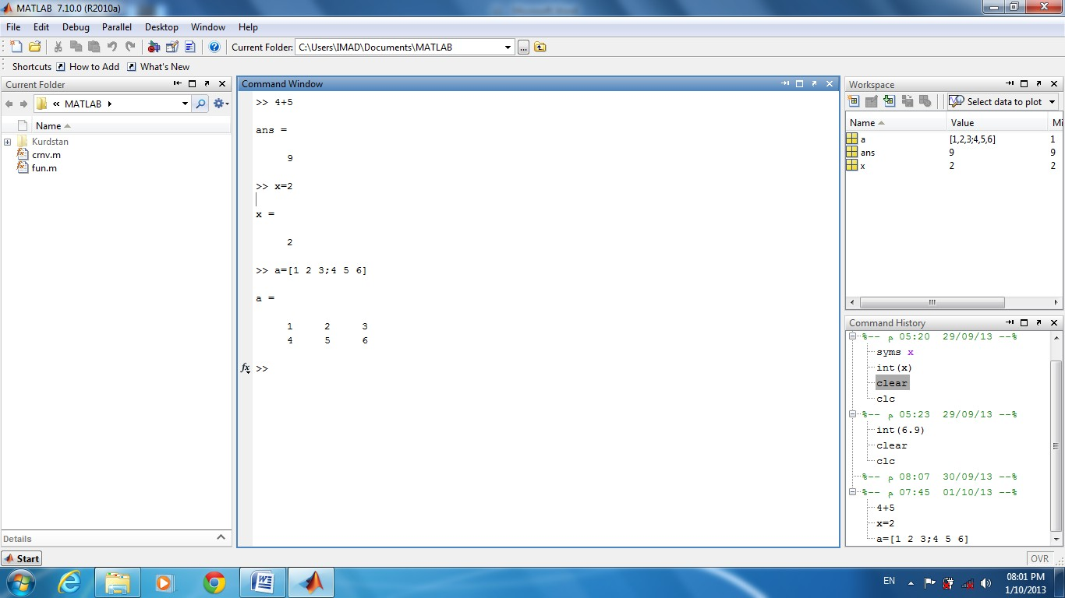
Figure 1.1
Command Window: - Use the Command Window to enter variables and to run MATLAB functions and scripts. MATLAB displays the results. Press
the up arrow key ↑ to recall a statement you previously typed. Edit the statement as needed, and then press Enter to run it.
Command History:-Statements you enter in the Command Window are logged with a timestamp in the Command History. From the Command History, you can view and search for previously run statements, as well as copy and execute selected statements.
Workspace: - The workspace consists of the set of variables built up during a session of using the MATLAB software and stored in memory. You add variables to the workspace by using functions, running M-files, and loading saved workspaces.
Current Directory Browser:-the files and subdirectories it contains are listed in the Current Directory Browser.

Slide 4
1.1.2 Typing in Command Window
Abort
In order to abort a command in MATLAB, hold down the control key and press c to generate a local abort with MATLAB.
The Semicolon (;)
If a semicolon (;) is typed at the end of a command the output of the command is not displayed.
Typing %
When percent symbol (%) is typed in the beginning of a line, the line is
designated as a comment. When the enter key is pressed the line is not executed.
The clc Command
Typing clc command and pressing enter cleans the command window. Once the
clc command is executed a clear window is displayed.
Help
MATLAB has a host of built-in functions. For a complete list, refer to MATLAB users
guide or refer to the on line Help. To obtain help on a particular topic in the list,
e.g., inverse, type help inv.
1.1.3 Display Format
MATLAB has several different screen output formats for displaying numbers. These formats can be found by typing the help command: help format in the Command Window. A few of these formats are shown in Table

Slide 5
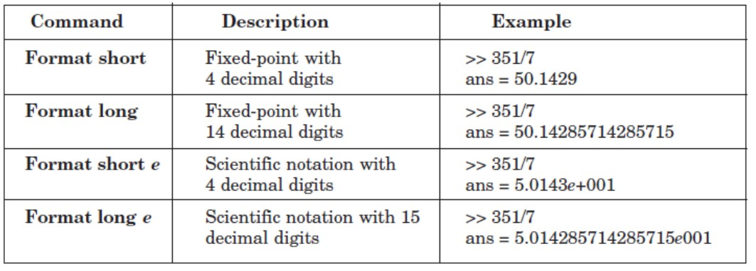
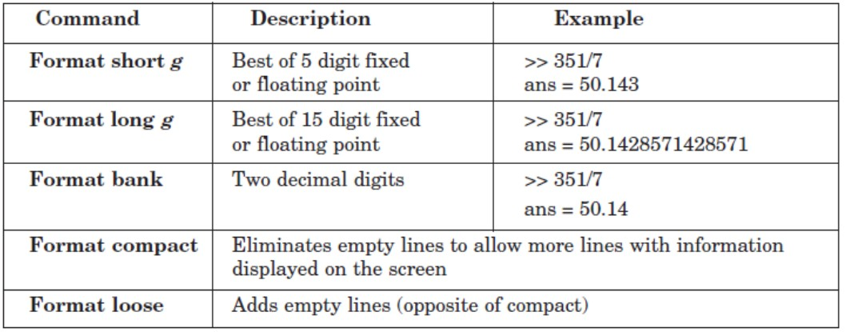
1.2 Arithmetic Operations
The symbols for arithmetic operations with scalars are summarized below in Table

Slide 6
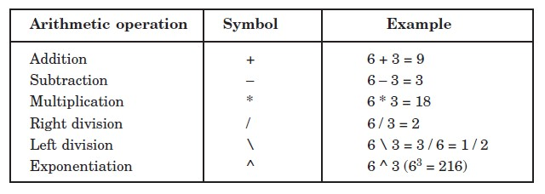
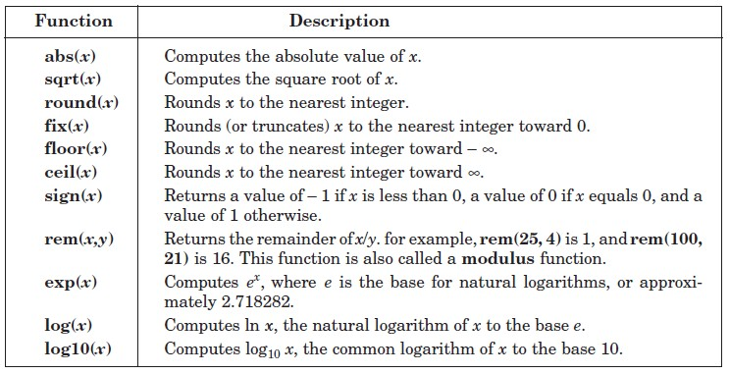
1.3 Elementary Math Built in Functions
MATLAB contains a number of functions for performing computations which require the use of logarithms, elementary math functions, and trigonometric math functions. List of these commonly used elementary MATLAB mathematical built-in functions are given in Tables.

Slide 7
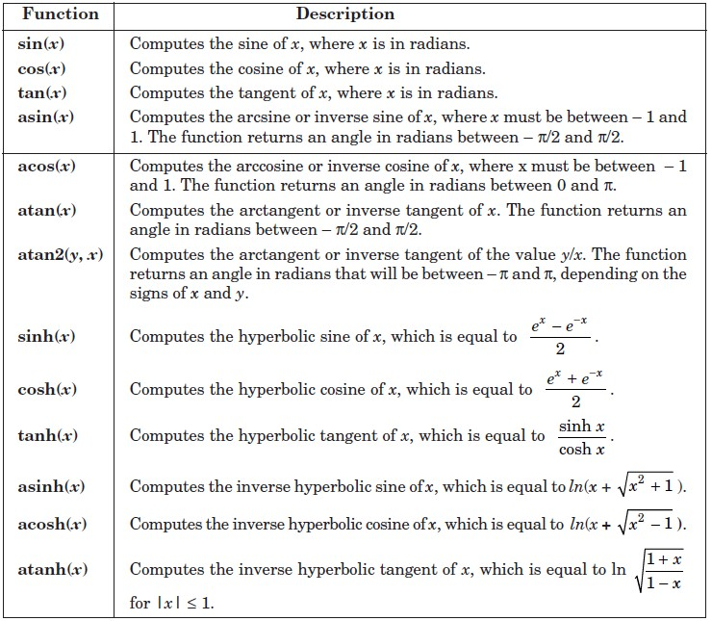
1.4 Variable Names
A variable is a name made of a letter or a combination of several letters and digits. Variable names can be up to 63 (in MATLAB 7) characters long (31 characters on MATLAB 6.0). MATLAB is case sensitive. For instance, XX, Xx, xX, and xx are the names of four different variables. It should be noted here that not to use the names of a built-in functions for a variable. For instance, avoid using: sin, cos, exp, sqrt, ..., etc. Once a function name is used to define a variable, the function cannot be used.

Slide 8
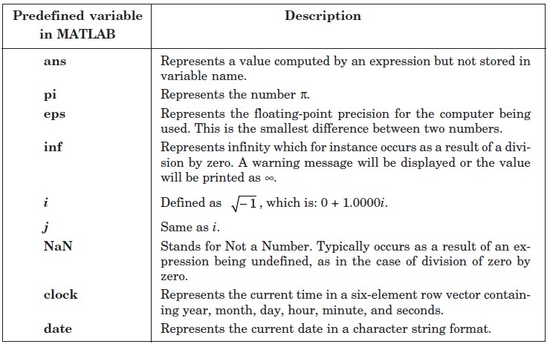
1.4.1 Predefined Variables
MATLAB includes a number of predefined variables. Some of the predefined variables that are available to use in MATLAB programs are summarized in Table
1.4.2 Command for Managing Variables
Table below lists commands that can be used to eliminate variables or to obtain information about variables that have been created. The procedure is to enter the command in the Command Window and the Enter key is to be pressed.

Slide 9
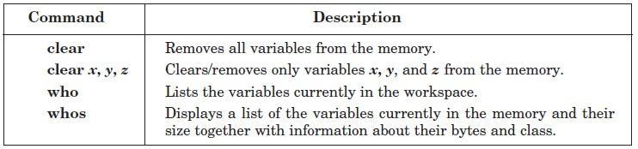
1.5 Complex Numbers
Complex numbers consist of two separate parts: a real part and an imaginary part. The basic imaginary unit is equal to the square root of -1. This is represented in MATLAB by either of two letters: i or j.
1.5.1 Creating Complex Numbers
The following statement shows one way of creating a complex value in MATLAB. The variable x is assigned a complex number with a real part of 2 and an imaginary part of 3:
x = 2 + 3i;
Another way to create a complex number is using the complex function. This function combines two numeric inputs into a complex output, making the first input real and the second imaginary:
x = 4;
y = -1;
z = complex(x, y) z =
4.0000 -1.0000i

Slide 10
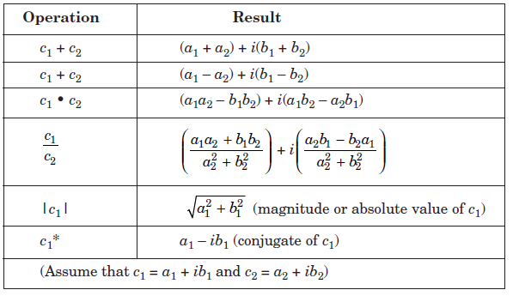
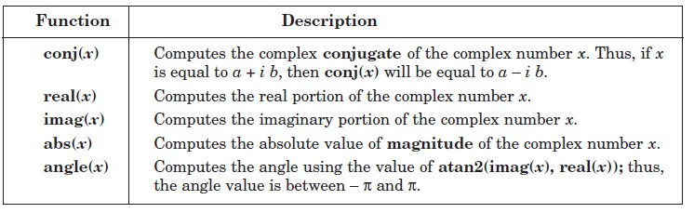
1.5.2 Arithmetic operations with complex numbers
1.5.3 Complex number functions

Slide 11

CHAPTER 2 VECTORS AND MATRICES
  Arrays
An array is a list of numbers arranged in rows and/or columns. A one-dimensional array is a row or a column of numbers and a two-dimensional array has a set of numbers arranged in rows and columns. An array operation is performed element- by-element.
    Row Vector
A vector is a row or column of elements.
In a row vector the elements are entered with a space or a comma between the elements inside the square brackets. For example,
x = [7 – 1 2 – 5 8]
    Column Vector
In a column vector the elements are entered with a semicolon between the elements inside the square brackets. For example,
x = [7 ; – 1 ; 2 ; – 5 ; 8]
  Matrix
A matrix is a two-dimensional array which has numbers in rows and columns. A matrix
is entered row-wise with consecutive elements of a row separated by a space or a
comma, and
the rows separated by semicolons or carriage returns. The entire matrix is enclosed within
square brackets. The elements of the matrix may be real numbers or complex
numbers. For
example to enter the matrix,

Slide 12

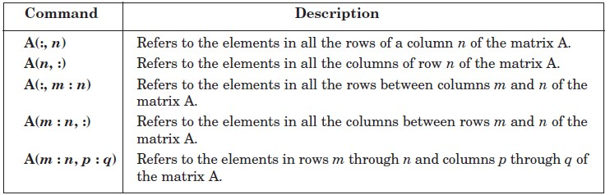
The MATLAB input command is
A = [1 3 – 4 ; 0 – 2 8]
Similarly, for complex number elements of a matrix B
The MATLAB input command is
B = [– 5 * x log(2 * x) + 7 * sin (3 * y) ; 3i 5 – 13i]
  Addressing Arrays
A colon can be used in MATLAB to address a range of elements in a vector or a matrix.
    Colon for a vector
Va(:) – refers to all the elements of the vector Va (either a row or a column vector). Va(m : n) – refers to elements m through n of the vector Va.
For instance
>> V = [2 5 – 1 11 8 4 7 – 3 11]
>> u = V(2 : 8)
u = 5 – 1 11 8 4 7 – 3 11
    Colon for a matrix
Table below gives the use of a colon in addressing arrays in a matrix.

Slide 13
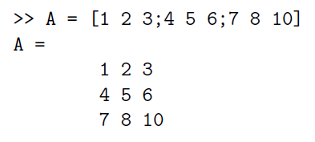
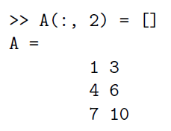
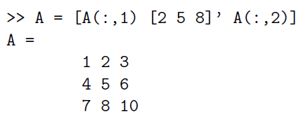
2.3.3 Deleting Elements
An element, or a range of elements, of an existing variable can be deleted by reassigning
blanks to these elements. This is done simply by the use of square brackets with
nothing typed in between them.
2.3.4 Adding Elements to a Vector or a Matrix
A variable that exists as a vector, or a matrix, can be changed by adding elements to it.
Addition of elements is done by assigning values of the additional elements, or by
appending existing variables. Rows and/or columns can be added to an existing matrix by assigning values to the new rows or columns.
2.4 Element-by-element operations
Element-by-element operations can only be done with arrays of the same size. Elementby- element multiplication, division, and exponentiation of two vectors or

Slide 14
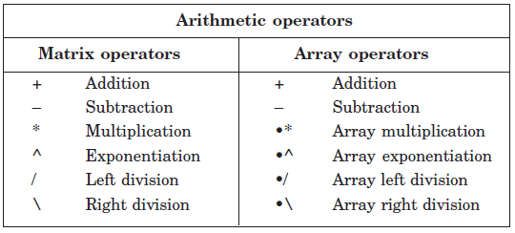
matrices is entered in MATLAB by typing a period in front of the arithmetic operator. Table below lists these operations
  Identity, Ones and Zeros Matrix
The function eye(m,n), ones(m,n) , zeros(m,n) returns an m-by-n rectangular identity ,all elements ones, all elements zero matrix and eye(n) returns an n-by-n square identity matrix and same for others.
  Built-in Functions for Arrays
Table below lists some of the many built-in functions available in MATLAB for analyzing
arrays.
Transpose
In MATLAB, the transpose of the matrix A is denoted by A'
Diagonal of matrix
diag (A) :-When A is a matrix, creates a vector from the diagonal elements of A.
diag (v) When v is a vector, creates a square matrix with the elements of v in the diagonal.

Slide 15
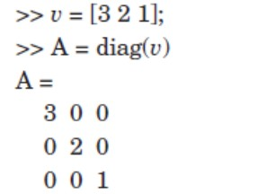
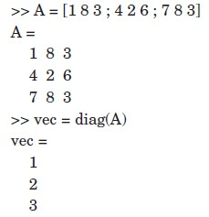
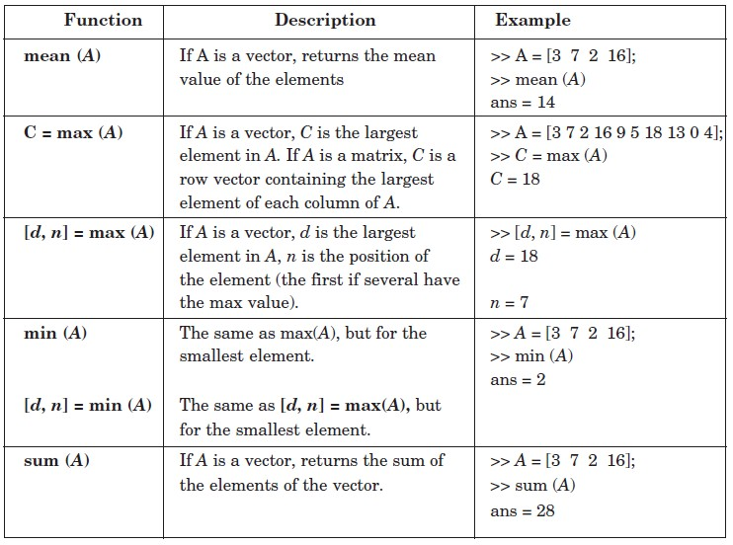
Also we have tril or triu functions to find lower or upper triangular of matrix.
c.

Slide 16
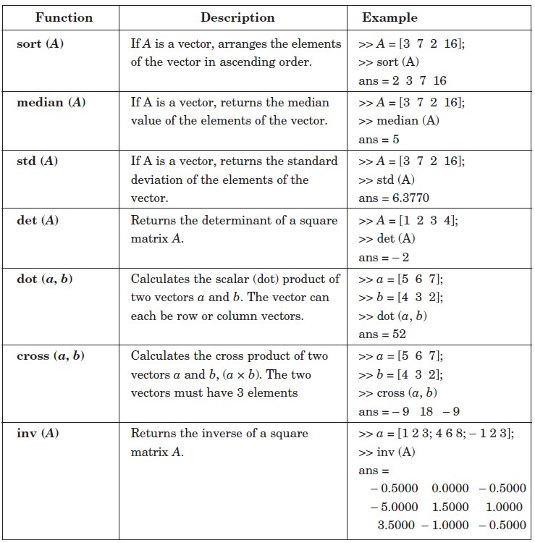

Slide 17
  Matrix dimension functions
    length(A): - Length of vector or largest array dimension.
    size(A): - returns the sizes of each dimension of array.
    ndims(A): - Number of array dimensions.
    reshape (A, m, n): - Rearrange a matrix A that has r rows and s columns to have m rows and n columns. r times s must be equal to m times n.
Example: - Let
𝐴 = (₃
Then
>> length(A) ans =
4
>> size(A) ans =
2 5 0 7
4 − 1
₄)
2 4
>> ndims(A) ans =
2
>> reshape(A,4,2) ans =
2 | 0
3 | -1
5 | 7
4 | 4
2.8 Relational and Logical Operators
A relational operator compares two numbers by finding whether a comparison statement is true (1) or false (0). A logical operator examines true/false statements and produces a result which is true or false according to the specific operator.

Slide 18
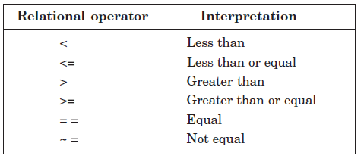
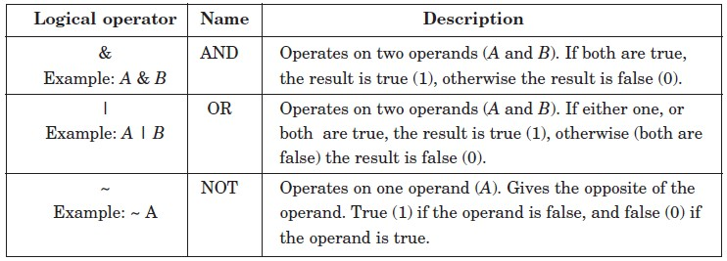
Relational operators Table
Logical operators Table
Example:-
>> 3>2 ans = 1 >> 3<2 ans = 0 >> k=3 k = 3 >> k<9 | a = 1 0 2 -3 b = 2 0 -1 5 >> b>a ans = 1 0 0 1 >> b~=1 ans = 1 1 1 1 | k = -3 >> k>0 | k<0 ans = 1 >> k>0 & k<0 ans = 0 >> k<0 ans = 1 | a = 1 0 2 -3 b = 2 0 -1 5 >> a|b ans = 1 0 1 1 >> a&b ans = 1 0 1 1

Slide 19
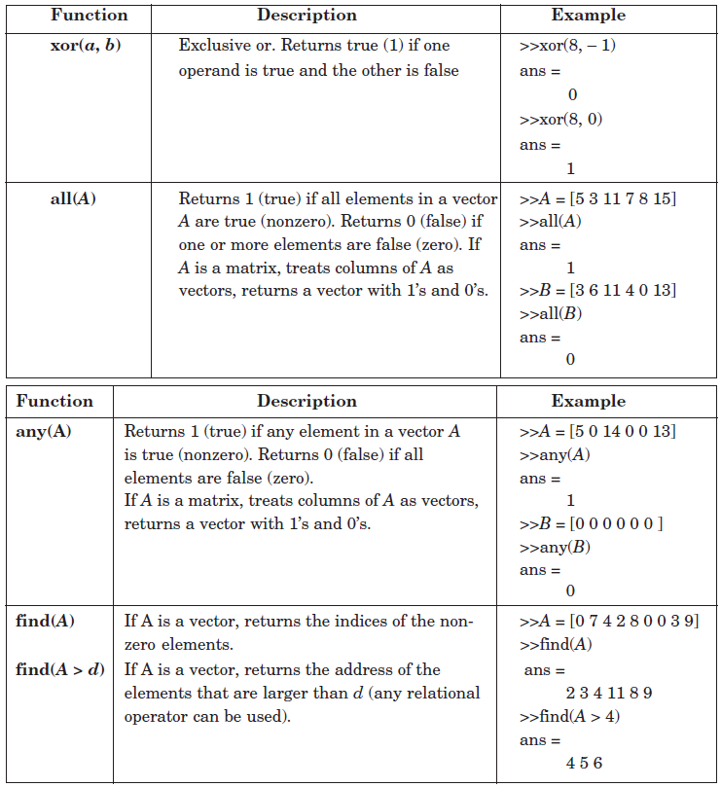
ans = 1 | >> a>0 ans = 1 0 1 0 | >> ~(k<0) ans = 0 | >> ~a ans = 0 1 0 0
Additional logical built-in functions Table

Slide 20
CHAPTER 3
PROGRAMMING IN MATLAB
  M-files: Scripts and functions
To take advantage of MATLAB’s full capabilities, we need to know how to construct long (and sometimes complex) sequences of statements. This can be done by writing the commands in a file and calling it from within MATLAB. Such files are called “m-files” because they must have the filename extension “.m”. This extension is required in order for these files to be interpreted by MATLAB.
There are two types of m-files: script files and function files.
Script files contain a sequence of usual MATLAB commands, that are executed (in order) once the script is called within MATLAB. For example, if such a file has the name compute .m , then typing the command compute at the MATLAB prompt will cause the statements in that file to be executed. Script files can be very useful when entering data into a matrix.
Example:- Create the script file then write a program to find the roots of equation 2x² -3x+1=0.
Sol:
% This Program written to Find the Roots of Equation 2x^2- 3x+1=0%
a=2; b=-3; c=1;
x1=(-b+sqrt(b^2-4*a*c))/2 x2=(-b-sqrt(b^2-4*a*c))/2
  Input and output command
    Disp(X)
disp(X) displays an array, without printing the array name. If X contains a text string, the string is displayed. Another way to display an array on the screen is to type its name, but this prints a leading "X=," which is not always desirable. Note that disp does not display empty arrays.

Slide 21
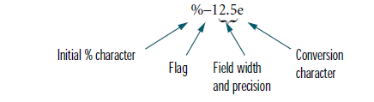
>> disp('string expression'); string expression
>> A=[3,2;2,3];
disp(A);
3
2
2
3
Input
The input function can be used for requesting user input. For example,
r=input('value for r: ');
displays value for r:
to the screen and waits for the user to enter an expression which is then assigned to r.
fprintf
The fprintf command displays output (text and data) on the screen or saves it to a file. The output can be formatted using this command.
fprintf (format,A,...) writes to standard output—the screen. The format string specifies notation, alignment, significant digits, field width, and other aspects of output format. It can contain ordinary alphanumeric characters; along with escape characters, conversion specifiers, and other characters, organized as shown below:

Slide 22
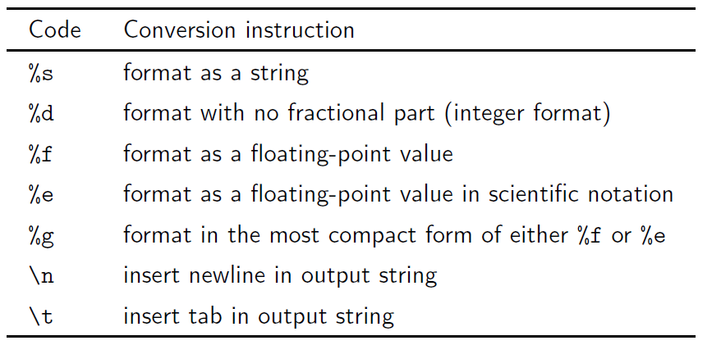
For more information, see “Tables” and “References”
Example:-
>> x = 2; y = sqrt(x);
>> fprintf('The squrt root of %g is %9.4f\n',x,y) The squrt root of 2 is 1.4142
Example:-
>> x = 1:4; y = sqrt(x);
>> fprintf('The squrt root of %d is %4.2f\n',[x;y])
The | squrt | root | of | 1 | is | 1.00
The | squrt | root | of | 2 | is | 1.41
The | squrt | root | of | 3 | is | 1.73
The | squrt | root | of | 4 | is | 2.00

Slide 23
3.3 Conditional Execution
3.3.1 Conditional Execution or Branching:
As the result of a comparison, or another logical (true/false) test, selected blocks of program code are executed or skipped. Conditional execution is implemented with if, if...else, and if...elseif constructs, or with a switch construct.
There are three types of if constructs
Plain if
if...else
if...elseif
if Constructs Syntax:
if expression
block of statements
end
The block of statements is executed only if the expression is true.
Example:
if a < 0
disp(’a is negative’);
end
One-line format uses comma after if expression
if a < 0, disp(’a is negative’); end
if. . . else
Multiple choices are allowed with if. . . else and if. . . elseif constructs
if x < 0

Slide 24
error(’x is negative; sqrt(x) is imaginary’);
else
r = sqrt(x); end
if. . . elseif
It’s a good idea to include a default else to catch cases that don’t match preceding
if and elseif blocks
if x > 0
disp(’x is positive’);
elseif x < 0
disp(’x is negative’);
else
disp(’x is exactly zero’);
end
3.3.2 The switch Construct
A switch construct is useful when a test value can take on discrete values that are either integers or strings.
Syntax:
switch expression case value1,
block of statements case value2,
block of statements
...
otherwise,

Slide 25
block of statements end
Example:
color = ’...’; % color is a string
switch color
case ’red’
disp(’Color is red’); case ’blue’
disp(’Color is blue’); case ’green’
disp(’Color is green’);
otherwise
disp(’Color is not red, blue, or green’);
end
3.4 Repetition or Looping
A sequence of calculations is repeated until either
All elements in a vector or matrix have been processed or
The calculations have produced a result that meets a predetermined termination criterion
Looping is achieved with for loops and while loops.
3.4.1 for loops
for loops are most often used when each element in a vector or matrix is to be processed.

Slide 26
Syntax:
for index = expression
block of statements end
Example: Sum of elements in a vector
x = 1:5; % create a row vector sumx = 0; % initialize the sum for k = 1:length(x)
sumx = sumx + x(k); end
3.4.2 for loop variations
Example: A loop with an index incremented by two
for k = 1:2:n
...
end
Example: A loop with an index that counts down
for k = n:-1:1
...
end
Example: A loop with non-integer increments
for x = 0:pi/15:pi
fprintf(’%8.2f %8.5f\n’,x,sin(x)); end
Note: In the last example, x is a scalar inside the loop. Each time through the loop, x is set equal to one of the columns of 0:pi/15:pi.

Slide 27
3.4.3 while loops
while loops are most often used when an iteration is repeated until some termination criterion is met.
Syntax:
while expression block of statements
end
The block of statements is executed as long as expression is true.
Example: Here is a simple example of a script M-file that uses while to numerically sum the infinite series 1/14 + 1/24 + 1/34 +· · ·, stopping only when the
terms become so small (compared to the machine precision) that the numerical sum stops changing:
n = 1; oldsum = -1; newsum = 0; while newsum > oldsum
oldsum = newsum;
newsum = newsum + nˆ(-4); n = n + 1;
end newsum
Note:-It is (almost) always a good idea to put a limit on the number of iterations to be performed by a while loop.
An improvement on the preceding loop,
n = 1; oldsum = -1; newsum = 0;
maxit = 25; it = 0;
while newsum > oldsum & it<maxit oldsum = newsum;
newsum = newsum + nˆ(-4);

Slide 28
n = n + 1; it = it + 1;
end newsum

Slide 29
CHAPTER 4 FUNCTIONS
  Function files
on the other hand, play the role of user defined commands that often have input and output. You can create your own commands for specific problems this way, which will have the same status as other MATLAB commands. Let us give a simple example. The text below is saved in a file called log3.m and it is used to calculate the base 3 logarithm of a positive number. The text file can be created in a variety of ways, for example using the built-in MATLAB editor through the command edit (that is available with MATLAB 5.0 and above), or your favorite (external) text editor (e.g. Notepad or Wordpad in Microsoft Windows). You must make sure that the filename has the extension “.m” !
function [a] = log3(x) a = log(abs(x))./log(3); end
» log3(5) ans =
1.4650
Syntax:
The first line of a function m-file has the form:
function [outArgs] = funName(inArgs)
outArgs are enclosed in [ ]
    outArgs is a comma-separated list of variable names
    [ ] is optional if there is only one parameter
    functions with no outArgs are legal
inArgs are enclosed in ( )
    inArgs is a comma-separated list of variable names
    functions with no inArgs are legal

Slide 30
Example:- Write the function to find Fibonnaci sequence.
function f = Fib1(n) F=zeros(1,n+1);
F(2) = 1;
for i = 3:n+1
F(i) = F(i-1) + F(i-2);
End End
Example:- Write the function to find area and perimeter of triangle.
function [A s] = area(a,b,c) s = (a+b+c)/2;
A = sqrt(s*(s-a)*(s-b)*(s-c)); End
  Loop and Function Cotroal
    return
return is used to force an exit from a function. This can have the effect of escaping from a loop. Any statements following the loop that are in the function body are skipped.
    break
break is used to escape from an enclosing while or for loop. Execution continues at the end of the enclosing loop construct.
Example: - write a function to check that the input number is prime or not.
function [p] = prim(x) p=0;
for i=2:x-1
if rem(x,i)==0 p=1;
return

Slide 31
end
end end
in above example we have only one element input but if we write program to work with array of element as an input we must write the program as follow
function p = prim(a) p=zero(size(a)); for i=1:length(a)
for j=2:a(i)-1
if rem(a(i),j)==0 p(i)=1;
Break
end end
end end
c. continue
The continue statement passes control to the next iteration of the for loop or while loop in which it appears, skipping any remaining statements in the body of the loop. In nested loops, continue passes control to the next iteration of the for loop or while loop enclosing it.
Example:- find the s where
𝑛
1
^{𝑠 = ∑} 𝑖 − 3
𝑖=0
𝑖≠3
n=input('n=') s=0;
for i=0:n
if i==3, continue, end s=s+1/(i-3);
end
s

Slide 32
d. error (‘text’)
Terminates execution and displays the message contained in text on the screen.
Example: - Write the function to replace the last row with last column of input matrix.
function b = lr2lc(a) [n m]=size(a);
if n~=m
error('The matrix must be square') else
b=a; b(n,:)=a(:,m);
b(:,m)=a(n,:);
end end

Slide 33
CHAPTER 5 STRINGS
5.1 Character Strings
While Matlab is primarily intended for number crunching, there are times when it is desirable to manipulate text, as is needed in placing labels and titles on plots. In Matlab, text is referred to as character strings or simply strings.
5.1.1 String Construction
Character strings in Matlab are special numerical arrays of ASCII values that are displayed as their character string representation. For example:
>> text = ’This is a character string’
text =
This is a character string
>> size(text) ans =
>> whos | 1 | 26
Name |  | Size | Bytes | Class
ans |  | 1x2 | 16 | double array
text |  | 1x26 | 52 | char array
Grand total is 28 elements using 68 bytes
5.1.2 ASCII Codes
Each character in a string is one element in an array that requires two bytes per character for storage, using the ASCII code. This differs from the eight bytes per element required for numerical or double arrays. The ASCII codes for the letters 'A' to 'Z' are the consecutive integers from 65 to 90, while the codes for 'a' to 'z' are 97 to 122. The function abs returns the ASCII codes for a string.
>> text = ’This is a character string’

Slide 34
text =
This is a character string
>> d = abs(text) d =
Columns 1 through 12
84 104 105 115 32 105 115 32 97
104
Columns 13 through 24
32 99
97 114 97 99 116
105
Columns 25 through 26
110 103
101 114 32 115
116 114
The function char performs the inverse transformation, from ASCII codes to a string:
>> char(d) ans =
is a character string
The relationship between strings and their ASCII codes allow you to do the following:
>> alpha = abs(’a’):abs(’z’);
>> disp(char(alpha)) Abcdefghijklmnopqrstuvwxyz
5.2 Strings are Arrays
Since strings are arrays, they can be manipulated with array manipulation tools:
>> text = ’This is a character string’;
>> u = text(11:19) u =
character

Slide 35
As with matrices, character strings can have multiple rows, but each row must have an equal number of columns. Therefore, blanks are explicitly required to make all rows the same length.
For example:
>> v = [’Character strings having more than’ ’one row must have the same number ’ ’of columns - just like matrices ’]
v =
Character strings having more than one row must have the same number of columns - just like matrices
>> size(v)
ans =
3 34
  Concatenation of Strings
Because strings are arrays, they may be concatenated (joined) with square brackets. For example:
>> today = ’May’;
>> today = [today, ’ 18’]
today =
May 18
  String Conversions
num2str(x) :- Converts the matrix x into a string representation with about 4 digits and an exponent if required.
The num2str function can be used to convert numerical results into strings for use in formatting displayed results with disp. For example;
a=input('a=');
for i=1:length(a); if isprime(a(i))

Slide 36
disp([num2str(a(i)) ' is prime']) else
disp([num2str(a(i)) ' is not prime'])
end
end
run
a=[2 8 5]
2 | is | prime
8 | is | not prime
5 | is | prime
str2num(s) :- converts the string s which is an ASCII character representation of a numeric value, to numeric representation. str2num also converts string matrices to
numeric matrices. If the input string does not represent a valid number or matrix, str2num(s) returns the empty matrix. For example;
s='423' » str2num(s)=423 s='3 0 2 5' » a=str2num(s)
a= 3 0 2 5 is matrix
str2num('2 4; 6 8') ans =
2
6
4
8
5.5 String Functions
blanks(n) :-Returns a string of n blanks. Used with disp, eg.
disp ([’xxx’ blanks(10) ’yyy’]).
xxx yyy
disp(blanks(n)') moves the cursor down n lines.

Slide 37
deblank(s):- Removes trailing blanks from string s.
strtrim(s):- returns a copy of string s with all leading and trailing white-space characters removed.
str=' AB CD deblank(str)= ' strtrim(str)='AB CD'
'
AB CD'
findstr(s1, s2) :- Find one string within another. Returns the starting indices of any occurrences of the shorter of the two strings in the longer.
s = 'Find the starting indices of the shorter string'; findstr(s, 'the')
ans =
6 30
findstr('the', s) ans =
6 30
strcmp(s1, s2) :- Returns 1 if strings s1 and s2 are identical and 0 otherwise.
strcmp('Yes', 'No') ans =
0
strcmp('Yes', 'Yes') ans =
1
strncmp(s1, s2, n) :- Returns 1 if the first n characters of the strings s1 and s2 are identical and 0 otherwise.
strmatch(str, strs) :- Searches through the rows of the character array of strings strs to find strings that begin with string str, returning the matching row indices.
strrep(s1, s2, s3):- Replaces all occurrences of the string s2 in string s1 with the string s3. The new string is returned.

Slide 38
lower(s) :- Converts any uppercase characters in string s to the corresponding lowercase character and leaves all other characters unchanged.
upper(s):- Converts any lower case characters in s to the corresponding upper case character and leaves all other characters unchanged.
eval(s):- Execute the string s as a Matlab expression or statement.
Example:- write a program to draw the graph of input function.
f = input( ’Enter function (of x) to be plotted: ’, ’s’);
x = 0:0.01:10;
y= eval(f); plot(x,y),grid
Here’s how the command line looks after you enter the function:
>> Enter function (of x) to be plotted: exp(-0.5*x) .* sin(x)
Example:- You can concatenate strings to create a complete expression for input to eval. This code shows how eval can create 10 variables named P1, P2, ...P10, and set each of them to a different value.
for i=1:10 eval(['P',int2str(i),'= i.^2']) end

