Slide 1
Principle of Statistics
Slides prepared
By
Lecture Israa Muayad Ali
Department of Administration
First Stage
2022 - 2023

Slide 2
Statistics:
is the science of planning studies and experiments, obtaining data, reviewing, organizing, summarizing, presenting, analyzing, interpreting, and drawing conclusions based on the data to give the best decision.

Slide 3
Statistics divided into two parts:
Descriptive statistics: consists of methods for obtaining data, reviewing, organizing, summarizing and presenting data.
Inferential statistics: consists of methods for drawing conclusions based on the data to give the best decision. It is divided into two parts also:
Estimation.
Testing Hypothesis.

Slide 4
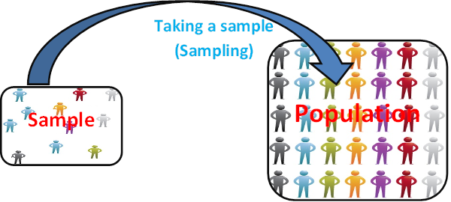
Population: is the complete collection of all elements to be studied.
Sample: is a sub-collection of elements drawn from a population.

Slide 5
Variable
Qualitative Variable
Quantitative Variable
Nominal Qualitative
Ordinal Qualitative
Discrete Quantitative
Continuous Quantitative

Slide 6
Variable: is a characteristic or property of the elements in the population. The name “variable” is derived from the fact that any particular characteristic may vary among the elements in a population.

Slide 7
Types of Variables
Qualitative variables: They are variables that can be placed into distinct categories, according to some characteristics or attributes. For example, gender (male, Female), grades of students in a course (A, B, C, D), and survey responses (yes, no, undecided).
Quantitative variables: They are numerical in nature and can be ordered or ranked. For example, the variable “Age” is numerical, and people can be ranked in order according to the value of their ages. Quantitative variables can be classified as:

Slide 8
Types of Quantitative Variable
Discrete variables: A variable is discrete if its range can assume only a finite or infinite number of values that is countable. For example, the number of children in a family.
Continuous variables: A variable is continuous if its range is uncountable. For example, the weights of students in a class.

Slide 9
Types of Qualitative Variable
Nominal Variables: It is characterized by data that consist of names, labels, or categories only. The data cannot be arranged in an ordering scheme (Such as low to high). For example, the genders of students (male, female).
Ordinal Variables: It involves data that may be arranged in some order, but differences between data values either cannot be determined or are meaningless. For example, the letter graded of students (A, B, C, and D).

Slide 10
Phenomenal or Problem
Collection data
Organizing summarizing data
Analysis
Result
Make decision

Slide 11
Data: are the values (Measurements or observations) that the variables can assume.
Sources of Collecting the Data
Historical Sources.
Field Sources.
Methods of Collecting the Data
Census.
Samples.
Census: is the collection of data from every element in a population.

Slide 12
Types of samples :-
Random samples : a sample collected in such a way that every element in the population has the same chance of selection .
Non – Random sample : has not the same chance of selection .

Slide 13
Types of random sample :
Simple random sampling : use these method when the population homogenous .
ئاسانترين جؤري بذاردةية بة مةرجيَ كؤمةلَطاكة ويَكضوبيَت .
EX:
If you have (4) person ……… A , B , C , D
How many way you select (2) person for (4) .
$$γ=\left({N \atop n}\right)\frac{N!}{n!(N−n)! }$$
N= population .
n=sample .
r= number of select way .

Slide 14
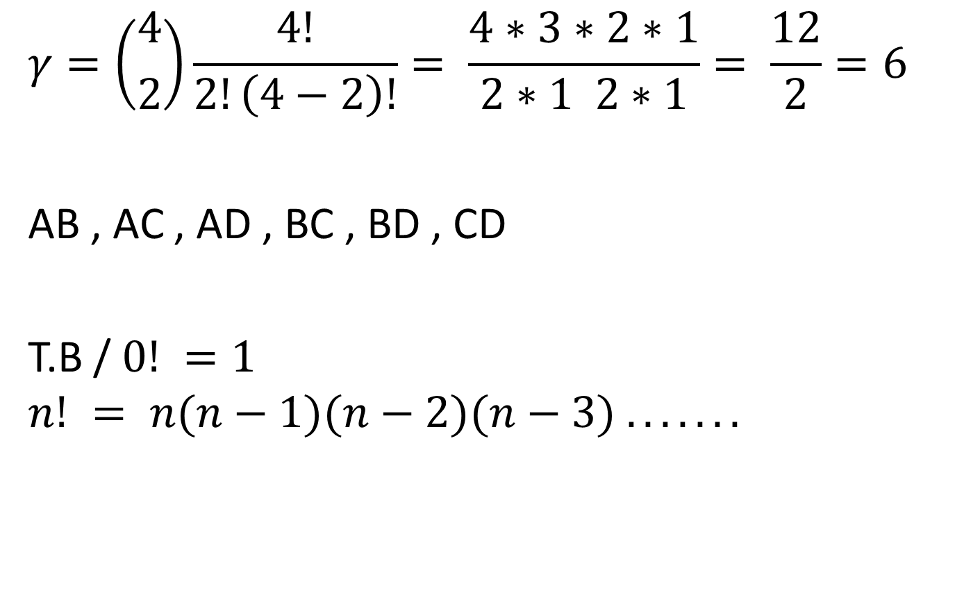
$$γ=\left({4 \atop 2}\right)\frac{4!}{2!\left(4−2\right)!}= \frac{4∗3∗2∗1}{2∗1 2∗1}= \frac{12}{2}=6$$
AB , AC , AD , BC , BD , CD
T.B / $0! =1$
$$n! = n(n−1)(n−2)(n−3) . . . . . . .$$

Slide 15
2-Stratified random sampling . بذاردةى هةرةمةكي ئالَؤز
Use these method when the population non- homogenous the sample select by dividing the population into groups (strata) according to same characteristic and then taken samples from each group by using simple random sampling .
N population
n sample size
$$N_{1}$$ | $$N_{2}$$ | $$N_{3}$$ | ……… | $$N_{i}$$
$$n_{1}$$ | $$n_{2}$$ | $$n_{3}$$ | ……… | $$n_{i}$$

Slide 16
$n_{i}=\frac{N_{i}}{N}∗n$ $n_{i}=$بذاردةيةكى داواكراو
$N_{i}=$ذمارةي هةر ضينيَك لة ضينةكان
$N=$ذمارةى كؤمةلَطا
$n =$ئةو بذاردةيةي كة دةتةويَ
Example:
Suppose that in a company there are the following staff.
Male , full time = 90
Male , part time = 18
Female , full time = 9
Female , part time = 63
And we are asked to take a sample of 40 staff randomly ?

Slide 17
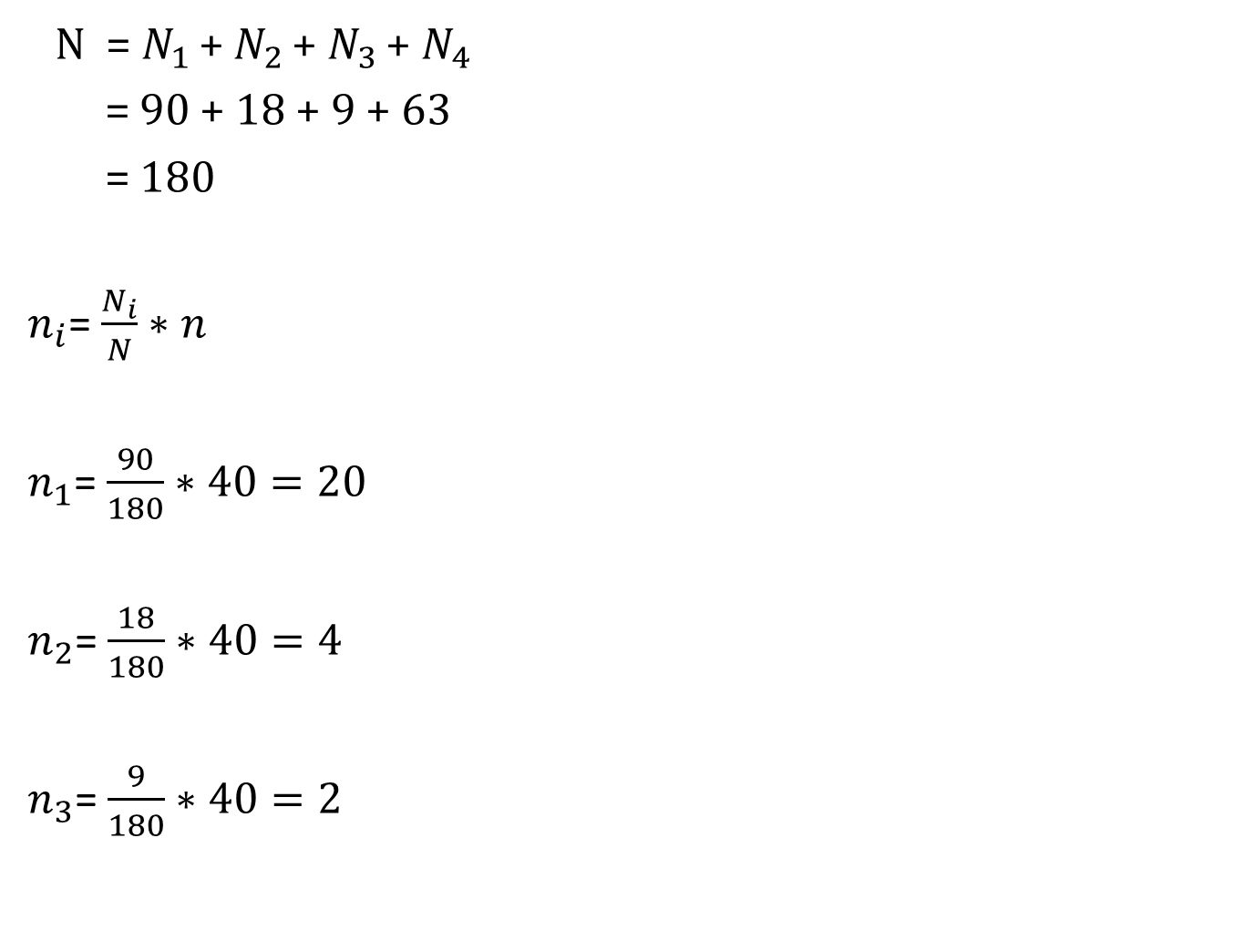
N = $N_{1 }$+ $N_{2 }$+${ N}_{3 }$+${ N}_{4 }$
= 90 + 18 + 9 + 63
= 180
$n_{i}$= $\frac{N_{i}}{N}∗n$
$n_{1}$= $\frac{90}{180}∗40=20$
$n_{2}$= $\frac{18}{180}∗40=4$
$n_{3}$= $\frac{9}{180}∗40=2$

Slide 18
$n_{4}$= $\frac{63}{180}∗40=14$
n= $n_{1 }$+ $n_{2 }$+${ n}_{3 }$+${ n}_{4 }$
= 20 + 4 + 2 + 14
= 40

Slide 19
3-Systematic random sampling : بذاردةي هةرةمةكي ريَكخراو
Systematic samples are obtained by numbering each element of the population and then selection every $k^{th}$ number .
K = $\frac{N}{n}= \frac{\# population}{\#sample}$
Ex:
Suppose there 24 elements in the population and a sample of 6 elements is needed?
K = $\frac{N}{n}= \frac{24}{6}=4$
3+k = 3 + 4 =7+k = 11+k = 15+k = 19 + k =23
4-Multistage random sampling : بذاردةي هةرةمةكي فرة قؤناغي

