Slide 1
Educational Texts
Asst Prof Dr Izzuddin. Aziz
2022

Slide 2
A Brief History of Education
We tend naturally to assume that there must be some good, logical reason for all this. Perhaps if we didn't force children to go to school, or if schools operated much differently.

Slide 3
A Brief History of Education
to understand why traditional schools are what they are, we must abandon the idea that they are products of logical necessity or scientific insight.
They are, instead, products of history. Schooling, as it exists today, only makes sense if we view it from a historical perspective.

Slide 4
To explain why schools are what they are, we could present here, in a nutshell, an outline of the history of education, from the beginning of humankind until now.

Slide 5
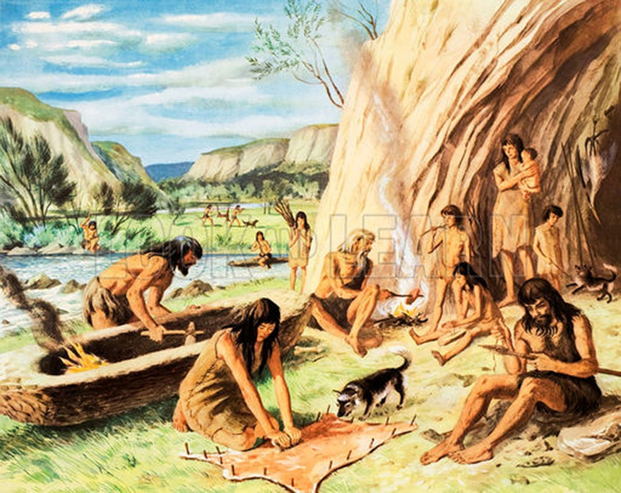
A Brief History of Education
In the beginning, for hundreds of thousands of years, children educated themselves through self-directed play and exploration.

Slide 6
A Brief History of Education
2. With the rise of agriculture and later industry, children became forced labourers. Play and exploration were suppressed. Willfulness, which had been a virtue, became a vice that had to be beaten out of children.

Slide 7
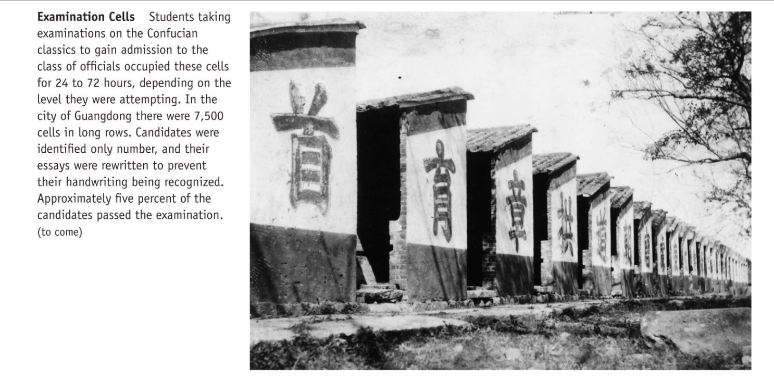
A Brief History of Education
3-For various reasons, some religious and some secular, the idea of universal, compulsory education arose and gradually spread. Education was understood as value inculcation.

Slide 8
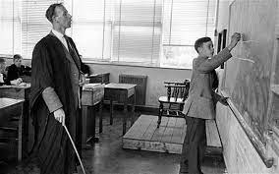
A Brief History of Education
4. With the rise of schooling, people began to think of learning as children's work. The same power-assertive methods used to make children work in fields and factories were naturally transferred to the classroom.

Slide 9
A Brief History of Education
5. In recent times, the methods of schooling have become less harsh, but basic assumptions have not changed. Learning continues to be defined as children's work, and power-assertive means are used to make children do that work.

Slide 10
Activity Review

Slide 11
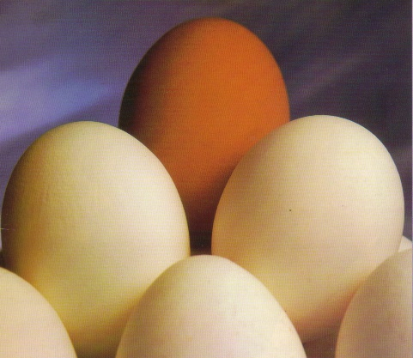
for attention

