Slide 2
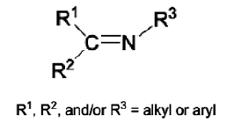
Schiff bases
Schiff bases are condensation products of primary amines and carbonyl compounds and they were discovered by a German chemist, Nobel Prize winner, Hugo Schiff in 1864.
Schiff-bases are considered as a very important class of organic compounds and have a wide application in many biological aspects, proteins, visual pigments, enzymatic.
Schiff bases are compounds containing azomethine group (-HC=N-). They are condensation products of ketones or aldehydes (aldehydes and ketones) with primary amines. Formation of Schiff base generally takes place under acid or base catalysis or with heat.
Structurally, Schiff base (also known as imine or azomethine) is an analogue of a ketone or aldehyde in which the carbonyl group (C=O) has been replaced by an imine or azomethine group .

Slide 3
A Schiff base is a nitrogen analog of an aldehyde or ketone in which the C=O group is replaced by C=N-R group. It is usually formed by condensation of an aldehyde or ketone with a primary amine according to the following scheme:
Where R, may be an alkyl or an aryl group. Schiff bases that contain aryl substituents are substantially more stable and more readily synthesized, while those which contain alkyl substituents are relatively unstable. Schiff bases of aliphatic aldehydes are relatively unstable and readily polymerizable ,while those of aromatic aldehydes having effective conjugation are more stable

Slide 4
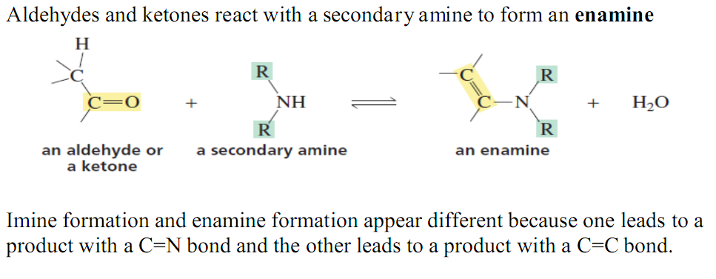

Slide 5
Overall, the addition of a nitrogen nucleophile to an aldehyde or a ketone is a
nucleophilic addition–elimination reaction. nucleophilic addition of an amine to form an unstable tetrahedral intermediate, followed by elimination of water.
* The lone pair on the nitrogen of an amine causes it to be nucleophilic as well as basic.
* An aldehyde has a greater partial positive charge on its carbonyl carbon than does a ketone because a hydrogen is electron withdrawing compared with an alkyl group An aldehyde, therefore, is less stable than a ketone, which makes it more reactive toward nucleophilic attack. Steric factors also contribute to the greater reactivity of an aldehyde.

Slide 6
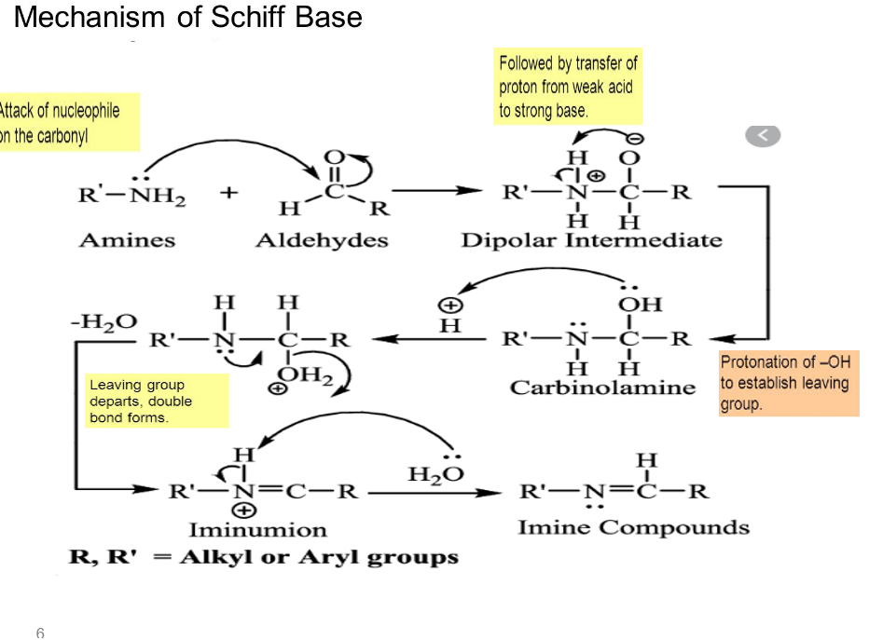

Slide 7
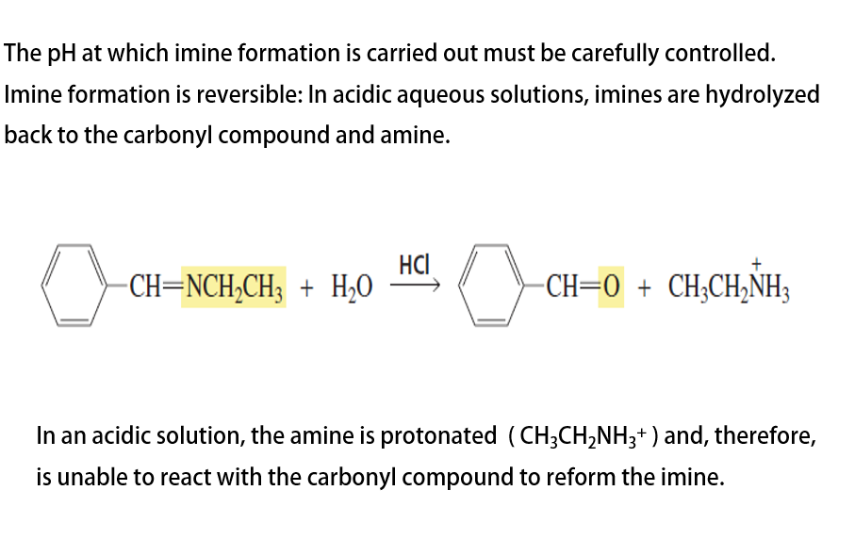

Slide 8
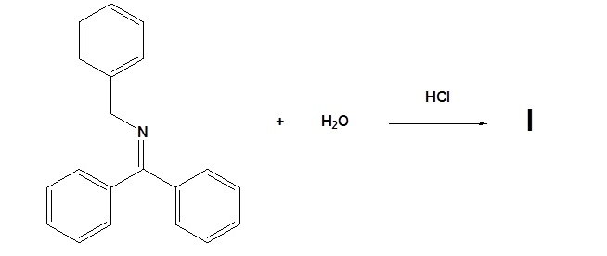
Procedure:
1-Mix 5mlof benzaldhyde and 5ml of aniline then add 1.0 of ethanol in conical flask.
2-Placethe conical in boiling water- bath and stir the mixture gently with a glass rod
3-Cool in ice bath to crystals produce.
4-Calcolute the yield and error.
Homework

Slide 9
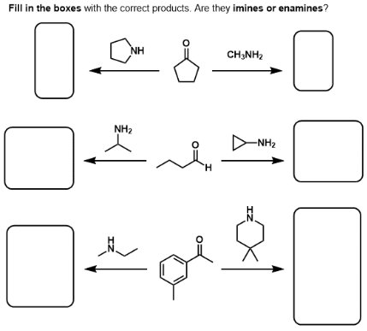

Slide 10
