Slide 1
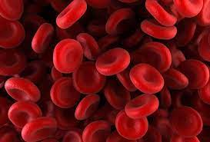
Hematology laboratory safety
Hematology is the study of blood and blood disorders.

Slide 2
Laboratory hazards
What are the overall potential Hazards in the hematology laboratory?
1- Biological hazards
2- Chemical hazards
3- Electrical hazards
4- Fire hazards

Slide 11
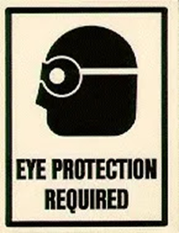

Slide 17
