Slide 1
University of Salahaddin–Erbil
College of Science
Department of Environmental Science
3rd Stage Environmental Science
The Effects of Acid rain on Seed Germination
BY: Jamal Kamal Muhammad Amin
E-mail: jamal.mohammedamin@su.edu.krd

Slide 2
The Effects of Acid rain on Seed Germination
Environmental POllution
Acid rain is caused by emissions of sulfur dioxide and nitrogen oxide, which react with the water molecules in the atmosphere to produce acids.
or
Any rainfall has a pH value less than 5.6 is defined as acid rain.

Slide 3
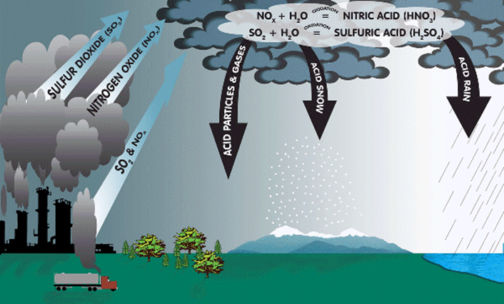
The Effects of Acid rain on Seed Germination
Environmental POllution

Slide 4
The Effects of Acid rain on Seed Germination
Environmental POllution

