Slide 1
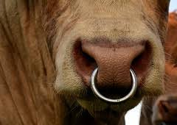
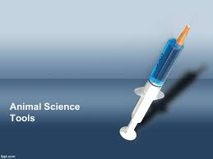
Instruments , tools and equipment use during animal husbandry procedures
Presented by :Dr. Jinan Najdat
Dr. Ekhlas salih

Slide 2
Importance of use the tools
Any farm live stock farmer is aware that live stock need tender loving care in order to benefit the owner, so since there are many health challenges to keeping healthy livestock it is essential to also know the basics of good animal care.
It may not come as much surprise that animals respond to tender loving care by coming more productive .

Slide 3
Importance tools for good care of animal
To take good care of animals, to diagnoses if animals are diseased and to treat animals there are some tools that can be useful and practical to have within reach in the following some of the more common tools are listed :-
1- mouth Gages :
Mouth gags are surgical devices placed between the upper and the lower jaw to prevent the mouth from closing during operative procedures of the mouth or throat

Slide 4
Uses of mouth gags
There are many uses of this device in animal farm
1-Signs of health
2-dentition
3-diseases detection
4-Removal of foreign bodies
5-drug administration
6-washing and antisepsis of mouth
7-rasping of the teeth
8-In horse-for application of stomach tube

Slide 5
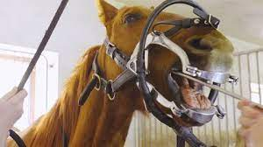
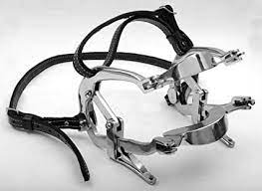
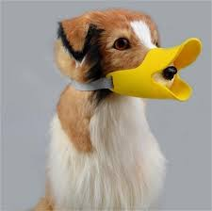
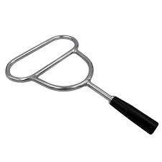
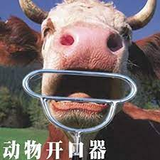
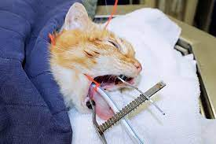
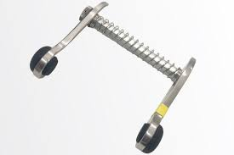
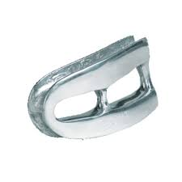
DIFFERENT TYPES OF MOUTH GAGS

Slide 6
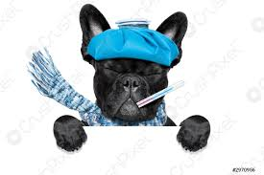
THERMOMETER
A thermometer is very useful to check body temperature and the veterinary one is very cheap can be found in most agro-vet shops help farmer in judging animal health.
If body temperature significantly (<0.5-1C˚)higher or lower indicated below there is usually a problem to be solved.

Slide 7
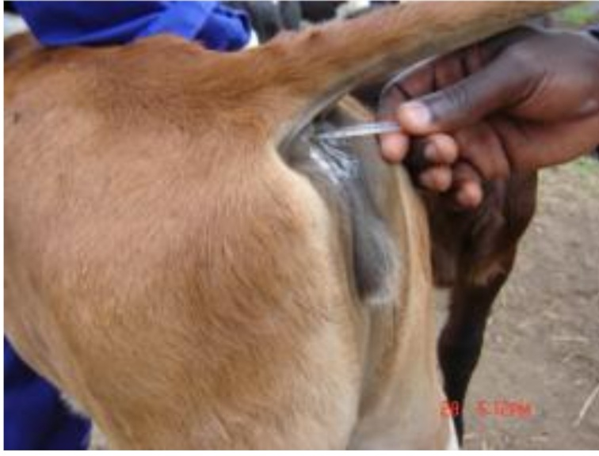
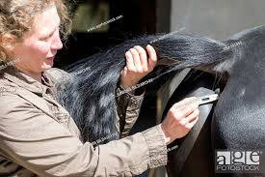
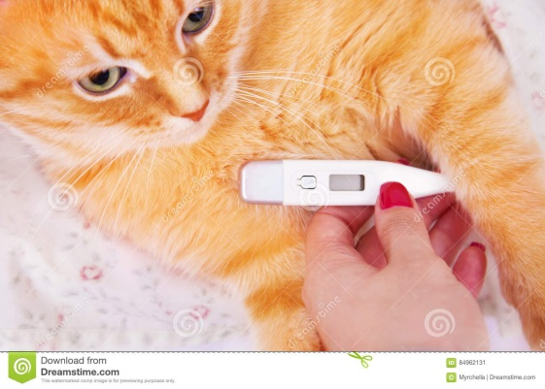
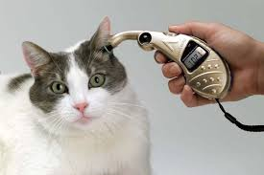
THERMOMETER

Slide 8
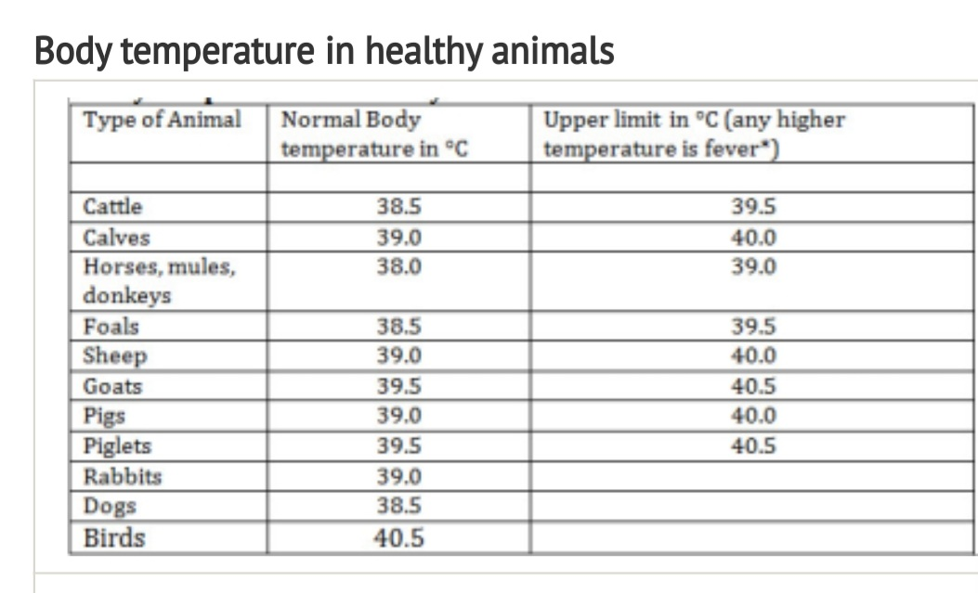
Normal temperature of animal

Slide 9
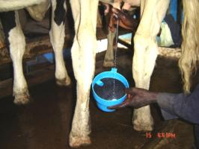
Mastitis testing tools
Consist from
1-strip cup
Very useful tool and important for all dairy farmer, milking first few strip cup will show if there is any lumps present indicating beginning of mastitis.

Slide 10
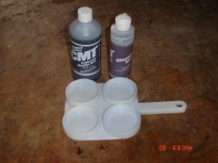
Mastitis testing tools
2-California Mastitis Test(CMT):
This test consist of a paddle with 4 cups one for each quarter(front left, front-right, hind- صهفا left, hind-right) with test solution from CMT bottle, if the mix of milk and test solution stay liquid the quarter is healthy but if the mix show stickiness' indicate mastitis

Slide 11
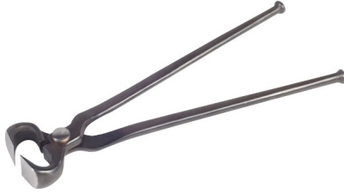
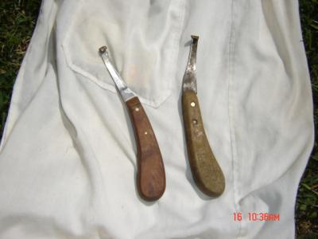
Hoof trimming tools
In some areas and specially where the ground is soft the hooves of animal grow faster so hoof trimming become necessary in order for animal to be able to walk normally ,deformed hoofs makes animal walking difficult and painful .

Slide 12
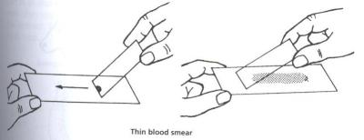
Glass slides for making blood smears
Blood samples are useful for examining diseases in cattle such as Babesiosis and Anaplasmosis caused by organisims will show under microscope in a good blood smear

Slide 13
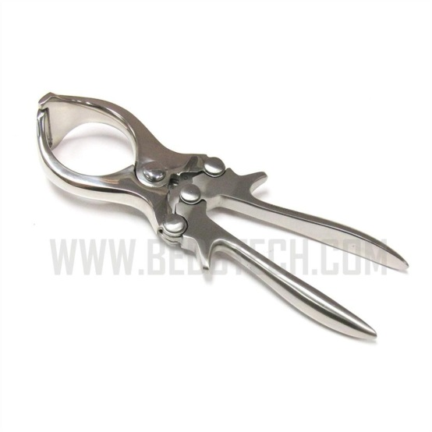
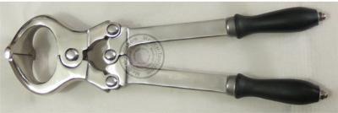
Burdizzo castrator
Burdizzo castrator is the best and cleanest tool for bulls and rams and bucks . Two different sizes are available (14 for bulls and smaller size for sheep and goats.
Size14 ssssho

Slide 14
Trocar
Trocar for making a hole into the rumen to treat serious cases of bloat .the trocar has an inside tube or canula which left in the wound and anti bloat medicine can be directly administer through this tube into stomach

Slide 15
Another important tools
*Bandages and clean clothes for cleaning wounds and covering them and for holding broken legs in place
*Container for sterilizing equipment
*Rope which is essential for any livestock keeper very useful for tying up animals or useful hen assisting a cow with difficult birth.
*syringes and needles for injection.
*castration rings mostly for goats and sheep and small new born calves.

Slide 16
Thanks for your attention

