Slide 1

Evaluate Beef Cattle
By:
Joshan Majeed Ahmed (PhD)

Slide 2

Ou ine 01
Cattle Judging
02
03
04
Importance of Evaluate
Parts of Animal's Body
Beef Animal Selection

Slide 3

Cattle Judging:
are the process of judging a series of cattle and pronouncing a first,
second and third place animal based on each animal's individual
compared to that of the others.
Importance of Evaluate
A livestock producer must possess the proper understanding of live
animal and carcass evaluation in order to remain competitive (rekabet)
in today's changing marketplace. Furthermore, the producer should
develop an ability to correlate these factors with the conformation or
shape of the live animal. Most market animals are bought and sold on
the basis of visual estimation.

Slide 4
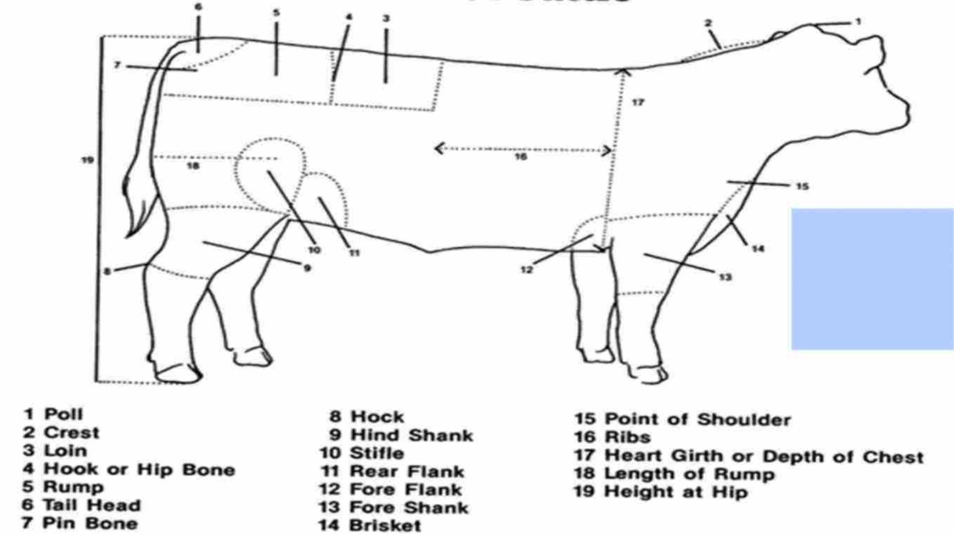
Figure 1.
Parts of
Animal's
Body

Slide 5
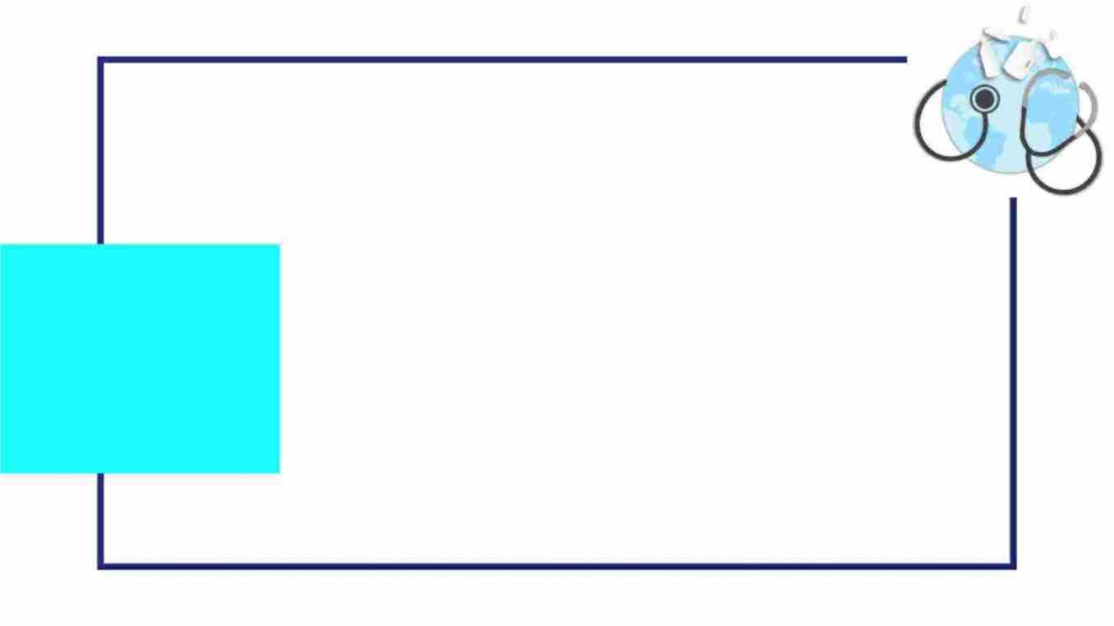
Beef Animal
Selection:
1. Growth, Frame and Skeletal Size:
The Beef Industry has ideal final weights and
carcass weights of 550 - 600 kg and 300 – 400 kg.
Market ready animals can be too small (less than
450 kg) and cost the industry more per kilogram or
too large (650 kg) for handling facilities or
consumers.

Slide 6
1. Growth, Frame and Skeletal
Size:
1. length of body
Indicators of size are:
2. height at the hip
3. length and size of cannon bone.
Below is a picture of a small, medium and large
frame steer.

Slide 7
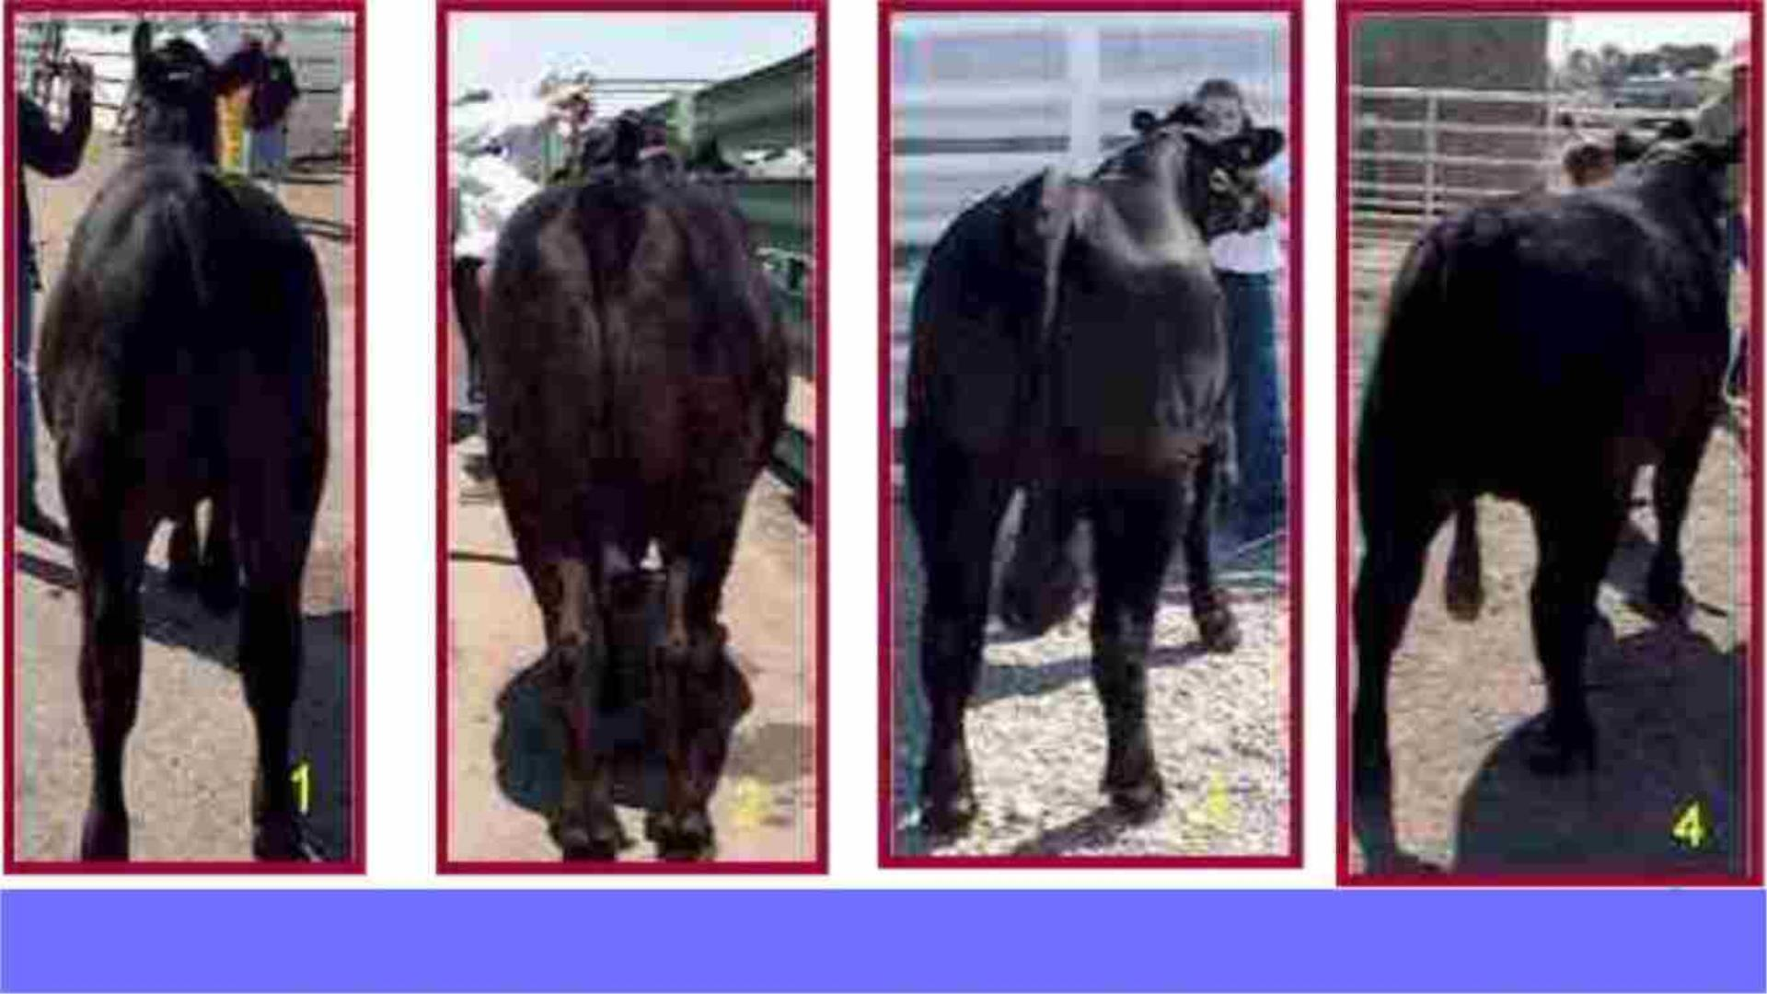
Figure 2. Cattle Frame

Slide 8
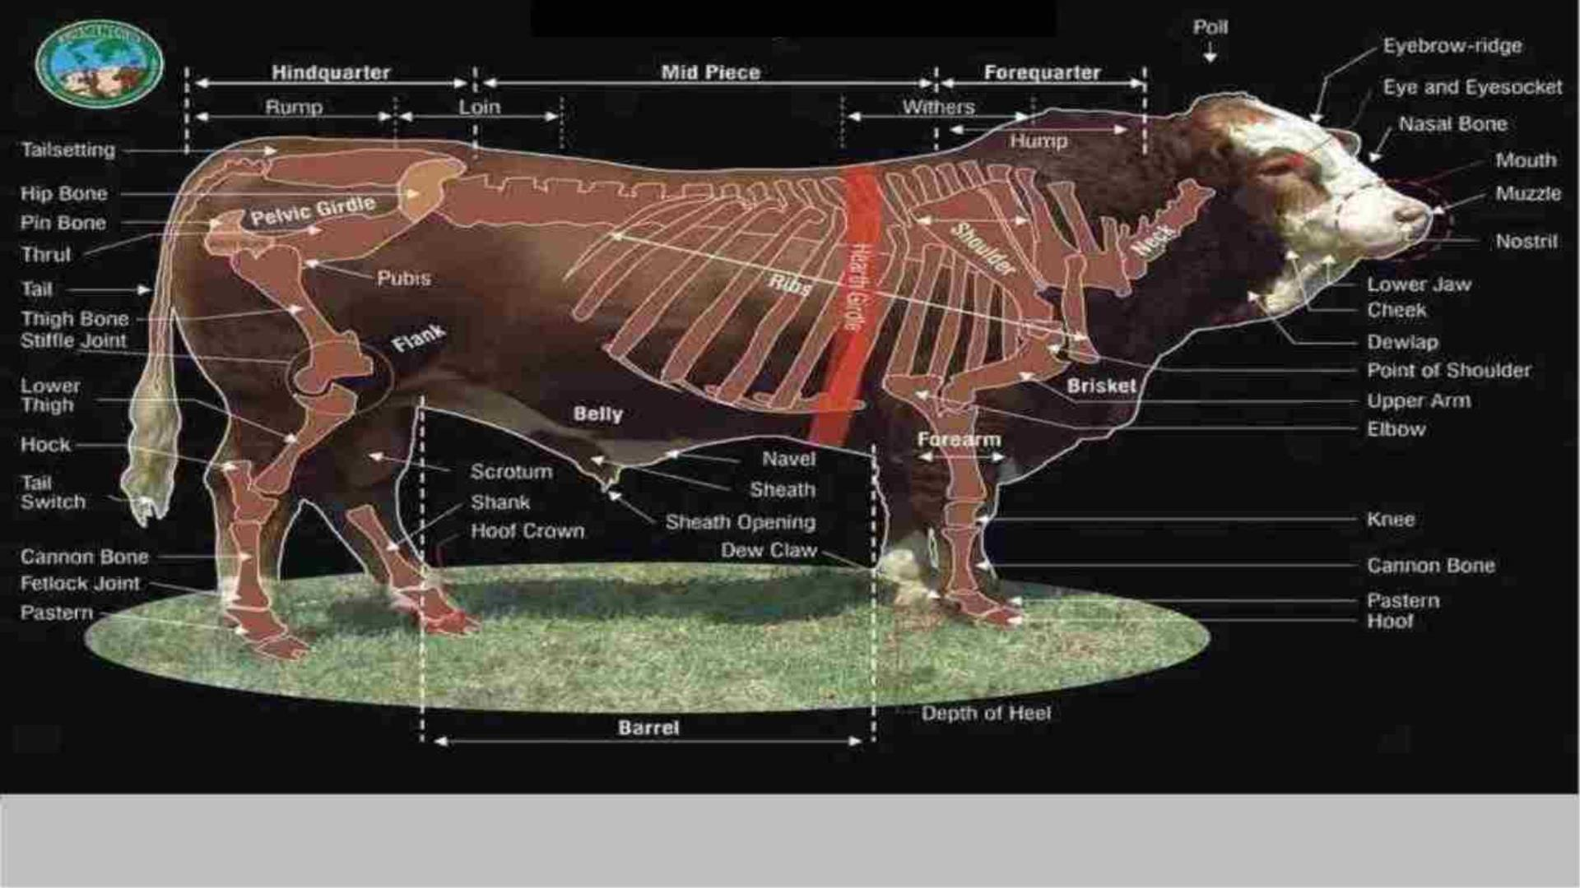
Figure 3. Skeletal System of Bull

Slide 9
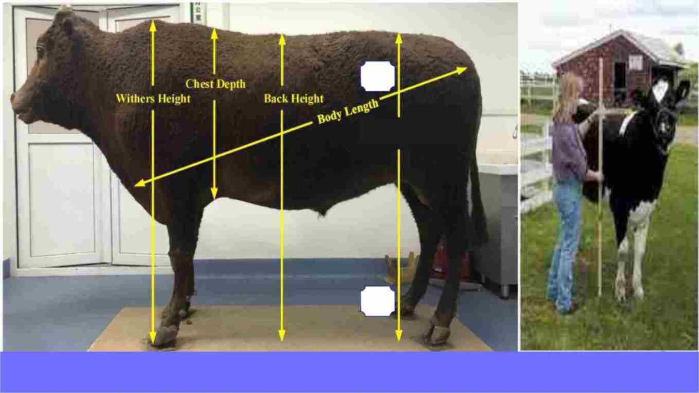
1
Hip Height
2
Figure 4. Body Measurements of

Slide 10
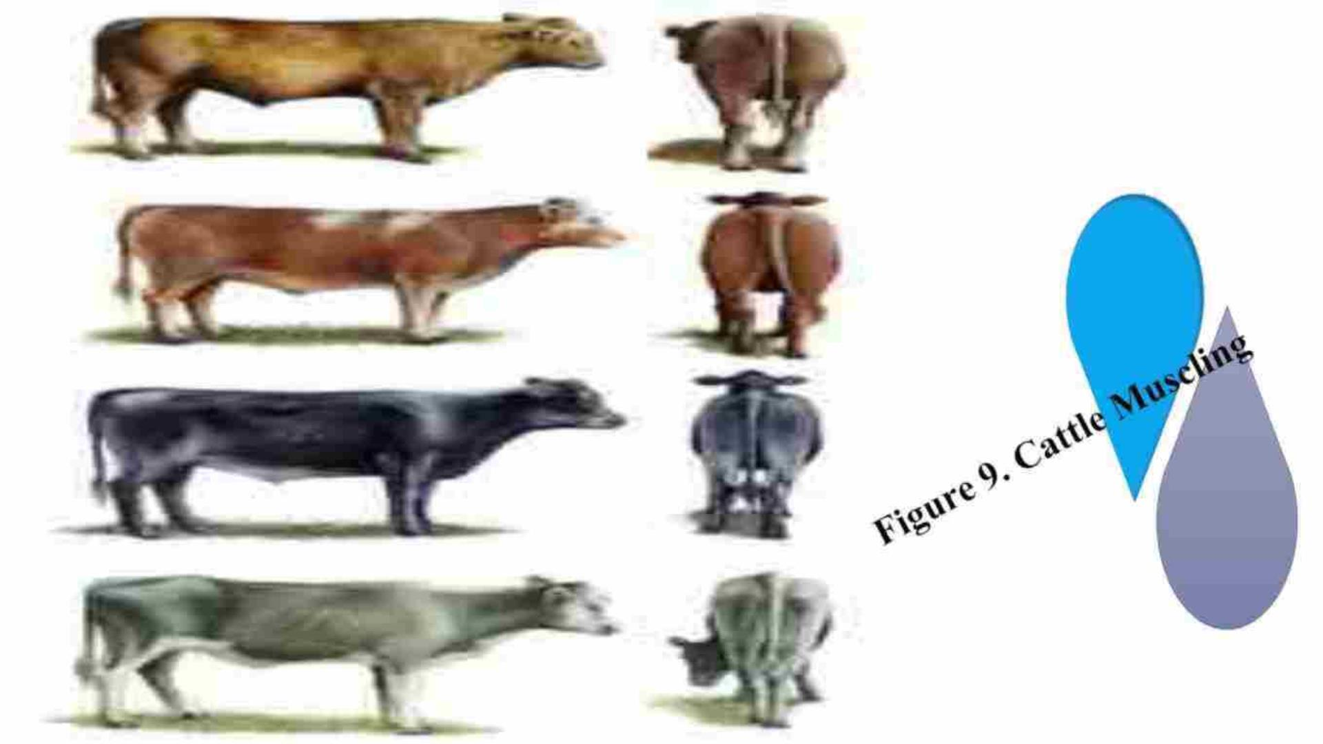

Slide 11

THANK YOU

