Slide 1
Salahaddin University – Erbil.
Agriculture Engineering Sciences College
Field Crop Departement
Technology of Pulse Production
Practical Part – Field crop Dept.
Third Stage – First Lecture

Slide 2
Pulses (legume crops)
-Pulses its Latin term (puls) form Ancient Greek.
-A legume crop in botanical is a plant in the family Fabaceae or Leguminosae ,
-It is commonly known as the Legume, Pea or Bean Family.
-Fruit of pulses is simple dry fruit known as Pod.

Slide 3
Pulse crops are the most important food crops after cereals, refer to “grain legumes.” They are rich source of proteins containing about 20-30%. The share of animal protein is low as 18% . Food legumes are commonly known as “poor man’s meat” because of their high protein content, low price and its wide spread access to the poor.
Pulses can fix atmospheric nitrogen and their deep penetrating root system enables the plants to utilize limited available moisture more efficiently. It improve the physical condition of the soil like soil aeration, water holding capacity, improving microbial population, breaking of hard pans and moisture retention. Pulses can be use as catch crop, cover crop, intercrop and crop rotation

Slide 4
Importance of Legume
1- Nitrogen fixation
The mutual interaction between the two species is known as symbiotic relationship
2- Nutritional benefits: it is inexpensive way of supplying required nutrients to the body.
3- Soil benefits:
Legumes are cultivated as a Green Crops or Cover Crops.
4- Other crop benefits:
*By Inter cropping with other perennial grass
* Control weed by cultivation legumes as a cover crop

Slide 5
Some legume crops:
Crop name Scientific name
1- Chickpea ____________________ _____ Cicer arietinum
2- Lentil ______________________ ______ Lens esculanta
3- Broad bean or Horse bean ____ ______ Vicia faba
4- Pea ______________________________ Pisum sativum
5- Green gram or Mung bean __________ Vigna radiata
6- pea nut or Ground nut ______________ Arachis hypogea
7- Soybean __________________________ Glycin max
8- Kidney bean or field bean _____ ______Phaseolus Vulgaris
9- Cowpea __________________________ Vigna aunguiculata
10- Lathryrus ________________________ Lathyrus sativus
11- Alfalfa ___________________________ Medicago sativa

Slide 6
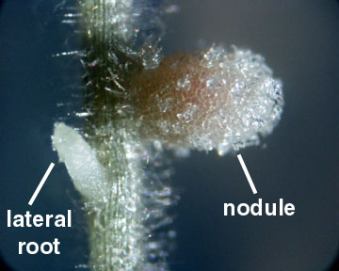
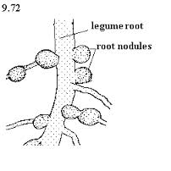
Characteristics and general description of pulses crops:
1- Root:
Tap root, Branched up to 2-3 m in depth or more, Bacterial nodules are formed on rootlets by Rhizobium spp.

Slide 7
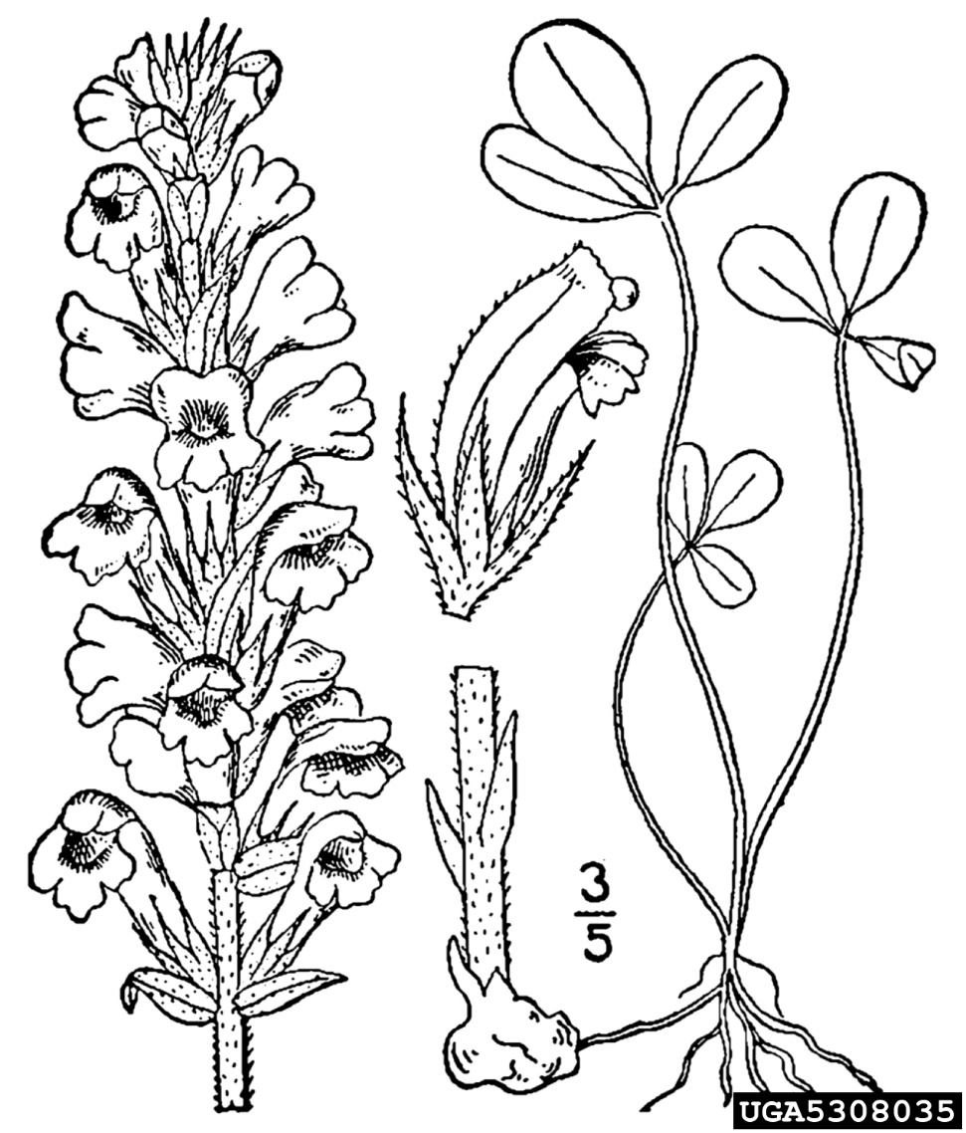
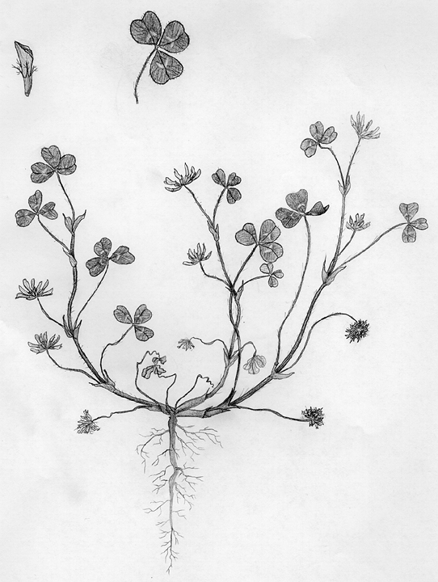
2- Stem:
It is erect or prostrate or semi- erect or semi- prostrate according to species and varieties , stems are different in length, size and branching.

Slide 8
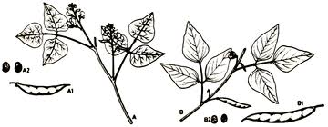
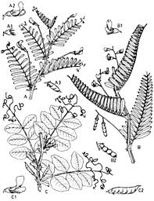
3-Leaf:
The leaf is compound consist of two leaflets or more at alternative position, with big stipulates at leaf base, leaves are normally compound, petiole or sessile some time, lateral leaflets is petiole or not, some of leaves are developed to tendrils, leaves have stipules some times

Slide 9
4- Inflorescence system:
It is raceme, head, panicle or spike. Bisexual florets are composed of CALYX its composed of four or five Sepals, and COROLLA its composed of a big central Petal called Standard and two lateral leaflets called wings and two fused leaves called keel or banner.
Stamen: it is composed of 10 Anther, nine of filament of them are fused and the tenth it is free which are called Diadelphaous in this case . But it called Monodelphous if all of 10 filament s are fused together.
Pistil: it is single carpel which composed of smooth stigma , and long style and big ovary. The pollination it is cross pollination.

Slide 10
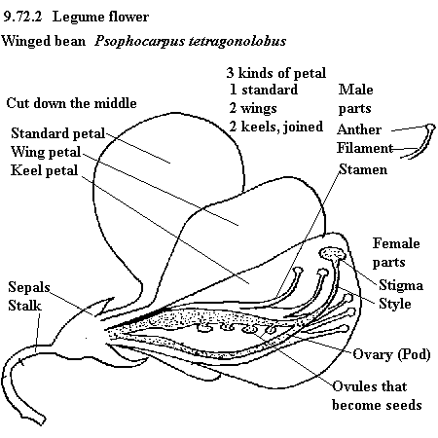

Slide 11
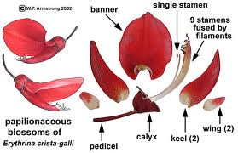

Slide 12
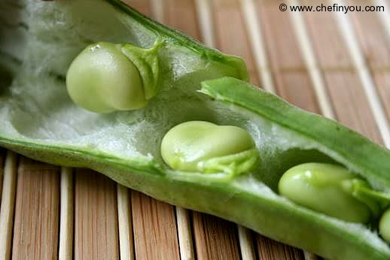
5- fruit: it is legume or pod its mature ovary which contain one seed or more it is mature ovule. The legume seed is non- endospermic, nutrients are stored in cotyledons, and seed recognized by hilum which represents the connection of seed s with fruit coat, seeds are connected with fruit coat by funical.

Slide 13
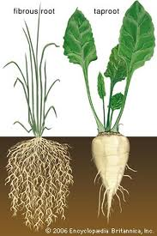
The difference between legumes and Cereals:
Cereals | Legumes
Fiber root with out any bacteria node | Tap root which has secondary branch root with bacteria node to nitrogen fixation. | Root
The stem is hollow or solid and solid in node | The stem is hollow but solid node | stem

Slide 14
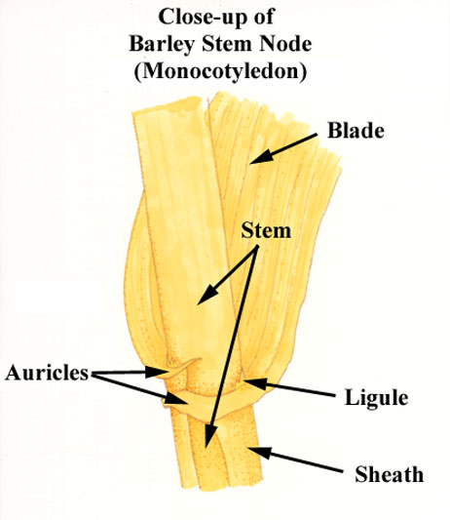
Cereals | Legumes
The leaves is simple and composed of blade, sheath, Auricles and ligule | The leave is compound which composed of two or more leaflets and big stipules in the base of leaf | Leaves

Slide 15
Cereals | Legumes
Spike, the unit of inflorescence is spikelet composed of Rachilla, palea and Lemma. Androecium composed of 3 Anthers which are free. Gynoecium is composed of two carpel called pistil composed of hairy stigma, two branch of style and ovary, the pollination it is self pollination. | Bisexual florets are composed of CALYX its composed of four or five Sepals, and COROLLA its composed of a big central Petal called Standard and two lateral leaflets called wings and two fused leaves called keel or banner. Stamen: it is composed of 10 Anther, nine of filament of them are fused and the tenth it is free which are called Diadelphaous in this case . But it called Monodelphous if all of 10 filament s are fused together. Pistil: it is single carpel which composed of smooth stigma , and long style and big ovary. The pollination it is cross pollination. | Flower
Caryopsis or Grain | Legume or Pod | Fruit

Slide 16
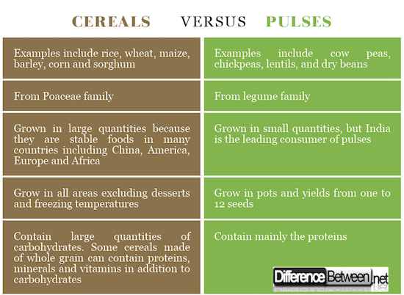

Slide 17
